Slide 1
ImageRekt
Mikael Gousetis
Matti Mäki-Kihniä
Juhani Lavonen

Slide 2
User stories
As a user I want to have an account, so that I can save pictures.
As a user I want to set my photo as private, so that it cannot be seen by everyone.
As a user I want my image to upload fast, so that I don’t have to wait.

Slide 3
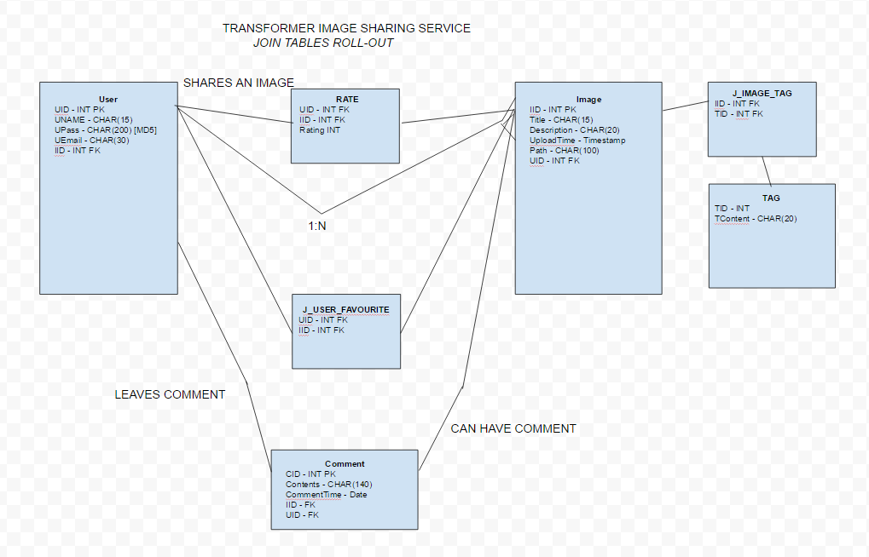
Database model

Slide 4
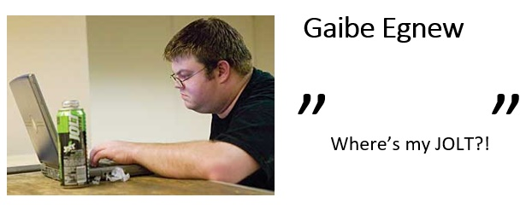
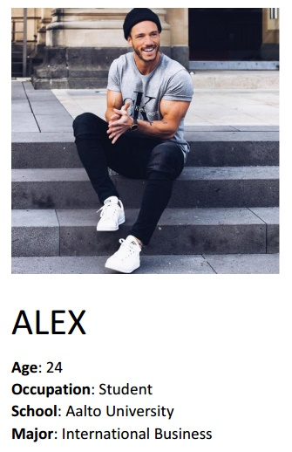
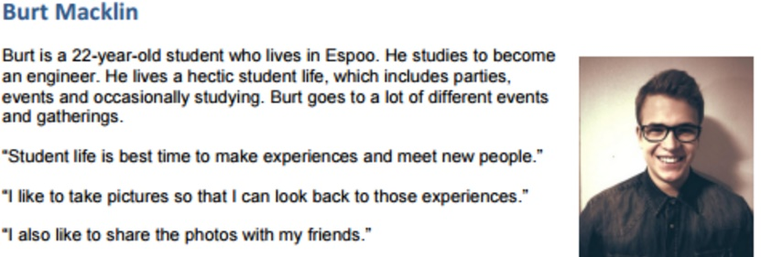
Personas

