Slide 1
POST CORRESPONDENCE PROBLEM (PCP)

Slide 2
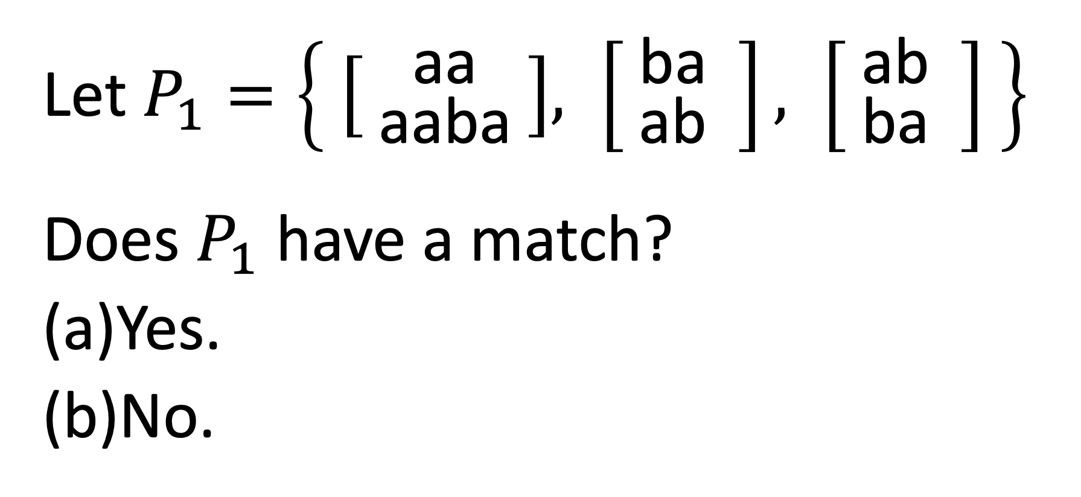
Let $P_{1}=\left\{ \left[ {\text{a}\text{a} \atop \text{a}\text{aba} }\right], \left[ {\text{ba} \atop \text{a}\text{b} } \right], \left[ {\text{ab} \atop \text{b}\text{a} } \right] \right\}$
Does $P_{1}$ have a match?
Yes.
No.

Slide 3
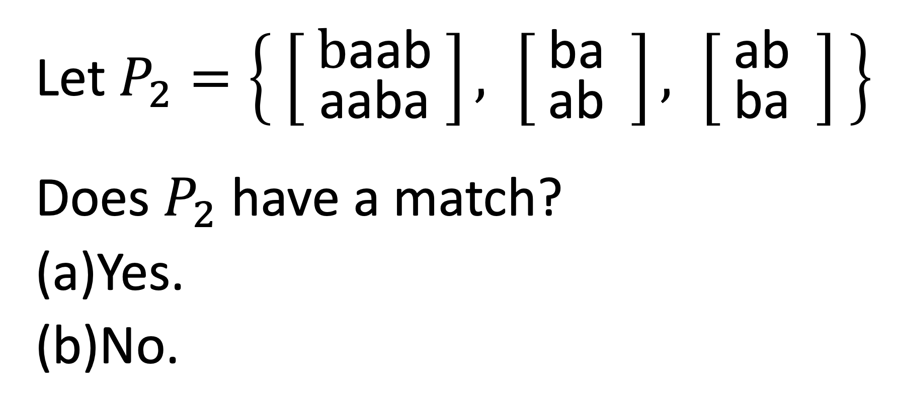
Let $P_{2}=\left\{ \left[ {\text{b}\text{a}\text{ab} \atop \text{a}\text{aba} }\right], \left[ {\text{ba} \atop \text{a}\text{b} } \right], \left[ {\text{ab} \atop \text{b}\text{a} } \right] \right\}$
Does $P_{2}$ have a match?
Yes.
No.

Slide 4

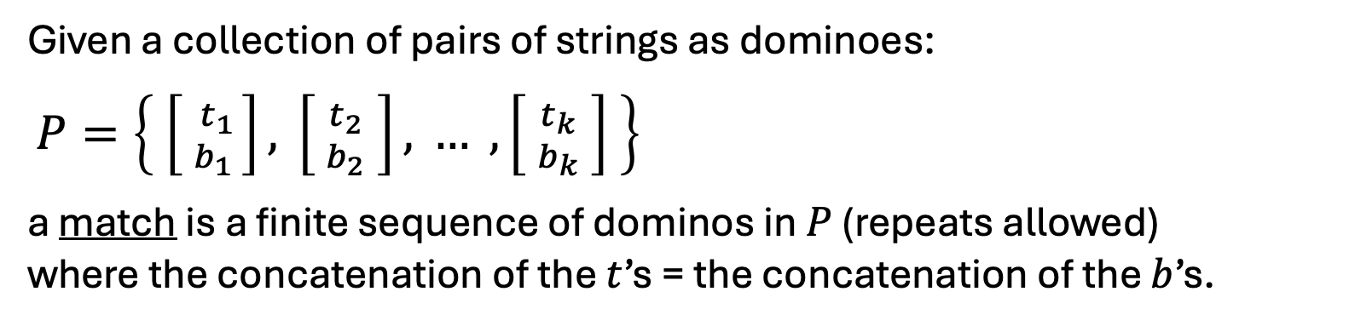
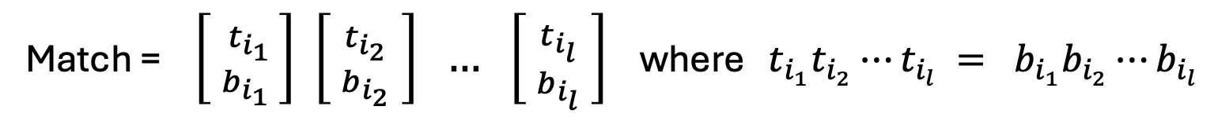
Given a collection of pairs of strings as dominoes:
$P=\left\{ \left[ {t_{1} \atop b_{1} }\right], \left[ {t_{2} \atop b_{2}} \right], … , \left[ {t_{k} \atop b_{k}} \right] \right\}$
a match is a finite sequence of dominos in $P$ (repeats allowed) where the concatenation of the $t$’s = the concatenation of the $b$’s.
Note: |t_{i}| may not be equal to |b_{i}|
Match = $\left[ {t_{i_{1}} \atop b_{i_{1}} }\right] \left[ {t_{i_{2}} \atop b_{i_{2}}} \right] … \left[ {t_{i_{l}} \atop b_{i_{l}}} \right]$ where $t_{i_{1}}t_{i_{2}}⋯t_{i_{l}} = b_{i_{1}}b_{i_{2}}⋯b_{i_{l}}$
Example: $P=\left\{ \left[ {\text{ab} \atop \text{aba} }\right], \left[{\text{aa} \atop \text{aba} }\right], \left[ {\text{ba} \atop \text{aa} } \right], \left[ {\text{abab} \atop \text{b} } \right] \right\}$
Match:
abaabaaaabab
abaabaaaabab

Slide 5
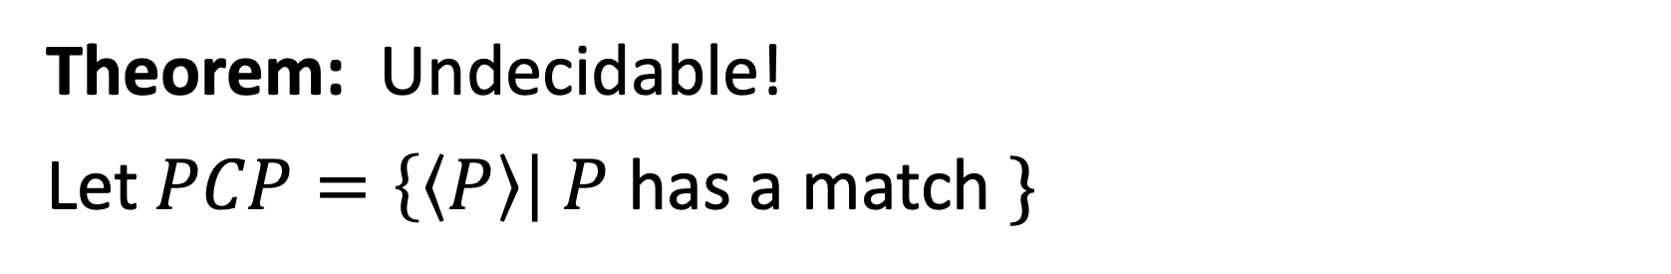

Problem: Given $P$, is there a match?
Is there an algorithm for determining where given P is there a match?
Theorem: Undecidable!
Let$PCP=\left\{〈P〉\right| P$ has a match $\}$
Proof: Show $A\text{TM}$ is reducible to $PCP$.
First: the Computation History Method.

Slide 6
TM Configuration and Computational History

Slide 7
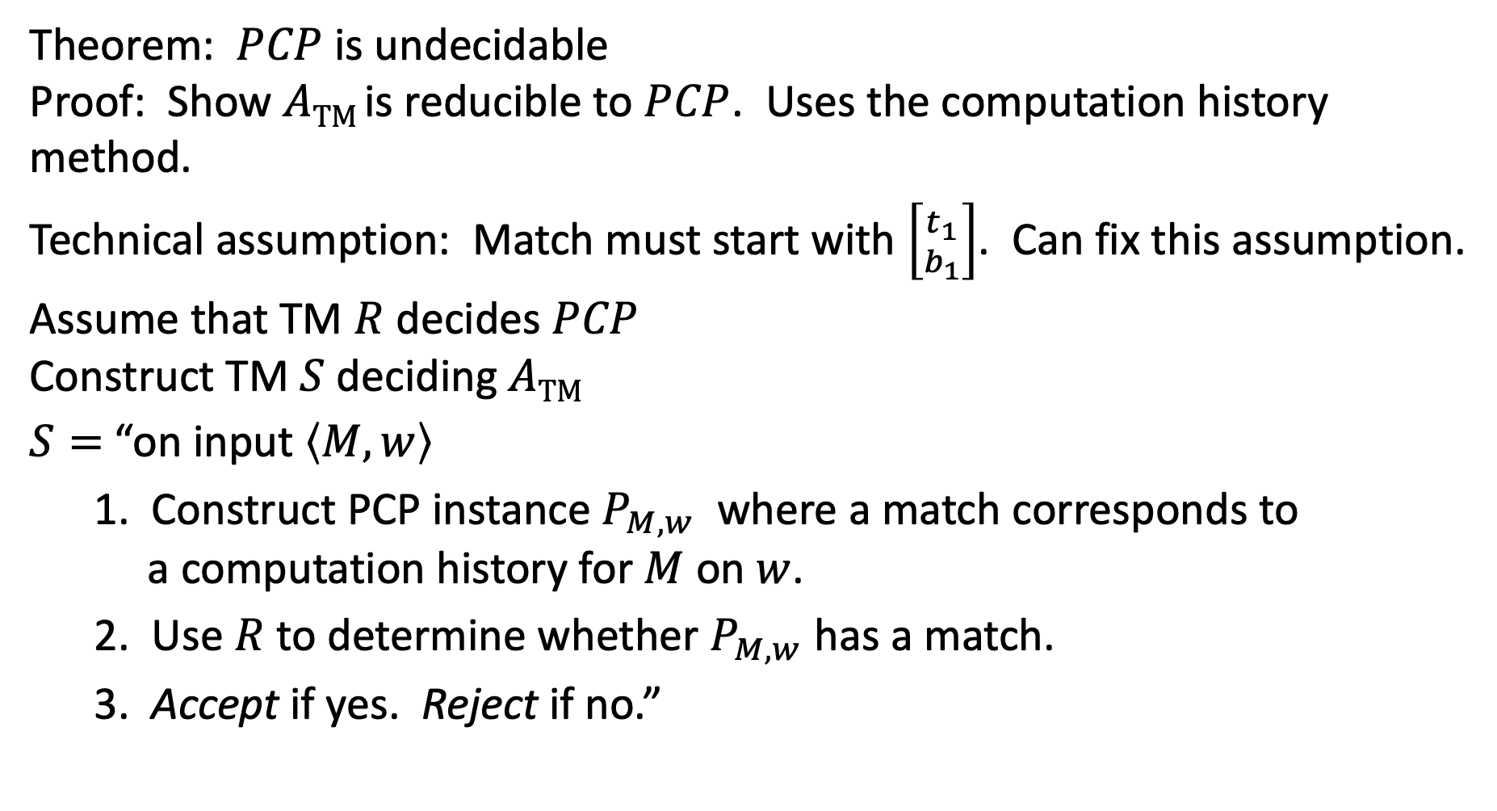
Theorem: $PCP$is undecidable
Proof: Show $A\text{TM}$is reducible to $PCP$. Uses the computation history method.
Technical assumption: Match must start with $\left[{t_{1} \atop b_{1}}\right]$. Can fix this assumption.
Assume that TM $R$ decides $PCP$
Construct TM $S$ deciding $A\text{TM}$
$S=$ “on input $〈M,w〉$
1. Construct PCP instance $P_{M,w}$ where a match corresponds to a computation history for $M$ on $w$.
2. Use $R$ to determine whether $P_{M,w}$ has a match.
3. Accept if yes. Reject if no.”

Slide 8
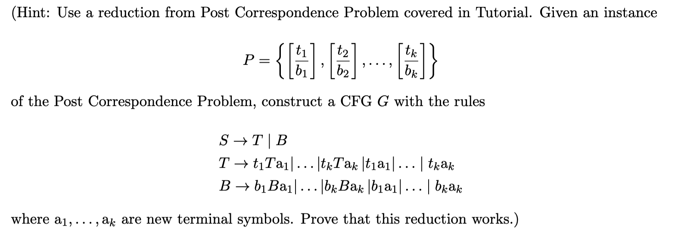
Proving Ambiguous Grammar is undecidable

