Slide 1
Software Testing
Some Material adapted from Lethbridge & Laganiere;
Some Material adapted from Pressman.

Slide 2
Testing phases: V model
Requirements
Acceptance Testing
Architecture
System Testing
Detailed Design
Integration Testing
Implementation
Unit Testing
A lifecycle view that shows relationships between development and test phases

Slide 3
Testing Phases
Unit Testing
  Developer tests individual modules
Integration testing
  Put modules together, try to get them working together
  Integration testing is complete when the different pieces are able to work together
System testing
  Testing of entire deliverable against specs
Acceptance testing
  Testing against user needs, often by the user

Slide 4
Exhaustive Testing
loop < 20 X
There are 10 possible paths! If we execute one test per millisecond, it would take 3,170 years to test this program!!

Slide 5
Selective Testing
Selected path
loop < 20 X

Slide 6
Coverage
Function coverage: Each function/method executed by at least one test case
Statement coverage: Each line of code covered by at least one test case (need more test cases than above)
Path coverage: Every possible path through code covered by at least one test case (need lots of test cases)

Slide 7
Equivalence classes
  It is inappropriate to test by brute force, using every possible input value
    Takes a huge amount of time
    Is impractical
    Is pointless!
  You should divide the possible inputs into groups which you believe will be treated similarly by all algorithms.
    Such groups are called equivalence classes.
    A tester needs only to run one test per equivalence class
    The tester has to
      understand the required input,
      appreciate how the software may have been designed

Slide 8
Example of equivalence classes
  Valid input is a month number (1-12)
    Equivalence classes are: [-∞..0], [1..12], [13.. ∞]

Slide 9
Combinations of equivalence classes
  Combinatorial explosion means that you cannot realistically test every possible system-wide equivalence class.
    If there are 4 inputs with 5 possible values there are 5⁴ (i.e.625) possible system-wide equivalence classes.
  You should first make sure that at least one test is run with every equivalence class of every individual input.
  You should also test all combinations where an input is likely to affect the interpretation of another.
  You should test a few other random combinations of equivalence classes.

Slide 10
Example equivalence class combinations
One valid input is either ‘Metric’ or ‘US/Imperial’
  Equivalence classes are:
    Metric, US/Imperial, Other
Another valid input is maximum speed: 1 to 750 km/h or 1 to 500 mph
  Validity depends on whether metric or US/imperial
  Equivalence classes are:
    [-∞..0], [1..500], [501..750], [751.. ∞]
Some test combinations
    Metric, [1..500] valid
    US/Imperial, [501..750] invalid
    Metric, [501..750] valid
    Metric, [501..750] valid

Slide 11
Testing at boundaries of equivalence classes
  More errors in software occur at the boundaries of equivalence classes
  The idea of equivalence class testing should be expanded to specifically test values at the extremes of each equivalence class
    E.g. The number 0 often causes problems
  E.g.: If the valid input is a month number (1-12)
    Test equivalence classes as before
    Test 0, 1, 12 and 13 as well as very large positive and negative values

Slide 12
Test Case
A triplet of [Input, Steps, Expected behavior]
(IEEE Standard 829-1983) Documentation specifying inputs, predicted results, and a set of execution conditions for a test item.”
Purpose: to get some information about the system behavior

Slide 13
Information that can be gained from Test Cases
Find defects
  A test is run in order to trigger failures that expose defects.
Assess conformance to specification.
Assess conformance to standards or regulations.
Find safe scenarios for use of the product
Assess quality
Block premature product releases.
Help managers make ship / no-ship decisions.
Minimize technical support costs.

Slide 14
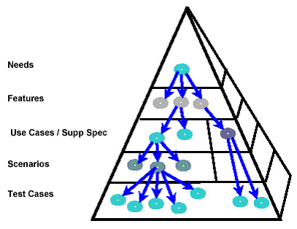
Getting test cases

Slide 15
Identifying Scenarios
Use case has one basic flow (B) and 0..* alternate flows (A1..An)
Notation:
  Basic flow: B
  Alternative flows: A1, A2, A3, ...
  Steps in a basic flow: B1, B2, B3, ...
  Steps in alternative flow 1: A1.1, A1.2, A1.3, ...
  Steps in alternative flow 2: A2.1, A2.2, A2.3, ...
Scenario - A possible path through basic and alternate flows that an actor can take.
Can be Usage, growth or exploratory.
  Usage from use cases, mostly for functional testing
  Growth and exploratory for system level testing
Notes:
A scenario is an instance of the use case.

Slide 16
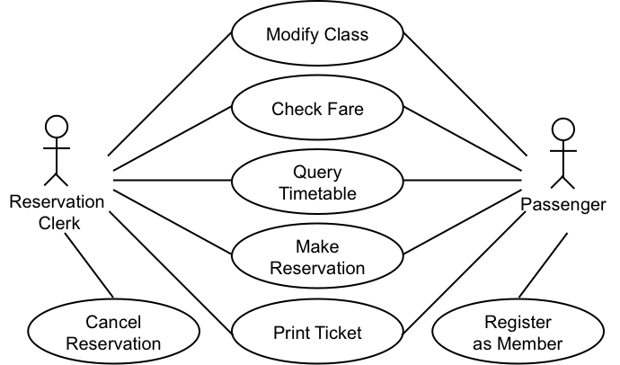
Writing test cases
Assume the simplified use case from IRCTC.co.in.

Slide 17
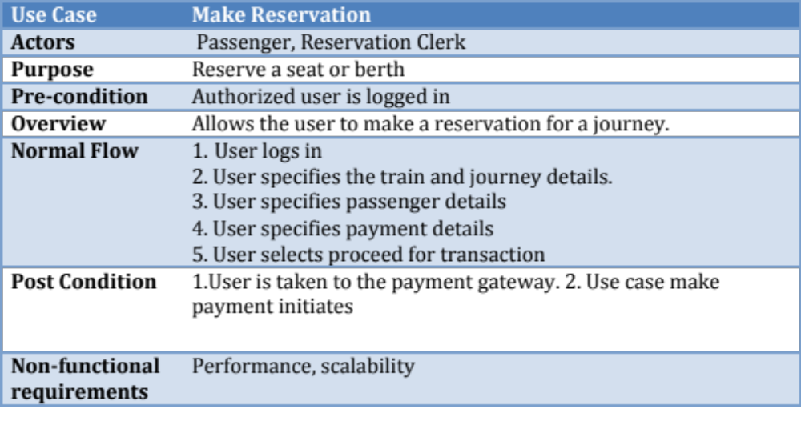
Make Reservation Basic Flow

Slide 18
Alternate Flows
A1 No matching trains found
A2 Source Destination require modification
A3 Session Expired
A4 Continue booking another ticket
A5 Leave in between
A6 Booking not permitted right now (time, date constraints due to business rules)
A7 Booking senior citizen ticket
A8 Changing boarding point
A9 Check availability
A10 Close transaction in between
…Many more

Slide 19
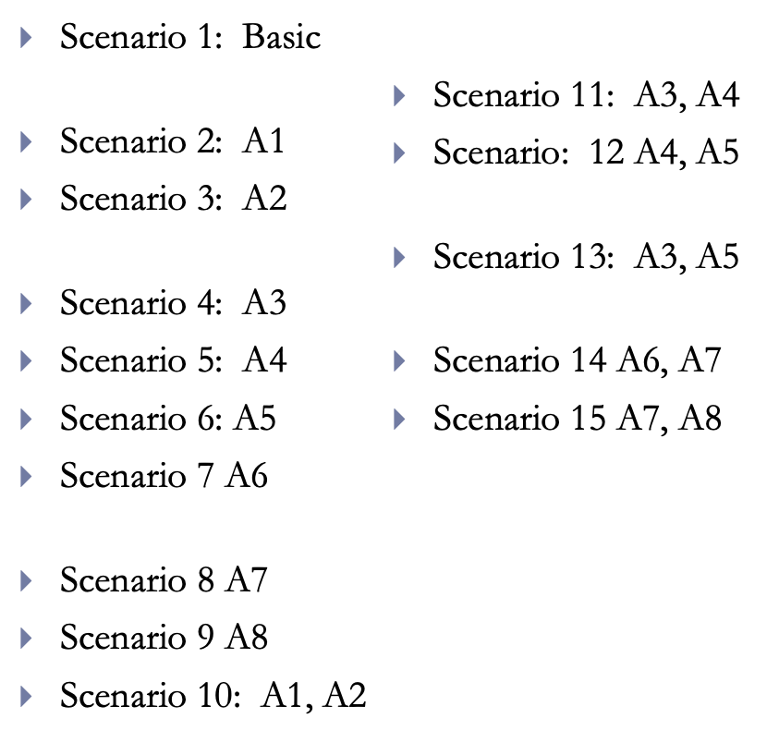
Identifying Scenarios from use cases
Should be feasible
Every basic +
alternate flows individually +
combinations of alternate flows.

Slide 20
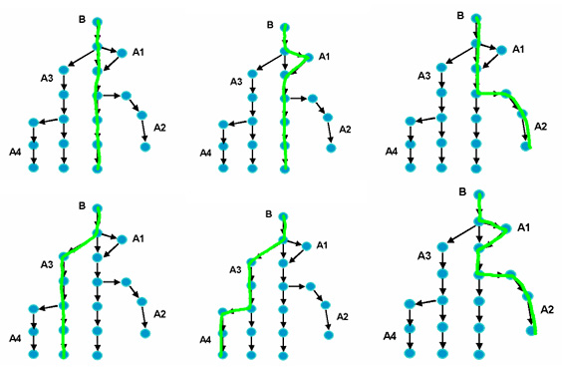
Possible Scenarios

Slide 21
Writing Formal Test Cases and Test Plans
A test case is an explicit set of instructions designed to detect a particular class of defect in a software system.
  A test case can give rise to many tests (test case instances).
  Each test is a particular running of the test case on a particular version of the system.

Slide 22
Test plans
A test plan is a document that contains a complete set of test cases for a system
    Along with other information about the testing process.
  The test plan is one of the standard forms of documentation.
  If a project does not have a test plan:
    Testing will inevitably be done in an ad-hoc manner.
    Leading to poor quality software.
  The test plan should be written long before the testing starts.
  You can start to develop the test plan once you have developed the requirements.

Slide 23
Information to include in a formal test case
  A. Identification and classification:
    Each test case should have a number, and may also be given a descriptive title.
    The system, subsystem or module being tested should also be clearly indicated.
    The importance of the test case should be indicated.
  B. Instructions:
    Tell the tester exactly what to do.
    The tester should not normally have to refer to any documentation in order to execute the instructions.
  C. Expected result:
    Tells the tester what the system should do in response to the instructions.
    The tester reports a failure if the expected result is not encountered.
  D. Cleanup (when needed):
    Tells the tester how to make the system go ‘back to normal’ or shut down after the test.

Slide 24
Detailed Example: Test cases for Phase 2 of the SimpleChat
GGeneral Setup for Test Cases in the 2000 Series
SSystem: SimpleChat/OCSF Phase: 2
IInstructions:
1. Install Java, minimum release 1.2.0, on Windows 95, 98 or ME.
2. Install Java, minimum release 1.2.0, on Windows NT or 2000.
3. Install Java, minimum release 1.2.0, on a Solaris system.
4. Install the SimpleChat - Phase 2 on each of the above platforms.

Slide 25
Test cases for Phase 2 of the SimpleChat
TTest Case 2001
SSystem: SimpleChat Phase: 2
SServer startup check with default arguments
SSeverity: 1
IInstructions:
1. At the console, enter: java EchoServer.
EExpected result:
1. The server reports that it is listening for clients by displaying the following message:
Server listening for clients on port 5555
2. The server console waits for user input.
CCleanup:
1. Hit CTRL+C to kill the server.

Slide 26
Test cases for Phase 2 of the SimpleChat
TTest Case 2002
SSystem: SimpleChat Phase: 2
CClient startup check without a login
SSeverity: 1
IInstructions:
1. At the console, enter: java ClientConsole.
EExpected result:
1. The client reports it cannot connect without a login by displaying:
ERROR - No login ID specified. Connection aborted.
2. The client terminates.
CCleanup: (if client is still active)
1. Hit CTRL+C to kill the client.

Slide 27
Test cases for Phase 2 of the SimpleChat
Test Case 2019
System: SimpleChat Phase: 2
Different platform tests
Severity: 3
Instructions:
1. Repeat test cases 2001 to 2018 on Windows 95, 98, NT or 2000, and Solaris
Expected results:
1. The same as before.

Slide 28
Various Dimensions of Testing
  Behavior
  Performance
  Usability
  Scalability
  Portability
  Maintainability
  Random Behavior
  Security
  ….
      Unit Testing
      Module
      Integration
      System
      Acceptance
Quality under test
Unit under test
Dimensions of Testing
  Manual
  Automated
Modality
Type of test
      Black box
      White box

Slide 29

White-Box Testing
... our goal is to ensure that all
statements and conditions have
been executed at least once ...

Slide 30
White-box testing
Also called ‘glass-box’ or ‘structural’ testing
Testers have access to the system design
  They can
    Examine the design documents
    View the code
    Observe at run time the steps taken by algorithms and their internal data
  Individual programmers often informally employ glass-box testing to verify their own code

Slide 31
White Box Methods
Can be applied at all levels of system development – unit, integration, and system
  Coverage (Control flow)
    Statement
    Branch
    Condition
  Dataflow
  Mutation

Slide 32
Statement Coverage
Execute each statement in the program
Considered minimum criterion for most unit testing
May be difficult to achieve for error cases

Slide 33
Example Program
Statement tests
a = 3, b = 4
executes 1, 3, 4, 5, 6, 7, 5, 6, 7, 5, 6, 7, 5, 8
a = -3, b = 2
executes 1, 2
1: if (a < 0) {
2: return 0 }
3: r = 0;
4: c = a;
5: while (c > 0) {
6: r = r + b;
7: c = c - 1; }
8: return r;

Slide 34
Branch Coverage
Execute each branch of the program at least once
Differs from statement coverage only for "if" statements without "else"s and case statements without default cases.

Slide 35
Structured Testing
Selected path
loop < 20 X

Slide 36
Basis Path Testing
1
Next, we derive the
independent paths:
2
Since V(G) = 4,
there are four paths
3
Path 1: 1,2,3,6,7,8
4
Path 2: 1,2,3,5,7,8
5
6
Path 3: 1,2,4,7,8
Path 4: 1,2,4,7,2..,8
Finally, we derive test
7
cases to exercise these
paths.
8

Slide 37
Basis Path Testing
First, we compute the McCabe’s cyclomatic complexity:
number of simple decisions + 1
or
number of enclosed areas + 1
In this case, V(G) = 4
If decisions are not binary, this can’t be used for computation of cyclomatic complexity

Slide 38
Cyclomatic complexity
Cyclomatic complexity of a graph is
C = edges – nodes + 2
A
B
C
D
G
E
F
H

Slide 39
Why Data flow testing?
Look at this simple C program
#include <stdio.h>
main() {
int x;
printf (“%d”,x);
}
What value for x will be printed ?

Slide 40
Dataflow Testing
Definitions and Uses
Defining node
  input statement
  lhs of assignment
Usage node
  output statement
  rhs of assignment
  control statement
DU testing: execute each du-path of each variable

Slide 41
Example Program
1: r = 0;
2: c = a;
3: while (c > 0) {
4: r = r + b;
5: c = c - 1; }
6: return r;
Def (c) = {2, 5} Use (c) = {3, 5}
Def (r) = {1, 4} Use (r) = {4, 6}

Slide 42
Other White box testing techniques
Loop Boundary Analysis
Data Dependency Testing
Path Predicate Testing
Combinatorial Testing
Error Guessing
Mutation Testing
Model Based Testing
Static Program Analysis

Slide 43
Loop Boundary Analysis
Testing the boundary conditions within loops
def calculate_average(numbers):
total = 0
count = 0
for num in numbers:
total += num
count += 1
return total / count
Test cases:
- Test Case 1: Empty input array
- Test Case 2: Array with a single element
- Test Case 3: Array with multiple elements

Slide 44
Data Dependency Testing
Focuses on identifying and testing relationships between different variables and data elements
Example: Testing a function that calculates the discounted price based on a product's original price and discount percentage.
def calculate_discounted_price(original_price, discount_percentage):
discounted_price = original_price - (original_price * discount_percentage / 100)
return discounted_price
Test cases:
Test Case 1: Positive original price and discount percentage
Test Case 2: Zero original price with non-zero discount percentage
Test Case 3: Negative discount percentage

Slide 45
Path Predicate Testing
Analyzing the predicates (Boolean expressions) within the code to create test cases that cover specific paths based on predicate outcomes
Example: Testing a function that determines the category of a product based on its price.
def determine_category (price):
if price < 0:
return "Invalid"
elif price < 100:
return "Low"
elif price < 1000:
return "Medium"
else:
return "High"
Test cases:
- Test Case 1: Price is negative
- Test Case 2: Price is between 0 and 99
- Test Case 3: Price is between 100 and 999
- Test Case 4: Price is 1000 or greater

Slide 46
Combinatorial Testing
Also known as pairwise testing, involves a subset of test cases that cover all possible combinations of input parameters.
Example: Testing a function that validates user login credentials.
def validate_login(username, password):
# Validation logic
pass
Test cases:
- Test Case 1: Valid username and password
- Test Case 2: Valid username with incorrect password
- Test Case 3: Invalid username with valid password
- Test Case 4: Invalid username and password

Slide 47
Error Guessing
Test cases are designed based on common mistakes or areas of concern that specific coverage criteria
Example: Testing a function that sorts a list of numbers.
def bubble_sort (numbers):
# Sorting logic
Test cases:
- Test Case 1: Empty list
- Test Case 2: Already sorted list
- Test Case 3: List with duplicate numbers

Slide 48
Mutation Testing
Making small deliberate changes (mutations) to assess effectiveness of test suite in detecting the changes
Example: Testing a function that calculates the factorial of a number.
def factorial(n):
result = 1
for i in range(1, n + 1):
result *= i
return result
Mutation:
- Change ‘result *= i’ to ‘result += i’
- Test Case: ‘factorial (5)’ should fail due to incorrect result.

Slide 49
Model-based Testing
Creating formal model of the system’s behavior and using it to generate test cases
Example: Testing a banking application's transfer funds feature.
Formal model includes states such as "Account Verified", "Sufficient Balance", and "Transfer Successful".
Test cases are generated based on transitions between these states, covering scenarios like successful transfer, insufficient balance, and invalid account.

Slide 50
Static Program Analysis
Analyze the source code without executing it to identify potential defects, vulnerabilities and performance issues
Involves data flow analysis, control flow analysis, and semantic analysis
Example: Using a static analysis tool like pylint to analyze a Python codebase for potential issues such as unused variables, missing docstrings, or code complexity violations.

Slide 51
Black-Box Testing
requirements
output
input
events

Slide 52
Testing
Software products are tested at four levels:
  Unit testing
  Integration testing
  System testing
  Acceptance testing

Slide 53
Unit testing
During unit testing, modules are tested in isolation:
  If all modules were to be tested together:
    it may not be easy to determine which module has the error.
Unit testing reduces debugging effort several folds.
  Programmers carry out unit testing immediately after they complete the coding of a module.

Slide 54
Unit Testing involves…
Writing Test Cases
Framework Usage
Isolation of the Unit
Mocking/Stubbing
Regression Testing
Test Coverage

Slide 55
Unit Testing Benefits
Facilitating change by ensuring the module works as expected.
Simplifying integration by verifying that individual units work beforehand.
Documentation, as they provide a written understanding of how units are supposed to work.
Design improvement and specification clarification.

Slide 56
TaskManager - Example
import org.junit.Before;
import org.junit.Test;
import static org.junit.Assert.*;
import java.util.List;
public class TaskManagerTest {
private TaskManager taskManager;
@Before
public void setUp() {
taskManager = new TaskManager();
taskManager.addTask("Task 1");
taskManager.addTask("Task 2");
taskManager.addTask("Task 3");
}
@Test
public void testAddTask() {
taskManager.addTask("New Task");
List<String> tasks = taskManager.getTasks();
assertEquals(4, tasks.size());
assertTrue(tasks.contains("New Task"));
}
@Test
public void testMarkTaskAsCompleted() {
taskManager.markTaskAsCompleted("Task 2");
List<String> tasks = taskManager.getTasks();
assertEquals(2, tasks.size());
assertFalse(tasks.contains("Task 2"));
}
@Test
public void testGetTasks() {
List<String> tasks = taskManager.getTasks();
assertEquals(3, tasks.size());
assertTrue(tasks.contains("Task 1"));
assertTrue(tasks.contains("Task 2"));
assertTrue(tasks.contains("Task 3"));
}
}
import java.util.ArrayList;
import java.util.List;
public class TaskManager {
private List<String> tasks;
public TaskManager() {
this.tasks = new ArrayList<>();
}
public void addTask(String task) {
tasks.add(task);
}
public void markTaskAsCompleted(String task) {
tasks.remove(task);
}
public List<String> getTasks() {
return tasks;
}
}

Slide 57
Writing effective unit tests…
Understanding Requirements
Complex Logic
Dependencies (Mocking/Stubbing)
State Management
Test Maintainability
Performance Overhead
False Positives/Negatives
Test Coverage
Testing Edge Cases
Maintaining Test Independence
Notes:
Understanding Requirements**: Sometimes, understanding the requirements or specifications of the software can be challenging. If the requirements are unclear or change frequently, it can make it difficult to write accurate tests.
2. **Complex Logic**: Writing tests for code with complex logic, such as algorithms or intricate business rules, can be challenging. It may require creating numerous test cases to cover all possible scenarios, leading to increased testing effort.
3. **Dependencies**: Unit tests should ideally test a single unit of code in isolation. However, dependencies such as databases, external services, or libraries can make it difficult to isolate the unit under test. Mocking or stubbing these dependencies may be necessary but can add complexity to the tests.
4. **State Management**: Managing the state of objects and ensuring they are in the correct state for each test can be challenging, especially in object-oriented programming where objects can have internal state changes.
5. **Test Maintainability**: As the codebase evolves, unit tests may need to be updated to reflect changes in the code. Maintaining a large suite of tests and keeping them up-to-date can be time-consuming.
6. **Performance Overhead**: Running unit tests can introduce performance overhead, especially if the tests interact with external systems or require setup and teardown procedures. Slow-running tests can impede the development workflow and discourage developers from running them frequently.
7. **False Positives/Negatives**: Unit tests can sometimes produce false positives (tests passing when they shouldn't) or false negatives (tests failing when they shouldn't), leading to confusion and loss of trust in the test suite.
8. **Test Coverage**: Achieving comprehensive test coverage, i.e., ensuring that all code paths are exercised by tests, can be challenging. Some parts of the code may be difficult or impractical to test, leading to gaps in test coverage.
9. **Testing Edge Cases**: Identifying and testing edge cases, boundary conditions, and error handling scenarios can be challenging. Developers may overlook certain edge cases, leading to incomplete test coverage.
10. **Maintaining Test Independence**: Ensuring that tests remain independent of each other is essential for reliable test results. If tests are coupled or dependent on the order of execution, it can lead to fragile tests and make debugging failures more difficult.

Slide 58
Complex logic - Factorial example
public class MathUtils {
public int computeFactorial(int n) {
if (n < 0) {
throw new IllegalArgumentException("Factorial is not defined for negative numbers");
} else if (n == 0) {
return 1;
} else {
return n * computeFactorial(n - 1);
}
}
}
// Test factorial of 0
assertEquals(1, mathUtils.computeFactorial(0));
// Test factorial of positive numbers
assertEquals(1, mathUtils.computeFactorial(1));
assertEquals(6, mathUtils.computeFactorial(3));
assertEquals(24, mathUtils.computeFactorial(4));
assertEquals(120, mathUtils.computeFactorial(5));
// Test factorial of negative number
try {
mathUtils.computeFactorial(-1);
fail("Expected IllegalArgumentException");
} catch (IllegalArgumentException e) {
assertEquals("Factorial is not defined for negative numbers", e.getMessage());
}

Slide 59
Mocking/Stubbing
import static org.junit.Assert.*;
import static org.mockito.Mockito.*;
import org.junit.Test;
public class PaymentProcessorTest {
@Test
public void testProcessPayment() {
// Create a mock PaymentGateway
PaymentGateway mockGateway = mock(PaymentGateway.class);
// Configure the mock to return true when charge method is called with any double value
when(mockGateway.charge(anyDouble())).thenReturn(true);
// Create PaymentProcessor with the mock PaymentGateway
PaymentProcessor paymentProcessor = new PaymentProcessor(mockGateway);
// Call the method under test
boolean result = paymentProcessor.processPayment(100.0);
// Verify that the payment was processed successfully
assertTrue(result);
// Verify that the charge method of the mock was called exactly once with the specified amount
verify(mockGateway, times(1)).charge(100.0);
}
}
public class PaymentProcessor {
private PaymentGateway paymentGateway;
public PaymentProcessor(PaymentGateway paymentGateway) {
this.paymentGateway = paymentGateway;
}
public boolean processPayment(double amount) {
// Call the payment gateway to process the payment
return paymentGateway.charge(amount);
}
}
public interface PaymentGateway {
boolean charge(double amount);
}
Notes:
Let's consider an example where we have a class PaymentProcessor that interacts with an external payment gateway to process payments. We want to test the processPayment method of this class, but we don't want to actually make calls to the payment gateway during the test. Instead, we'll mock the payment gateway dependency.

Slide 60
False Positives
public class EmailValidator {
public boolean isValidEmail(String email) {
// Simplified email validation logic
return email != null && email.contains("@") && email.contains(".");
}
}
import static org.junit.Assert.*;
import org.junit.Test;
public class EmailValidatorTest {
@Test
public void testIsValidEmail() {
EmailValidator emailValidator = new EmailValidator();
assertTrue(emailValidator.isValidEmail("test@@example.com")); // Incorrect assertion
}
}

Slide 61
Maintaining Test independence
import org.junit.Test;
import static org.junit.Assert.*;
public class CalculatorTest {
@Test
public void testAddition() {
Calculator calculator = new Calculator();
assertEquals(5, calculator.add(2, 3));
}
@Test
public void testSubtraction() {
Calculator calculator = new Calculator();
assertEquals(2, calculator.subtract(5, 3));
}
@Test
public void testMultiplication() {
Calculator calculator = new Calculator();
assertEquals(15, calculator.multiply(5, 3));
}
@Test
public void testDivision() {
Calculator calculator = new Calculator();
assertEquals(2, calculator.divide(6, 3));
}
@Test(expected = IllegalArgumentException.class)
public void testDivisionByZero() {
Calculator calculator = new Calculator();
calculator.divide(6, 0);
}
}

Slide 62
Integration testing
After different modules of a system have been coded and unit tested:
  modules are integrated in steps according to an integration plan
  partially integrated system is tested at each integration step.
Objectives:
Gain confidence in the integrity of overall system design
Ensure proper interaction of components

Slide 63
Simple example…
Let's consider a scenario where a software application is being developed, consisting of three separate modules: User Interface (UI), Database (DB), and Payment Gateway (PG).
UI: Handles user interactions and displays information.
DB: Manages data storage and retrieval.
PG: Processes payment transactions.
Each module is first tested individually (Unit Testing) to ensure it works correctly on its own.
UI Test: Checking if the UI displays data correctly.
DB Test: Ensuring data is stored and retrieved correctly.
PG Test: Verifying that transactions are processed accurately.

Slide 64
Simple example… integration testing
After unit testing, the modules are combined and tested together.
UI + DB Integration: Checking if the UI correctly displays data fetched from the DB.
DB + PG Integration: Ensuring the DB correctly processes data received from and sent to the PG.
UI + PG Integration: Verifying that the UI can initiate and display results of payment transactions through the PG.
Scenario for Integration Testing:
- A user performs an action on the UI, like placing an order.
- The order data is sent from the UI to the DB for storage.
- The payment details are sent from the UI to the PG for transaction processing.
- The PG sends transaction status back to the UI.
- The UI displays the order and payment status to the user.

Slide 65
Integration Testing Strategies
  Big-bang
  Top-down
  Bottom-up
  Critical-first
  Function-at-a-time
  As-delivered
  Sandwich

Slide 66
Big Bang Integration Testing
Big bang approach is the simplest integration testing approach:
  all the modules are simply put together and tested.
  this technique is used only for very small systems.
Issues:
avoids cost of scaffolding (stubs or drivers)
does not provide any locality for finding faults

Slide 67
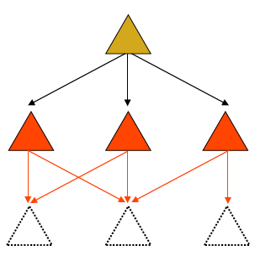
Top-down integration testing
Start with top-level modules
Use stubs for lower-level modules
As each level is completed, replace
stubs with next level of modules
Pros:
Always have a top-level system
Stubs can be written from interface specifications
Cons:
May delay performance problems until too late
Stubs can be expensive

Slide 68
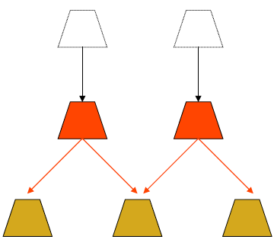
Bottom-up Integration Testing
Start with bottom-level modules
Use drivers for upper-level modules
As each level is completed, replace drivers with next level of modules
Pros:
Primitive functions get most testing
Drivers are usually cheap
Cons:
Only have a complete system at the end

Slide 69
Critical-first Integration
Integrate the most critical components first
Add the remaining pieces later
Issues:
Guarantees that the most important components work
May be difficult to integrate

Slide 70
Function-at-a-time Integration
Integrate all modules needed to perform a particular function
For each function, add another set of modules
Issues
Makes for easier test generation
May postpone function interaction for too long
  Dependencies may create a problem

Slide 71
As-Delivered Integration
Integrate the modules as and when they become available
Issues
Efficient – Just-in-time Integration
Lazy – may lead to missed schedules

Slide 72
Sandwich Integration Testing
Mixed (or sandwiched) integration testing:
  uses both top-down and bottom-up testing approaches.
  Most common approach

Slide 73
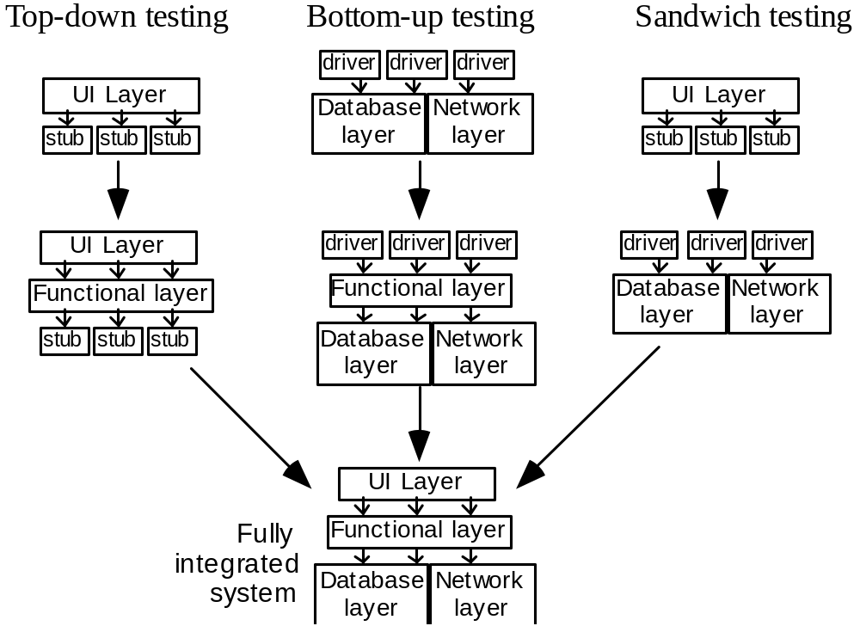
Example of different integration strategies

Slide 74
System Testing
Objectives
Gain confidence in the integrity of the system as a whole
  Ensure compliance with functional requirements
  Ensure compliance with non-functional requirements (for example, performance requirements)

Slide 75
Testing Functional Requirements
1. Prepare a test plan from the functional specification of the system
2. Prepare tests for all areas of functionality
3. Review test plan and tests
4. Execute tests
5. Monitor fault rate

Slide 76
Testing Performance Requirements
1. Identify stress points of system
2. Create or obtain load generators
  might use existing system
  might buy/make special purpose tools
3. Run stress tests
4. Monitor system performance
  usually needs instrumentation

Slide 77
Acceptance Testing
Testing performed by the customer or end-user himself:
  to determine whether the system should be accepted or rejected.
Other paths to acceptance:
Beta testing
  Distribute system to volunteers
  Collect change requests, fix, redistribute
  Collect statistics on beta use
Shadowing
  Collect or redistribute real-time use of existing system
  Compare results
  Collect statistics

Slide 78
The test-fix-test cycle
When a failure occurs during testing:
  Each failure report is entered into a failure tracking system.
  It is then screened and assigned a priority.
  Low-priority failures might be put on a known bugs list that is included with the software’s release notes.
  Some failure reports might be merged if they appear to result from the same defects.
  Somebody is assigned to investigate a failure.
  That person tracks down the defect and fixes it.
  Finally a new version of the system is created, ready to be tested again.

Slide 79
Deciding when to stop testing
  All of the level 1 (“critical”) test cases must have been successfully executed.
  Certain pre-defined percentages of level 2 and level 3 test cases must have been executed successfully.
  The targets must have been achieved and are maintained for at least two cycles of ‘builds’.
    A build involves compiling and integrating all the components.
    Failure rates can fluctuate from build to build as:
      Different sets of regression tests are run.
      New defects are introduced.

Slide 80
The roles of people involved in testing
  The first pass of unit and integration testing is called developer testing.
    Preliminary testing performed by the software developers who do the design.
  Independent testing may be performed by separate group.
    They do not have a vested interest in seeing as many test cases pass as possible.
    They develop specific expertise in how to do good testing, and how to use testing tools.

Slide 81
Test planning
Decide on overall test strategy
  What type of integration
  Whether to automate system tests
  Whether there is an independent test team
Decide on the coverage strategy for system tests
  Compute the number of test cases needed
Identify the test cases and implement them
  The set of test cases constitutes a “test suite”
  May categorize into critical, important, optional tests (level 1, 2, 3)
Identify a subset of the tests as regression tests

Slide 82
Testing performed by users and clients
  Alpha testing
    Performed by the user or client, but under the supervision of the software development team.
  Beta testing
    Performed by the user or client in a normal work environment.
    Recruited from the potential user population.
    An open beta release is the release of low-quality software to the general population.
  Acceptance testing
    Performed by users and customers.
    However, the customers do it on their own initiative.

