Slide 1
Five Queries That Require
Geographic Embedding
A Visualization Engine for Exploratory Spatial Data Analysis
Use Case: India's 2024 Lok Sabha Election
543 Constituencies | 642 Million Voters | 8,902 Candidates
Vishakha Agrawal | Malini Krishnan
Lab for Spatial Informatics | IIIT Hyderabad | Advisors: Kuldeep Kurte, K.S. Rajan

Slide 2
The Problem: Charts That Discard Location
Standard statistical charts (histograms, scatterplots, bar charts) encode VALUE but discard LOCATION. Two observations recording identical values appear equivalent. But if one sits in a cluster of similar values and the other is surrounded by opposite values, their positions in the data structure are fundamentally different.
This project identifies five classes of queries that CANNOT be answered without geographic embedding, implements two core spatializations (histogram to LISA, scatterplot to Moran) that answer them, and demonstrates the engine on a real dataset.
The five query classes are domain-independent. They apply to any variable measured at geographic units.
Crime rates by district | House prices by zip code | COVID cases by county | Hospital wait times by region | Crop yield by block | School test scores by district | Pollution readings by sensor | Service delivery failures by branch | Infrastructure deficits by municipality | Poverty indicators by sub-region
Use Case Dataset
India's 2024 Lok Sabha election: 543 parliamentary constituencies, 642 million voters, 8,902 candidates. Geographic unit = constituency centroid. Variables: turnout, victory margin, alliance, women's candidature, fiscal returns, seat allocation. Each query class is demonstrated on this dataset, then stated in generalizable form.

Slide 3
Five Query Classes That Have No Aspatial Equivalent
1
Cluster Detection
Aspatial: Histogram, bar chart
Does variable X exhibit spatial autocorrelation, and where are the clusters?
Spatial: LISA Cluster Map (Anselin 1995)
Do burglaries cluster by district? Where are the COVID hot spots?
2
Spatial Outlier
Aspatial: Scatterplot, ranked list
Is observation X anomalous relative to the global distribution, or relative to its geographic neighborhood?
Spatial: Moran Scatterplot (value vs spatial lag)
Is this hospital's wait time a local anomaly or a national trend?
3
Absence as Evidence
Aspatial: Count, histogram
Does the LACK of spatial structure in variable X prove a non-geographic cause?
Spatial: LISA with I near zero
Are equipment failures systemic or concentrated in certain plants?
4
Co-location
Aspatial: Separate bar charts
Do multiple disadvantages occupy the same geographic belt?
Spatial: Spatial spine / overlay map
Do poverty, poor health, and low education share the same districts?
5
Policy Simulation
Aspatial: Slider + table
Does a policy intervention change the spatial structure of inequality, or does the geographic pattern persist?
Spatial: Simulator + Moran's I
Does increasing hospital funding reduce geographic clustering of wait times?

Slide 4
The Engine: Data to Algorithm to Code
The same pipeline answers all five query classes. Only the input variable changes.
1. Data
Any CSV with geographic identifier (lat/lon or polygon ID) + numeric variable(s).
Python / PySAL
from libpysal.weights import KNN
from esda.moran import Moran, Moran_Local
import geopandas as gpd
# Works on ANY geographic dataset
gdf = gpd.read_file('units.geojson')
gdf = gdf.merge(data_df, on='UNIT_ID')
w = KNN.from_dataframe(gdf, k=8)
w.transform = 'r'
# Query 1: Cluster Detection
mi = Moran(gdf['variable_X'], w,
permutations=999)
# Returns: I, p_sim, z_sim
# Query 2: Spatial Outlier
lisa = Moran_Local(gdf['variable_X'], w)
# Returns: q (quadrant), p_sim per unit
# Query 3: Absence as Evidence
# If I ~ 0 and p > 0.05: random.
# Non-geographic cause confirmed.
2. Weights
KNN(k=8), row-standardized. Links each unit to k nearest neighbors. W: n x n.
3. Algorithm
Global I = [n/S0] * [sum(w_ij * z_i * z_j) / sum(z_i^2)]. 999 permutations.
4. LISA
Local I_i = z_i * sum(w_ij * z_j). Classify: HH, LL, HL, LH, NS. p-values per unit.
5. Visualize
Plotly.js interactive maps + Three.js WebGL 3D. Self-contained HTML.
Use case inputs (provided by advisor): ECI 2024 base datasets, 15th Finance Commission fiscal maps, reservation % simulation code, constituency count simulation code.

Slide 5
Why This Use Case, Why Now
April 16, 2026
Three bills introduced: Constitution (131st Amendment), Delimitation Bill, UT Laws Amendment. Proposed expanding 543 to 850 seats AND activating 33% women's reservation (Nari Shakti Vandan Adhiniyam, passed 2023 but tied to delimitation).
April 17, 2026: Amendment voted down. 298 for, 230 against (needed 352). First Modi govt amendment failure.
The Lok Sabha dataset is not an arbitrary choice. The five query classes address the exact questions that were debated:
Cluster Detection
Does the low-turnout belt co-locate with the underrepresented states?
Spatial Outlier
Is Bangalore's low turnout a national phenomenon or a Karnataka anomaly?
Absence as Evidence
Is women's exclusion concentrated in specific states, or everywhere equally?
Co-location
Do three crises (turnout, seats, fiscal) share the same north-south axis?
Policy Simulation
Which delimitation formula reduces geographic clustering of disadvantage?

Slide 6
Query Class 1
Cluster Detection
"Does variable X exhibit statistically significant spatial
autocorrelation, and if so, where are the clusters?"
Aspatial charts cannot answer this. A histogram shows shape. A bar chart shows rank.
Neither shows geographic contiguity, cluster boundaries, or spillover potential.

Slide 7
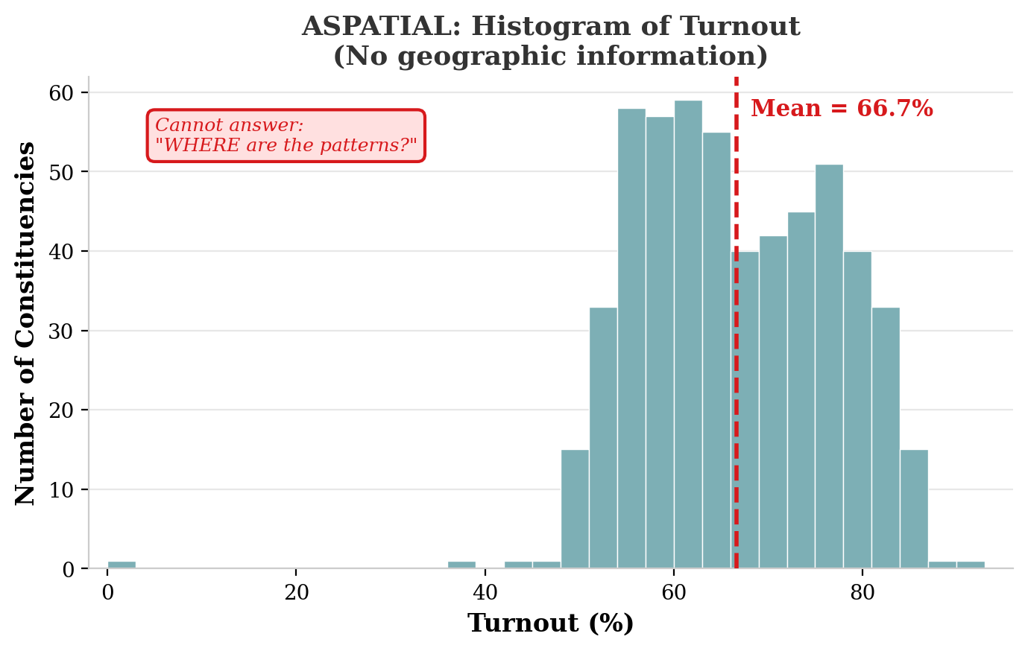
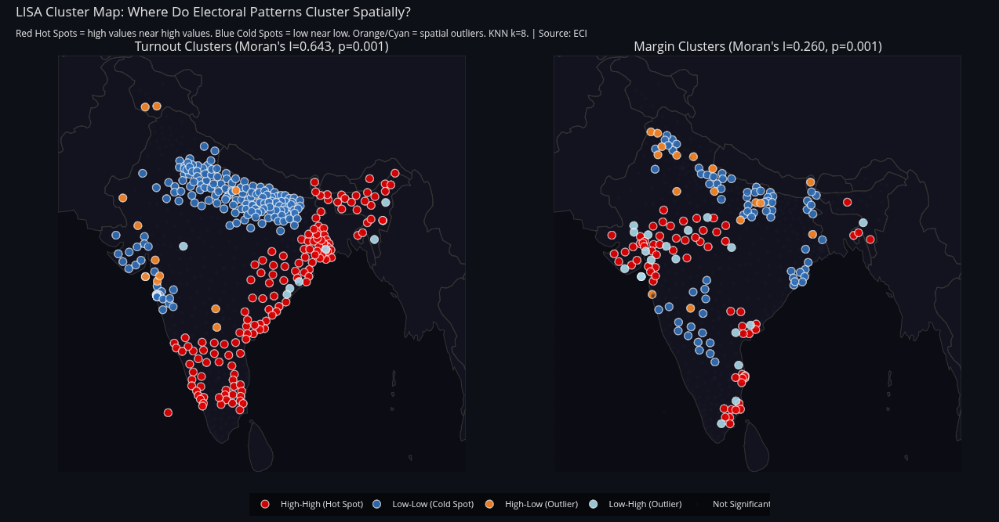
Use Case: Voter Turnout in 548 Constituencies
ASPATIAL
SPATIALIZED (Chart 37)
Result: Moran's I = 0.614 (p < 0.001). 57% of PCs in LISA clusters. Two contiguous hot-spot belts (South + NE) separated by a cold-spot belt (Hindi heartland). The histogram says "roughly normal." LISA says "two connected zones."
Generalizable: Does crime cluster by district? Where are the COVID hot spots? Do house prices form contiguous high-value belts? Is crop failure concentrated or scattered? Any variable with a lat/lon can be tested.
Use case finding: The cold-spot belt (UP, Bihar, Rajasthan) is the SAME geography that reappears in every subsequent query class.

Slide 8
Query Class 2
Spatial Outlier
"Is observation X anomalous relative to the global
distribution, or relative to its geographic neighborhood?"
A distributional outlier deviates from the global mean. A spatial outlier deviates from its
neighbors. These are different concepts. The second requires a neighborhood definition.

Slide 9
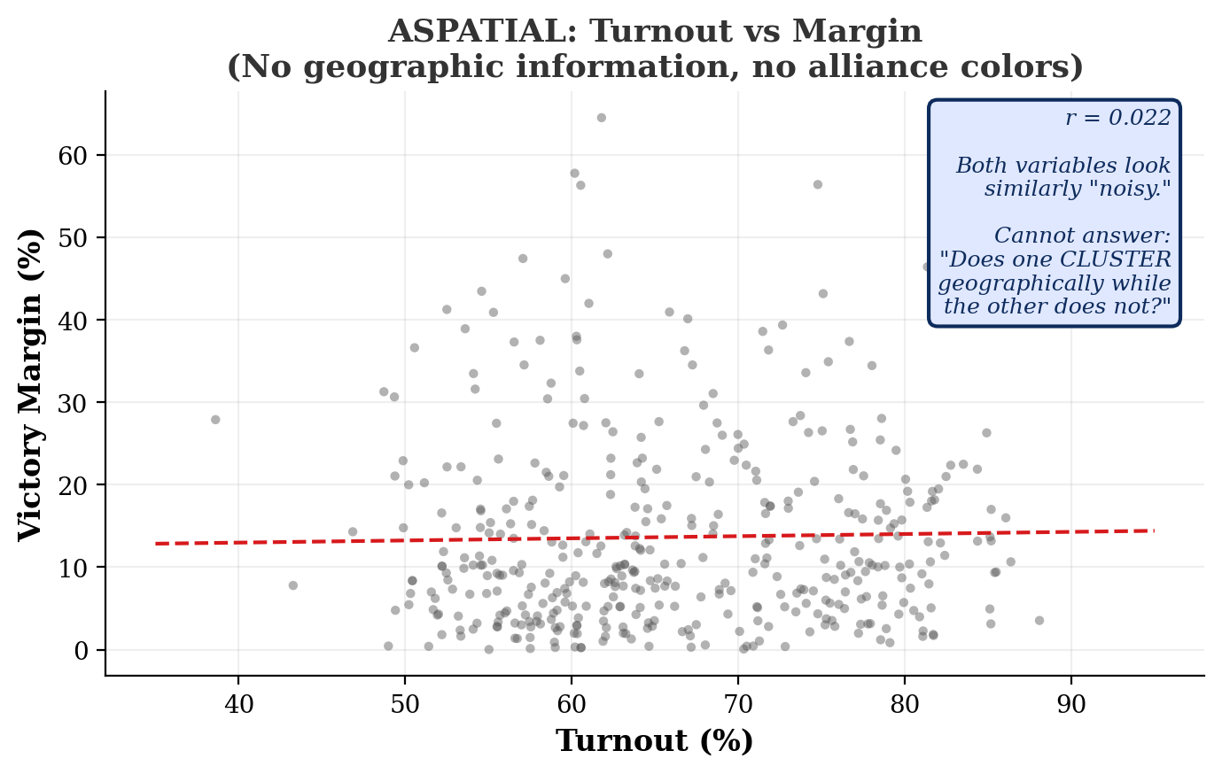
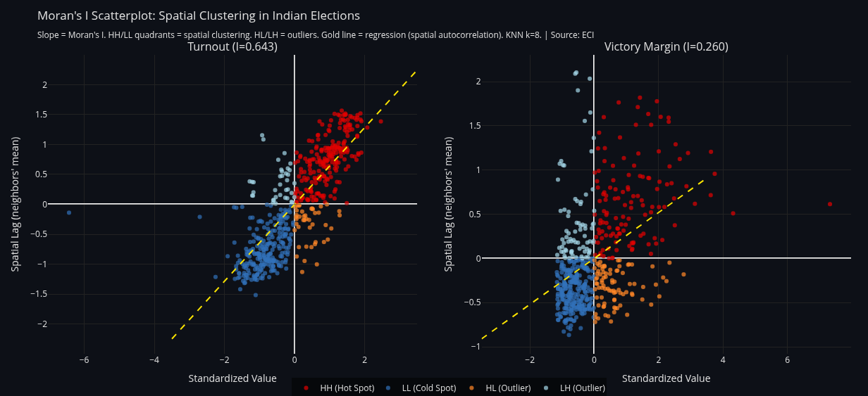
Use Case: Bangalore -- Distributional or Spatial Outlier?
ASPATIAL
SPATIALIZED (Chart 39)
Result: Scatterplot says "Bangalore is 1.2 std below the mean" (distributional outlier). Moran says "Bangalore is low in a HIGH neighborhood" (LH quadrant, spatial outlier). Different diagnosis, different policy. Turnout I=0.614 vs Margin I=0.277: participation is 2.2x more geographically structured than competition. Invisible in any scatterplot.
Generalizable: Is this hospital's wait time a local management failure or a regional pattern? Is this school's low score a staffing issue or a neighborhood effect? Is a pollution sensor reading an event or a malfunction? The Moran scatterplot transforms any X-Y plot into a spatial diagnostic.
Use case finding: The 2.2x asymmetry (turnout clusters, competition does not) is the central analytical result.

Slide 10
Query Class 3
Absence as Evidence
"Does the LACK of spatial structure in variable X
constitute evidence for a non-geographic cause?"
A histogram says "121 units had zero." It cannot say whether those 121 are concentrated
or scattered. Only a near-zero Moran's I can prove spatial randomness. Randomness IS the finding.

Slide 11
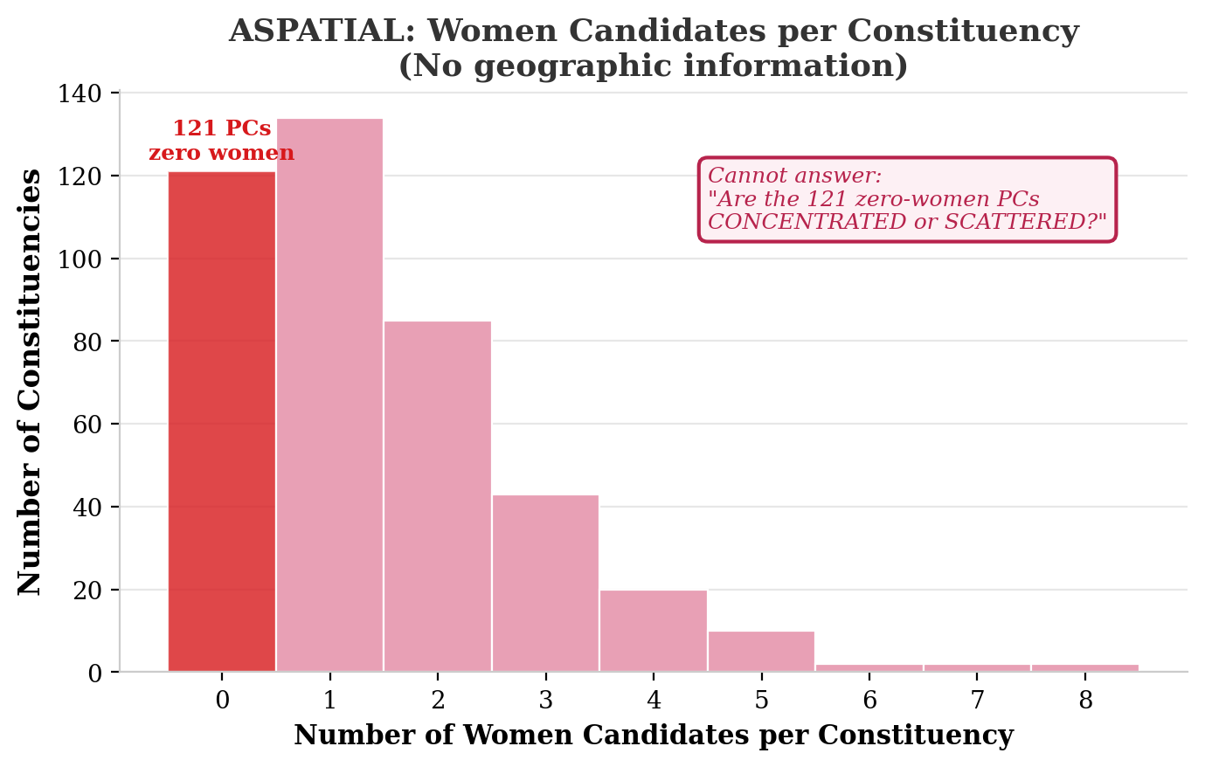
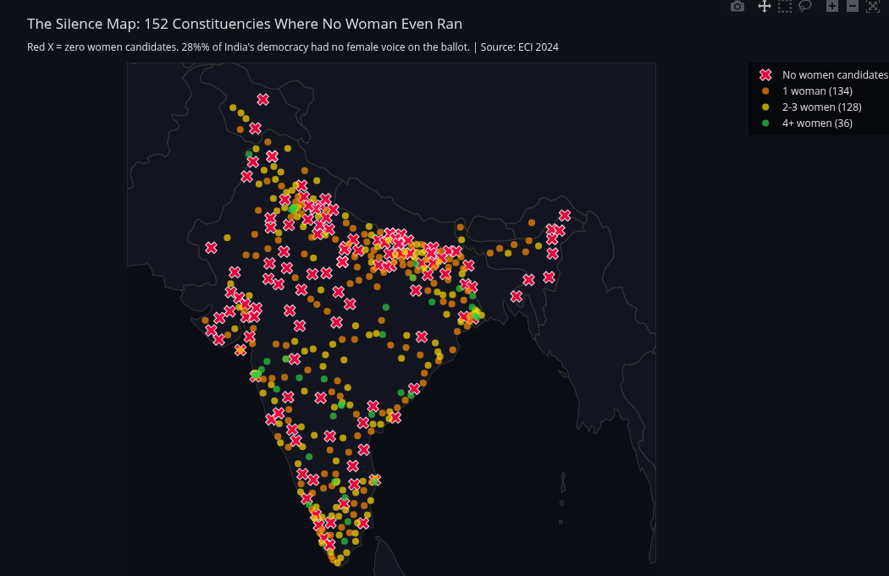
Use Case: Women's Exclusion -- Regional or Institutional?
ASPATIAL
SPATIALIZED (Chart 65)
Result: I = 0.113 (near-random). 121 zero-women PCs span every region. The histogram says "121 had zero" (a number). LISA says "the 121 are geographically random" (a spatial proof). The barrier is institutional (party nomination), not regional (culture). Targeting "problem states" would miss the majority of exclusion.
Generalizable: Are equipment failures across plants systemic or concentrated? Are regulatory violations an industry practice or regional enforcement gap? Are bank branch service failures a policy issue or a geography issue? Near-zero I proves systemic cause.
Use case finding: This changes policy design. Systemic reform (party quotas, deposit waivers) is needed, not geographic targeting.

Slide 12
Query Class 4
Co-location
"Do multiple disadvantages occupy the same
geographic belt? Is the overlap coincidental?"
Separate bar charts show each variable's ranking. They cannot show that the same states
appear at the top of EVERY list, or that a single geographic axis explains all three gradients.

Slide 13
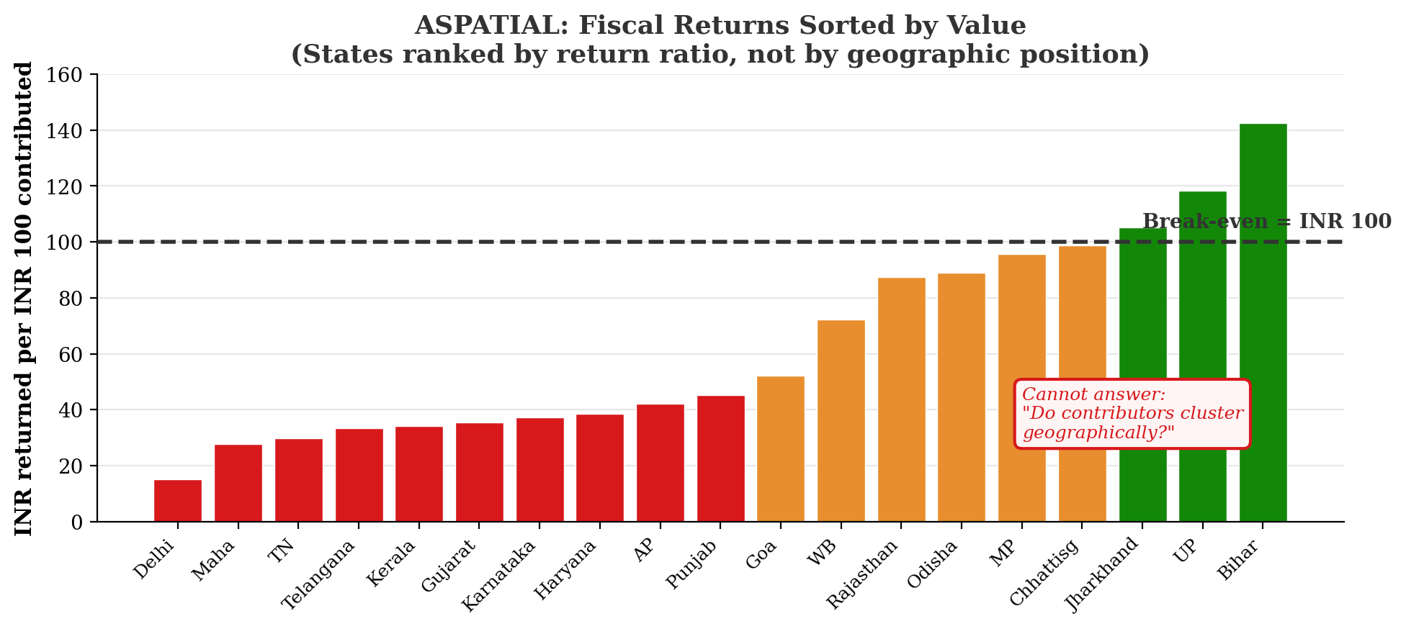
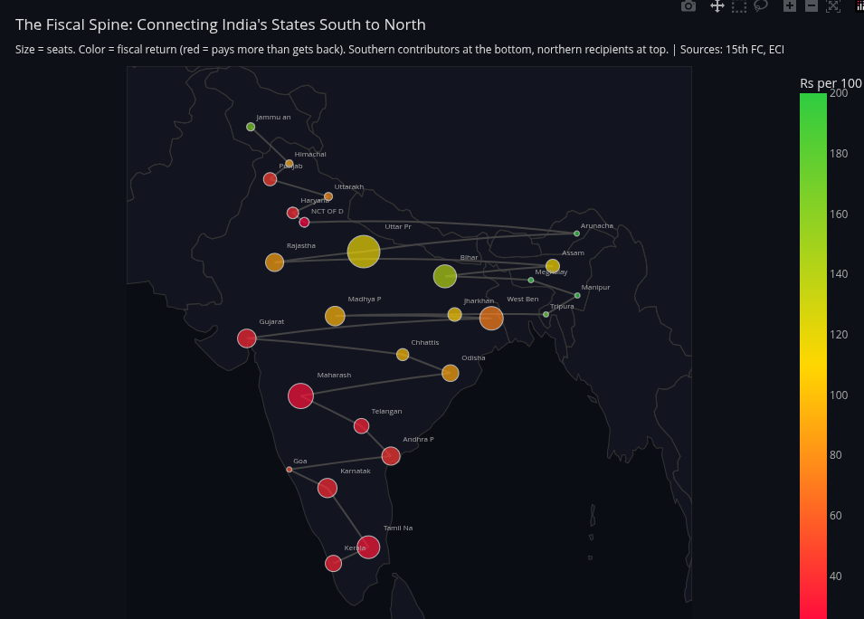
Use Case: Three Crises, One Geographic Axis
ASPATIAL
SPATIALIZED (Chart 77)
Result: Turnout clusters (south=high, north=low). Delimitation distortion (north underrepresented). Fiscal returns (south contributes, north receives). All three share the SAME north-south axis. The bar chart shows WHO pays. The Fiscal Spine shows they are ALL in the south.
Generalizable: Do poverty + poor health + low education co-locate in the same districts? Do infrastructure deficits + low investment + brain drain share the same regions? Do flood risk + low insurance + poor drainage overlap in the same urban zones? Only spatial embedding reveals geographic co-location.
Use case finding: The same belt is penalized three times. The fourth penalty (women's exclusion) is everywhere.

Slide 14
Query Class 5
Policy Simulation
"Does a policy intervention change the spatial structure
of variable X, or does the geographic pattern persist?"
A simulator produces numbers (seat counts, quotas). Without Moran's I, it cannot evaluate
whether the GEOGRAPHIC DISTRIBUTION of inequality improves or worsens under each scenario.

Slide 15
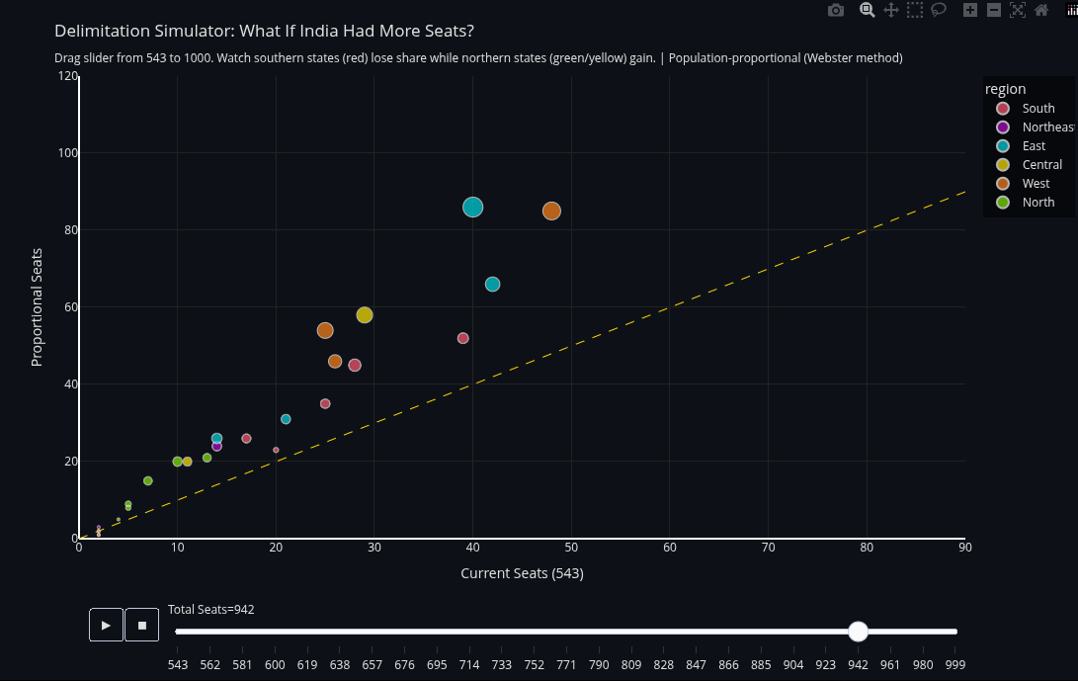
Use Case: Delimitation Simulator (Chart 71, advisor's code)
Without Moran's I: "At 850 seats, UP gains 37, TN loses 6." Numbers. No spatial structure.
With Moran's I: "At 850, I of electors-per-seat drops from 0.52 to 0.31. Clustering of underrepresentation reduced by 40%." Chart 74 extends: which allocation formula (population only vs +area vs +women vs +fiscal) produces the lowest I?
Generalizable: Which school zoning minimizes geographic clustering of low scores? Which hospital budget reduces spatial concentration of wait times? Which tax policy reduces clustering of fiscal dependency?
Reservation simulator (Chart 73, advisor's code): At any reservation %, women's I stays ~0.113. The spatial randomness persists. The barrier is institutional regardless of quota level.

Slide 16
How Every Atlas Chart Maps to a Query Class
The atlas is not separate from the project. It IS the five query classes applied to multiple variables.
Query Class | Chart(s) | Variable | Input Used
1. Cluster Detection | 37, 48 | Turnout, Alliance | Base dataset
2. Spatial Outlier | 39, 40 | Turnout vs Margin, Swing | Base dataset
3. Absence = Evidence | 65, 68 | Women's candidature | Base dataset
4. Co-location | 77, 75 | Fiscal + turnout + seats | Fiscal maps
5. Policy Simulation | 71, 73, 74 | Seat count, reservation % | Simulation code
3D / Depth | 47, 70, 85-89 | Multiple variables | All inputs
Every chart uses the SAME spatial weights (KNN k=8) and SAME Moran's I / LISA algorithm. What changes is the input variable.

Slide 17
Summary
Query | Aspatial Answer | Spatialized Answer | Generalizable Form
Cluster Detection | "Roughly normal." | "Two contiguous belts, I=0.614." | Does X cluster geographically?
Spatial Outlier | "1.2 std below mean." | "Low in high neighborhood (LH)." | Anomalous vs global or local?
Absence = Evidence | "121 had zero women." | "I=0.113: random. Institutional." | Does non-clustering prove cause?
Co-location | "Three separate bar charts." | "Same north-south axis." | Do disadvantages share geography?
Policy Simulation | "UP gains 37 seats." | "I drops 0.52 to 0.31 at 850." | Does intervention change spatial structure?
None of these queries have aspatial equivalents. Each requires a neighborhood definition that standard charts do not provide. The visualization engine that answers them is dataset-agnostic.

Slide 18
Thank You
Vishakha Agrawal | Malini Krishnan
Lab for Spatial Informatics | IIIT Hyderabad
Advisors: Kuldeep Kurte, K.S. Rajan
Five generalizable query classes | Two core spatializations
30 use-case charts | One dataset-agnostic engine

