Slide 1


Federated Sentiment Analysis Large-Scale Sentiment Analysis on Reddit Comments
Team A3 Final Presentation
Devarshi Kaushikkumar Shah Gaurang Kishorbhai Sumara Spoorthi Gudagunti Varad Kulkarni

Slide 2
Line UP
The Problem
Understand our Solution approach
Solution Architecture
Demo
User Stories
Technical Issues
Future Scope
QnA

Slide 3
What’s the project about?
Our project is about sentiment analysis based on Reddit comments
What is Sentiment?
Method used in NLP to understand opinions, emotions/attitude
expressed towards specific keywords.
In this project we are using Reddit data stream from the “The pushshift Reddit Dataset”, to train our Federated machine learning model to get “Sentiment” for user provided keywords

Slide 4
Solution Approach
Our solution implements Streaming of Reddit comments to emulate “real world” scenarios. This is performed using Apache Kafka.
Once we have “streams” of comments coming, we use Apache Flink for preprocessing of the data.
Finally preprocessed data is provided to our federated machine Learning Model, to ensure distributed learning; as the dataset is quite large, and the number of comments being streamed is rather heavy.
However, not entire dataset is used. To get the desired processing time on given resources.

Slide 5














Solution Architecture
Docker Container
.zst data
.py script
.json data
Streaming
- Tokenization: BERT
- Vectorization: TFIDF
-Labeling:Vader Lexicon
Clients
Docker Engine
Federated Learning
Aggregator
Query
Web Page
Output
Docker File
User
Input

Slide 6
Solution
.zst file is decompressed, and then converted into .json with our custom script.
This .json file is then pushed into the docker file for further processing.
.zst data
.py script
.json data

Slide 7
Solution Continue
To eliminate the requirement of setting and configuring multiple software and their dependencies, the tech stack is built on a single Docker container; discarding “but it works on my machine” phenomenon.
Ubuntu based Docker container installs and sets below modules:
miniconda, Apache Kafka, Apache Flink, Flink-kafka-connector, .json file
Other utilities such as curl, wget
Custom python and Bash scripts
Frontend packages like, Plotly, Dash and Flask for Frontend and Backend integration
Docker File

Slide 8
Solution Continue
conda.sh and trigger.sh combine automate below tasks:
Setup conda environment with various dependencies.
Triggers Zookeeper server, Kafka server and Producer, Flink cluster.
Performs health check of the services.
Triggers the Flink job.
Triggers Model’s Server, Clients, Global.
Initiate webpage, and port forward to the host machine.

Slide 9
Solution Continue
Once all the services are healthy and running
Kafka producer produces messages which in turn is streamed by kafka
Flink consumes the stream and performs below action
Tokenization: BERT
Vectorization: TFIDF Vectorizer
Labelling: Vader Lexicon
Distribution of data
Client models consumes a batch of 1000 messages (in 1 iteration) from their own Kafka topics, perform sentiment analysis; after which the weights and biases are forwarded to the global model.
Docker Container
Streaming
- Tokenization: BERT
- Vectorization: TFIDF
- Labeling: Vader Lexicon
Clients
Federated Learning
Aggregator
Query
Web Page
Output
User
Input

Slide 10
Solution Continue
Docker Container
Then the Global model updates the local models by aggregating weights and biases.
Flask integrates the backend with a web page, made with Plotly & Dash.
The User inputs a text prompt on the webpage, which then being queried by the global model.
Global model returns the sentiment based on ad hoc knowledge.
Streaming
- Tokenization: BERT
- Vectorization: TFIDF
- Labeling: Vader Lexicon
Clients
Federated Learning
Aggregator
Query
Web Page
Output
User
Input

Slide 11
Solution Continue
Framework: Pytorch Flower
We have 4 Federated clients which are trained on LSTM model
Optimizer: Adam Optimizer
Input Features:
input_ids: These are the token IDs generated from the input text, used as input to the embedding layer of the LSTM.
attention_mask: These masks are used to indicate which tokens are actual words and which are padding, helping the model to ignore the padding tokens during training.
tfidf_vector: These vectors represent the input text using “Term Frequency-Inverse Document Frequency” (TF-IDF) scores, capturing the importance of words in the text.

Slide 12
Demo!

Slide 13
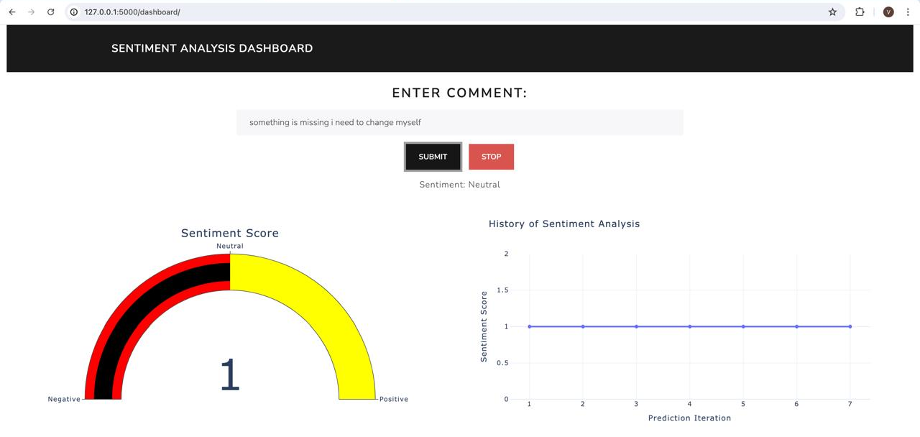
Sample Output

Slide 14
User Stories
Though the user stories created by us were divided among the team members, we worked together on almost all of the tasks.
Google Cloud Setup, Docker, Bash, Markdown: Devarshi
Data cleaning and preprocessing: Gaurang
User Interface design and testing: Spoorthi
Kafka, Flink, Federated Machine Learning Pipeline: Varad Kulkarni

Slide 15
Technical Issues
1. Version incompatibility issues with below isolated softwares:
Kafka, Flink, Pyflink, Confluent Kafka, Pandas, Torch, Numpy & Torch Flower
2. Docker image:
Missing Dependencies in Alpine Linux, hence moved to Ubuntu Server 24.04 LTS on X86 running on Google Cloud
Pip installation failing due to Python version mismatch, hence moved to Miniconda

Slide 16
Future Scope
Optimisation of pipeline, using multi-container architecture.
Slimmer Docker image by replacing Ubuntu with other minimal Linux base image.
We can have more federated clients, hyper parameter tuning, more capable pretrained model for precise sentiment.
More, realtime metadata to be presented on the Webpage, such as Loss of the ad hoc iteration,
Efficient tuning of Flink and Kafka according to the requirements of the project.

Slide 17
References
Gitlab Code Repository: https://collaborating.tuhh.de/e-19/teaching/bd24_project_a3_a
Docker Image: https://hub.docker.com/repository/docker/devarshikshah/bd24_project_a3_a/tags

Slide 18
QnA

Slide 19
Thanks!

