Slide 1
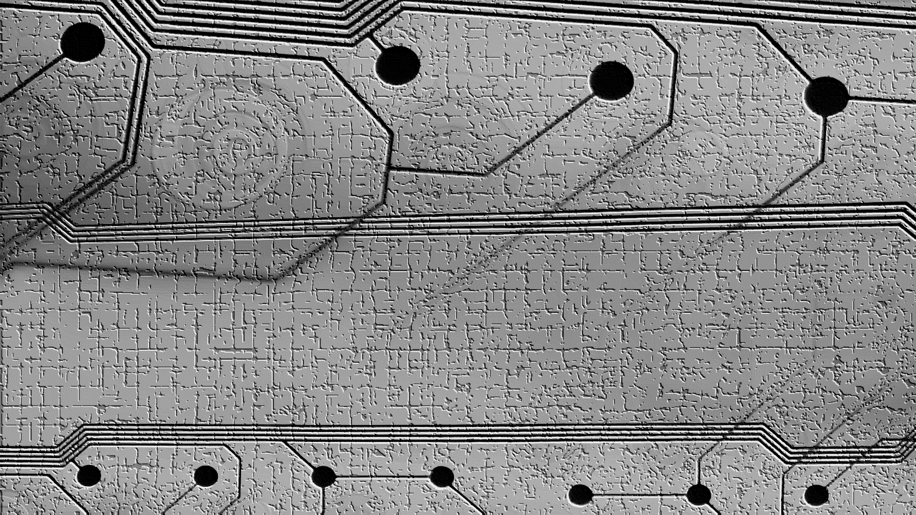


Validator DAO Charter: Ratification
Charter
Summary : This proposal is to ratify the Validator DAO Charter.
Background : The Harmony Validator DAO is a Decentralized Autonomous Organization that represents both Harmony Validators and Delegators.
Motivation : To provide official rules and governance by the community for the Validator DAO
Specification : Please click the link to review the proposed charter
Suggested voting options : yes or no for ratification.
talk.harmony.one

