Slide 1
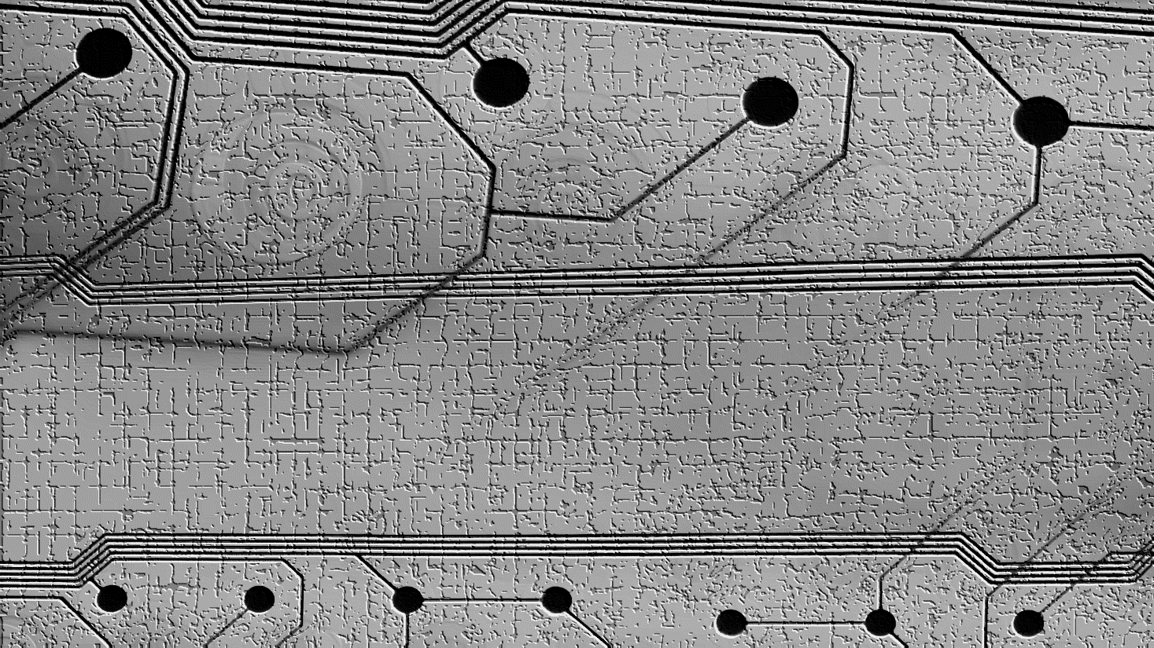


HIP-24: Harmony testnets
HIP-24
Proposal overview:
Devnet setup and operation (1 shard with only 1 or 2 internal node, 1 dns node, 1 explorer, 1 endpoint, faucet, explorer dashboard and documentation for the dev to refers to)
Testnet operation (assuming this is the same as now) (4 shards, 8 dns node, 4 explorer, 8 external; validators, 1 explorer dashboard, faucet)
Maintenance of both testnets, upgrades, monitoring
talk.harmony.one

