Slide 1
SF
StudyFlow
A smart campus service that puts every student’s academic life in one place
Full-stack web application · React + Node.js + AI
Innovation Challenge · Sub-theme A: Smart Campus Services
Peter Mutethia · CO27-01-2632/2024 · School of Computer Science & IT
Notes:
StudyFlow is a smart campus service built for Sub-theme A. Each student gets a private account, and the system measures their progress from the work they already record.

Slide 2
THE PROBLEM
Students juggle five tools and still lose track
Scattered
Invisible
Forgotten
Notes in one folder, deadlines in a chat group, past papers on a flash disk.
No honest answer to "am I actually on track this semester?"
Last semester disappears the moment the new one starts.
StudyFlow puts all of it behind one private account — and turns the work you already record into a progress score.
12
1
4
2
feature areas
account, fully private
progress measures
databases supported
Notes:
Three failure modes students actually hit. StudyFlow answers all three from one account.

Slide 3
SUB-THEME A · SMART CAMPUS SERVICES
What the challenge asked for
The brief lists seven expected projects for Smart Campus Services. StudyFlow already delivers five of them in one platform.
School customer care tool / virtual help desk
Study Assistant answers questions from the student’s own data
AI chatbot for student inquiries
Same assistant, also explains how every page works
Academic information platform: deadlines, timetables, exams
Assignments, timetable, calendar and deadline notifications
Course materials, lecture notes and past papers
Notes and Past Papers, with AI summaries and generated quizzes
Student inquiry and feedback tracking
Notifications and alert history per account
Campus navigation / locating offices and halls
Not in scope — lecture venues are recorded on the timetable
Notes:
Mapping StudyFlow directly onto the brief. Five of the seven expected projects are built and working; campus navigation is the one deliberately left out of scope.

Slide 4
ARCHITECTURE
How it is built
Frontend
Single-page app. Token kept in localStorage and attached to every request.
React 18 · Vite · Tailwind CSS · React Router
Backend
Every /api route sits behind one auth middleware, so no endpoint can forget it.
Node.js · Express · REST API
Data
One driver interface, two engines. Schema migrates itself on boot.
SQLite (sql.js) locally · PostgreSQL in production
AI
Summaries, quiz generation, marking, exam prep, chatbot. Degrades gracefully without a key.
OpenAI gpt-4o-mini
No paid infrastructure — it runs on a laptop with a single npm install.
Notes:
Two database engines behind one interface. The same code runs on a laptop with SQLite and on a host with Postgres.

Slide 5
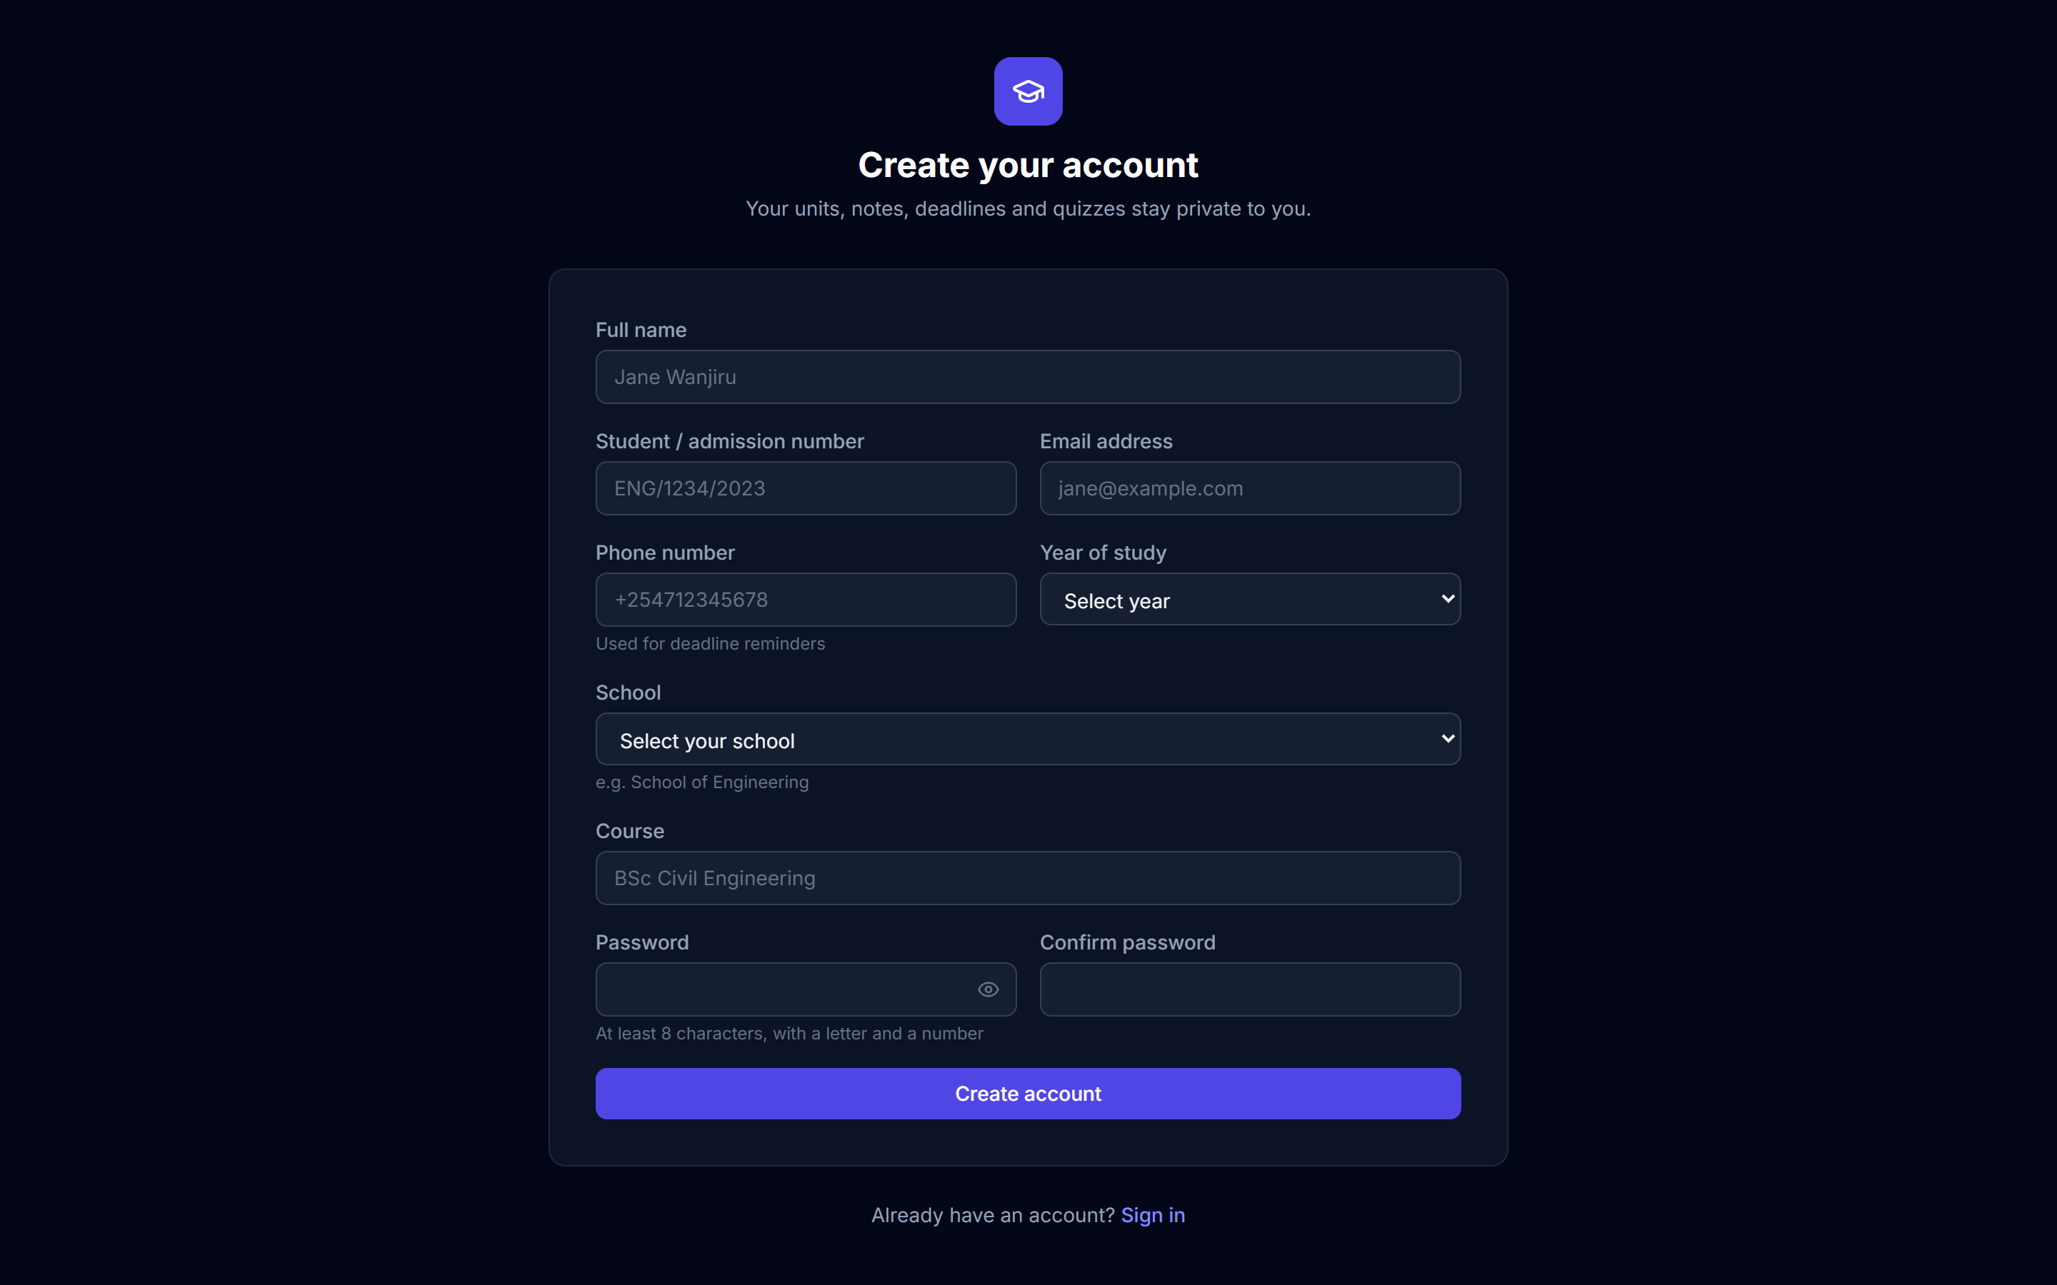
ACCOUNTS
Every student gets a private account
Full student profile
Name, admission number, email, phone, school, course and year of study — collected at sign-up.
Sign in either way
Email or admission number, matched case-insensitively. Passwords hashed with scrypt.
Strict isolation
Every query is scoped by account. Tested: one student cannot read, edit or delete another’s work.
Notes:
Registration collects the full academic profile. Passwords use scrypt; sessions use signed tokens. Data isolation was tested with two accounts.

Slide 6
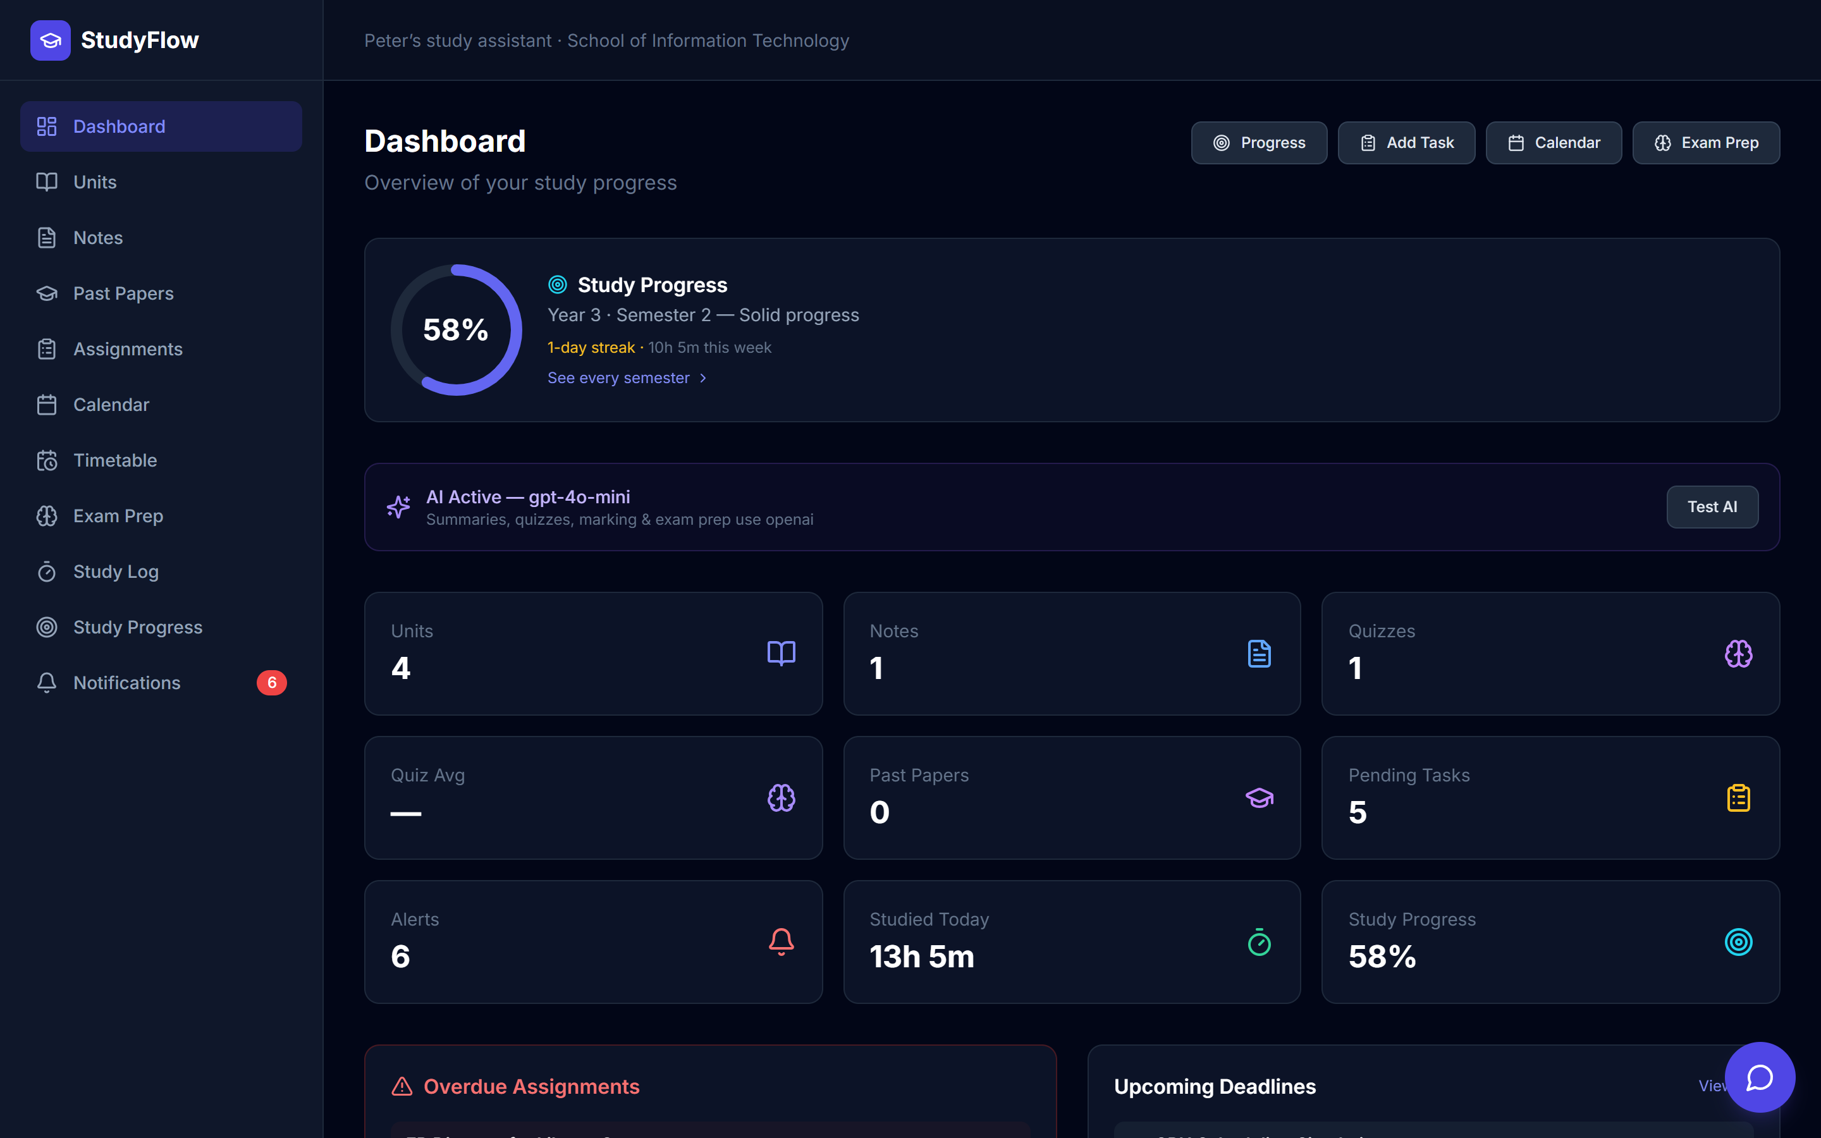
DASHBOARD
Everything that matters, on one screen
Progress first
The ring leads the page — current semester score at a glance.
Today at a glance
Timetable slots, overdue work and upcoming deadlines.
Live counters
Units, notes, quizzes, study time and unread alerts.
Notes:
The dashboard answers "what do I need to do right now" without clicking into anything.

Slide 7
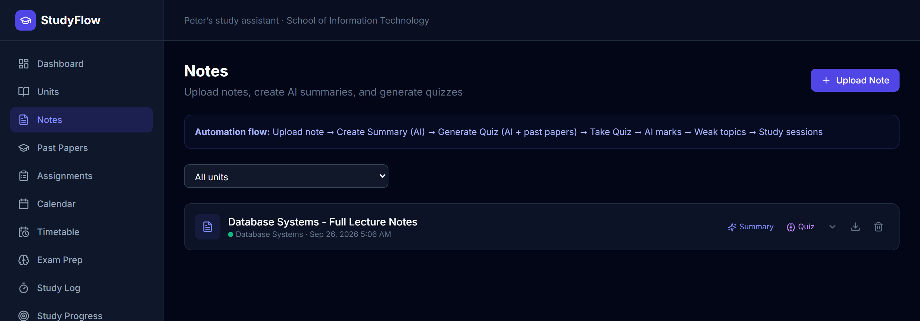
AI AUTOMATION
Upload notes, get summaries and quizzes
1
2
3
4
5
6
Upload note
AI summary
Quiz generated
AI marks it
Weak topics
Revision scheduled
One upload starts the whole chain. Marking finds the topics you got wrong and books revision sessions for them automatically.
Notes:
Verified end to end on a 287-page PDF: summary in 16s, quiz in 15s, marking in 17s, five revision sessions created.

Slide 8
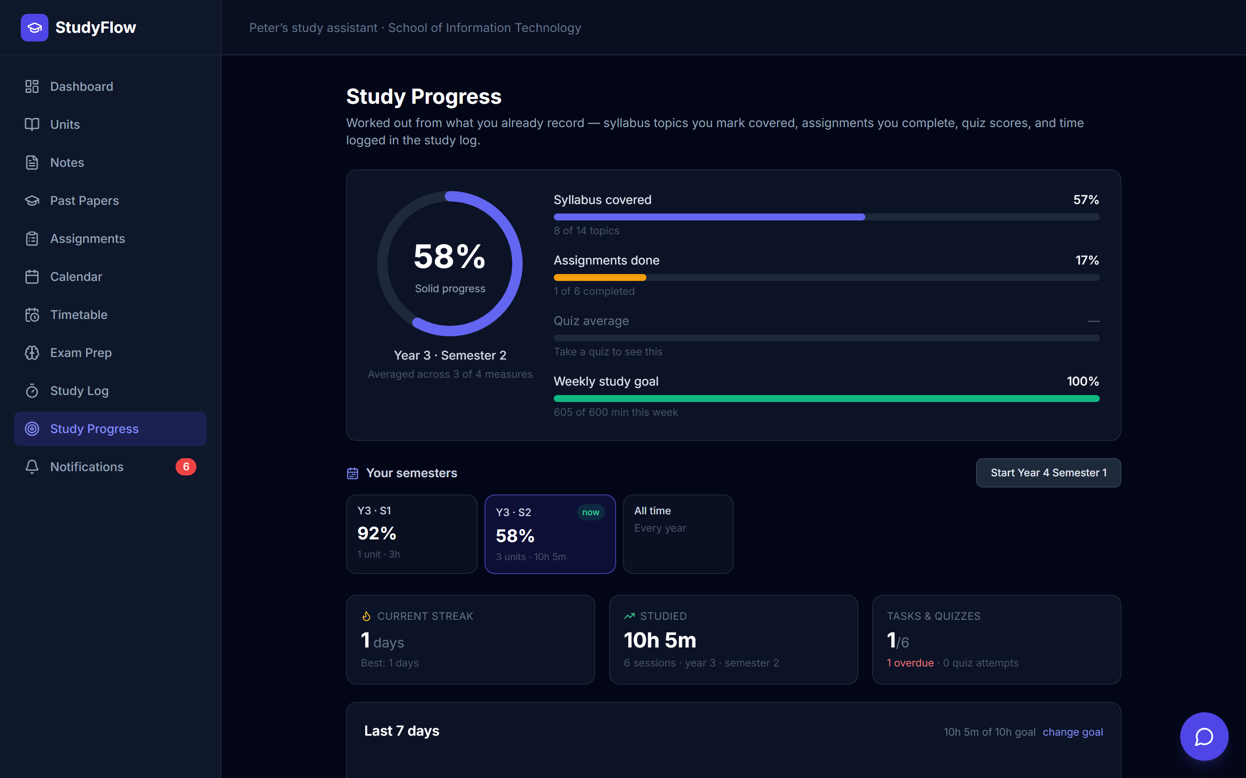
STUDY PROGRESS
Progress, split by year and semester
Four measures
Syllabus covered, assignments done, quiz average, and study time against a weekly goal.
Honest scoring
A measure with no data is skipped, not counted as zero — an empty quiz history cannot drag you down.
Semesters kept
Start a new semester and the old one keeps its units, notes and final score. Nothing is deleted.
Notes:
The ring averages only the measures that have data. Finished semesters drop the weekly-goal measure, because judging a past term by this week would be unfair.

Slide 9
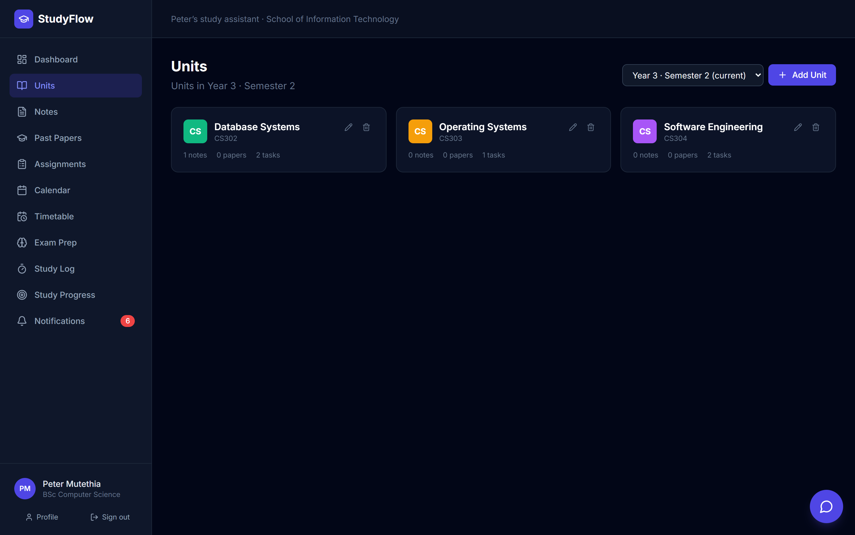
UNITS & SEMESTERS
Work is organised into terms
Units belong to a semester
Notes, past papers, assignments, topics and quizzes hang off a unit, so they follow it.
Filter by term
See only what you are studying now, or switch to any past semester.
Carry a unit forward
Move it between terms and its whole history moves with it.
Notes:
Because everything hangs off a unit, one term filter scopes the entire application.

Slide 10
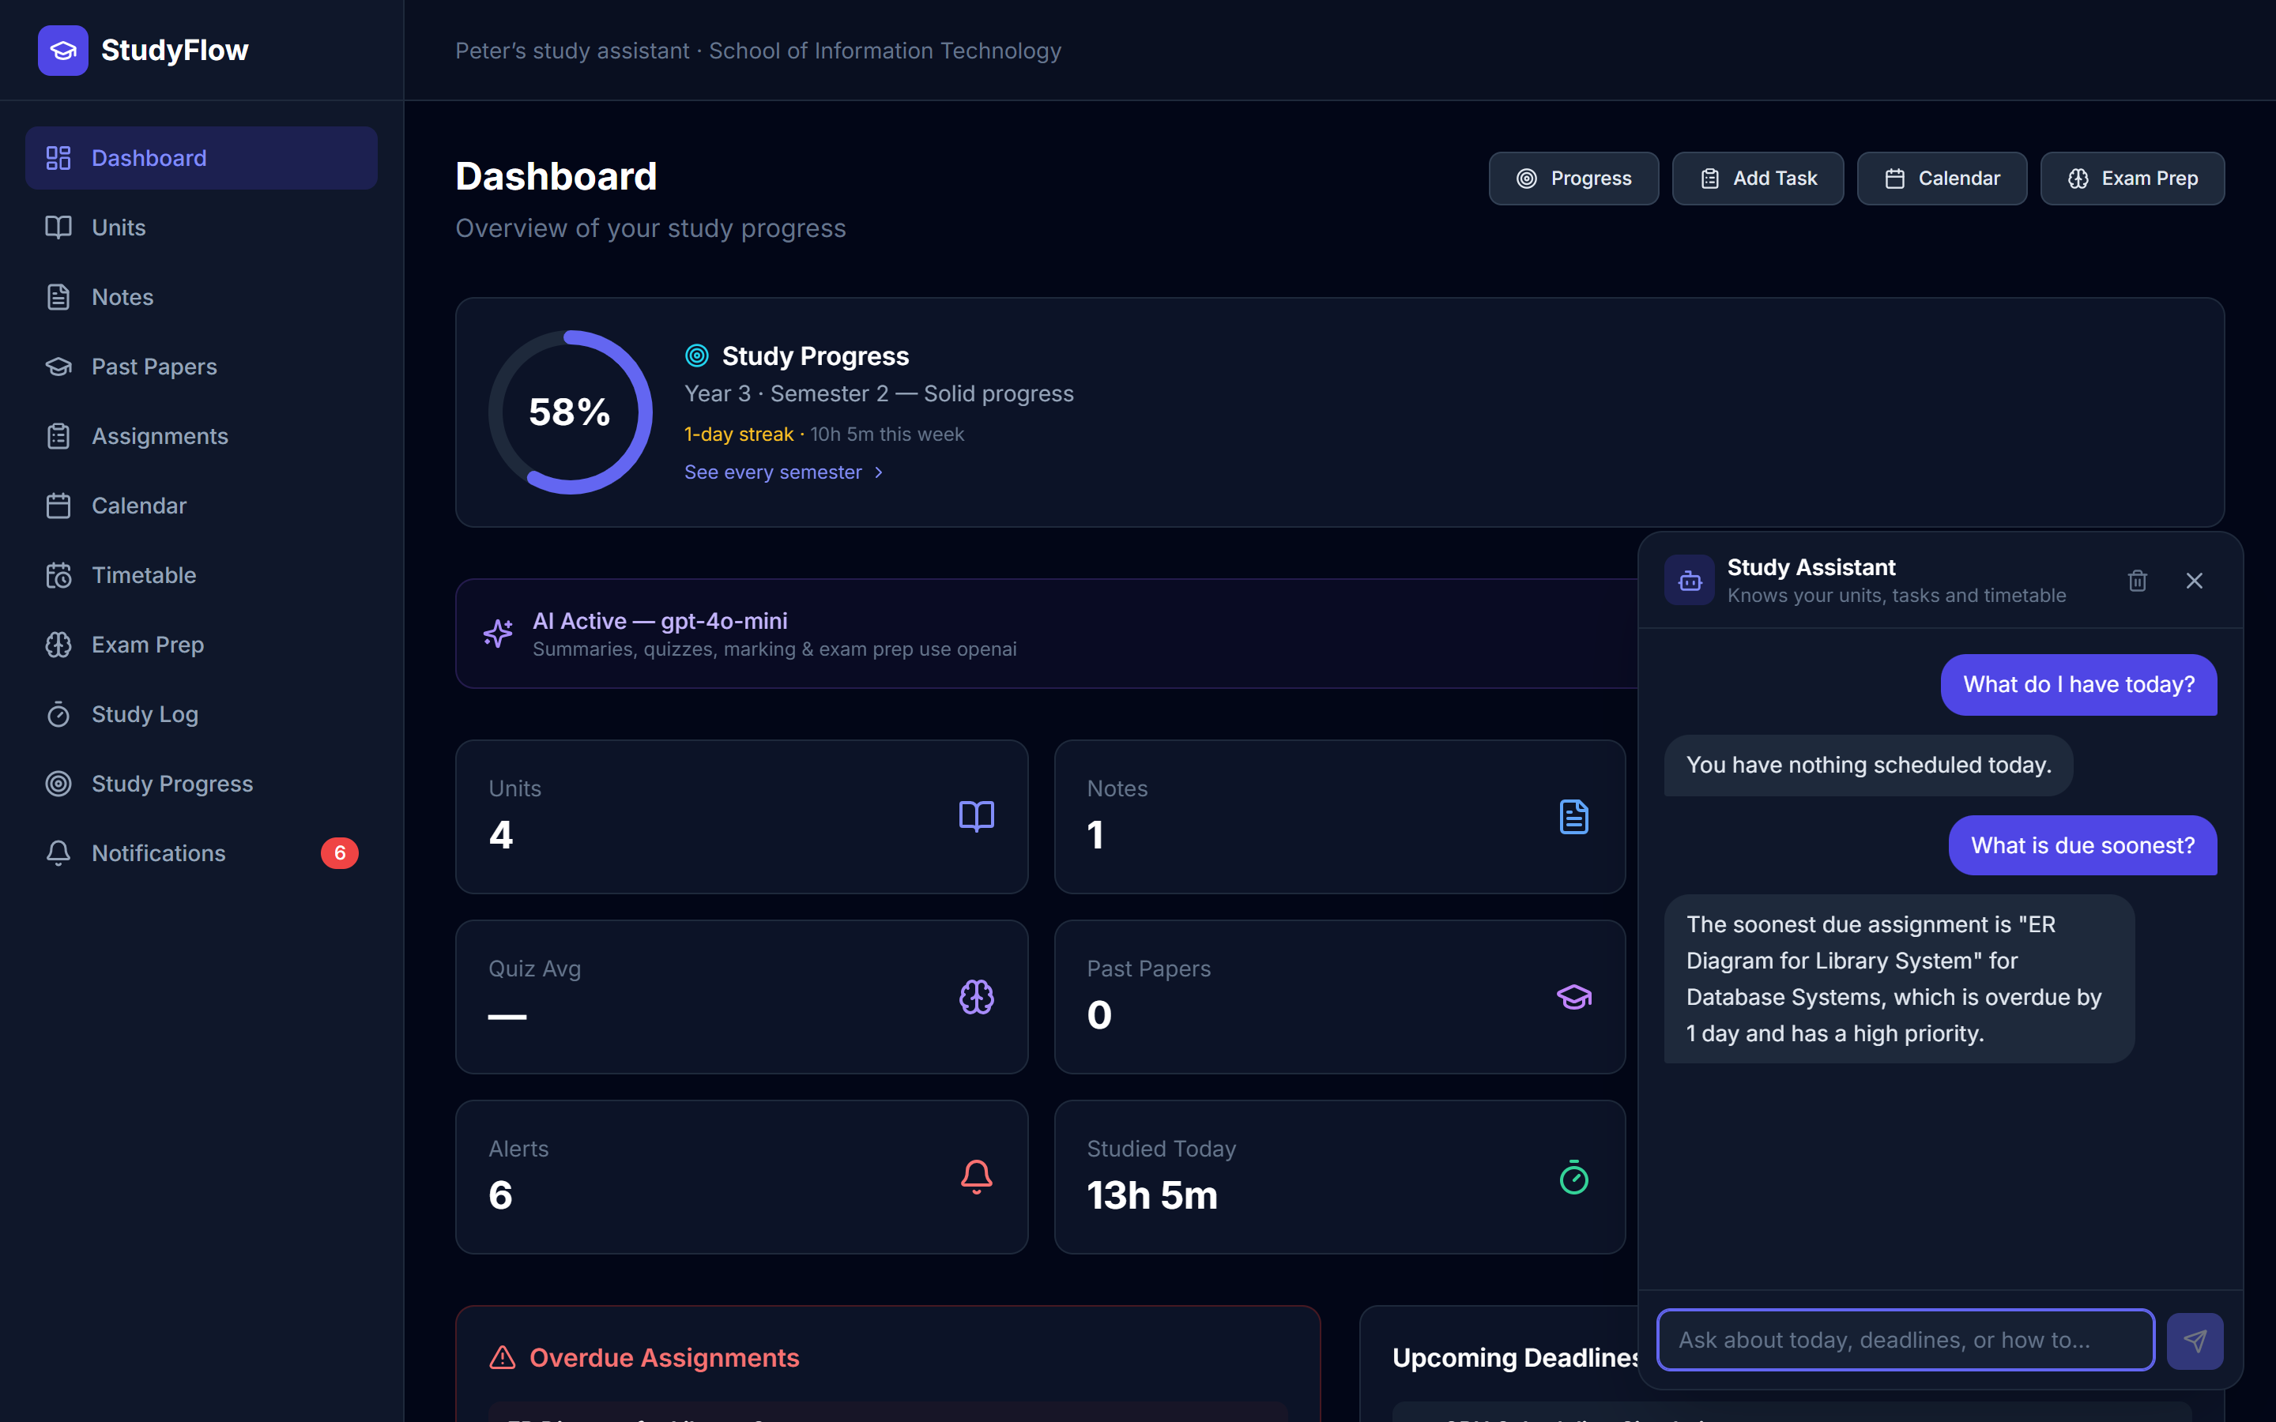
STUDY ASSISTANT
A chatbot that knows your actual data
Grounded answers
"What do I have today?" returns your real timetable and your real deadlines — not generic advice.
Explains the app
Also answers "how do I upload notes?" or "how do I start a new semester?"
Works without AI
If the API key is missing it still answers the common questions straight from your data.
Notes:
The assistant is given a snapshot of the student’s own rows on every question, and is instructed never to invent units or deadlines.

Slide 11
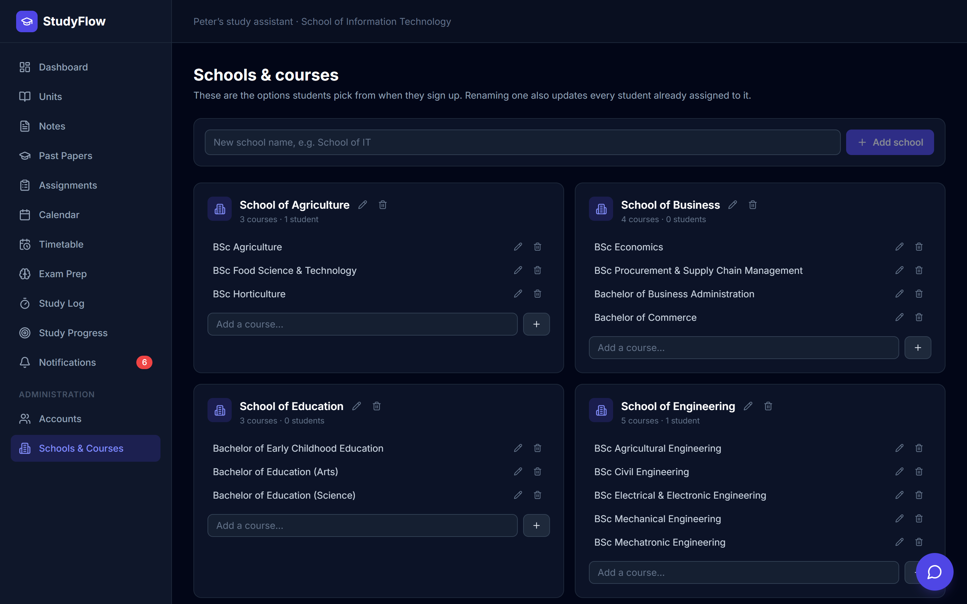
ADMIN ROLE
Administration
Manage the catalogue
Admins control the schools and courses students choose from at sign-up.
Manage accounts
Search, promote, suspend, reset passwords, or delete an account and all its data.
Safe by design
Admins cannot demote or delete themselves, and never see student content — only counts.
Notes:
Renaming a school updates every student assigned to it. Deleting one only removes it from the sign-up list; nobody’s profile is edited.

Slide 12
Five of seven expected projects, built
Private accounts with full academic profiles
NEXT
Notes, past papers, assignments, timetable, calendar
Campus navigation and office locator
AI summaries, quiz generation, marking and exam prep
Kiswahili interface and Kiswahili-language assistant
Progress tracking split by year and semester
Deploy university-wide on hosted Postgres
Study assistant chatbot grounded in the student’s data
Admin area for accounts, schools and courses
Thank you
github.com/harmonymwirigi/learningautomation
Notes:
Everything on the left is implemented and tested. The right column is what I would build next — including a Kiswahili interface, which would bridge into Sub-theme B.

