Slide 1

HvA Immersive Lab Template
Introduction

Slide 2
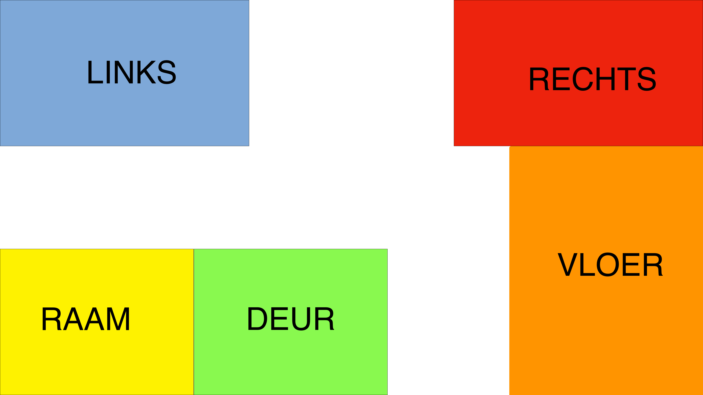
Immersive lab

Slide 3
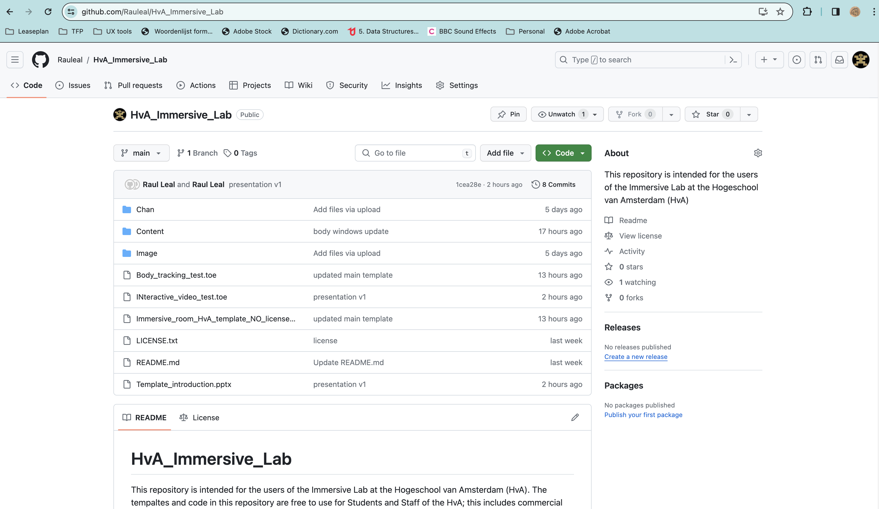
Git Repository
https://github.com/Rauleal/HvA_Immersive_Lab

Slide 4
Basics of the template I
No need to re-render for the position
Easy to change
Content
Content
Content
Content
Content
Screen/
beamer
Screen/
beamer
Screen/
beamer
Screen/
beamer
Screen/
beamer

Slide 5
Basics of the template II
No need to re-render for the position
Easy to change
Content
Splitter
Screen/
beamer
Screen/
beamer
Screen/
beamer
Screen/
beamer
Screen/
beamer

Slide 6
Types of content we can load
Images
Video
Sound

Slide 7
Basics of the template - interaction
Content
Modifier
Screen/
beamer
Interaction/trigger

Slide 8

Your body can modify your content.

Slide 9
Triggers ready to use
Mac / Windows
Device movement
Facial recognition
Open mount
Smile
Eyes closed
Windows (NVIDIA)
Body tracking
Hands position
Squads

Slide 10

Depending on your ideas we can add more triggers and interactions.

Slide 11
Zig sim I
Free version
Good for interactions where you attach the device to the user
Pro Version
Facial recognition
Depth Camera
Not very stable for body tracking

Slide 12
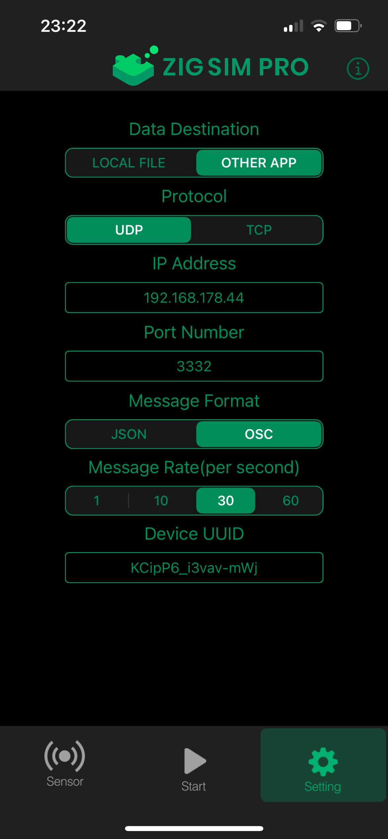
Zig Sim II

Slide 13
Tips
Keep it simple
For interaction triggers use 2-3 data points
Content modifiers solve one property at the time
Think generic instead of specific constraints
Precision is hard, embrace 80-20

Slide 14
References
Zig Sim https://1-10.github.io/zigsim/getting-started.html
ARKIT Face recognition model
Body track model

