Slide 2
Exam format:
Conventional midterm
Take home final

Slide 3
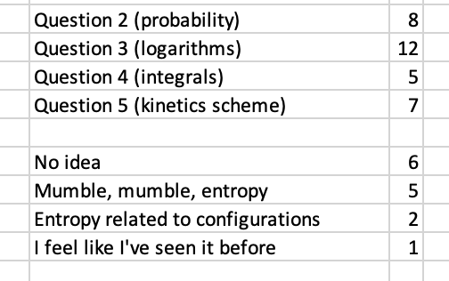
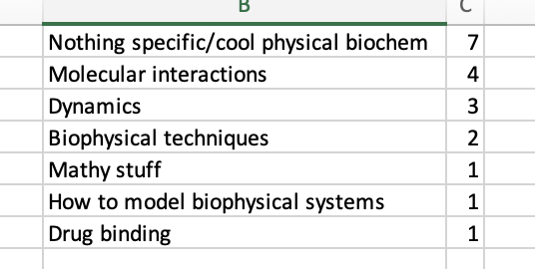

Slide 4
Statistics of biomolecules, Part I
Statistics of biomolecules, Part II
(entropy!)

Slide 5
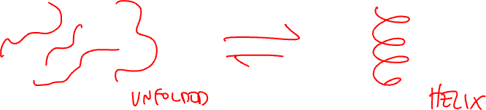
Consider the following reaction:
What would you want to know to say you understand the reaction fully?
How could you figure these things out?

Slide 6
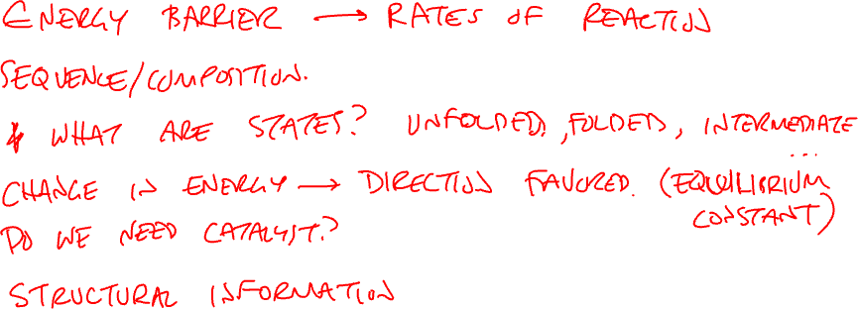
What would you want to know to say you understand the reaction fully?

Slide 7
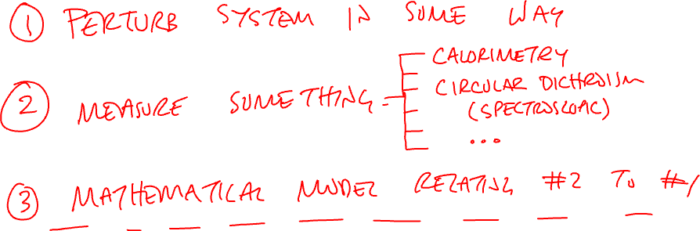
How could you figure these things out?

Slide 9
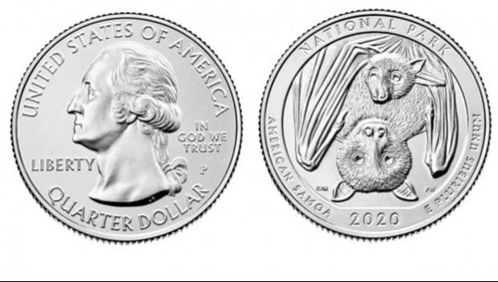
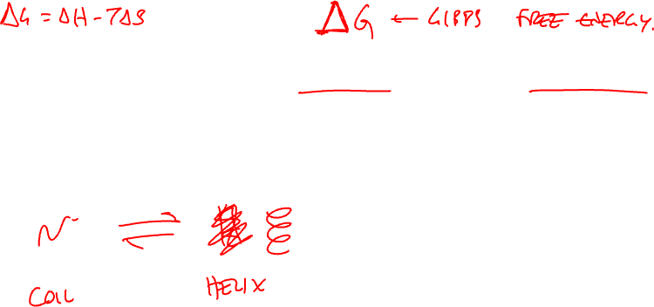
Reactions are stochastic and probabilistic

Slide 10
Simulating a coin “reaction”
Pick up a coin
Toss it
Put it back on table
Repeat
T
T
H
H
T
H
H
T
H
H
T
H
T
H
T
T
H
T
H
T
T
T
H
H

Slide 11
Simulating a coin “reaction”
H
T
Pick up a coin
Toss it
Put it back on table
Repeat
H
T
T
H
T
H
H
T
H
T
H
H
T
T
H
T
H
T
H
T
T
T
H
H

Slide 12
Make a prediction:
If we start with the same number of heads and tails, what will happen to the number of heads and tails as we start flipping coins?

Slide 13
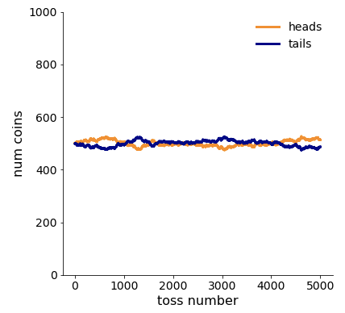
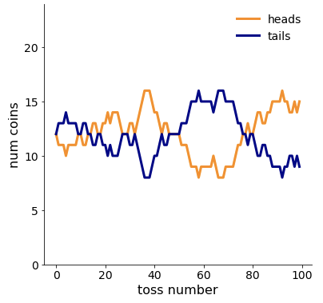
If reaction starts 50:50 heads:tails,
it: .

Slide 14
Equilibrium
State of a reaction where rate of formation and the rate of degradation exactly offset so the concentrations of products and reactants do not change over time.
IMPORTANT: individual molecules continue to react! The system is not frozen.

Slide 15
Make a prediction:
What will the curve look like if you start with
all heads and no tails?

Slide 16
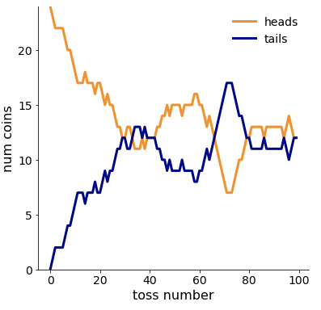
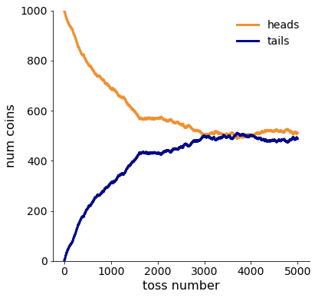

If reaction starts 100:0 heads:tails,
it equilibrates to 50:50

Slide 17
Spontaneous reaction:
A thermodynamic process that occurs without the input of free energy from outside the system

Slide 18
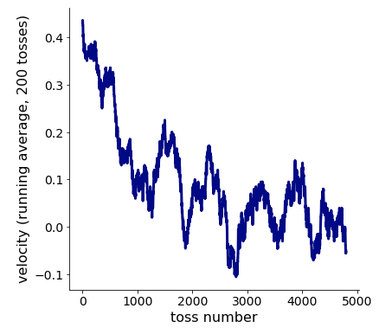
Reaction velocity starts high, then goes to zero

Slide 19
Reaction velocity:
The rate of appearance of product disappearance of reactant.

Slide 20

Why does the curve have this shape?
At early time points,
N_{H} N_{T}.
On average we’ll see
H→T T→H.
After a long time,
N_{H} N_{T}.
On average we’ll see
H→T T→H.

Slide 21
Let’s describe this mathematically

Slide 22
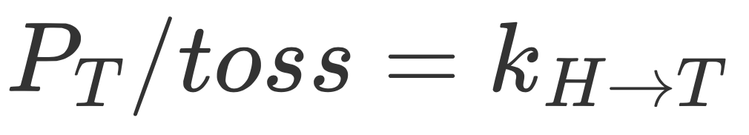
Velocity is determined by concentrations and rate constants

Slide 23
Rate constant:
The proportionality constant between the velocity of a chemical reaction and the concentration(s) of the reactant(s). (k_{H→T}, k_{T→H}, etc.)

Slide 24
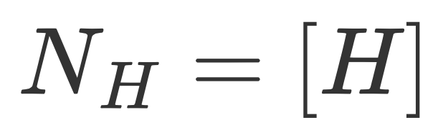
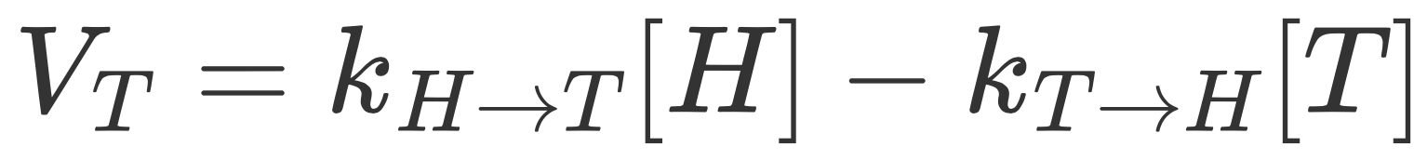
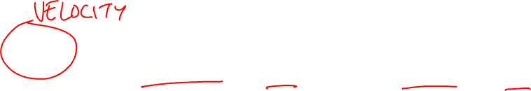
Velocity is determined by concentrations and rate constants

Slide 25
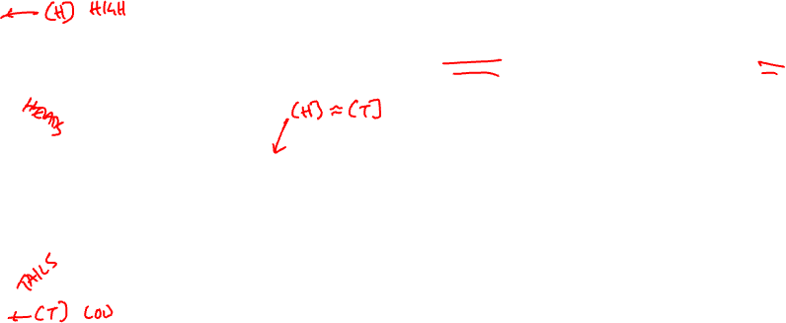
Why does the curve have this shape?

Slide 26
Make a prediction: what happens if we use a weighted coin?
Fair coin
Weighted coin
P_{H} = 0.5
P_{T} = 0.5
P_{H} = 0.25
P_{T} = 0.75

Slide 27
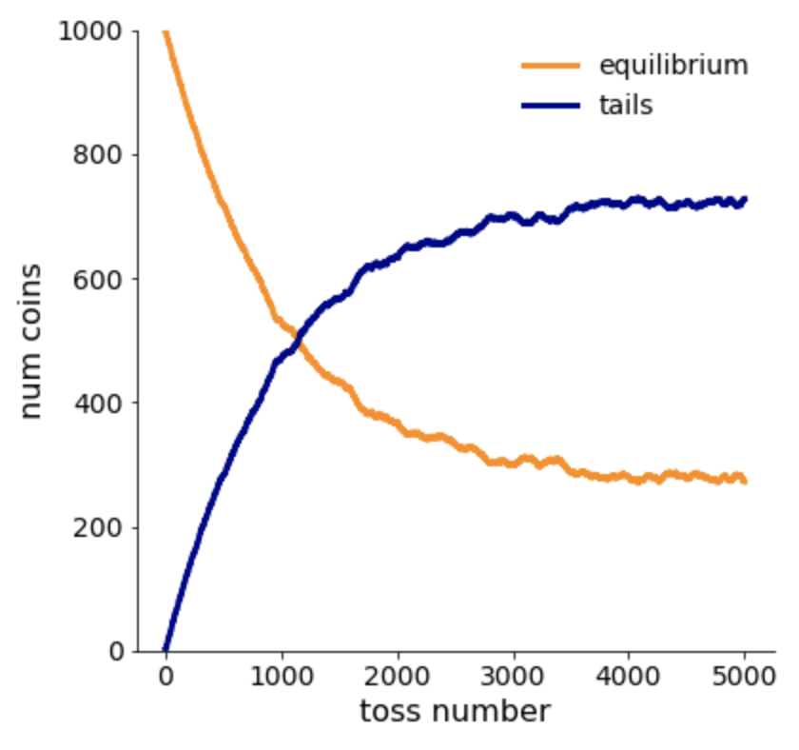
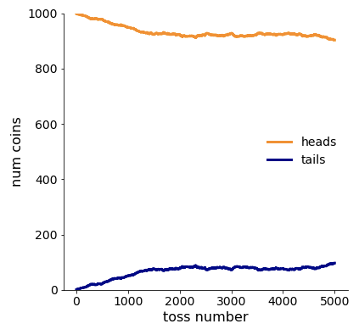
The weight on the coin changes the final state.
Start @ 1000 H, P_{T} = 0.5
Start @ 1000 H, P_{T} = 0.75

Slide 28
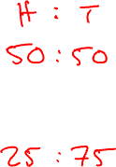
With P_{T} = 0.50, equilibrates to
With P_{T} = 0.75, equilibrates to

Slide 29
Let’s describe this mathematically

Slide 30
Equilibrium is determined by rate constants

Slide 31
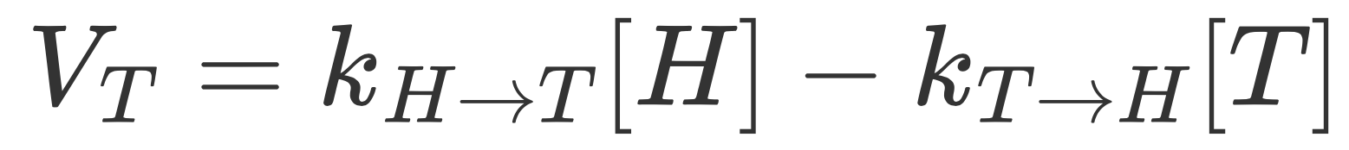
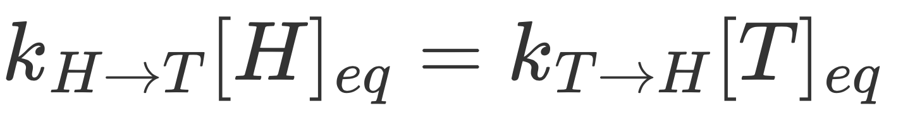
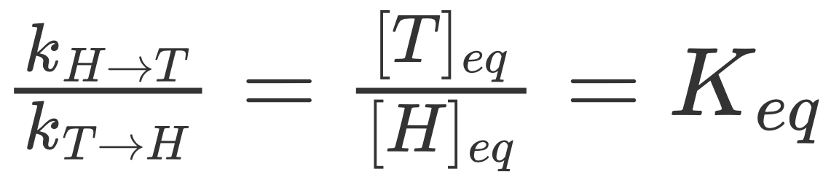
Equilibrium is determined by rate constants

Slide 32
Equilibrium is determined by rate constants
0.5/0.5 = 500/500 = K_{eq}
0.75/0.25 = 750/250 = K_{eq}

Slide 33
So far:
When the concentrations of products and reactants differ from their equilibrium values, the system will spontaneously move towards equilibrium.
The equilibrium concentrations of products and reactants are determined by their rates of interconversion.

Slide 34
Let’s make a wager.
Uncle Phil says he’ll give you
$1,000 if you guess the next
transition (H to T vs. T to H).*
Would you rather guess
after 2 tosses or after
5,000. Why?
*Not really.

Slide 35
This is free energy (ΔG).
Practically: how confident would I be if I had to bet
whether the next reaction is forward or reverse?
Formally: the maximum reversible work that may be
performed by a thermodynamic system at a constant
temperature and pressure.

Slide 36
What does this have to do with “work?”
As a reaction equilibrates it proceeds in a predictable direction. This can be captured to do other cool stuff.
http://www.njbcomputing.co.uk/electrobaconics/water01.shtml

Slide 37
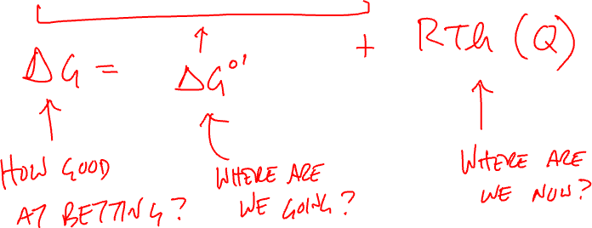
Formula for free energy:

Slide 38
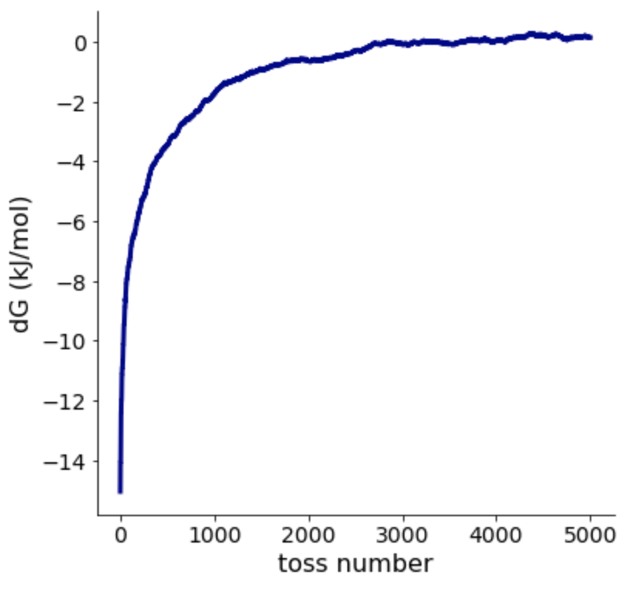
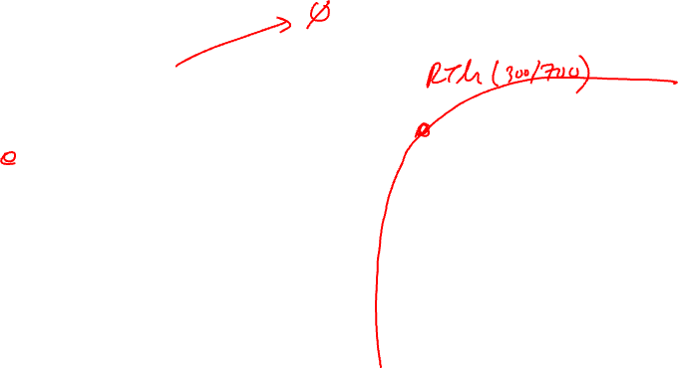
Start @ 1,000 H, P_{T} = 0.5
300/700
500/500

Slide 39
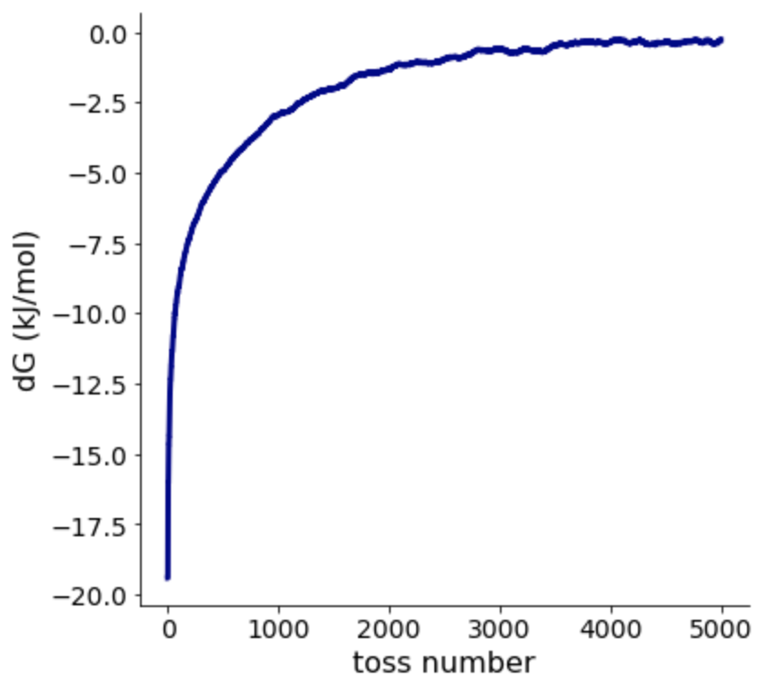
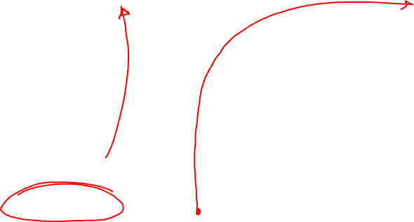
Start @ 1,000 H, P_{T} = 0.75
450/550
750/250

Slide 40
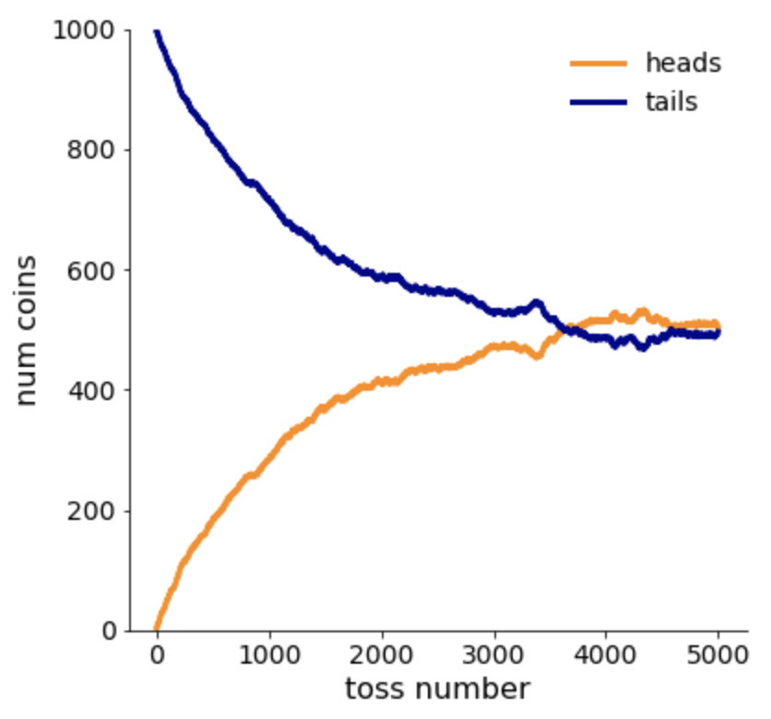
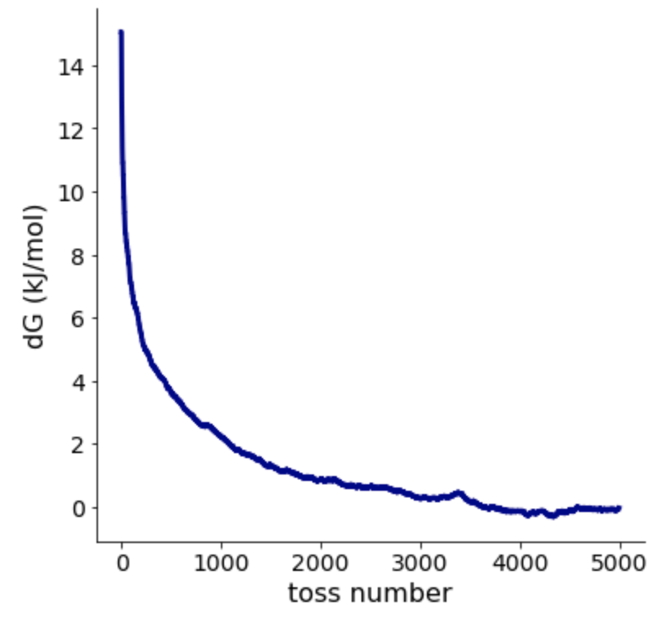
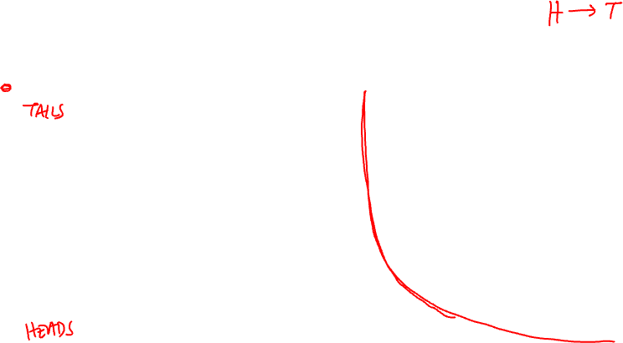
Start @ 1,000 T, P_{T} = 0.50
700/300
500/500

Slide 41
ΔG < 0
Conditions favor product
(You can bet next reaction will be forward)
ΔG = 0
Reaction is at equilibrium
(50:50 chance the next reaction is forward)
ΔG > 0
Conditions favor reactant
(You can bet next reaction will be reverse)

Slide 42
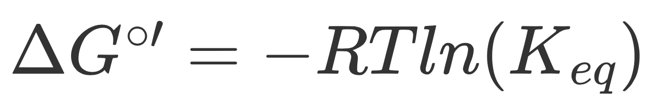
Formula for free energy:

Slide 43
Standard state free energy ΔG°′ :
Practically: measures the ratio of product/reactant when the system reaches equilibrium
Formally: the favorability of a reaction at biochemical standard state. This is [products] = [reactants] = 1M, 55.5 M H₂O, pH 7.0, 278.15 K (25 °C), 1 atm.

Slide 44
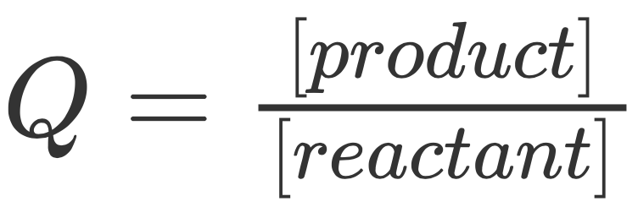
Formula for free energy:

Slide 45
Reaction Quotient (Q)
The relative amounts of products and reactants present during a reaction at a particular point in time.

Slide 46
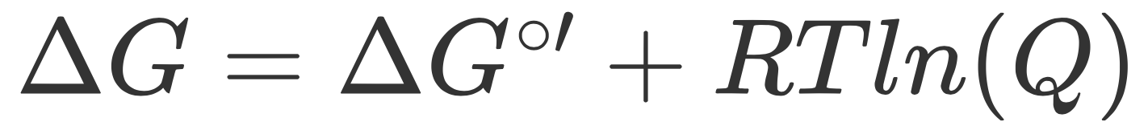
Formula for free energy:

