Slide 1
CNNs
Harmya Bhatt

Slide 2
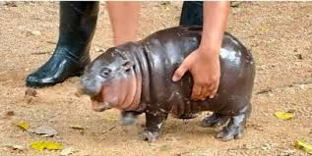
Goals
Get some intuition about why we use CNNs
Understand the math behind backpropagation in CNNs
Build one
Me when math behind CNNs

Slide 3
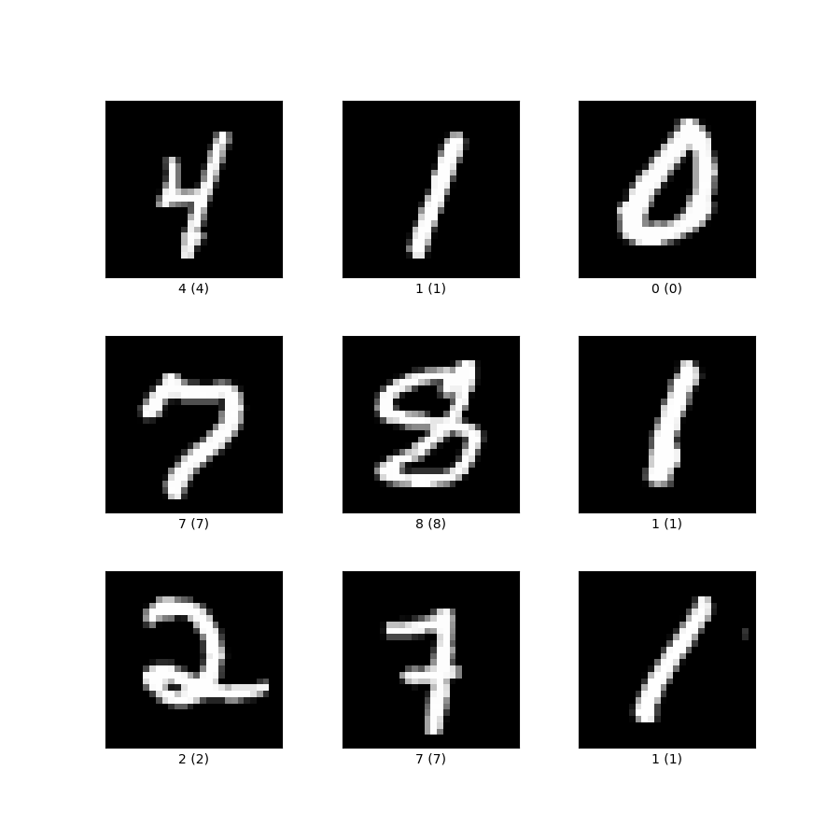
MNIST
Why? Because small image, easy to access
You can download it in css format
Google mnist csv download
Go to the kaggle link
Download it
Profit????

Slide 4
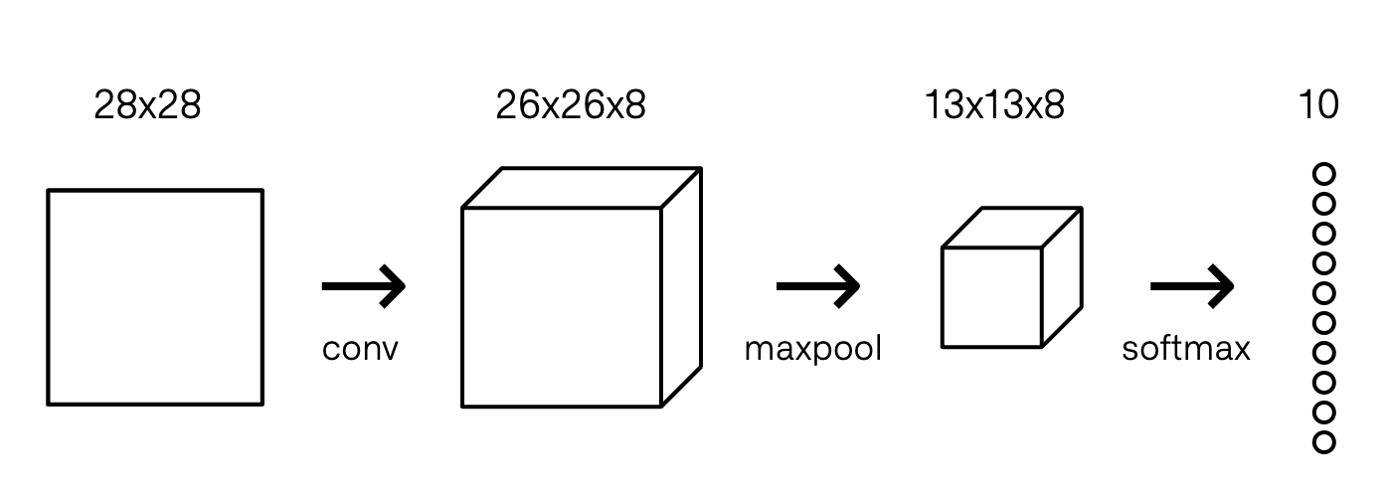
What we are building
28 x 28
28 x 28 x 8
14 x 14 x 8

Slide 5
Convolution Layer
The Convolutional Layer makes use of a set of learnable filters. A filter is used to detect the presence of specific features or patterns present in the original image (input)
This filter is convolved (slided) across the width and height of the input file, and a dot product is computed to give an activation map.

Slide 6
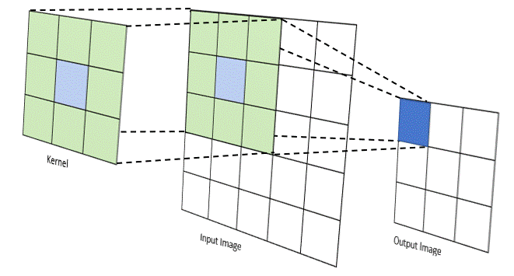
Kernel = Filter
Think about how we notice an object? Do you look for certain parts of it and then make a conclusion. Intuitively, a kernel is “looking” at different parts of an image. We will train the CNN to “look” for “features” that are “important”

Slide 7
Role of a filter in convolution

Slide 8
Pooling
Different types of pooling: max, min, average
Neighboring pixels in images tend to have similar values, so conv layers will typically also produce similar values for neighboring pixels in outputs. As a result, much of the information contained in a conv layer’s output is redundant
Solution??? Pooling

Slide 9
Max Pool

Slide 10
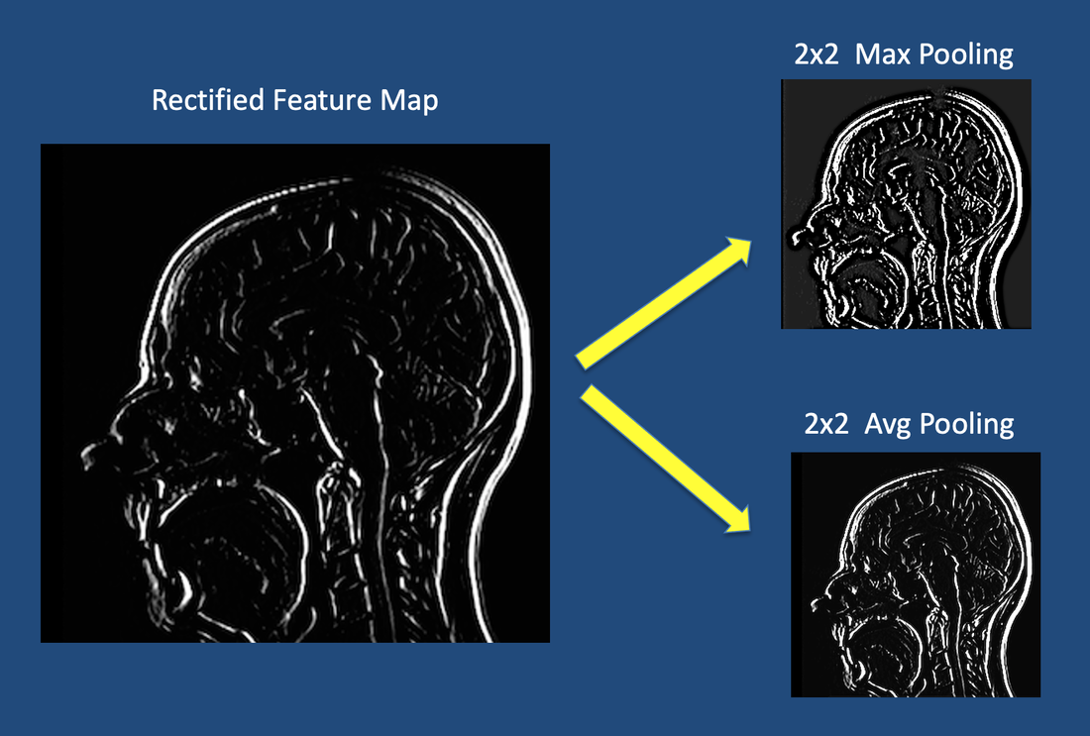
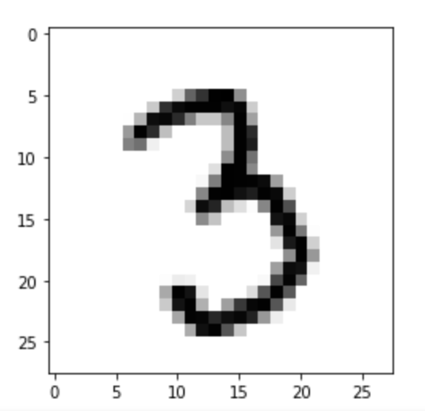
Intuition behind pooling (Average vs Max)
Average pooling “smoothes” the features
Max pooling picks the “outlier”
Which one should we use for our task?

Slide 11
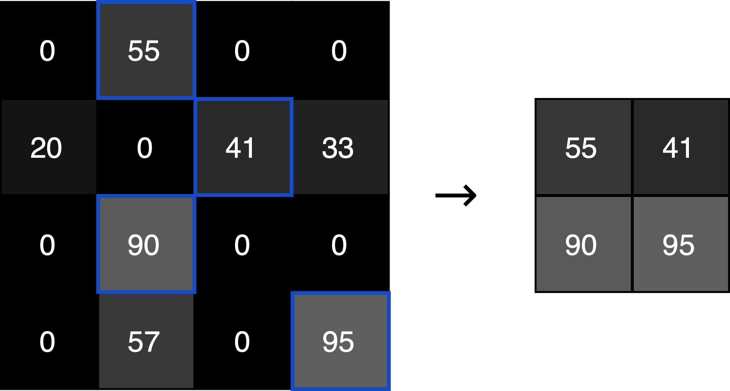
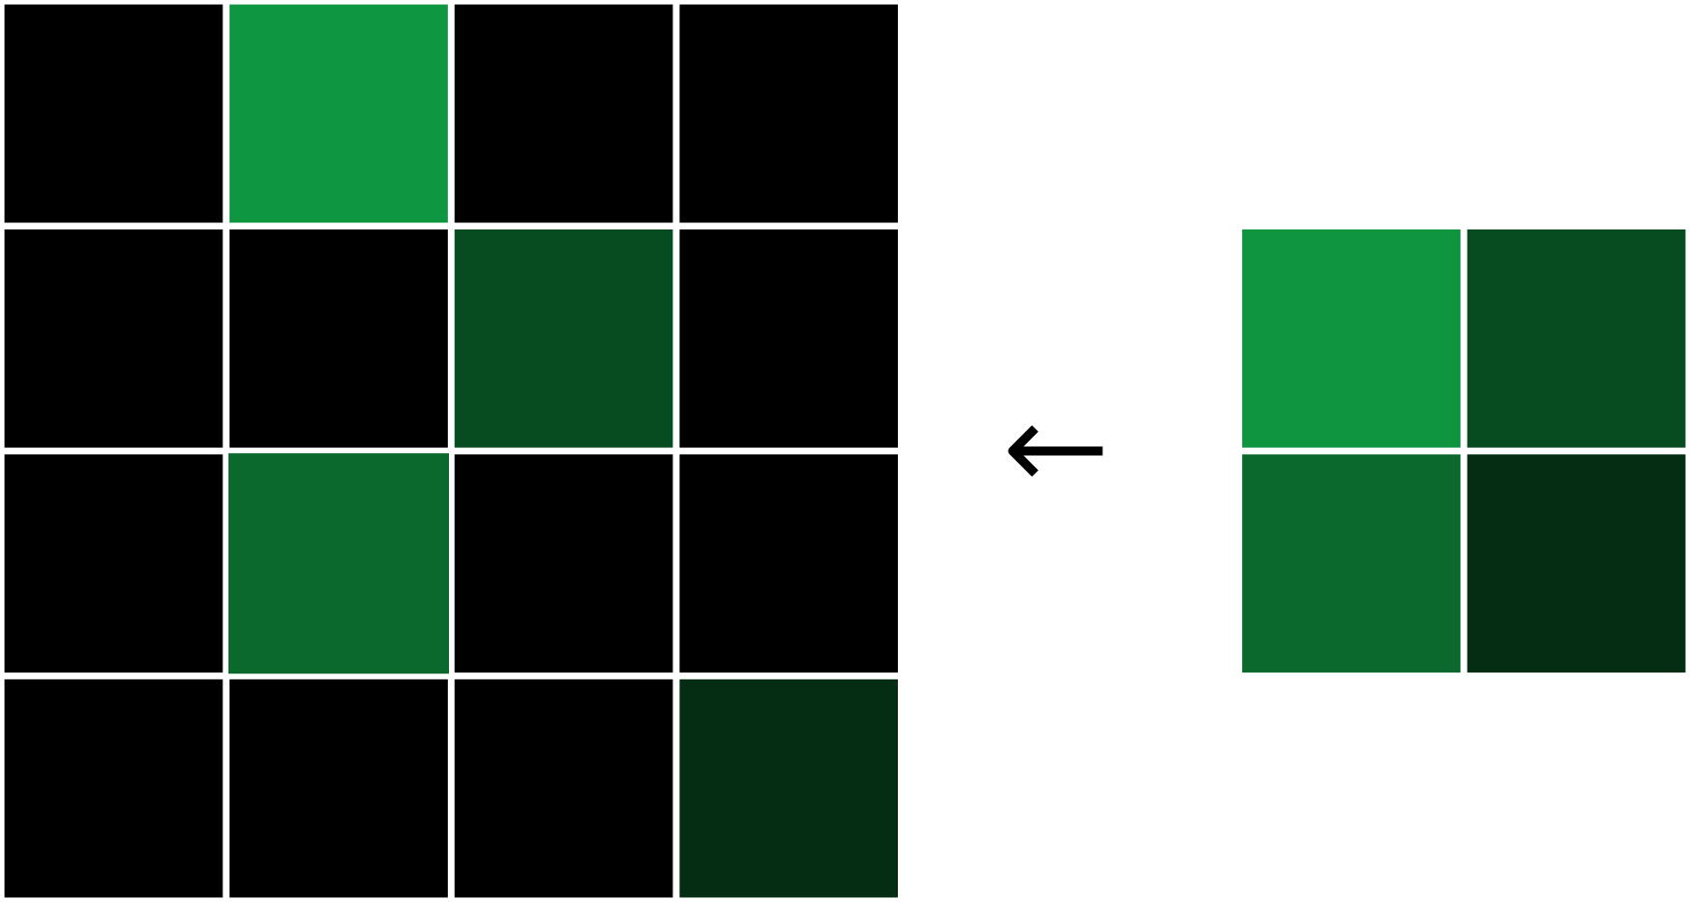
Max Pool backpropagation
Each gradient value is assigned to where the original max value was, and every other value is zero.
Forward pass
Backward pass

