Slide 1
Predicting US Home Sales Prices
A Lighthouse Labs Data Science Bootcamp Midterm Project
Innocent Byiringiro and Derek Harnett

Slide 2
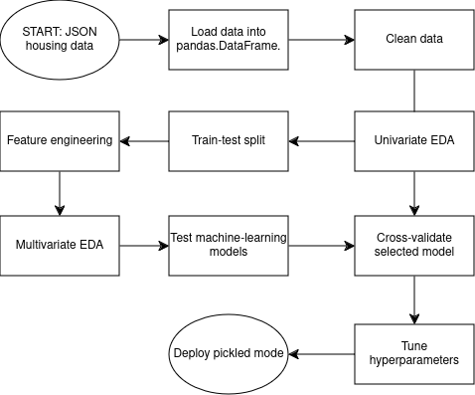
Process Flow Chart

Slide 3
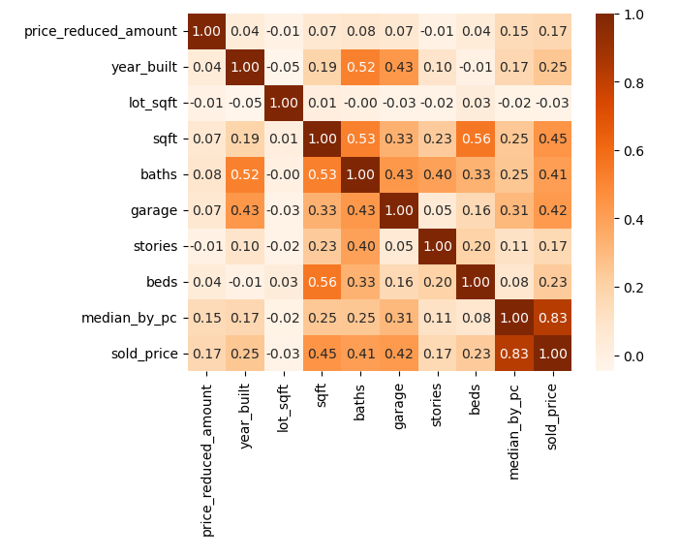
Correlation Heat Map
EDA suggests:
Median price by postal code the most significant feature
Square footage next most significant
Number of bathrooms, garage size, year built, and number of bedrooms also of interest

Slide 4
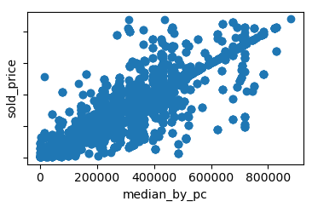
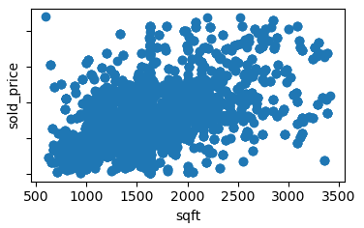
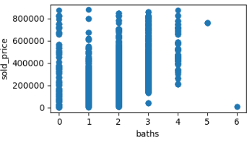
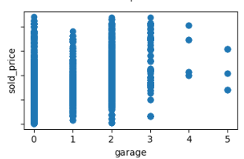
Scatter Plots

Slide 5
Model Investigations
Linear (+ Regularization):
OLS, Ridge, Lasso
MinMaxScaler()
SelectKBest(k=8)
PolynomialFeatures()?
  No
Testing adj. R²: ~0.78
SVM:
Linear, RBF kernels
MinMaxScaler()
SelectKBest(k=8)
Testing adj. R²: ~0.82 (RBF)
XGBoost:
XGBRegressor
RMSE: $24.6k
R²: 0.98
Random Forest:
RandomForestRegressor
RMSE: $28.7k
R²: 0.97

Slide 6
Validation, Tuning, Pickling
Cross-validation & hyperparameter tuning done “by-hand” to prevent data leakage.
Best model pickled to external file
QA:
  Rigorous data cleaning process
  Multiple scores per model
  5-Fold cross validation

