Slide 1
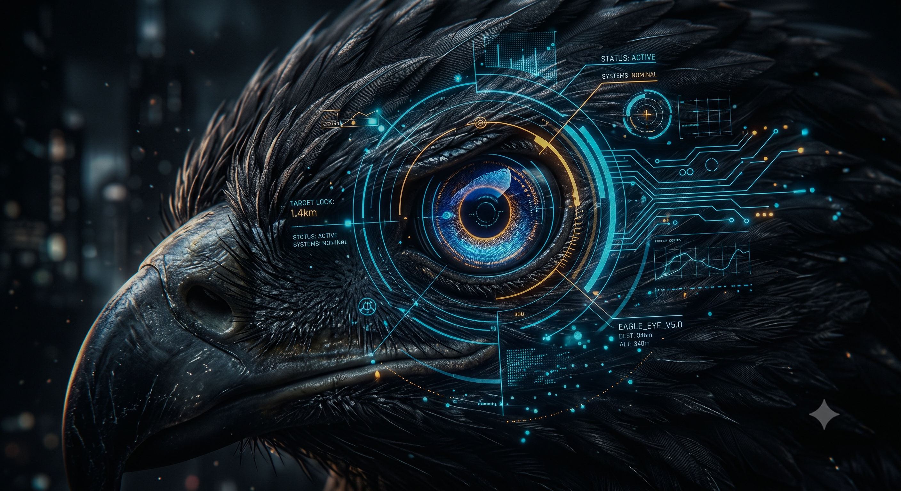
IBM x NFSU INNOVAI HACKATHON 2026
Eagle-Eye
AI-Powered Document Forgery Detection
A digital forensic examiner that classifies anomalies, scores forgery confidence, and generates court-admissible expert reports.
1
Notes:
Opening — 15 seconds. Lead with the name and one sentence about what it does. Let the tagline breathe. Do not read the description — just say: This is not a chatbot wrapper. This is a calibrated forensic identity built on Bob.

Slide 2
01 / THE PROBLEM
Forgery Is Invisible To The Naked Eye.
₹1.3L Cr+ document fraud losses are reported annually in India
Weeks required for manual FSL examination per case
No Standard tool links findings to court-admissible format
Certificates. Agreements. Identity documents. Courts need expert opinions ---- but examiners are few and slow.
2
Notes:
20 seconds. Hit the scale of the problem fast. Pause after the three stat boxes. Then pivot: the system today is manual, slow, and inconsistent.

Slide 3
02 / THE SOLUTION
WHAT THE TOOL DOES.
INPUT
─────────────────
Case File
(.pdf, .jpg, .png, .tiff, .docx)
Structured Observations
Document Metadata
EAGLE-EYE
─────────────────
MCP Analysis Server
6-Step Examination
OUTPUT
─────────────────
Confidence Score
Standards Mapping
Court-Ready Report
▶
▶
3
Notes:
25 seconds. This is the solution in one sentence. Emphasise: not prompting a generic AI — a calibrated identity with real forensic tools behind it. Walk left to right across the diagram.

Slide 4
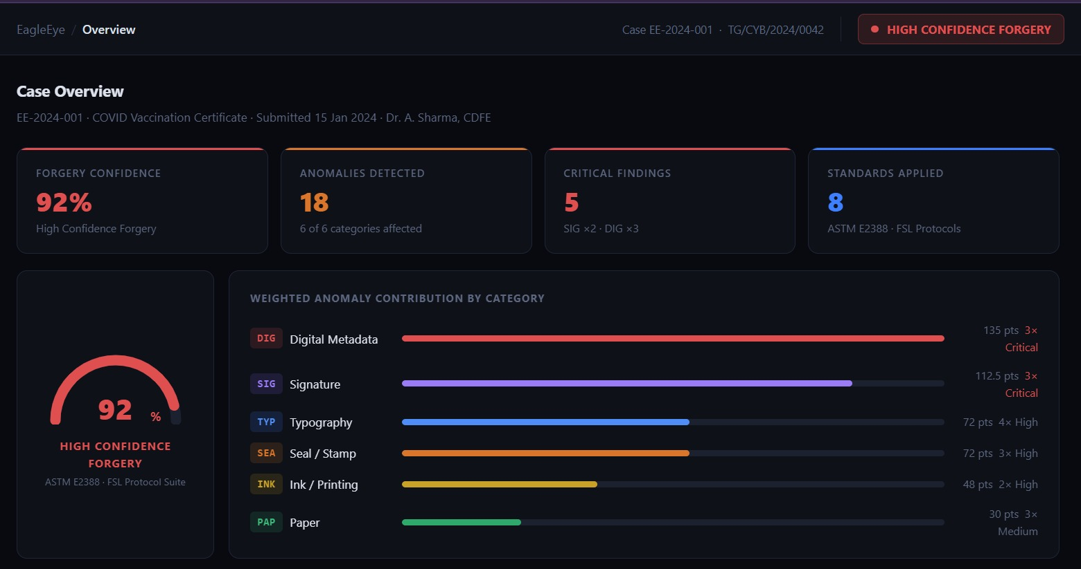

Slide 5
03 / HOW IT'S BUILT
Four Bob-Native Layers.
🔴 Custom Bob Mode
Forensic-examiner — QD Examiner persona trained on ASTM E2388, FSL protocols, Indian Evidence Act §45
🟠 MCP Server — eagleeye-forensics
Classify anomaly · score_forgery_confidence · map_to_standards · fetch_case_precedents · generate_expert_report
🟡 Bob Skills — Domain Injection
Questioned-documents · digital-forgery-patterns · signature-analysis · court-report-format
🟢 Structured JSON Case File
Reproducible, auditable input — eliminates ambiguity across every examination
4
Notes:
30 seconds. Four layers — spend 6-7 seconds per layer. The key message: each layer is a genuine Bob product feature being used for a real purpose, not a workaround.

Slide 6
04 / THE WORKFLOW
5 Steps. 1 Report. Courtroom-Ready.
① Upload
JSON case file +
observations
② Classify
Anomaly type
+ category
③ Score
Forgery confidence
0–100%
④ Map
ASTM E2388
FSL checklist
⑤ Report
Court-admissible
PDF + declaration
Real output example: COVID Certificate → Typography Forgery → 87% Confidence → ASTM E2388 §4.2 triggered → Expert Opinion signed
5
Notes:
25 seconds. Walk through each step with one word each. Then land on the real example at the bottom — this is an actual case output, not a mockup.

Slide 7
05 / THE OUTPUT
What a Judge Actually Receives.
EXPERT OPINION REPORT | Case No: EE-2024-001
─────────────────────────────────────────────
1. Brief Facts & Nature of Document
2. Documents Received for Examination
3. Examination Conducted
3.1 Physical · 3.2 Typographic · 3.3 Signature · 3.4 Digital
4. Findings — Anomaly Table + Standards Referenced
5. Opinion
"HIGH probability of forgery. Confidence: 87%"
6. Declaration — Indian Evidence Act, Section 45
7. Examiner Credentials & Signature
✓ Section 45 compliant
✓ Standards cited inline
✓ Confidence with reasoning
✓ Zero ambiguity for court
6
Notes:
20 seconds. Show the report structure quickly. Emphasise that a lawyer or judge can use this the same day. The Section 45 declaration is what makes it legally valid — EagleEye generates it automatically.

Slide 8
06 / WHY IT WINS
Every Layer Is a Product Feature, Not a Prompt.
WHAT
WHY IT MATTERS
Domain-specific Bob Mode
Calibrated forensic persona — not generic AI reasoning
MCP-backed real analysis
Executes actual forensic algorithms, not approximations
Standards mapping
ASTM E2388, FSL, IS 1921 — findings are legally anchored
Explainable confidence score
Judges can scrutinise the reasoning — not just the number
Instant court-format report
Section 45 declaration generated automatically — zero drafting time
7
Notes:
20 seconds. Read the left column fast, let judges absorb the right. Key emphasis: this is genuinely using Bob as a platform — not a thin wrapper.

Slide 9
07 / TECH STACK
Built On Real Tools. No Shortcuts.
Bob IDE
Custom Mode + Skills
MCP Server
Node.js / Python
watsonx.ai
Anomaly Classification
exiftool · pdfinfo
PDF / DOCX metadata
OpenCV · PyMuPDF
Image anomaly detection
SQLite
Case precedents DB
8
Notes:
15 seconds. Don't linger here. Just say: every tool is chosen for a forensic purpose — nothing is arbitrary. Then move.

Slide 10
TEAM HAWKS
Document forgery — detected, scored, reported.
Built on IBM Bob · INNOVAI 2026
THANK YOU!
9
Notes:
Closing — 10 seconds. Just read the tagline out loud and stop. Let the silence work. If judges ask one question, it will be: how do you handle real document images? Your answer: that is our Phase 2 — live image ingestion via OpenCV. Right now the demo proves the reasoning engine is solid.

