Slide 1
FACE RECOGNIZATION
SYSTEM

Slide 2
GROUP MEMBERS DETAILS
1.
Name :- Harneet Kumar
Roll no :-11172662
Email :- harnitsoni8@gmail.com
Section - B ‘1‘
Course - B.TECH (CSE)
2.
Name :- Aditya Chowdhury
Roll no :-11172638
Email :-
Section - B ‘3’
Course - B.TECH (CSE)

Slide 3
Introduction:-
A facial recognition system is a technology capable of identifying or verifying a person from a digital image or a video frame from a video source. There are multiple methods in which facial recognition systems work, but in general, they work by comparing selected facial features from given image with faces within a database. It is also described as a Biometric Artificial Intelligence based application that can uniquely identify a person by analysing patterns based on the person's facial textures and shape.

Slide 4
Objective/Aim:-
To implement a Face Recognization System for the uniquely identifying or verifying a person by comparing and analyzing patterns based on the person's facial contours. Facial recognition is mostly used for security purposes, though there is increasing interest in other areas of use.

Slide 5
We are creating :-
Face Detection System
Face Recognization System

Slide 6
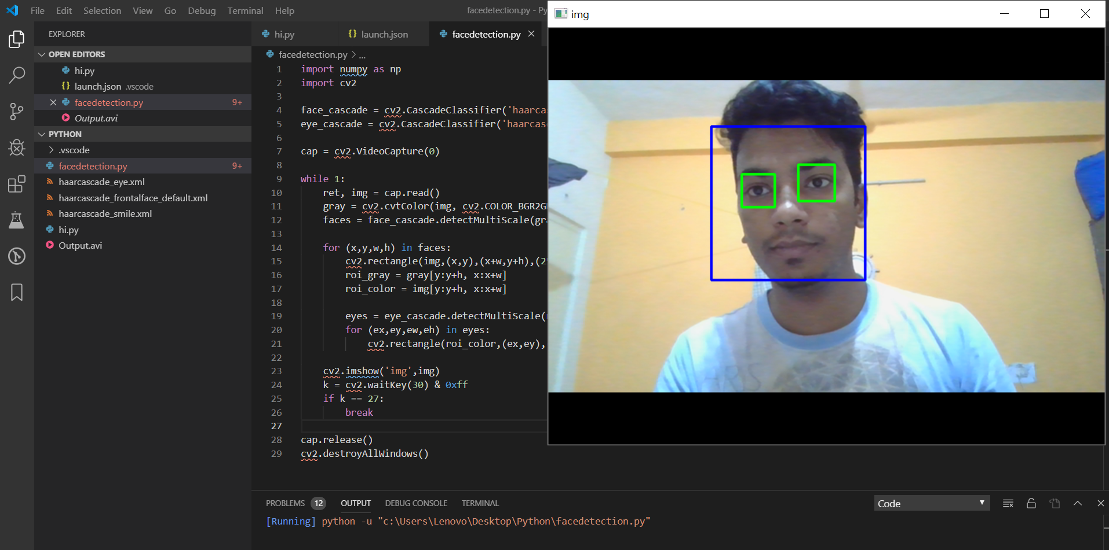
LOGIN PAGE

Slide 7
Thank you
project - Face recognization system

