Slide 1
Menu Based Programs

Slide 2
https://drive.google.com/file/d/1-zZsPHIYfR4iL9te9iHU2qwXBsGfWv3-/view?usp=sharing

Slide 3
Binary Search

Slide 4
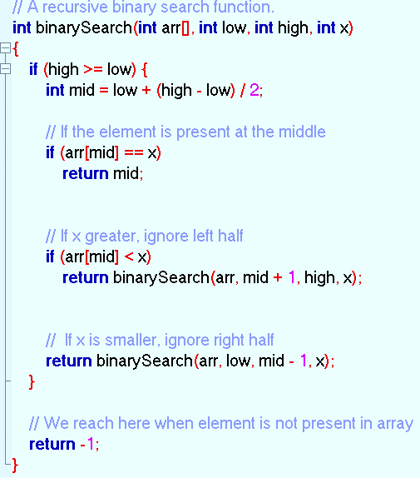
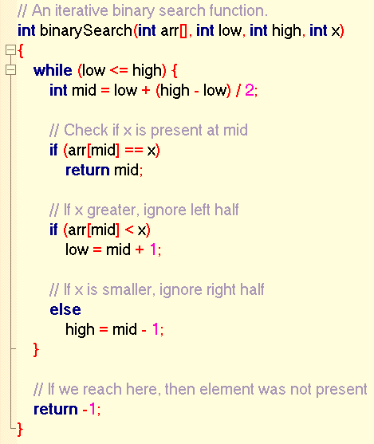

Slide 5
Bubble Sort

Slide 6
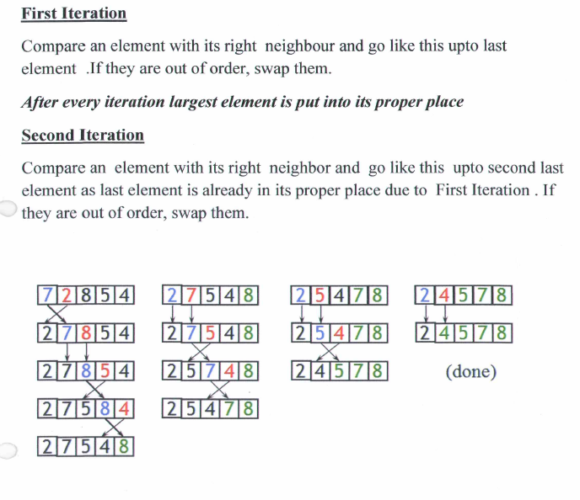

Slide 7
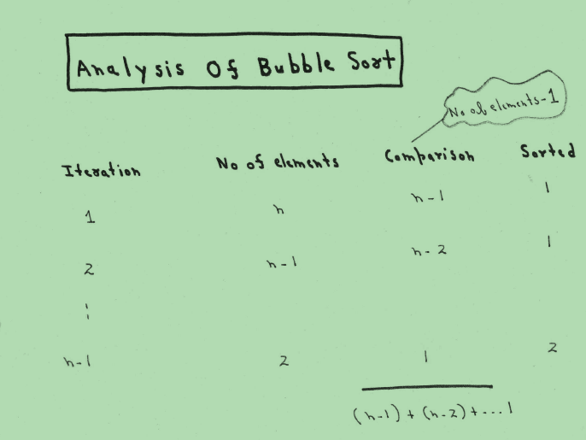

Slide 8
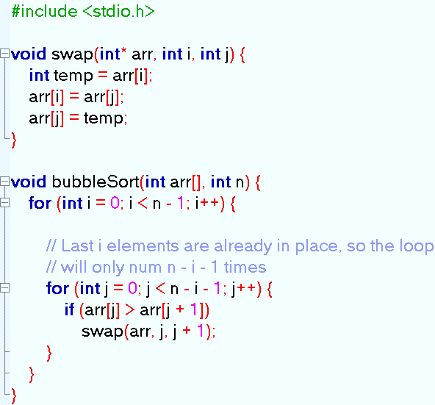

Slide 9
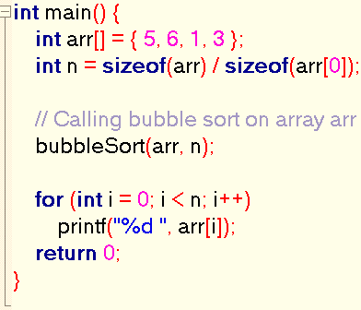

Slide 10
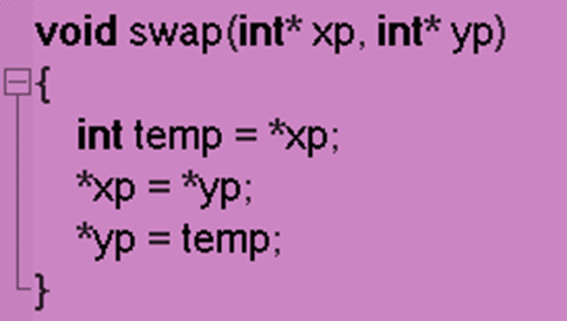
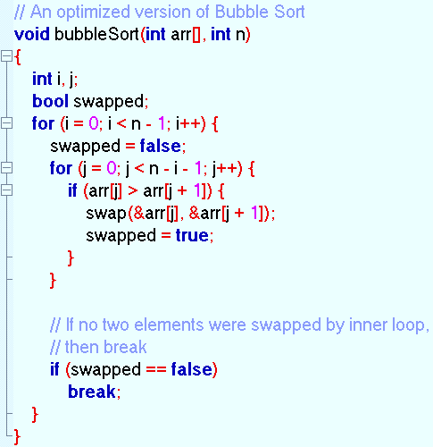
Optimized Bubble Sort

Slide 11
Stacks

Slide 12
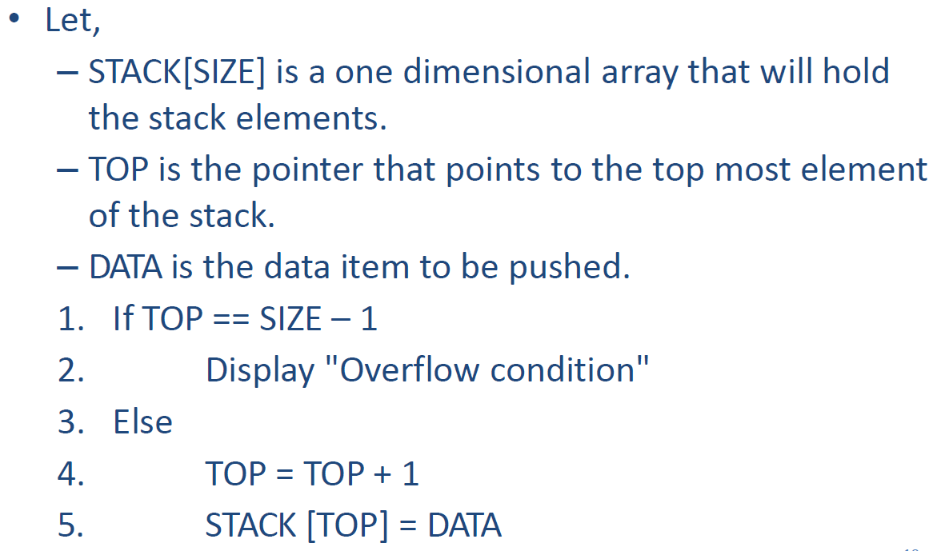
Algorithm for Push

Slide 13
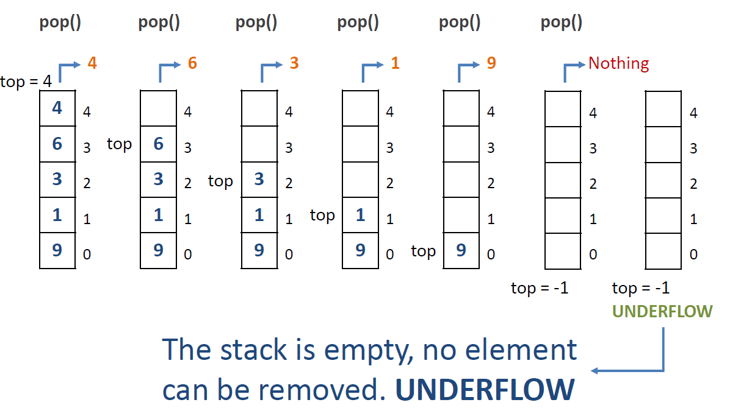

Slide 14
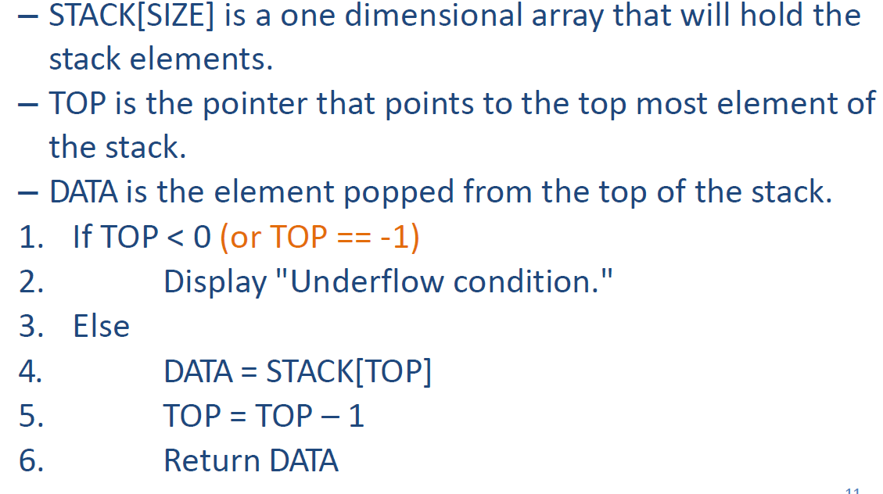
Algorithm for Pop

Slide 15
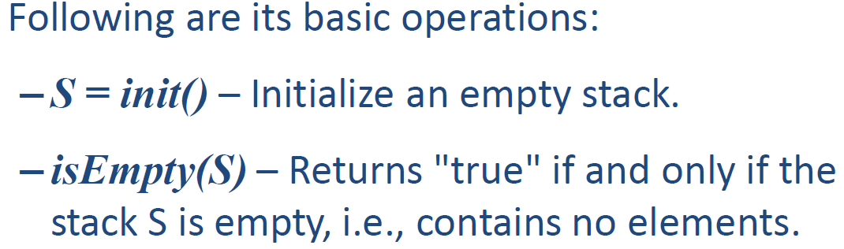
Stack as ADT
Just gives the definition of a stack in terms of data representations and operations.
Data representations
Stack follows the discipline LIFO (Last-in-first-out) / FILO
Allows operations at one end only.
The top element can only be accessed at anytime.
Operations

Slide 16
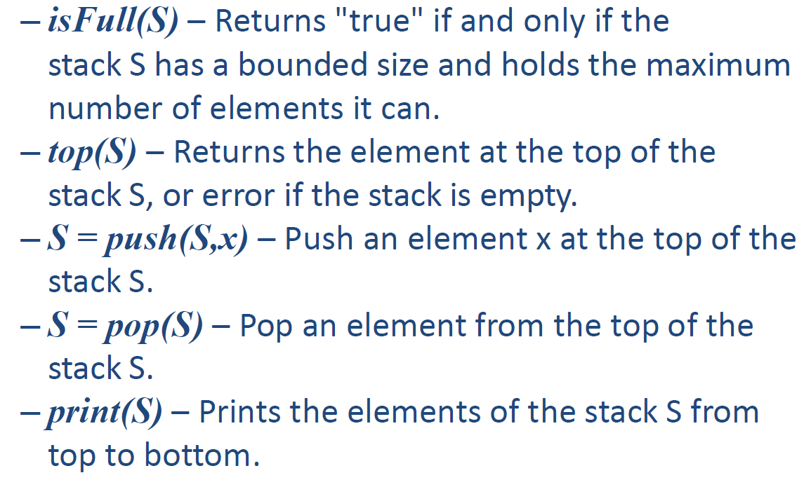

Slide 17
Stack Implementation Using Array

Slide 18
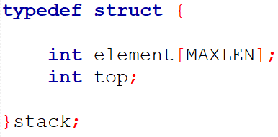
A new data type can be created using typedef with structure.

Slide 19
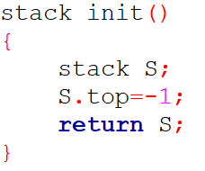

Slide 20
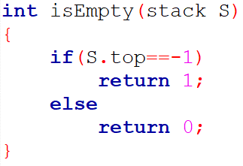

Slide 21
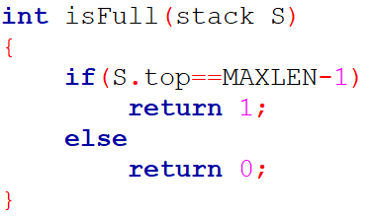

Slide 22
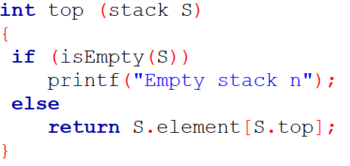

Slide 23
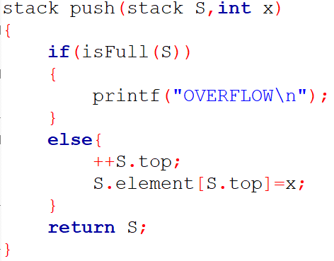

Slide 24
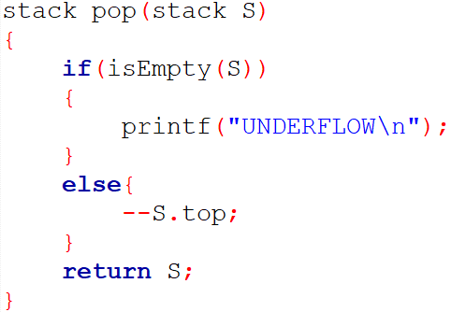

Slide 25
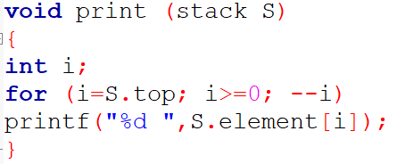

Slide 26
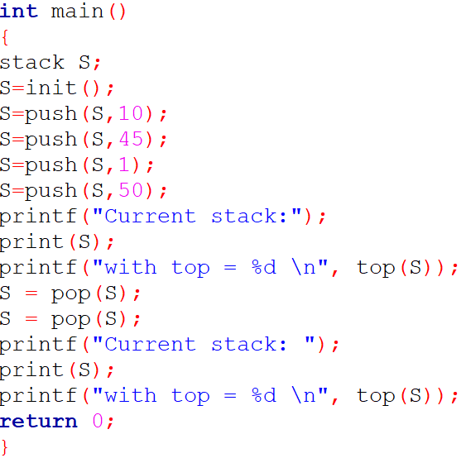

Slide 27
Infix <----->Postfix & Prefix

Slide 28
Expression Representation
• Infix: Operator is in between the operands.
• Prefix: Operator is before the operands. Also known as polish notation.
• Postfix: Operator is after the operands. Also known as suffix or reverse polish notation.

Slide 29

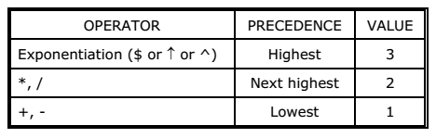
Operator and Operand
+ is an arithmetic operators while the symbols appearing on either side of them are operands. Operands may be constant or variable.

Slide 30
Infix to Postfix Conversion Algorithm
1.Add opening and closing bracket to the given infix expression if already not there then scan given Input from left to right and repeat step 2 to 5 for each element until
the STACK is empty.
2. If an operand is encountered add it to OUTPUT.
3. If a left parenthesis is encountered push it onto the STACK.
4. If an operator is encountered then:
  Repeatedly pop from STACK and add to OUTPUT each operator which has same or higher precedence than the operator encountered.
  Push the encountered operator onto the STACK.
  5. If a right parenthesis is encountered, then
  Repeatedly pop from the STACK and add to OUTPUT each operator until a left parenthesis is encountered.
  Remove the left parenthesis; do not add it to OUTPUT.

Slide 31
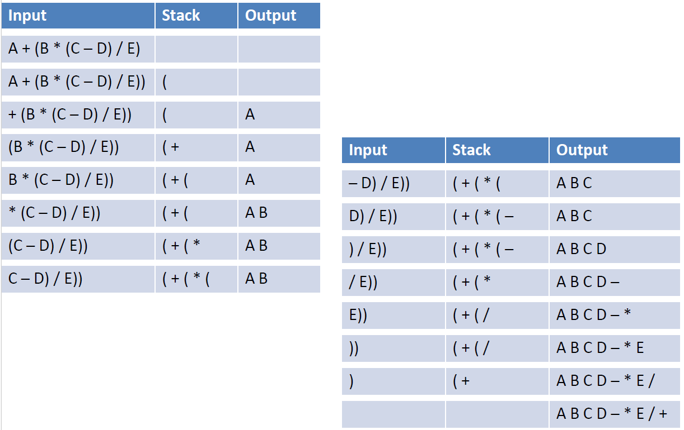

Slide 32
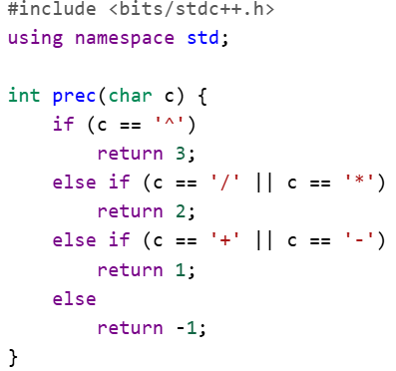

Slide 33
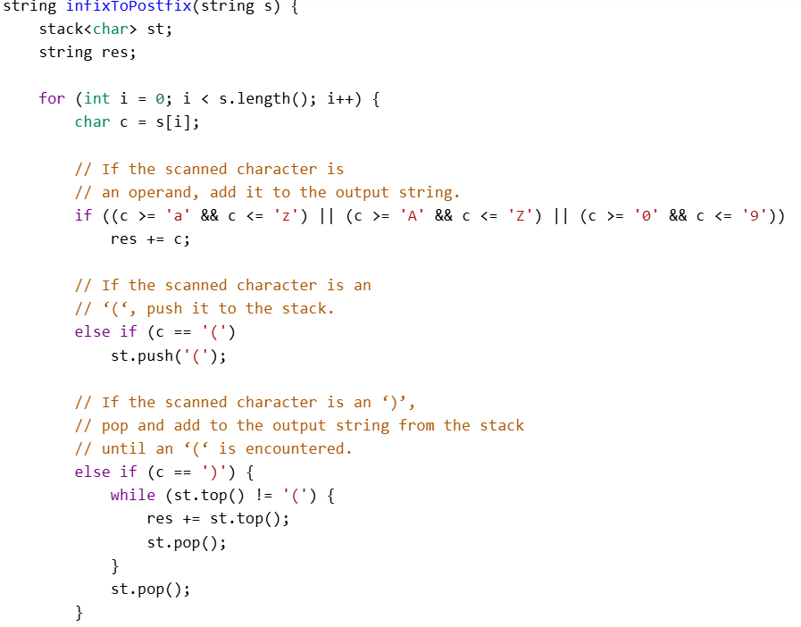

Slide 34
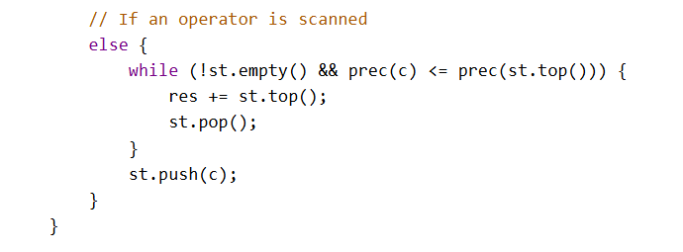

Slide 35
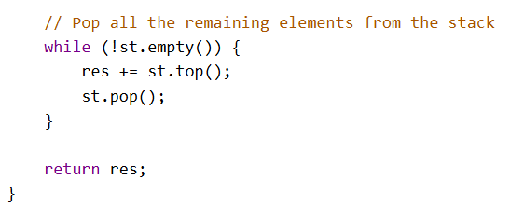

Slide 36
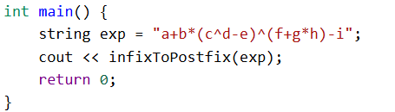
abcd^e-fgh*+^*+i-

Slide 37
Infix to Prefix Conversion Algorithm
Reverse the given expression and make every ( as ) and every ) as (
Apply algorithm for infix to postfix conversion.
Reverse the expression obtained from Step 2.

Slide 38



Step 1. Reverse the given expression and make every ( as ) and every ) as (
Given Infix Expression
Reverse of Given Infix Expression
Make every ( as ) and every ) as (

Slide 39
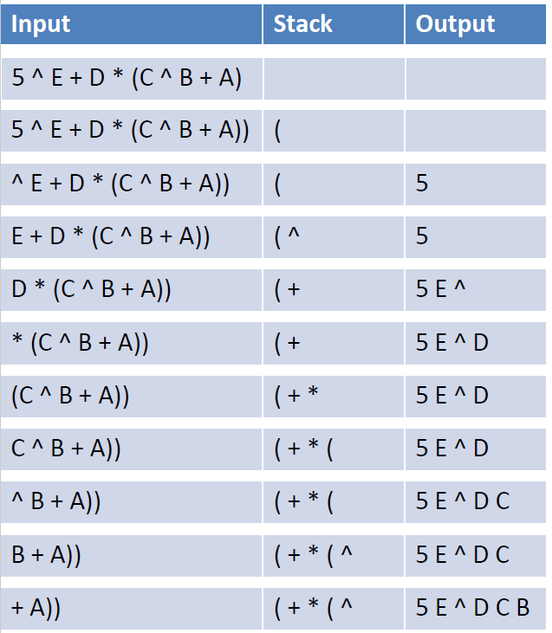
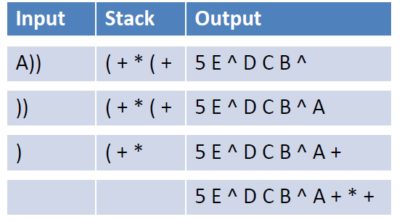
Step 2. Apply algorithm for infix to postfix conversion

Slide 40

Step 3. Reverse the expression obtained from Step2

Slide 41
Postfix Evaluation Algorithm

Slide 42
Postfix Evaluation Algorithm
For every token in the postfix expression (scanned from left to right):
If the token is an operand ( push it on the stack)
Otherwise, if the token is an operator (or function):
Check if the stack contains the sufficient number of values (usually two) for given operator. If there are not enough values, finish the algorithm with an error.
Else Pop the appropriate number of values from the stack and evaluate the operator using the popped values and push the single result on the stack.
At last if the stack contains only one value, return it as a final result of the calculation Otherwise, finish the algorithm with an error
A: Top element
B: Next to top element
Result = B operator A

Slide 43
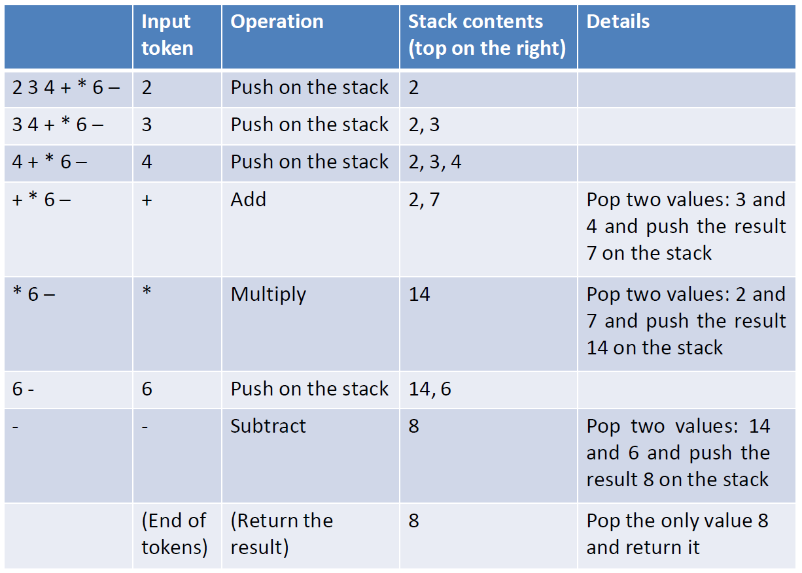

Slide 44
Postfix & Prefix <-----> Infix

Slide 45
Postfix to Infix Conversion Algorithm | Prefix to Infix Conversion
1. Accept a postfix string from the user. 2.Start scanning the string (from left) one character at a time. 3.If it is an operand, push it in stack. 4.If it is an operator, pop opnd1, opnd2 and concatenate them in the order "(opnd2, optr, opnd1)". 5.Push the result in the stack. 6.Repeat these steps until scanning completes. 7. Pop the remaining element of the stack, which is the required Infix notation equivalentto a given Postfix notation. | 1. Reverse the given prefix expression first. 2. Start scanning the string (from left) one character at atime. 3.If it is an operand, push it in stack. 4.If it is an operator, pop opnd1, opnd2 and concatenate them in the order "(opnd1, optr, opnd2)". 5.Push the result in the stack. 6.Repeat these steps until scanning completes. 7. Pop the remaining element of the stack, which is the required Infix notation equivalent to a given Prefix notation.

Slide 46
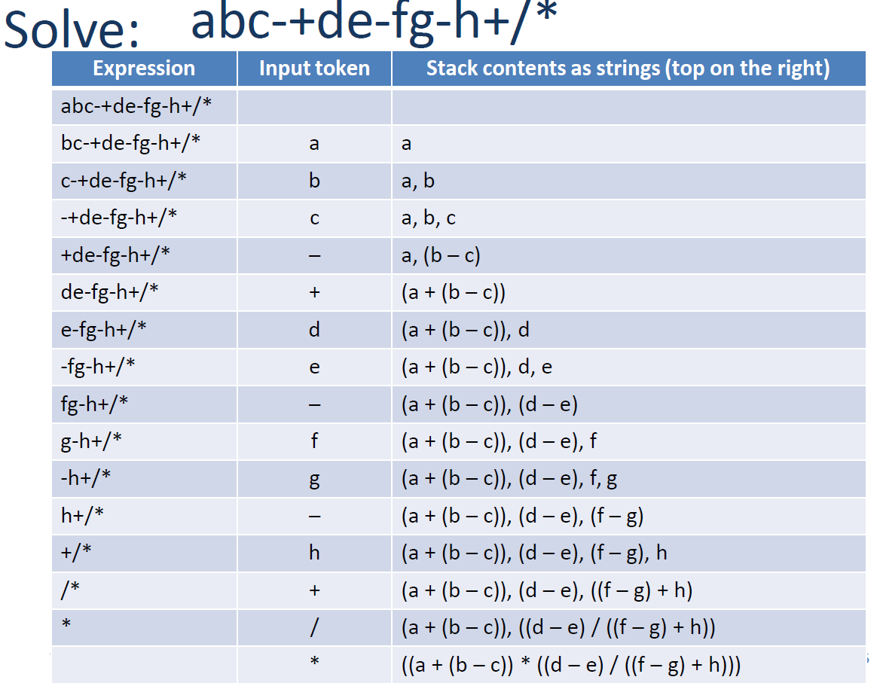
Postfix to
Infix Conversion

Slide 47

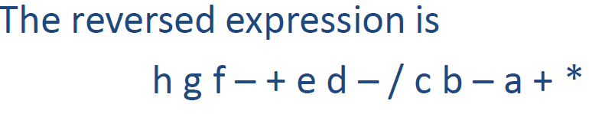
Prefix to Infix Conversion

Slide 48
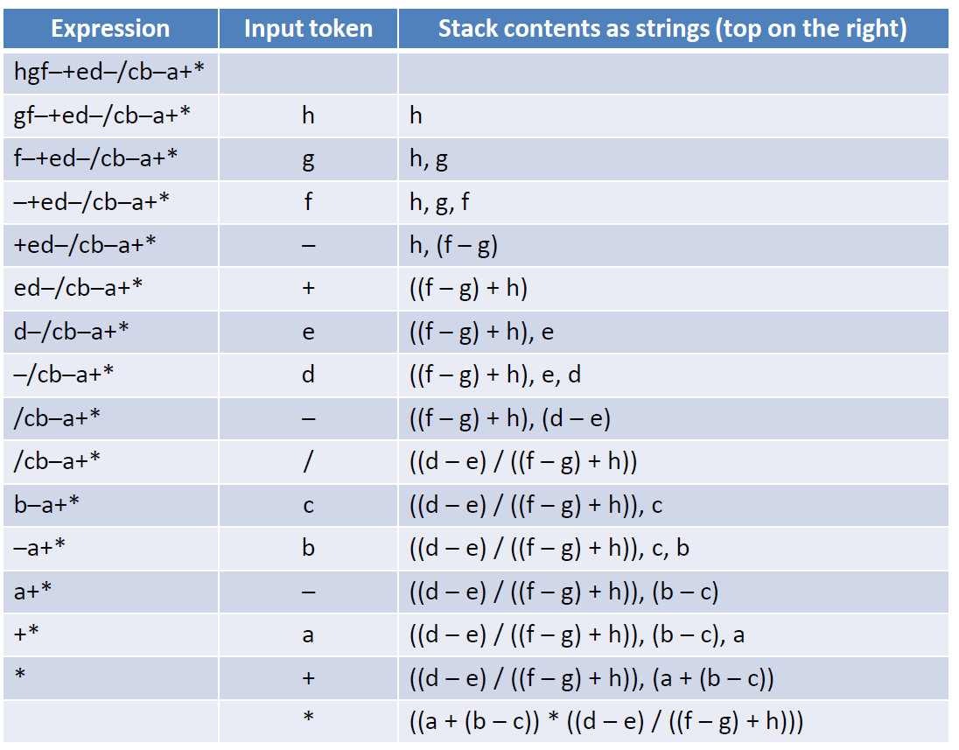
Prefix to Infix Conversion

Slide 49
Sorting

Slide 50
Selection Sort

Slide 51
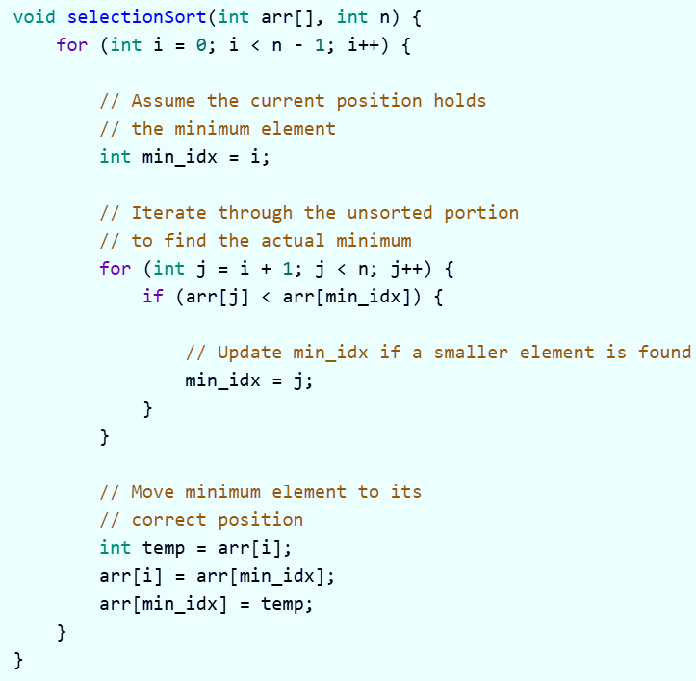

Slide 52
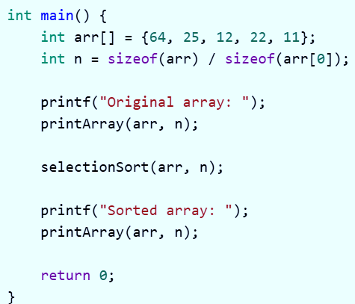
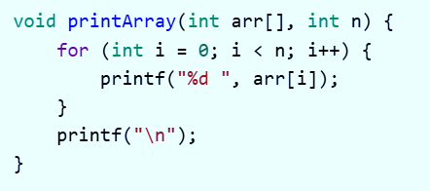

Slide 53
Insertion Sort

Slide 54
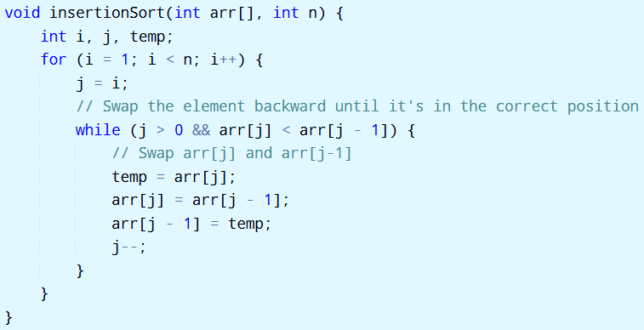
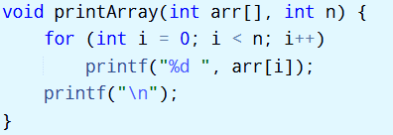
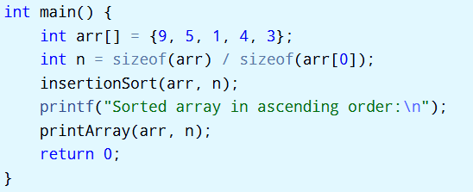

Slide 55
Merge Sort

Slide 56
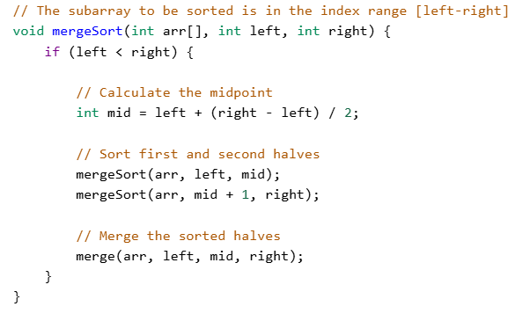
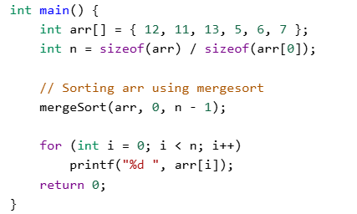

Slide 57
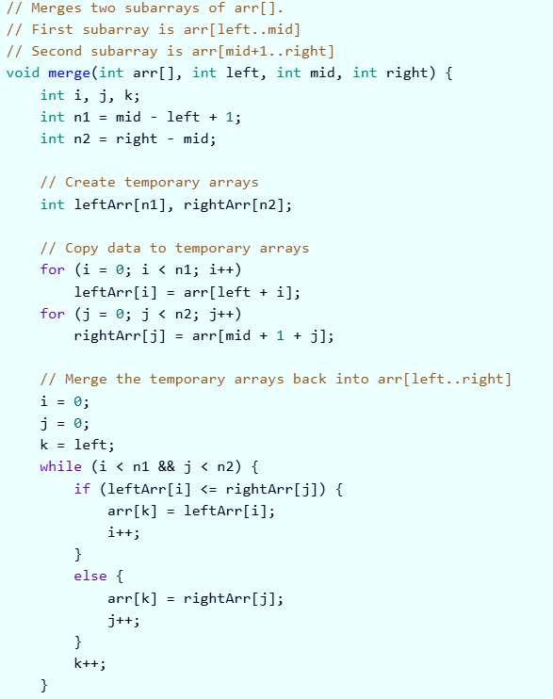
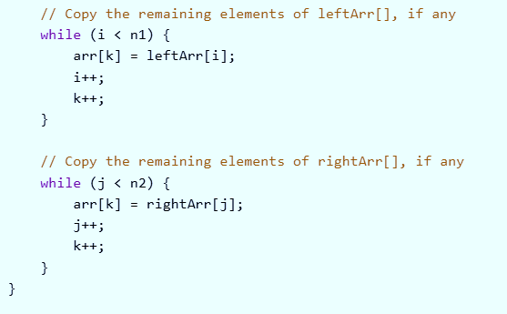
Merge Function in
Merge Sort

Slide 58
Quick Sort

Slide 59
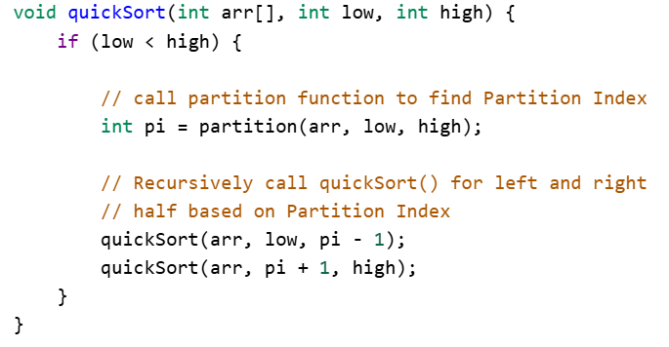
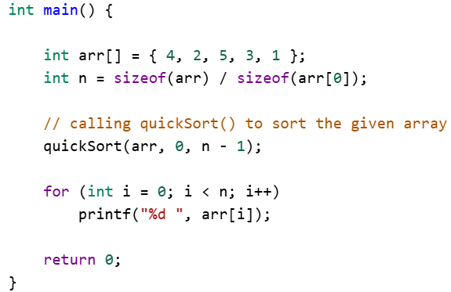

Slide 60
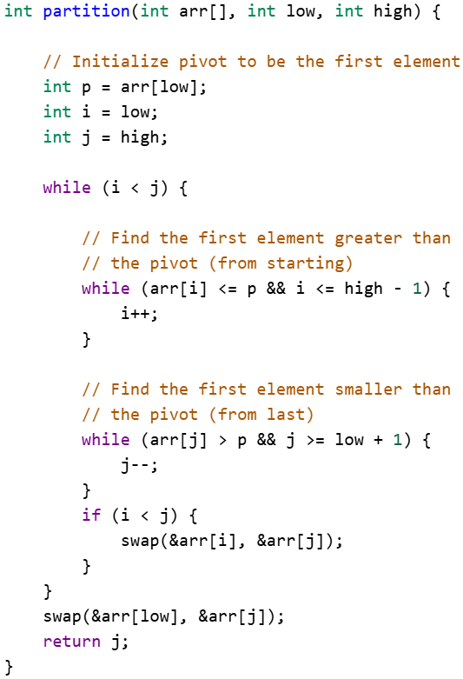
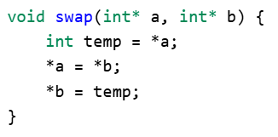
Divide Function in
Quick Sort

Slide 61
Trees

Slide 62
// Tree traversal in C
#include <stdio.h>
#include <stdlib.h>
struct node {
int item;
struct node* left;
struct node* right;
};
// Inorder traversal
void inorderTraversal(struct node* root) {
if (root == NULL) return;
inorderTraversal(root->left);
printf("%d ->", root->item);
inorderTraversal(root->right);
}
// preorderTraversal traversal
void preorderTraversal(struct node* root) {
if (root == NULL) return;
printf("%d ->", root->item);
preorderTraversal(root->left);
preorderTraversal(root->right);
}
// postorderTraversal traversal
void postorderTraversal(struct node* root) {
if (root == NULL) return;
postorderTraversal(root->left);
postorderTraversal(root->right);
printf("%d ->", root->item);
}
// Create a new Node
struct node* createNode(value) {
struct node* newNode = malloc(sizeof(struct node));
newNode->item = value;
newNode->left = NULL;
newNode->right = NULL;
return newNode;
}
// Insert on the left of the node
struct node* insertLeft(struct node* root, int value) {
root->left = createNode(value);
return root->left;
}
// Insert on the right of the node
struct node* insertRight(struct node* root, int value) {
root->right = createNode(value);
return root->right;
}

Slide 63
int main() {
struct node* root = createNode(1);
insertLeft(root, 12);
insertRight(root, 9);
insertLeft(root->left, 5);
insertRight(root->left, 6);
printf("Inorder traversal \n");
inorderTraversal(root);
printf("\nPreorder traversal \n");
preorderTraversal(root);
printf("\nPostorder traversal \n");
postorderTraversal(root);
}

