Slide 1




Introduction to User Materials in Abaqus FEA
Harnoor Saini
IRTG STR regular meeting 16.12.2019 Stuttgart, Germany
Soft Tissue Robotics

Slide 2
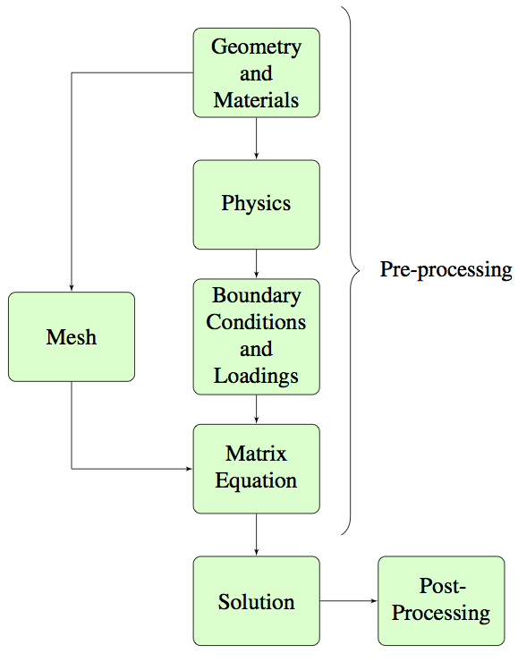
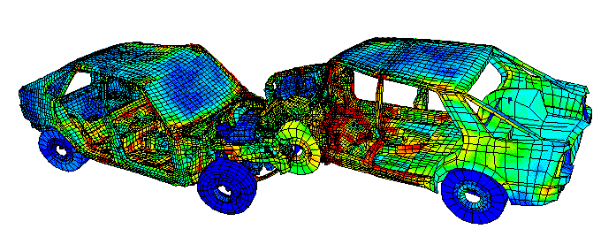
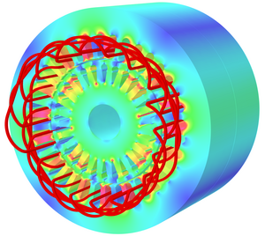
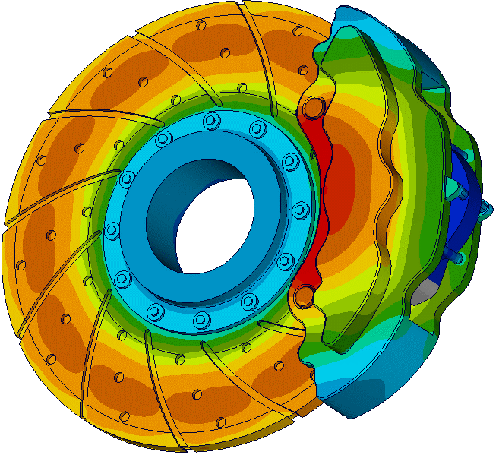
Introduction
Finite Element Analysis
Structural mechanics
Momentum balance
http://www.tam.northwestern.edu/tb/D26/
Electromagnetic
Maxwell equations
Heat-transfer
Heat equation (Fourier)
https://www.3ds.com/products-services/simulia/products/opera/
http://www.iue.tuwien.ac.at/phd/rovitto/node72.html
https://www.theseus-fe.com/simulation-software/heat-transfer-analysis

Slide 3
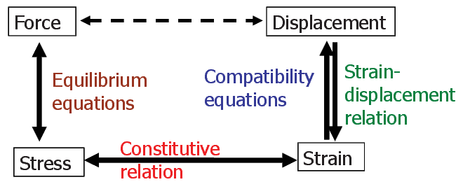

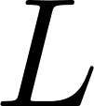

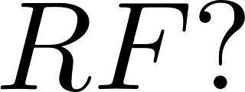
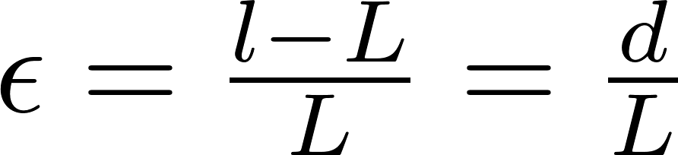
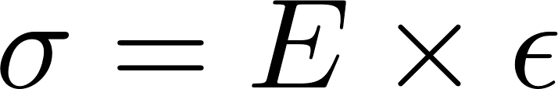
Introduction
Material Modelling
1D Example
https://nptel.ac.in/courses/105106049/

Slide 4

Introduction
User Materials in Abaqus (Explicit)
Abaqus/implicit uses information at current and previous time
Abaqus/explicit uses information only from previous time
Abaqus/Explicit
VUMAT
https://nptel.ac.in/courses/105106049/

Slide 5
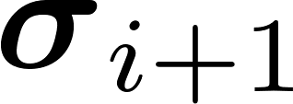
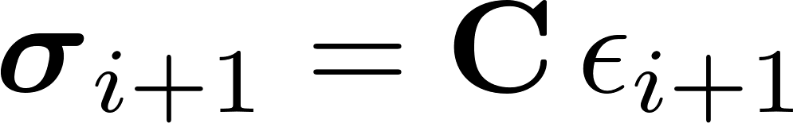
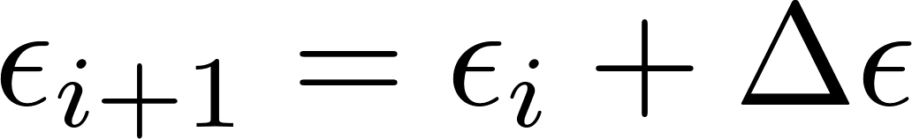
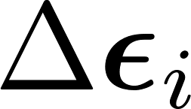
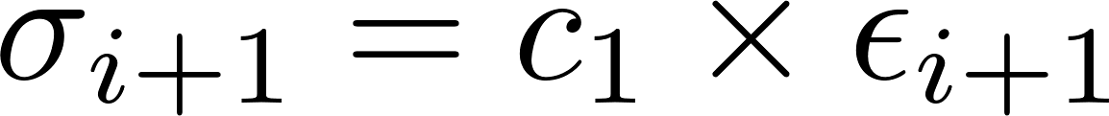
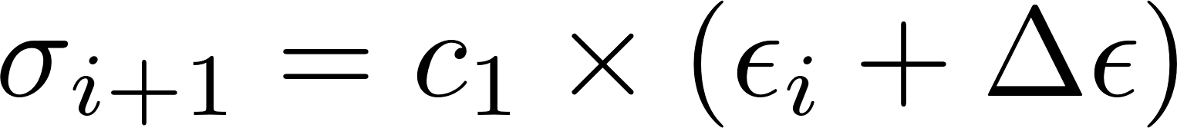
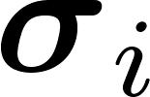

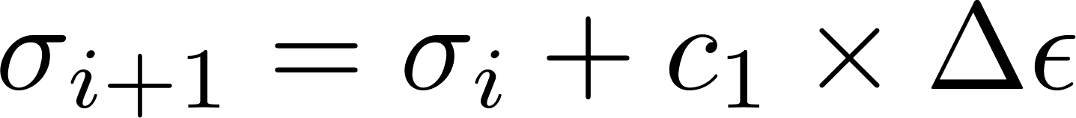
VUMAT
Basic Structure
1
2
3
VUMAT
4
5
6
…
7
8
9
Per element; call VUMAT:

Slide 6
VUMAT
Welcome to the real world
VUMAT
subroutine vumat(
C Read only (unmodifiable)variables -
1 nblock, ndir, nshr, nstatev, nfieldv, nprops, lanneal,
2 stepTime, totalTime, dt, ...,
4 tempOld, stretchOld, defgradOld, fieldOld,
5 stressOld, ...,
C Write only (modifiable) variables -
7 stressNew, stateNew, enerInternNew, enerInelasNew )
C
include 'vaba_param.inc'
C
dimension props(nprops), density(nblock), coordMp(nblock,*),
1 charLength(nblock), strainInc(nblock,ndir+nshr),
2 relSpinInc(nblock,nshr), tempOld(nblock),
3 stretchOld(nblock,ndir+nshr),
4 ...
2 enerInternNew(nblock), enerInelasNew(nblock),
do 100 km = 1,nblock
user coding
100 continue
return
end
stretchNew(nblock)
stressOld(nblock,ndir+nshr)
props(nprops)
totalTime,...
stressNew(nblock,ndir+nshr)

Slide 7
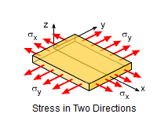
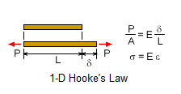
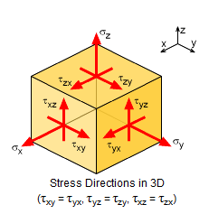



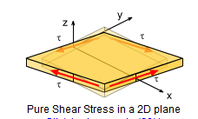
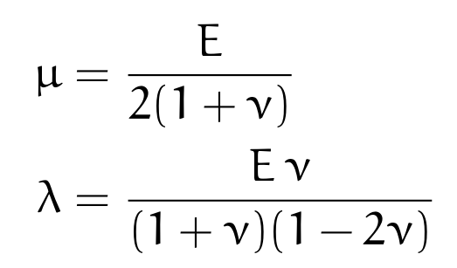
VUMAT
A worked example – three-dimensional isotropic, linear elasticity
Generalise 1D elasticity to 3D
Implement in FORTRAN according to VUMAT requirements
Validate against in-built Abaqus linear elasticity
https://www.ecourses.ou.edu/cgi-bin/eBook.cgi?doc=&topic=me&chap_sec=01.4&page=theory

Slide 8
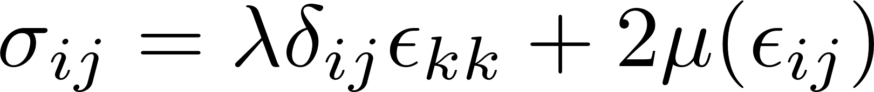
VUMAT
A worked example – three-dimensional isotropic, linear elasticity
do i = 1,nblock
c sigma_11 component
stressNew(i,1)=
c sigma_22 component
stressNew(i,2)=
c sigma_33 component
stressNew(i,3)=
c sigma_12 component (shear stress)
stressNew(i,4)=
c sigma_13 component (shear stress)
stressNew(i,5)=
c sigma_23 component (shear stress)
stressNew(i,6)=
end do
current configuration
→ Linear or non-linear analyses: (1) material (2) geometric (3) boundary conditions
reference configuration

Slide 9
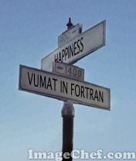

Slide 10
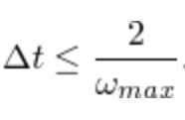
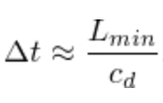
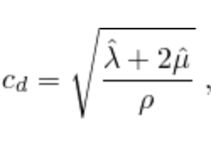
Stable time increment

