Slide 1
DIGITAL
Humanities
Close & Distant Reading
Harold Cha
Michelle Li
Latosha Sanchez
Notes:
Our topic is on close and distant reading

Slide 2
TABLE OF CONTENTS
1
4
2
3
6
INTRODUCTION
CLOSE READING
5
READINGS
LIMITATIONS
CONCLUSION
DISTANT READING
Notes:
The breakdown of our presentation is as follows: introduction, our readings, close and distant reading and their limitations, followed by our conclusion

Slide 3
INTRODUCTION
“Ars longa, vita brevis”
- Hippocrates
Digital Humanities
Computational & Traditional methods
Notes:
Quote by greek physician… art is long, but life is short.
Here, Hippocrates is essentially telling us that art has grown timelessly over the centuries, and our lives are too often not long enough to explore the numerous forms and pieces of creativity out there. We only have so much time to look for and appreciate the countless artistic works created by us humans.
The rise of the digital humanities and computational methods has given us the ability to analyze large amounts of text faster than ever before.
Yet with this new power, there are drawbacks to how well we can truly understand and interpret the nuances of literature. Here will be taking a look into two methods of text analysis. Distant and Close Reading.

Slide 4
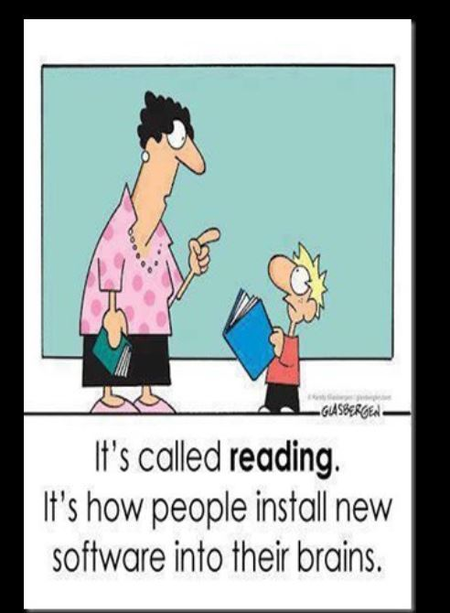
READINGS
What is Distant Learning, Schultz
The State of Digital Humanities, Alan Liu
Topic Modeling and Figurative Language, Rhody
Canons, Close Reading, and the Evolution of Method, Matthew Wilken
Credits: This presentation template was created by Slidesgo, icons by Flaticon, and infographics & images by Freepik
Notes:
-Through Kathryn Schulz’s “What is Distant Reading?” and Alan Liu’s “The State of the Digital Humanities”, we learn about what distant reading is, along with the important and underlying issues, trade offs, and benefits of this powerful yet double-edged tool.
-Looking closer in Lisa Rhody’s “Topic Modeling and Figurative Language” and Matthew Wilken’s “Canons, Close Reading, and the Evolution of Method”, we get to explore distant reading in action and see what findings each author stumbles upon.

Slide 5
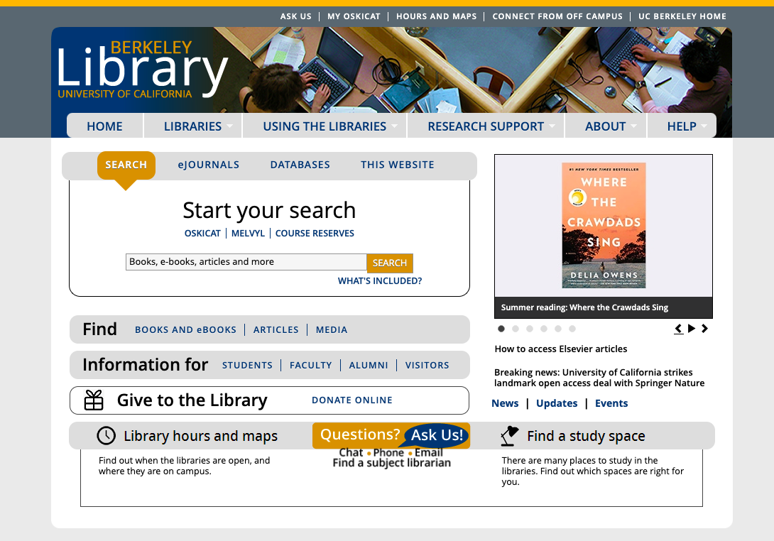
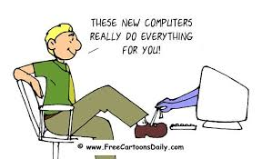
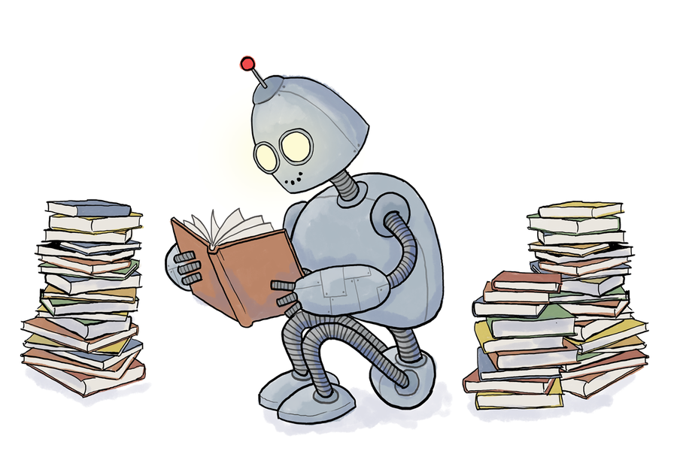
DISTANT READING
Notes:
Distant reading is an approach of literary studies that applies computational methods, such as aggregation and text analysis, to literary data
The methods used can be used to identify literary genres, envision plots, and reveil writing styles, by mining through each text and phrases.
Franco Moretti, who founded the Stanford Literary Lab and also coined the term “distant reading”, claims that simply reading texts is archaic and is insufficient for understanding the full scope of the material.
He argues that one’s exposure would be limited to a small sample size of texts when hundreds in the same topic exist. Utilizing distant reading and text mining, this opens up endless possibilities of better understanding the scope and nature of numerous works and topics.

Slide 6
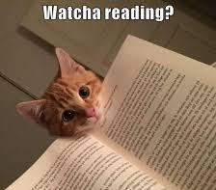
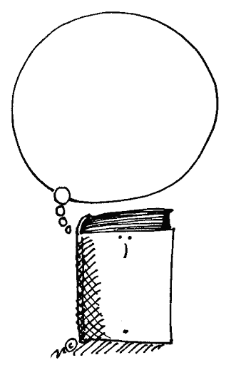
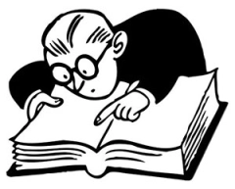
CLOSE READING
Notes:
Benefits/uses
I’m sure that many of you have heard about this or applied this technique somewhere throughout your educational career, especially in college
But close reading is a technique used while reading texts filled with rhetorical or figurative languages, such as fictional works or famous poems like Robert Frost’s “The Road Not Taken”
Emerged in America during the middle of 20th century, during a formalist movement called New Criticism
Shifting the “impressionist” view of literature to more of a “practical, literary criticism”
Close reading focuses on diving into the autonomy of the work, usually by identifying the authors’ intentions, exploring the cultural context and references made in the texts, and developing ideologies and messages found from the authors.
It provides for careful and sustained interpretation of the text, enabling the reading to pay attention to the small nuances in the text, such as individual words, metaphors, syntax, etc.
With its importance and daily usage, the education system recently began embedding and focusing more on close reading within the Common Core State Standards, ensuring that students have a thorough understanding of the text via analysis and to prepare them for college and beyond
Close reading encourages readers to re-read the text, asking what the text says, how it says it, why does the author say it, and what connections can be made
The benefits are that individuals can have a closer (no pun intended), deeper understanding and appreciation of the text itself
In addition, close reading allows scholars to ponder about some text, some event that occurred within the book, or some profound message, long after reading it
To wrap up this slide, with close reading, one can interpret texts through detailed observation and reflection, develop new insights and ideas, and have a deeper appreciation for the humanities.
Close reading provides for careful and sustained interpretation of text, enabling the reader to pay attention to the small nuances in the text, such as individual words, metaphors, syntax, etc.
With close reading, one can interpret texts through detailed observation and reflection, develop new insights and ideas, and have a deeper appreciation for the humanities.

Slide 7
Which Side Are You On?
https://strawpoll.com/fzb5961as

Slide 8
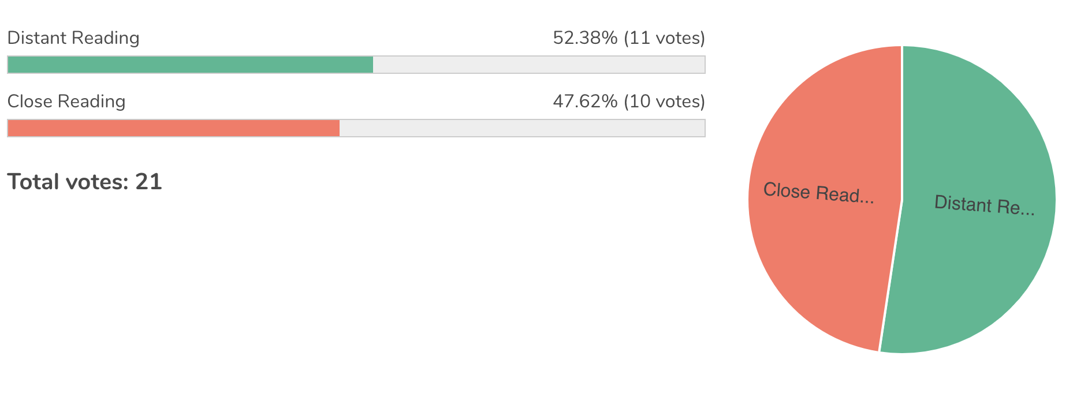

Slide 9
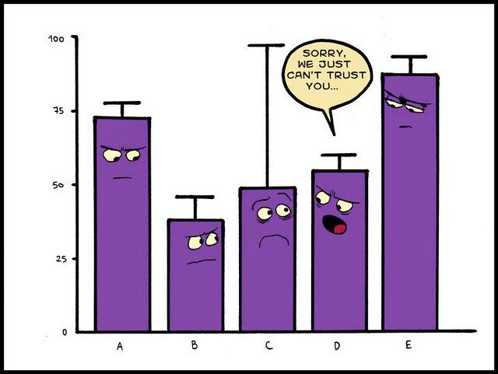
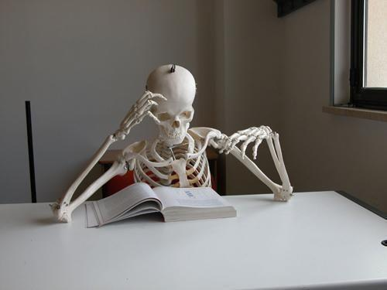
LIMITATIONS
DISTANT READING
CLOSE READING
Notes:
-Distant Learning: There are underlying concerns and limitations with the method of distant reading textual analysis. Interpretation of texts might be inaccurate (i.e, if there are metaphors or analogies people might not be able to catch on). We may lose the vitality and deeper meaning of these texts, and at times could yield shallow and inaccurate results.
(From the topic writing): Close Reading text analysis can take a lifetime to just graze the tip of the literatures available for exploration

Slide 10
Conclusion
AUTHORS’ NOTES
Be wary of Distant Reading!
OUR THOUGHTS
Distant Reading shouldn’t replace Close Reading
Notes:
-based on the readings, we have found that, while the authors allowed for perspective into distant reading, most were critical or hesitant of distant learning
-Distant reading gives us the capability to categorize, analyze, and digitize entire collections, allowing us to absorb information faster than ever before.
-However, while distant reading may prove beneficial for studying literature and yield more information than from close reading, we should not be entirely dependent on these computational tools as we may lose the vitality and deeper meaning of these texts, and at times could yield shallow and inaccurate results.
-Close reading gives the interpreter a greater sense and understanding of the literature and have led to greater reasoning and advancements in literature, deriving styles and themes from the inspiration of texts.
-close reading limits individuals’ time, energy, and scope, and there may be aspects that we are missing in texts
-We collectively concluded that distant reading is a powerful tool when used wisely, however it should not be a complete replacement of our close reading abilities.
Our stance would lean more towards agreeing with Dr. Nan Z. Da’s opinion. As explored throughout the findings mentioned above, distant reading is a powerful tool when used wisely, however it should not be a complete replacement of our close reading abilities.

Slide 11
Which Side Are You On Now?
https://strawpoll.com/yfjproocs

Slide 12
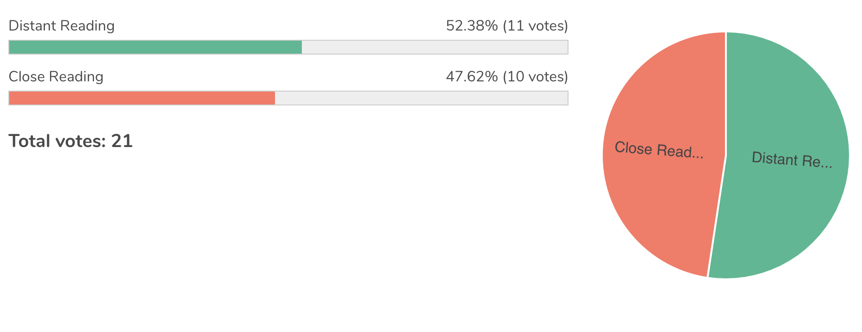

Slide 13
Q&As

Slide 14
RESOURCES
Liu, Alan. “The State of the Digital Humanities.” Arts and Humanities in Higher Education, vol. 11, no. 1-2, 2012, pp. 8–41., doi:10.1177/1474022211427364.
Rhody, Lisa. “Topic Modeling and Figurative Language.” Journal of Digital Humanities, 2012, http://journalofdigitalhumanities.org/2-1/topic-modeling-and-figurative-language-by-lisa-m-rhody//.
Schulz, Kathryn. “What Is Distant Reading?” The New York Times, The Mechanic Muse, 24 June 2011, www.nytimes.com/2011/06/26/books/review/the-mechanic-muse-what-is-distant-reading.html.
Wilkens, Matthew. “Ch. 14: Canons, Close Reading, and the Evolution of Method.” Debates in the Digital Humanities, edited by Matthew K. Gold, University of Minnesota Press, 2019, http://dhdebates.gc.cuny.edu/read/untitled-88c11800-9446-469b-a3be-3fdb36bfbd1e/section/6c7cbaa1-5ff8-4439-9ffb-aeccbc6d5734.
Credits: This presentation template was created by Slidesgo, icons by Flaticon, and infographics & images by Freepik
Notes:
-Through Kathryn Schulz’s “What is Distant Reading?” and Alan Liu’s “The State of the Digital Humanities”, we learn about what distant reading is, along with the important and underlying issues, trade offs, and benefits of this powerful yet double-edged tool.
-Looking closer in Lisa Rhody’s “Topic Modeling and Figurative Language” and Matthew Wilken’s “Canons, Close Reading, and the Evolution of Method”, we get to explore distant reading in action and see what findings each author stumbles upon.

