Slide 1
Facilitator Instructions (not for presentation)
Session: This presentation is the one-hour Club Secretary breakout session for Round 1: New Year Club Officer Training. The order of presentations for the full Club Officer Training is Hall of Fame slides shown before the training starts, Round 1: New Year General Session Part 1 followed by the individual club officer breakout sessions, ending with Round 1: New Year General Session Part 2 . Round 1: New Year General Session Parts 1 and 2 are presented to all club officers.
Facilitator notes on each slide: These notes begin with the estimated time to present the individual slide and then the overall elapsed session time. It is essential that you review the facilitator notes on each slide and practice delivering the presentation to familiarize yourself with the material and stay on time. Facilitator notes should be used as a guide rather than a script that must be stated “word-for-word”. Parentheses denote instructions for facilitators – what facilitators should “do”.
Interaction: To interact in online training, ask participants to enter their responses in the chat. Ask the Chat Master to share a few of the responses. If the training is physically in-person, ask a few of the participants to share their responses verbally. For interaction in a hybrid training, do both.
Zoom/Chat Masters: For online training, it is critical to have sufficient District technical support to manage the training. To facilitate interaction, please assign a Zoom/Chat Master to each session.
Notes:
A duration of 4 hours is recommended for Club Officer Training, allowing for comprehensive review and discussion of topics, like the Club Success Plan, the Distinguished Club Program, and leadership development. The full Club Officer Training is composed of three 1-hour sessions, but we recommend breaks between each session. This leaves approximately 30 to 45 minutes for another session or keynote presentation focused on the needs of the clubs in your District.

Slide 2
Secretary
Club Officer Training (COT)
Round 1: New Year Training
Notes:
Time on slide: 2 minutes
Elapsed time: 2 minutes
Facilitator Notes:
Welcome to the Secretary training.
(To begin the session, ask the club secretaries why they are serving as club secretaries. If the training is online, have them enter their responses into the chat and ask the Chat Master to read a few aloud. If the training is physically in-person, ask a few of them to briefly verbalize their reason for serving in no more than ONE SENTENCE.)

Slide 3

Agenda
Club Success Cycle
Transferable Skills
Role & Responsibilities
Best Practices
Resources
Test Questions
Q&A
Next Steps
Notes:
Time on slide: 1 minute
Elapsed time: 3 minutes
Facilitator Notes:
(Briefly mention the high-level agenda items to be covered in the session.)
Club Success Cycle
Transferrable Skills
Role & Responsibilities
Best Practices
Resources
Test Questions
Q&A
Next Steps

Slide 4

  Session Goals
Notes:
Time on slide: 2 minutes
Elapsed time: 5 minutes
Facilitator Notes:
(Ask the club secretaries to share their session goals. If the training is online, ask participants to enter their responses in the chat feature. If the training is physically in-person, ask a few of the participants to share a goal in a phrase or in a single sentence.)
(Facilitator then shares the goals of the COT session.)
Identify your role and responsibilities within the club
Comprehend how to fulfil your responsibilities within the club and within the Executive Committee
Recognize the benefits to be gained from the role

Slide 5
Club Success Cycle
Guest Interest
Leadership
Research
VPPR
Sergeant at Arms
VPM
VPE
President
Secretary
Treasurer
Advocate – All Members
Engage-ment
Meeting
Advocate
Pathways
Member-ship
Mentoring
Orientation
Notes:
Time on slide: 2 minutes
Elapsed time: 7 minutes
Facilitator Notes:
(Refer to the Club Success Cycle all attendees will have seen in session 1 and ask club officers where they think the Club Secretary role fits into the Club Success Cycle. After discussion, refer to the next slide for some responses.)

Slide 6
Club Success Cycle – Secretary
Maintains club’s official documents
Updates club officer and member status in Club Central
Records, distributes, and maintains minutes of Executive Committee and club business meetings
Supports the VPM and VPE in recording new members and Pathways Level completions
Invites guests to meetings and serves on the Meet and Greet Team
Advocate
Pathways
Membership
Notes:
Time on slide: 2 minutes
Elapsed time: 9 minutes
Facilitators Notes:
Advocate: As with all other club officers and club members, the Club Secretary is an advocate for the club.
(Remind them that speaking with non-members and discussing a personal experience and how Toastmasters has been a benefit to them is a great marketing tool. People tend to trust stories they have heard from friends.)
Membership: Secretaries can play a role in the “meet and greet” team to help the VPM and VPPR inform guests about the meeting and Toastmasters. You can also help the VPM register new members on Club Central after helping them fill in the Toastmasters membership application form.
Pathways: In many clubs the Secretary also supports the VPE by recording Pathways Level completions in Basecamp and ensuring that the data in Basecamp is accurate.
Best Practice: Other responsibilities for the Club Secretary can be discussed and decided during the completion of the Club Success Plan.

Slide 7

Secretary Transferable Skills
Document management (including archiving)
Writing skills (taking minutes, emails)
Communication skills
Organization
Meeting coordination
Time management
Attention to detail
Collaboration
Notes:
Time on slide: 2 minutes
Elapsed time: 11 minutes
Facilitator Notes:
(Ask the club secretaries for the transferable skills they can gain from serving as Club Secretary. Emphasize the importance of transferable skills in both our personal and professional lives.)
We all join Toastmasters for our own personal and professional reasons. What are transferable skills we can learn from serving as Club Secretary?
(Then share the list and comment briefly on any of them from your own experiences as Club Secretary.)
Document management (including archiving)
Writing skills (taking minutes, emails)
Communication skills
Organization
Meeting coordination
Time management
Attention to detail
Collaboration

Slide 8
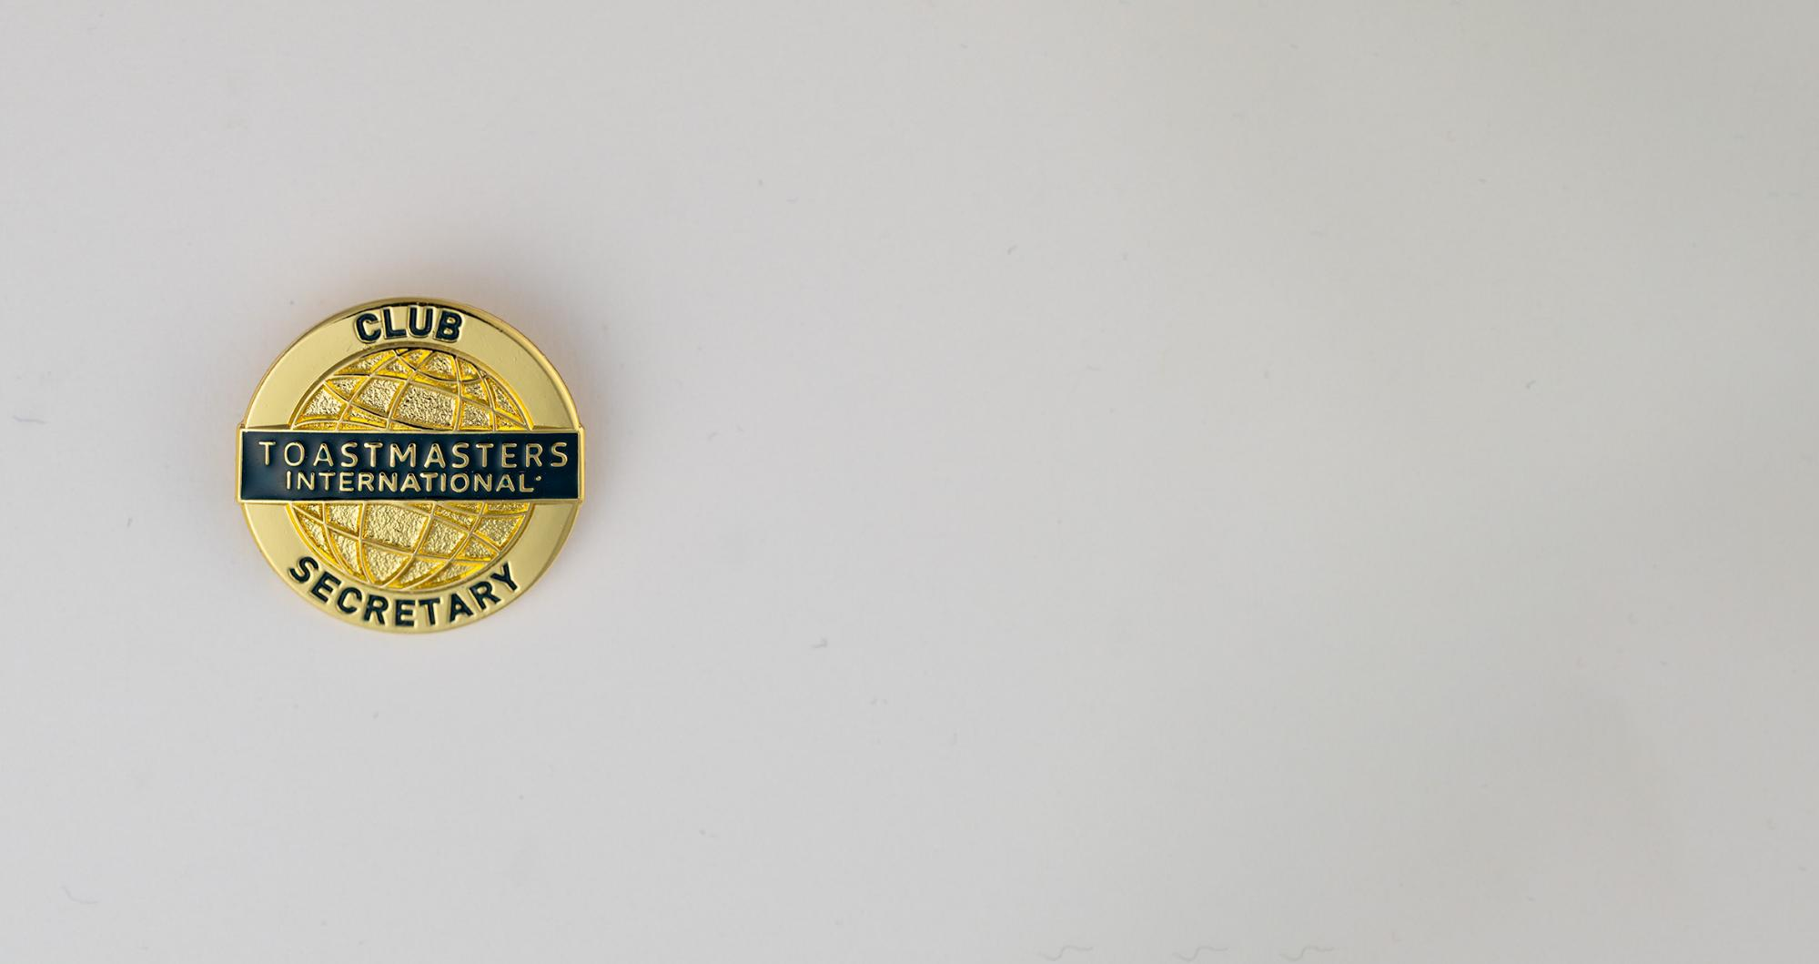
Secretary Role & Responsibilities
Notes:
Time on slide: 1 minute
Elapsed time: 12 minutes
Facilitator Notes:
Let’s investigate the main responsibilities of club secretaries.

Slide 9

You Make a Difference
A Toastmasters club literally cannot exist without a Secretary.
Notes:
Time on slide: 1 minute
Elapsed time: 13 minutes
Facilitator Notes:
(Underscore the importance of the role of the Secretary in ensuring the smooth operations of the club, which you will describe in detail in the coming slides.)
A Toastmasters club literally cannot exist without a Club Secretary. Club Secretary is one of three required club officer roles, along with President and one Vice President. As a minimum, three different members must hold these three roles to be considered a valid club officer list. The Secretary prepares the minutes of Executive Committee and club business meetings, but the Club Secretary does much more than this, as we will learn throughout this training.

Slide 10

Secretary Role
Notes:
Time on slide: 3 minutes
Elapsed time: 16 minutes
Facilitator Notes:
(Ask the club secretaries what they think the role and responsibilities of a Club Secretary are.)
The Club Secretary is responsible for club records and correspondence. The Club Secretary manages the club’s documents and communication that keep the club operating efficiently. Essential skills for the job are:
Organizational skills, the ability to listen, and reporting accurately
Recording, distributing, and maintaining minutes of meetings, including Executive Committee meetings and club business meetings
Following up on action items decided by the Club Executive Committee and the club
Communicating with Toastmasters International World Headquarters staff when questions arise that cannot be answered online
Source: https://www.toastmasters.org/magazine/magazine-issues/2022/nov/club-secretary

Slide 11
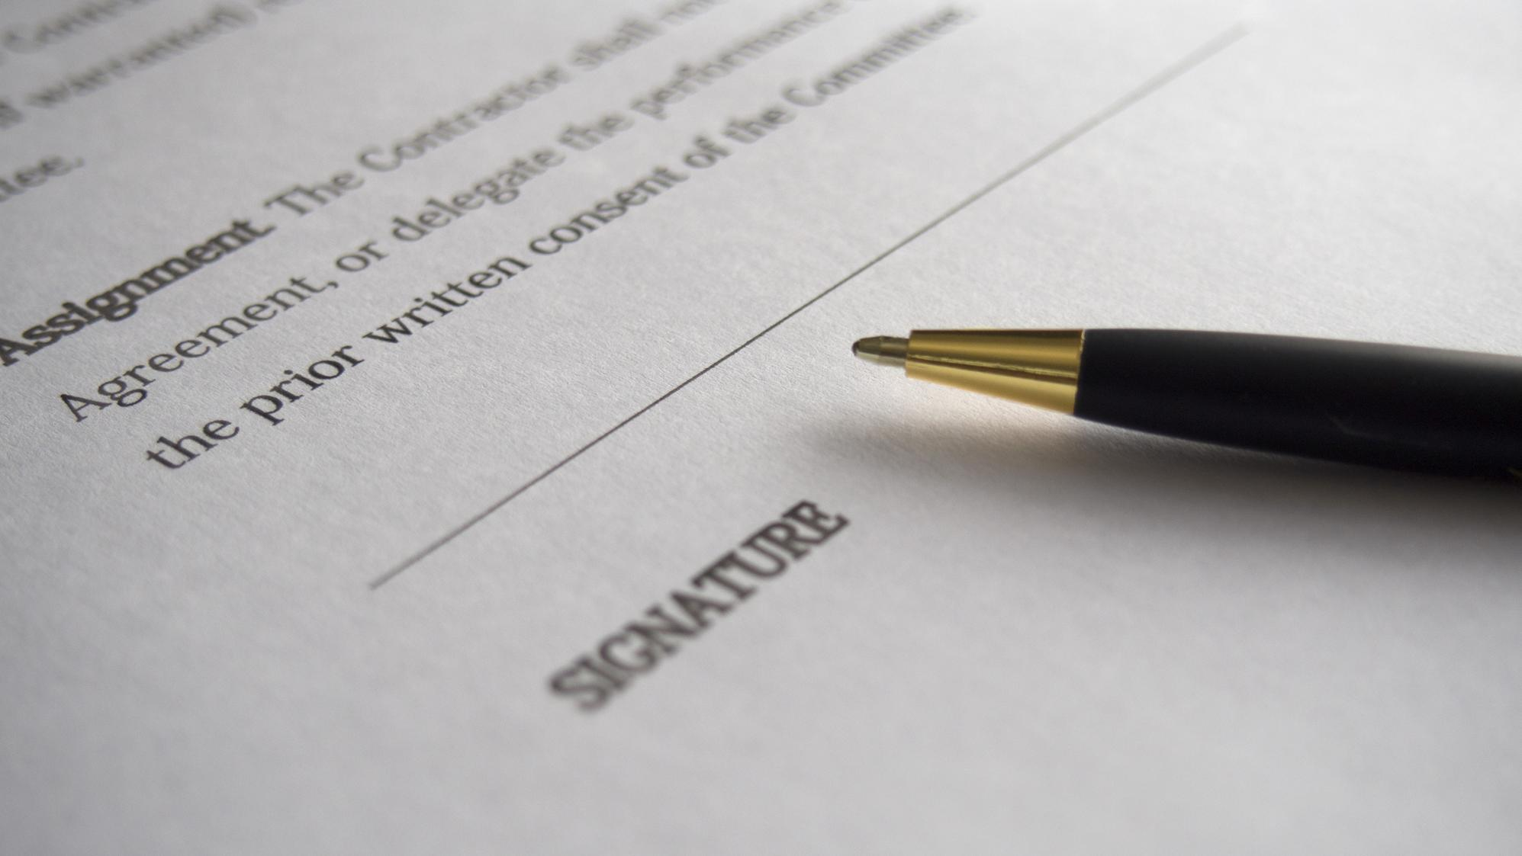
Secretary Responsibilities
Record, distribute, and maintain minutes of club business meetings
Maintain effective club records and administration
Handle club and member communication and correspondence
Notes:
Time on slide: 2 minutes
Elapsed time: 18 minutes
Facilitator Notes:
(Review each responsibility.)
When business is transacted at a club meeting, the Secretary is responsible for recording and maintaining the records of the club’s decisions and distributing the minutes of these business meetings to club members.
Share with all club members where minutes and other important club documents will be stored, e.g. Google Drive, OneDrive, etc.
Manage club correspondence
IMPORTANT: Refer to the Club Leadership Handbook for the list of items to record in business meetings.

Slide 12
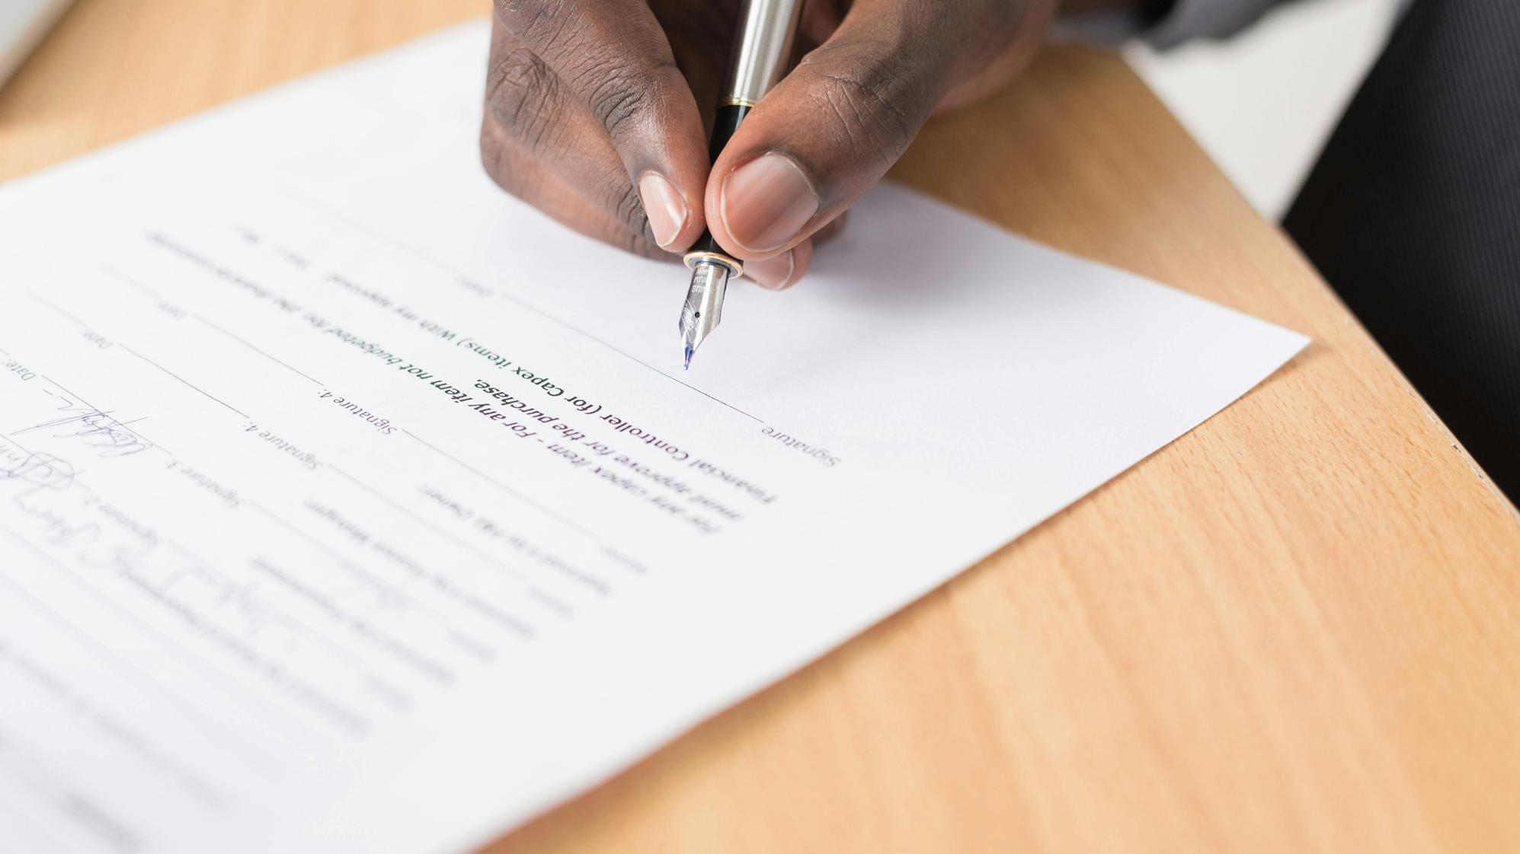
Secretary Responsibilities
Ensure relevant legal requirements/documents are readily accessible, e.g. GDPR requirements in Europe
Develop a club calendar
Update Club Central, as required
Assign club proxy for TI Annual Business meeting
Approve projects in Base Camp when asked to do so
Notes:
Time on slide: 2 minutes
Elapsed time: 20 minutes
Facilitator Notes:
(Continued from previous slide.)
The Secretary needs to ensure relevant legal requirements/documents are readily accessible, e.g. GDPR (General Data Protection Regulations) requirements In Europe.
The club’s calendar maintained by the Secretary will remind the Secretary when to update Club Central.
Other responsibilities to repeat:
Maintain a calendar of club events (with President and VPE)
Assign the club proxy by the deadline for the August Toastmasters International Annual Business meeting (TI ABM)
(Both Club Secretary and President have access to assign the club proxy for the TI ABM. One or the other may handle this on behalf of the club.)
Submit new club officer list in June (and December if semi-annual officers) through Club Central
Organize transition with new team (transition checklist, lessons learned, transition meeting)
The Secretary is also a Base Camp manager and may need to approve members’ projects. All club officers now have access to approve member level completions in Base Camp.

Slide 13

Executive Committee Meetings
Coordinate meeting dates and agendas with the President
Record and maintain minutes of Executive Committee meetings
Distribute meeting minutes to Executive Committee members timely
Maintain list of action items and follow up
Notes:
Time on slide: 2 minutes
Elapsed time: 22 minutes
Facilitator Notes:
(Ask what they think the responsibilities of the Club Secretary are for the Executive Committee Meetings. Then click to show the list.)
Secretary works closely with the Club President to plan Executive Committee meetings, to prepare the agendas, and circulate these to the Executive Committee members in advance (one to two weeks before the meeting). Best practice: Conduct Executive Committee meetings at least monthly and at the beginning of the year decide the Executive Committee meeting dates for the whole year, e.g. the first Tuesday evening of each month.
Secretary takes minutes of Executive Committee meetings and sends to the President for approval before being circulated to other Executive Committee members. It is important to agree to the deadline for circulation, e.g. within 24 hours, 3 days or 7 days of each meeting. (Include this expectation in your Club Success Plan.) You can use Artificial Intelligence (AI) or a transcription application to help you achieve accurate minutes. (Ask club officers which program(s) they can use as not everyone will be familiar with these sorts of Apps.)
It is also worth setting up a standard agenda for parts of the meeting, such as reports by each club officer at each meeting. At the start of the year, the Club Success Plan will feature strongly as it needs to be submitted by the end of September. After an Area Director visit and report is submitted, you may want to add a discussion about the report's findings to the next agenda.
Secretary is responsible for maintaining these Executive Committee meeting minutes.
IMPORTANT: Refer to the Club Leadership Handbook for the list of items to record in business meetings.

Slide 14

Official Club Records to File/Archive
Club Charter
Club Constitution
Addendum of Standard Club Options
Club Policies
Signed Membership Applications
Employer Identification Number Letter (USA clubs only)
Notes:
Time on slide: 3 minutes
Elapsed time: 25 minutes
Facilitator Notes:
(Ask what they think are the “official” documents for a club. Then click to show the list.)
These are OFFICIAL Toastmasters club documents and must be maintained in perpetuity by the club. The Club President is responsible for understanding the importance and impact of legal documents, and the Secretary is responsible for filing and retrieving the information when required.
Signed membership applications should be kept secure, such as in a lock box, or properly destroyed once they are digitized and stored according to jurisdictional privacy laws.
IMPORTANT: Please refer to the Club Leadership Handbook for a complete list of club files that must be maintained and for what length of time.

Slide 15

Other Documents to File/Archive
Club Success Plan
Executive Committee and Club Business Meeting minutes
Area Visit Reports
Important Toastmasters correspondence
Notes:
Time on slide: 2 minutes
Elapsed time: 27 minutes
Facilitator Notes:
(Continues on the next slide. Facilitator to walk through list. Clubs may vary in what they expect the Secretary to file.)

Slide 16



Other Documents to File/Archive
Asset inventory (banner, lectern, etc.)
Password list
Contract for venue and TI insurance form (if applicable)
Year-end transition checklist
(Save information on a shared online storage drive, e.g. OneDrive, Google Drive, or cloud storage.)
Notes:
Time on slide: 2 minutes
Elapsed time: 29 minutes
Facilitator Notes:
(Continued from previous slide. Facilitator to walk through list. Clubs may vary in what they expect the Secretary to file.)
Store documents on a Google Drive, OneDrive, or some other storage application that is automatically backed up and that all club officers can access. Pathways stores all member achievements, and these are accessible by club officers.

Slide 17

Best Practices
An annual calendar
Password management (social media, Google Drive)
Use of document templates
Meeting minutes using AI
Executive Committee meeting planning (plan and ask for reports in advance)
Additional training
Notes:
Time on slide: 3 minutes
Elapsed time: 32 minutes
Facilitator Notes:
(Ask the club secretaries about the best practices of their club secretaries. Then share the best practices with everyone.)

Slide 18


Additional Training
Use of templates (document, email, newsletter)
Parliamentary Procedure Basics
AI for taking minutes
Canva training
Notes:
Time on slide: 2 minutes
Elapsed time: 34 minutes
Facilitator Notes:
(Ask what additional training could be useful to a Club Secretary. Then click to show the list. These may be offered by the District or online by other Districts. Some commercial training, such as Canva training is free on YouTube as well.)

Slide 19

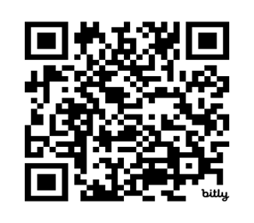
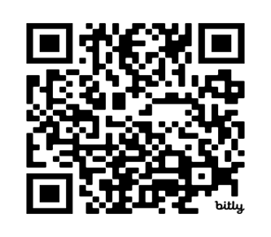
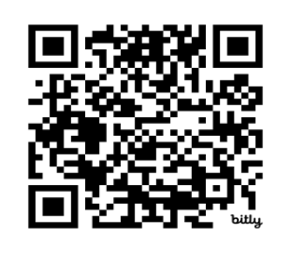
Useful Resources
Club Leadership Handbook
Club Central
Toastmasters Website
Meeting Minutes Template
District Administration Manager
Sec Role Extra
Navigate
Club Central
Template for
Meeting Minutes
Notes:
Time on slide: 2 minutes
Elapsed time: 36 minutes
Facilitator Notes:
(Ask what resources club secretaries can use to obtain information or help. Then show the list and Q-codes.
Invite them to scan the Q-codes and link to the information provided.)

Slide 20

Notes:
Time on slide: 1 minute
Elapsed time: 37 minutes
Facilitator Notes:
Let’s check our learning!

Slide 21

What are the primary responsibilities of the Club Secretary in a Toastmasters club?
What type of records is the Club Secretary expected to maintain throughout the Toastmasters year?
Who does the Secretary typically collaborate with when preparing meeting minutes for Executive Committee meetings?
What steps should the Secretary take when there is a change in club officers during the year?
Where should the Club Secretary update the club’s officer list and membership information?
What is the purpose of maintaining accurate club business meeting minutes, and who should receive them?
Notes:
Time on slide: 5 minutes
Elapsed time: 42 minutes
Facilitator Notes:
(Ask club secretaries for the answers to each question. Ask a different secretary to answer each question.)
Answer 1: To maintain all club records, manage official club correspondence, record and distribute meeting minutes (especially for Executive Committee meetings), and update club records via Club Central with Toastmasters International
Answer 2: Membership rosters, meeting minutes, club officer lists, Club Constitution and Bylaws, historical documents, and correspondence
Answer 3: The Club President and other club officers to ensure accuracy and that all decisions and action items are recorded.
Answer 4: Update the club officer list in Club Central on the Toastmasters International website and inform the relevant club members and Area/Division leaders, as needed
Answer 5: In Club Central on the Toastmasters International website
Answer 6: To ensure that club decisions are recorded for future reference and to confirm tasks allocated to committee members. Club business meeting minutes, decisions, and action items should be communicated to all club members

Slide 22
What is the purpose of maintaining accurate Executive Committee meeting minutes, and who should receive them?
How does the Club Secretary support the Club President and the Executive Committee in ensuring effective communication?
Name at least three key documents the Club Secretary is responsible for storing or archiving.
In what ways can the Club Secretary assist with the Distinguished Club Program (DCP) tracking?
What tools or platforms provided by Toastmasters International are essential for the Club Secretary to be able to use?
Notes:
Time on slide: 5 minutes
Elapsed time: 47 minutes
Facilitator Notes:
(Ask club secretaries for the answers to each question. Ask a different secretary to answer each question.)
Answer 7: To ensure that Executive Meeting transparency and continuity by documenting discussions, decisions, and action items. Executive Committee meeting minutes should be distributed to all Executive Committee members and archived for future reference
Answer 8: By distributing minutes, maintaining up-to-date contact lists, managing correspondence, and ensuring timely access to important records and information
Answer 9: Meeting minutes (club and Executive Committee)
Club Charter
Club Constitution and Bylaws
Addendum of Standard Club Options
Officer and membership records
Official correspondence
Answer 10: By maintaining accurate records, documenting meeting attendance and member progress, and confirming achievements and completed goals with the VP Education and President
Answer 11: Tools/Resources
Club Central (for managing officer lists, member updates)
Base Camp (optional, but useful if helping with Pathways support)
Toastmasters.org (for accessing official documents, policies, and procedures)

Slide 23

Questions &
Answers
Notes:
Time on slide: 3 minutes
Elapsed time: 50 minutes
Facilitator Notes:
(At the beginning of the session you asked the club secretaries to share their session goals. Address any questions from the club secretaries to ensure that all their goals were met.)

Slide 24

Next Steps
Develop a Club Calendar
Coordinate Executive Committee meetings for the year
Submit the completed Club Success Plan by 30th September
Update passwords
Review, update, and maintain club records and files, as needed
Notes:
Time on slide: 2 minutes
Elapsed time: 52 minutes
Facilitator Notes:
(Ask club secretaries about their next steps. After discussion, review the items listed on the slide.)

Slide 25
Build Momentum in Your Club—Act Now!
Thank you for serving as a club officer!
Notes:
Time on slide: 1 minute
Elapsed time: 53 minutes
Facilitator Notes:
(End the session by thanking all the participants for stepping up to serve their clubs as club officers and encourage the club secretaries to take action today to create a Club Calendar, schedule “at least” monthly Executive Committee meetings, and submit the Club Success Plan by 30th September.)

