Slide 1
Facilitator Instructions (not for presentation)
Session: This presentation is the one-hour Club Vice President Public Relations breakout session for Round 1: New Year Club Officer Training. The order of presentations for the full Club Officer Training: Hall of Fame slides shown before the training starts, Round 1: New Year General Session Part 1 followed by the individual club officer breakout sessions, ending with Round 1: New Year General Session Part 2 . Round 1: New Year General Session Parts 1 and 2 are presented to all club officers.
Facilitator notes on each slide: These notes begin with the estimated time to present the individual slide and then the overall elapsed session time. It is essential that you review the facilitator notes on each slide and practice delivering the presentation to familiarize yourself with the material and stay on time. Facilitator notes should be used as a guide rather than a script that must be stated “word-for-word”. Parentheses denote instructions for facilitators – what facilitators should “do”.
Interaction: To interact in online training, ask participants to enter their responses in the chat. Ask the Chat Master to share a few of the responses. If the training is physically in-person, ask a few of the participants to share their responses verbally. For interaction in a hybrid training, do both.
Zoom/Chat Masters: For online training, it is critical to have sufficient District technical support to manage the training. To facilitate interaction, please assign a Zoom/Chat Master to each session.
Notes:
A duration of 4 hours is recommended for Club Officer Training, allowing for comprehensive review and discussion of topics, like the Club Success Plan, the Distinguished Club Program, and leadership development. The full Club Officer Training is composed of three 1-hour sessions, but we recommend breaks between each session. This leaves approximately 30 to 45 minutes for another session or keynote presentation focused on the needs of the clubs in your District.

Slide 2
Vice President Public Relations (VPPR)
Club Officer Training (COT)
Round 1: New Year Training
Notes:
Time on slide: 30 seconds
Elapsed time: 0.5 minutes
Facilitator Notes:
(Open with energy and enthusiasm. Emphasize that the VPPR role serves as a vital bridge between the club and community.)
Welcome to the Vice President Public Relations Officer training. As VPPR, you are responsible for marketing your club to the outside world or inside to your corporation/organization to attracts guests to your meetings and then ensuring that members stay fully informed about meetings, events, and contests.

Slide 3

Agenda
Notes:
Time on slide: 1 minute
Elapsed time: 1.5 minutes
Facilitator Notes:
(Set expectations for a content-rich but quick paced session. Maintain an encouraging tone about their new leadership role.)
This session provides practical tools and strategic understanding for your success as VPPR. We'll move efficiently while ensuring you absorb the key concepts.
Let's review today's agenda. We'll cover why the VPPR role matters, the transferable skills you'll develop, your core responsibilities, and communication strategies. We'll also discuss branding, available resources, and your next steps.
WHY VPPR?
Transferable Skills
VPPR Role in the Club Success Cycle
Responsibilities
Resources
Summary
Next Steps

Slide 4

Agenda
Why VPPR?
Club Success Cycle
Transferable Skills
Responsibilities
Branding
Resources
Summary
Next Steps
Notes:
Time on slide: 1 minute
Elapsed time: 1.5 minutes
Facilitator Notes:
(Set expectations for a content-rich but quick paced session. Maintain an encouraging tone about their new leadership role.)
This session provides practical tools and strategic understanding for your success as VPPR. We'll move efficiently while ensuring you absorb the key concepts.
Let's review today's agenda. We'll cover why the VPPR role matters, the transferable skills you'll develop, your core responsibilities, and communication strategies. We'll also discuss branding, available resources, and your next steps.
Why VPPR?
VPPR Role in the Club Success Cycle
Transferable Skills
VPPR Responsibilities
Branding
Resources
Summary
Next Steps

Slide 5
Club Success Cycle
Guest Interest
Leadership
Research
VPPR
Sergeant at Arms
VPM
VPE
President
Secretary
Treasurer
Advocate – All Members
Engage-ment
Meeting
Advocate
Pathways
Member-ship
Mentoring
Orientation
Notes:
Time on slide: 1.5 minute
Elapsed time: 4.5 minutes
Facilitator Notes:
We viewed the Club Success Cycle at the end of General Session Part 1.
(Ask) Which stages of the Club Success Cycle are influenced by the VP Public Relations?
As VPPR, you raise awareness about your club in the local area or in your corporation or organization to attract guests to your meetings. Target individuals who want to improve their communication and leadership skills and gain confidence in the process.

Slide 6
Club Success Cycle – Vice President Public Relations
Guest Interest
Promoting the club to attract guests to your club meetings
Social media presence for community clubs
Internal marketing for corporations
Research
Meeting
Maintaining a club website
Club newsletter for members
Notes:
Time on slide: 1.5 minutes
Elapsed time: 6 minutes
Facilitator Notes:
(Emphasize the connection between VPPR activities and club success and the partnership of the VPPR with the VPM.)
The Vice President Public Relations (VPPR) publicizes the club to the local community or inside their corporation/organization. The VPPR notifies the media about the club’s existence, the benefits it provides, and the achievements of its members. The VPPR promotes awareness of the club to encourage guests to visit the club on a regular basis. This is done by maintaining the club website, posting regularly on social media channels, and building relationships with local press.
The VPPR and VP Membership roles represent a partnership, like a relay race where a smooth handoff is essential for success. The conversion from guest to member requires both officers working in coordination, not independently.
You, as the VPPR, are the public voice of your club. When the community or your corporation/organization sees Toastmasters, they see your work. When members stay informed and excited, that's your impact. When new guests walk through the door, they often attended your club meeting because of your promotional efforts.

Slide 7

Transferable Skills
Communication skills
Media relations skills
Marketing and strategy
Creative and technical skills
Business development
Networking
Relationship building
Succession planning
Notes:
Time on slide: 1.5 minutes
Elapsed time: 3 minutes
Facilitator Notes:
(Ask the vice presidents for the transferrable skills they should gain from serving as Vice President Public Relations. Emphasize how these skills directly translate to workplace success. Help officers see the VPPR role as professional development, not just volunteer work.)
What skills can you learn by serving as Vice President Public Relations?
You will develop valuable transferable skills that enhance your professional life.
Communication and Media Skills: Media relations, press release writing, and media interview techniques that improve your workplace communication abilities.
Marketing and Strategy: Campaign development, advertising and promotion, and branding materials creation. You'll learn to plan publicity calendars and develop reward and incentive programs.
Creative and Technical Skills: Photography, graphic design, and seminar development that are valuable in any professional setting.
Business Development: Consulting skills, networking abilities, relationship building, and succession planning that advance your career.
These aren't just Toastmasters skills. They're professional competencies that employers value highly. Whether you're promoting a product launch, organizing company events, or building stakeholder relationships, your VPPR experience provides real-world expertise.

Slide 8
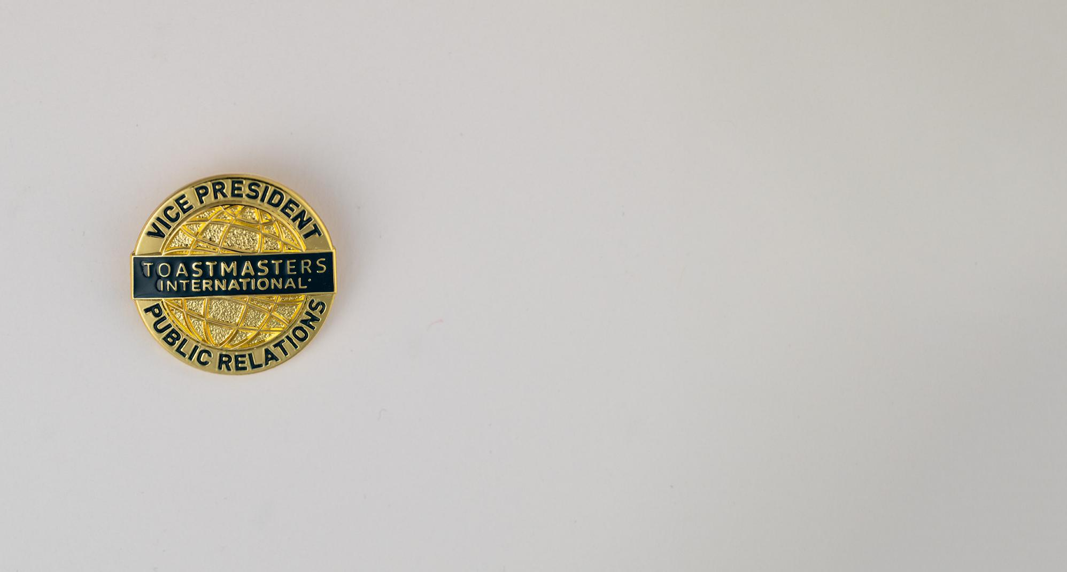
Vice President
Public Relations
Responsibilities
Notes:
Time on slide: 1 minute
Elapsed time: 7 minutes
Facilitator Notes:
(Deliver this as a clear, concise wrap-up of the VPPR’s core purpose.)
In summary, as VPPR you coordinate an active public relations and publicity program. You maintain communication between the club, its members, and the public. Your work increases Toastmasters awareness through local news and social media channels. In a Toastmasters club affiliated with a corporation or other organization, the VPPR promotes the presence and benefits of Toastmasters, using the organization’s internal communication channels.

Slide 9
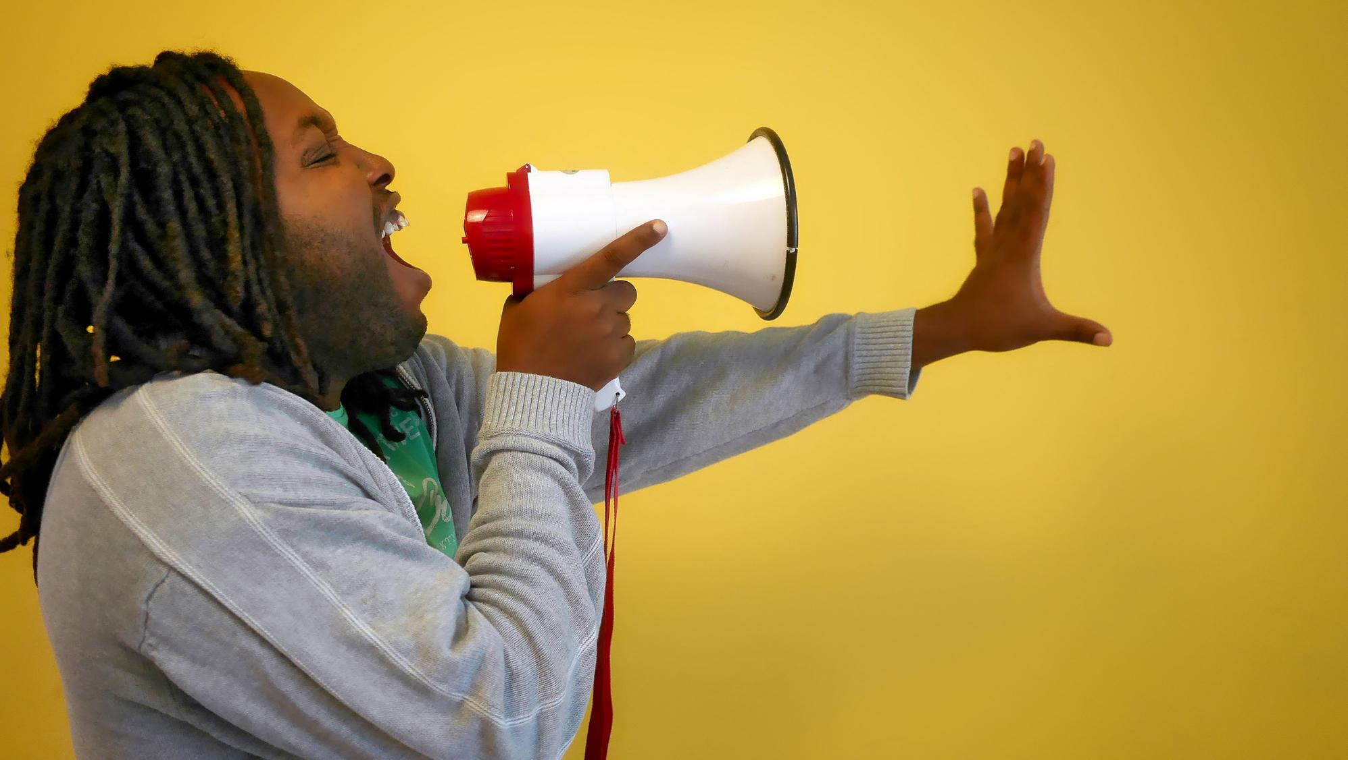
Communication
Notes:
Time on slide: 3 minutes
Elapsed time: 10 minutes
Facilitator Notes:
(Keep the pace energetic.)
When planning communication, ask yourself these four crucial questions:
Who is your target audience for the communication?
How will you reach them?
When is the right timing?
What is your key message?
Let's test this with your own clubs right now, using this "think of someone" exercise. (For online training, tell participants to use the Zoom chat to enter their responses. For in-person training, ask a few of the participants for a phrase or one sentence verbal answers.)
Quick exercise (1.5 minute for this exercise):
Think of someone you want to attract to your club. Got someone in mind?
What type of person are you thinking of? Young professional? Retiree? Co-worker? Someone wanting confidence?
Now, answer by raising your hand: For that person you're thinking of, would you reach them through Facebook? Raise hand, if yes. How about LinkedIn? Hands up for LinkedIn. Local newspaper? Show those hands.
Do you see how different audiences, different target markets, use different media channels? The busy professional might be on LinkedIn, while the retiree may use Facebook or read the local paper.
Final questions: What would make that person want to visit your club? What's in it for them? (Limit answers to no more than three words.)
This is your strategic thinking in action. Right audience, right channel, right message.

Slide 10

Audience Types
Notes:
Time on slide: 2 minutes
Elapsed time: 12 minutes
Facilitator Notes:
(Emphasize the internal/external distinction as the key strategic concept on this slide.)
What types of audiences do you communicate with as VPPR? (Take several quick responses in the Zoom chat or in-person.)
Excellent! There are two main types: Internal audiences and External audiences.
Internal means current members, recent alumni (unless they have unsubscribed) and officers.
External means potential members and community.
This matters because your messages and channels are completely different. The Internal audience receives club news and updates. The External audience learns about Toastmasters and the benefits of membership through external communication channels.
This difference drives your entire communication strategy.

Slide 11

Internal Audiences
Notes:
Time on slide: 2 minutes
Elapsed time: 14 minutes
Facilitator Notes:
(Emphasize the partnership with VPM on renewals. Stress that internal communication is about keeping members engaged and informed.)
Internal audiences include:
Club Members
Other Clubs
District Leaders
Club Alumni
These members already understand Toastmasters benefits, so focus on club-specific activities. Internal audiences want club news: who was best speaker, evaluator, Table Topics winner, meeting dates, renewal reminders.
Key communication points throughout the year:
Coordinate with the VPM on Membership Renewal Campaigns starting in August and February. Give members plenty of time before September 30th and March 31st to renew their membership. Send “we miss you" or “we want you back” emails to prompt forgotten renewals.
Member Recognition and achievements. Take photos and publish in WhatsApp, Facebook, Instagram, etc.
Notify members about meetings and events including competitions. Promote joint meetings and educational events with other clubs.
Share contest dates and social events.

Slide 12

Internal Audience Channels
Notes:
Time on slide: 1 minute
Elapsed time: 15 minutes
Facilitator Notes:
(Emphasize checking current platform usage rather than assuming. Highlight the Facebook Group vs. Facebook Page distinction quickly.)
Quick exercise: How do you reach your internal audience? (Take a few quick responses.)
Main channels for internal communication:
Facebook Group (not page) for member discussions and engagement.
WhatsApp or other messaging services like Telegram, WeChat, Facebook Messenger.
Club Newsletters
Important tip: Use existing club channels. Check to confirm if members still use the same channels or different ones.

Slide 13

External Audiences
Notes:
Time on slide: 2 minutes
Elapsed time: 17 minutes
Facilitator Notes:
(Use “raised hands” or “show of hands” to help them relate these categories to people they actually know. Group similar audiences together to simplify the concept while keeping it relatable and practical.)
The second audience type is External audience.
Let’s see how many of you know people in these groups:
Career-focused professionals: Starting out, middle management, graduate students. (Raise your hands if you know people like this.)
Community groups: Local organizations, retirees looking to give back. (Raise your hands if you know people like this.)
Skill builders: English improvers, self-help enthusiasts. (Raise your hands if you know people like this.)
Media contacts: Local journalists. (Raise your hands if you know media contacts.)
These are your main external audience categories. Each group has different needs.
Career-focused people want leadership skills and confidence. Community groups seek involvement and networking. Skill builders need specific improvement areas. Media contacts want newsworthy stories.
Your message must match their specific needs, not just promote general Toastmasters benefits. A graduate student's motivation differs completely from a retiree's motivation.

Slide 14

Raise Awareness and Reach Out
Meet people where they are
Notes:
Time on slide: 2 minutes
Elapsed time: 19 minutes
Facilitator Notes:
(Emphasize the outreach concept using the market analogy. Emphasize active placement in digital and physical spaces where potential members search for solutions.)
To reach busy external audiences, we must meet people where they are already looking for communication skills.
If you're selling strawberries, do you wait at home or go to the market? The market, obviously! You sell faster where people are already shopping.
This is outreach. Don't wait for people to find your club. Go where they're already looking for communication solutions. People don't buy washing machines because they're shiny. They buy them to solve a problem: dirty clothes.
They choose based on features that matter most to them.
Same with Toastmasters. Don't say "join because we're friendly." Explain how we solve their problems: confidence, speaking skills, presentation skills, leadership skills, career advancement.
Your job as VPPR: Be in the marketplace where people shop for communication improvement, like LinkedIn groups, community centers, professional networks.
Make your club easy to find on Google (or it’s local equivalent) where people are constantly searching. One way to make your club easy to find on Google is by creating a Google Profile for your club, which we will explain later in the presentation.
Remember the slogan: "Go where they're shopping, don't wait for them to knock.“

Slide 15

Benefits of Membership
THE RIPPLE EFFECT
Beginning benefits that attract people
Growing benefits that keep them engaged
Life-changing benefits that create loyal members
Notes:
Time on slide: 2 minutes
Elapsed time: 21 minutes
Facilitator Notes:
(Emphasize that benefit-focused messaging converts prospects into guests. Help VPPRs understand they're selling transformation, not club membership.)
External audiences search for solutions to their specific challenges. Your job is to sell benefits, not features.
Here's the key: Toastmasters benefits build momentum over time. Each skill strengthens the next, creating a powerful ripple effect in members' lives.
Beginning benefits that attract people:
Self-paced learning fits any schedule
Confidence building for everyday conversations
Public speaking skills for presentations
Growing benefits that keep them engaged:
Leadership development through hands-on roles
Communication planning for workplace success
Presentation mastery that impresses colleagues
Life-changing benefits that create loyal members:
Handling difficult questions with ease
Negotiation skills for career advancement
Networking abilities that open doors
The transformation story: A nervous new member becomes a confident leader. Someone afraid of meetings becomes the person others turn to for guidance. Career advancement follows naturally.
Focus on the outcomes they want, not the activities we do. Sell the destination, not the journey details.

Slide 16
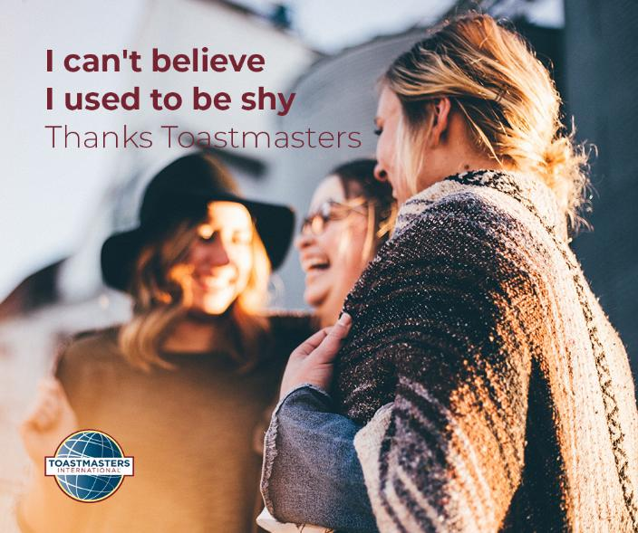
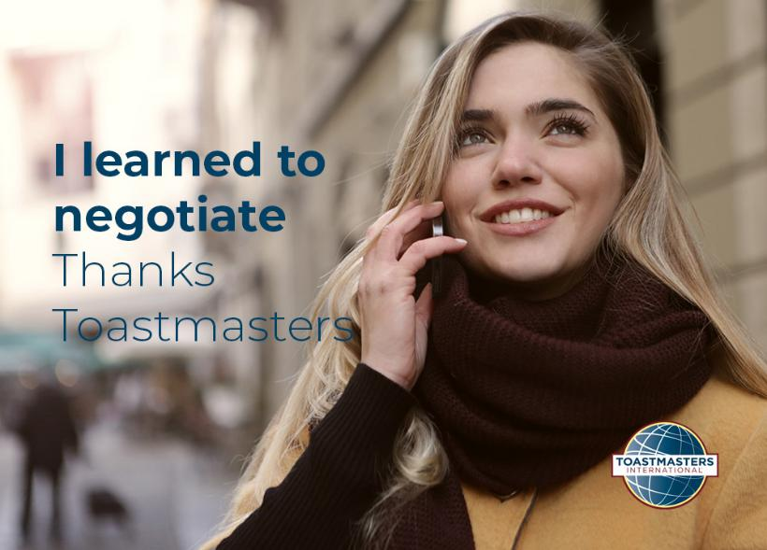
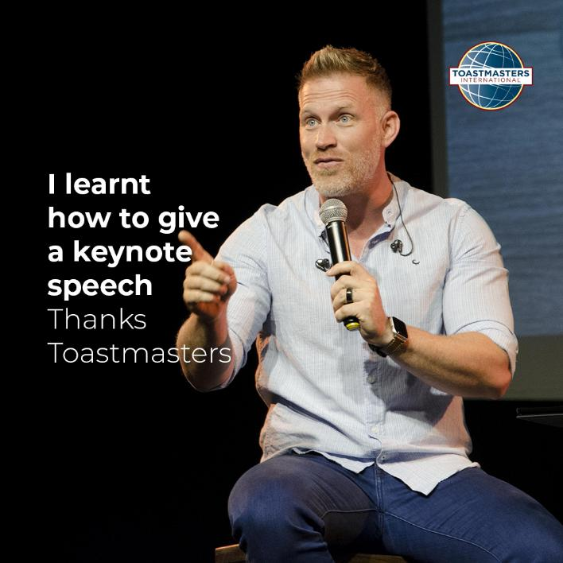
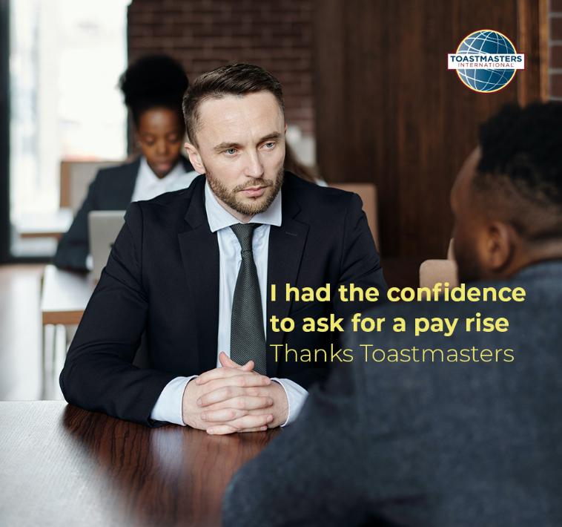
One Ad, One Message!
Notes:
Time on slide: 1 minute
Elapsed time: 22 minutes
Facilitator Notes:
(Point to specific poster examples while explaining each principle. Emphasize how the simplicity and focus make these advertisements effective at connecting with external audiences' immediate needs.)
Here are sample social media posts from District 91 that demonstrate effective benefit-focused advertising.
Notice each post uses simple, direct language and focuses on one benefit only. This one tackles public speaking fears. This one addresses confidence building. This one addresses negotiation skills. Lastly, this post targets confidence.
Key principles:
Simple language everyone understands.
Direct messaging that gets straight to the point.
Relatable situations that potential members recognize from their own lives.
One ad, one message. Don't overwhelm with multiple messages. Make it easy for people to immediately understand how Toastmasters solves their specific problem.
Clear, focused messaging converts prospects into guests by selling the destination.

Slide 17

Choose 3 Channels Maximum!
Notes:
Time on slide: 1 minute
Elapsed time: 23 minutes
Facilitator Notes:
(Emphasize the strategic limitation to three channels as essential for sustainable VPPR workload. Highlight how algorithm preferences reward consistency of channel over channel variety.)
There are many channels available for external communication. However, if you try using all available channels, you'll work full-time on PR and still not cover everything.
Focus on THREE channels maximum. This lets you make regular posts on each platform. Regular posting helps gain exposure because social media algorithms promote consistent posters.
Use pre-planned posting options that many platforms offer. You can schedule several weeks of content in one session to save time.

Slide 18
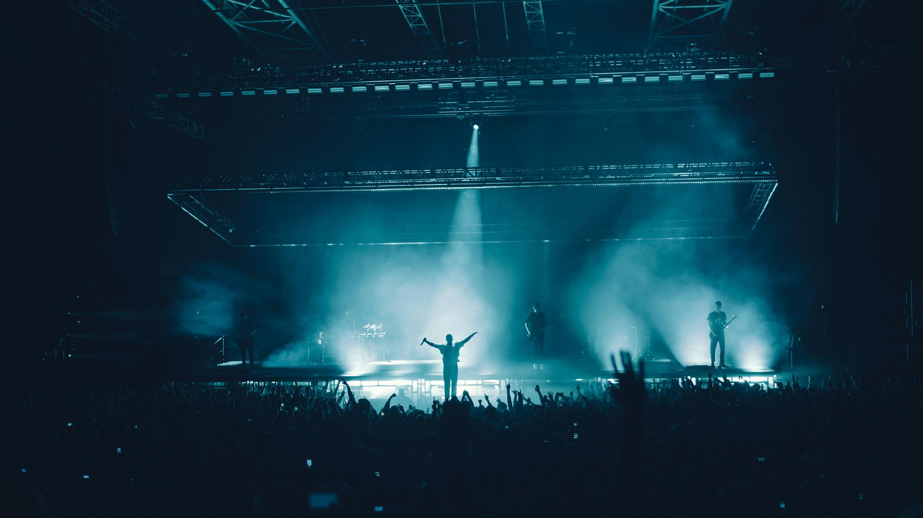
Event Promotion Channels
Eventbrite/Meetup
Facebook Events
LinkedIn Events
Local listing social media channels
Notes:
Time on slide: 1 minute
Elapsed time: 24 minutes
Facilitator Notes:
(Present these as proven strategies rather than suggestions. Emphasize testing platforms to find what works best locally, as effectiveness varies by geographic region and demographics.)
When communicating with external audiences, these channels have proven successful:
Eventbrite and Meetup - try both and see which attracts more inquiries.
Facebook events on local community groups work well for Open Houses.
LinkedIn events reaches professional demographics who use Facebook limitedly.
Local listing channels like Nextdoor vary by location, so research what works in your area.

Slide 19
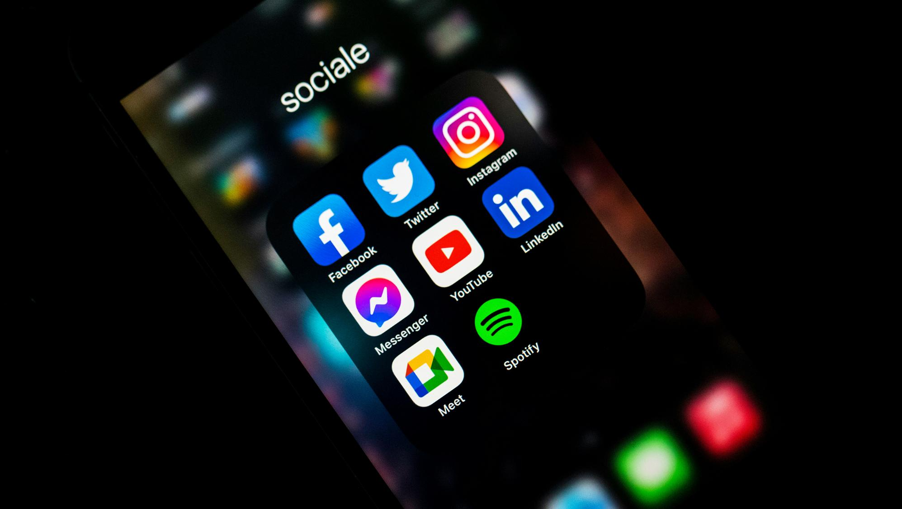
External Audience
Media Channels
Notes:
Time on slide: 1 minute
Elapsed time: 25 minutes
Facilitator Notes:
(Focus purely on social media strategy. Emphasize how different platforms serve different demographic targets and highlight the effectiveness of member testimonial videos.)
Social media platforms for outreach:
Facebook page - targets local community members and general audiences.
LinkedIn page - reaches professionals and career-focused individuals.
Instagram - appeals to younger demographics and visual storytelling.
YouTube and TikTok - broader reach through "My Why" videos where members explain why they joined Toastmasters and why they stayed.
These personal story videos have proven very successful because they're authentic and relatable to potential members.

Slide 20

Hashtags #
Notes:
Time on slide: 1.5 minutes
Elapsed time: 26.5 minutes
Facilitator Notes:
(Emphasize the counter-intuitive nature of "fewer hashtags = better results." Stress that this is different from older social media advice. Focus on quality over quantity approach.)
Hashtag best practices for maximizing social media impact:
Research your audience and trending hashtags in your local area.
Balance popular and niche hashtags - popular ones reach broad audiences, while niche hashtags target more engaged communities interested in specific topics.
Critical point: Limit hashtag numbers to only 4-5 on Instagram, 2-3 on LinkedIn, X, and Facebook. Social media algorithms now flag high hashtag counts as spam. Research shows posts with fewer hashtags actually get significantly more views than posts loaded with hashtags.
Integrate hashtags naturally into your captions rather than dumping them at the end. This makes content more readable and engaging.
Use hashtags consistently across posts to build recognizable brand presence. Monitor performance using analytics tools and avoid banned or overused hashtags that could hurt your reach.
Create unique club hashtags like #YourClubNameToastmasters to encourage community engagement and user-generated content.

Slide 21

Google Profile
Notes:
Time on slide: 1.5 minutes
Elapsed time: 28 minutes
Facilitator Notes:
(Lead with the compelling 90% statistic, explain the search advantage, detail the benefits, emphasize ease of setup, then close with the consequence of not having one.)
Earlier in the presentation we recommended that you make your club easy to find on Google. We recommend that your club has a Google Business Profile if it does not already have one.
A Google Business Profile is essential because over 90% of all searches worldwide happen on Google. When people search "public speaking clubs near me" or "communication skills training," you want your club to appear.
Search advantage: Local searches show Google Business listings before websites. People find your meeting location, see reviews, and get directions without leaving Google.
Key benefits: Your club appears in Google Maps with location, meeting times, and contact details. You get customer reviews that build credibility. Upload photos to showcase meetings and members.
Direct messaging lets people contact you instantly.
It's completely free and takes about 15 minutes to set up following the instructions on the Google website. Simply verify your location, add meeting times, upload photos, and write a compelling description.
Bottom line: If you're not on Google Business, you're invisible to the vast majority of potential members actively searching for what you offer.

Slide 22
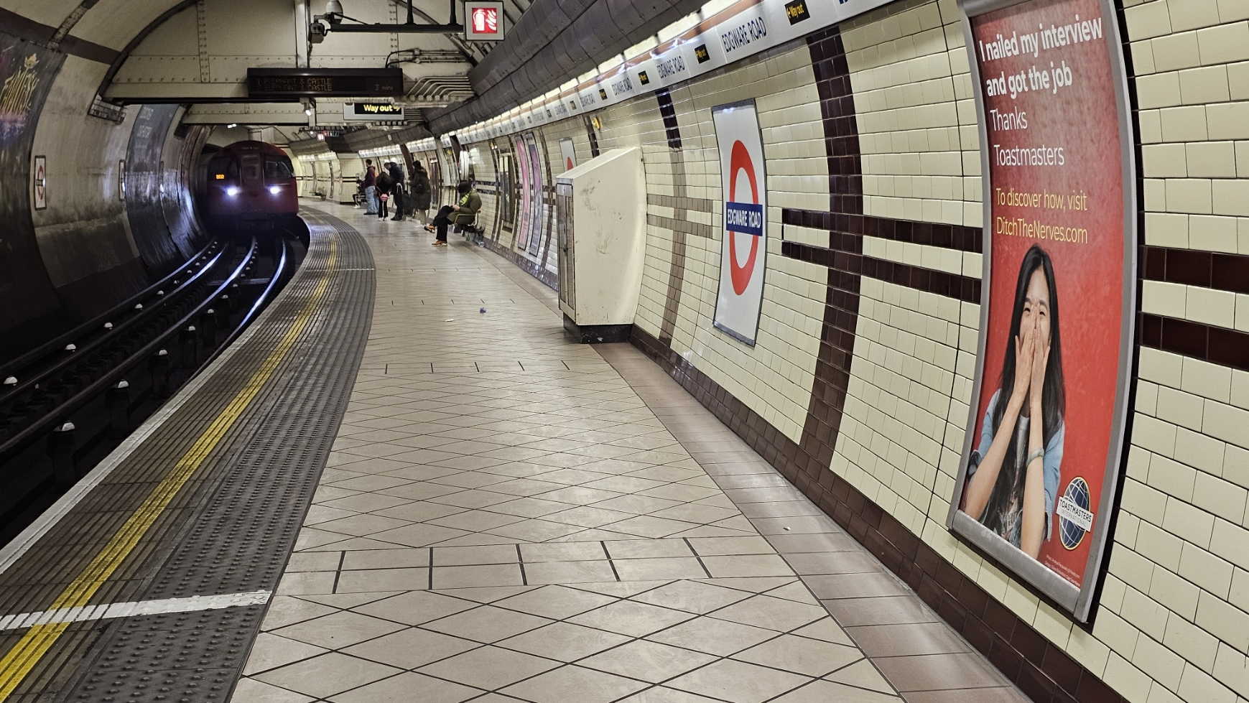
Notes:
Time on slide: 1.5 minutes
Elapsed time: 29.5 minutes
Facilitator Notes:
(Emphasize how platform choice and location targeting align with audience behavior. Highlight the strategic thinking behind placing ads where target demographics naturally gather.)
District 91 took one of these social media ads and turned it into Tube poster campaigns. The strategy was to reach new audiences who stand next to posters waiting for trains instead of scrolling past social media ads in less than a second.
The advertisements were strategically placed at stations near London's financial and business districts to reach their target external audience of working professionals.
This message is particularly strong because of its focus and the simple phrase "Thanks Toastmasters." This raises the immediate question: "What is Toastmasters?“
The curiosity created by this simple acknowledgment draws people in. They want to know what organization helped create this transformation.
The call-to-action directing people to visit a landing page to learn more completes the strategy perfectly. It moves interested prospects from curiosity to information gathering in one smooth step.
This demonstrates how the same benefit-focused message can work across different platforms. The key difference is dwell time - commuters have minutes to absorb your message, while social media users have seconds. Strategic placement puts your club's message where your ideal members already spend time.
Clubs can do something similar by placing A4 or Letter sized posters on local community boards, often found in supermarkets, public libraries and other community venues and placed where people gather pr regularly pass by. This means that a non Toastmaster audience can see a club’s poster for much longer that they would do if they just scrolled using social media.
Some corporate clubs arrange through their IT department for a club poster to be displayed on staff members’ PC screens or on the big screens in the reception area the day before each meeting to raise awareness.

Slide 23

Offline Channels – Choose from Ala Carte Menu
Market Stands/Job Fairs
Leafleting/Mail Drops
Community Boards etc
Notes:
Time on slide: 0.5 minute
Elapsed time: 30 minutes
Facilitator Notes:
(Add your own local examples that work in your area.)
Clubs can choose from offline channels including:
Maildrops of leaflets at homes.
Local community boards at supermarkets, libraries, town halls, or university rooms.
Stands at job fairs or market stalls provide opportunities to meet non-members.
Business networking and Rotary meetings offer professional connections.

Slide 24

Newspapers/Articles
Printed media
Notes:
Time on slide: 0.5 minute
Elapsed time: 30.5 minutes
Facilitator Notes:
Traditional media remains effective in many regions worldwide. Get regular mentions in local "What's On" sections. Write articles before and after Open Houses or contests for both print and online publications.
For Open House events, invite local media or send a press release with photos. Photos significantly increase publication chances.

Slide 25
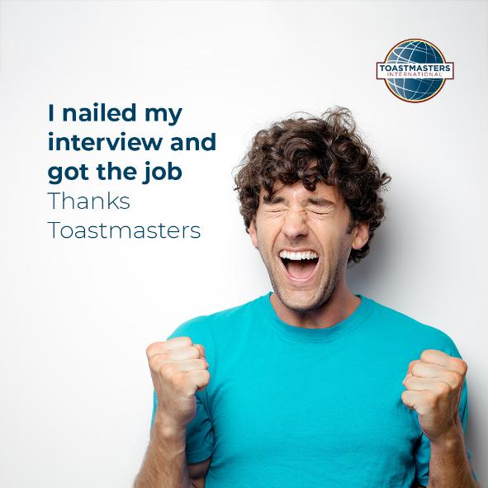
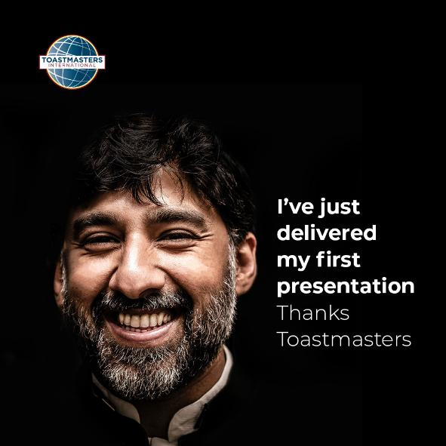
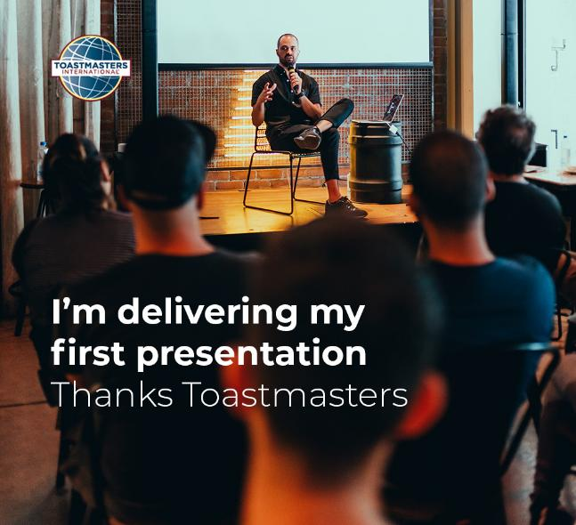
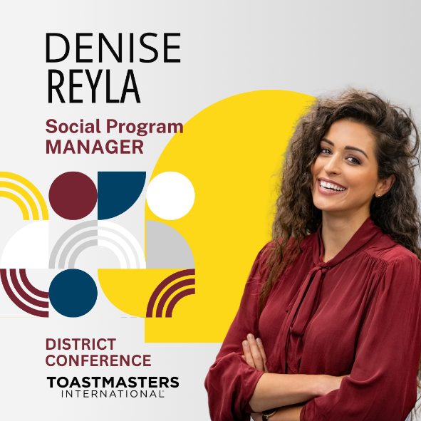
Testimonials
Creation of testimonial campaign (links to external audiences)
Notes:
Time on slide: 1.5 minute
Elapsed time: 32 minutes
Facilitator Notes:
(Emphasize testimonials as dual-purpose content that simultaneously celebrates current members while attracting new ones through relatable success stories.)
Creation of testimonial campaigns serves both audiences effectively.
Remember you're telling a story when creating testimonials. Spotlight members' success and achievements since joining Toastmasters.
Internal audience benefit: Makes members feel heard and seen as each testimonial focuses on individual achievements and personal growth journeys.
External audience benefit: Testimonials resonate with potential members who have similar needs or challenges. This creates a connection between both audiences.
Key insight: We often check reviews before making purchasing decisions. Testimonials serve as social proof that Toastmasters delivers real results for real people.
Effective testimonials tell transformation stories that current members recognize, and potential members aspire to achieve.

Slide 26

Word of Mouth (Personal Testimonials)
Include friends and
business networking
Notes:
Time on slide: 1 minute
Elapsed time: 33 minutes
Facilitator Notes:
We are all ambassadors for Toastmasters.
Tell your friends, colleagues and connections about how membership has benefited you. Personal testimonials from someone we know are very powerful and trusted.
Word-of-mouth recommendations from trusted contacts often carry more weight than any advertisement or promotional material.

Slide 27
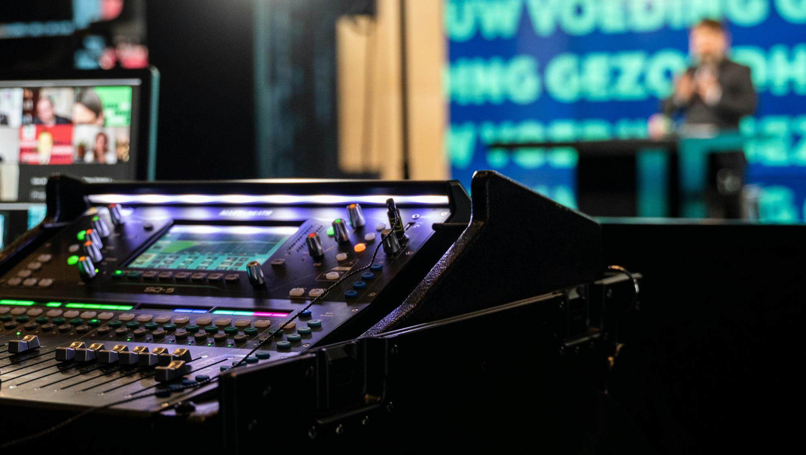
Local Radio & TV
Notes:
Time on slide: 1 minute
Elapsed time: 34 minutes
Facilitator Notes:
Local radio and TV stations and university radio and TV are often looking for content. Offer free communication advice in return for a short mention about your club at the end. This provides value while promoting your club. Consider becoming a regular presenter by offering an ongoing communication course or segment.

Slide 28

Website
Notes:
Time on slide: 1 minute
Elapsed time: 35 minutes
Facilitator Notes:
If your club has a website, ensure it's included in your Google Business Profile to improve search visibility. Keep content up-to-date as search engines promote recently updated sites over stagnant ones.
Consider: How often will it be updated? Who will maintain it? Not all clubs have websites, but if yours does, actively maintain it, as this helps improve the chances of search engine algorithms putting the club on their first page of results. A website that is not updated on a regular basis may deter guests from visiting as they may think that your club is no longer active.

Slide 29

Communication Plan
Notes:
Time on slide: 2 minutes
Elapsed time: 37 minutes
Facilitator Notes:
The Communications Plan outlines how you will organize your communications and how you will bring your communications to life.
Your Communications Plan needs to be divided into two parts, the first for your internal audience and the second for the external audience.
The VPPR should recruit another member or a team of other members to assist them. These team members can edit and produce a club newsletter or become responsible for the Facebook Group. This will help prepare a successor to take over the VPPR role next year.

Slide 30
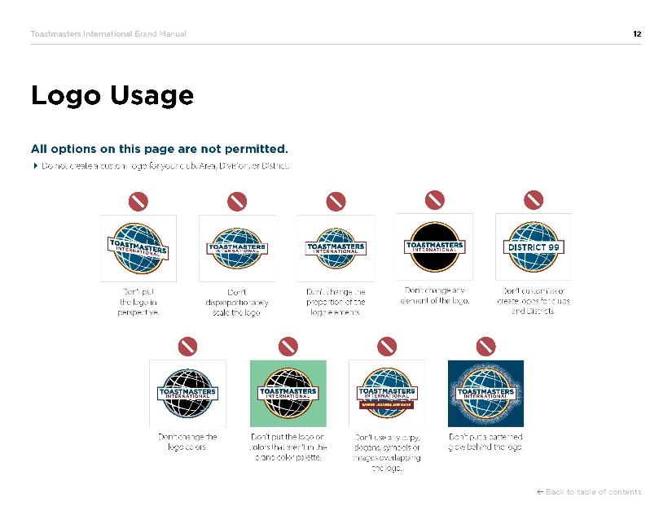
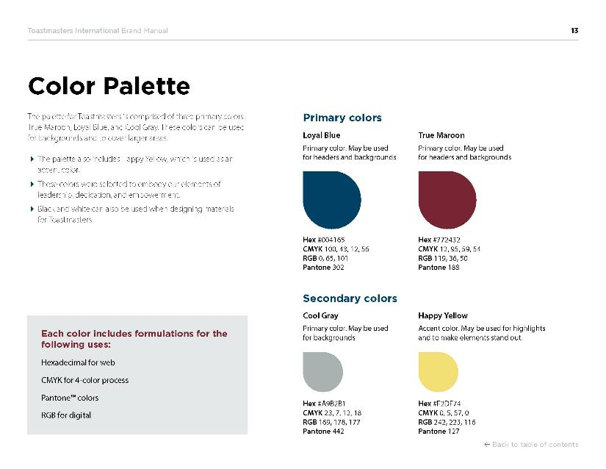

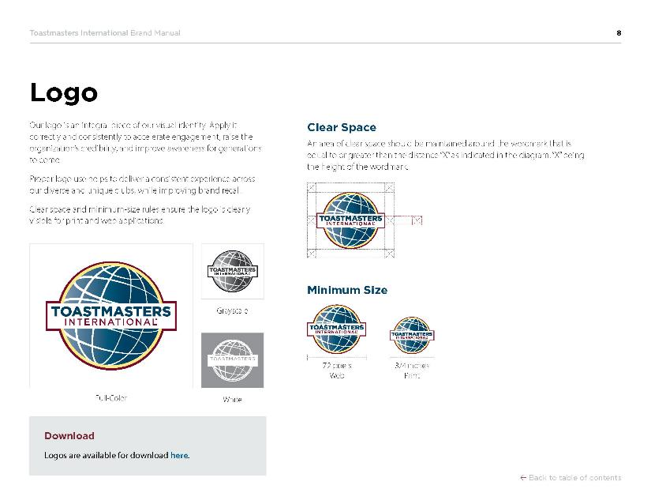
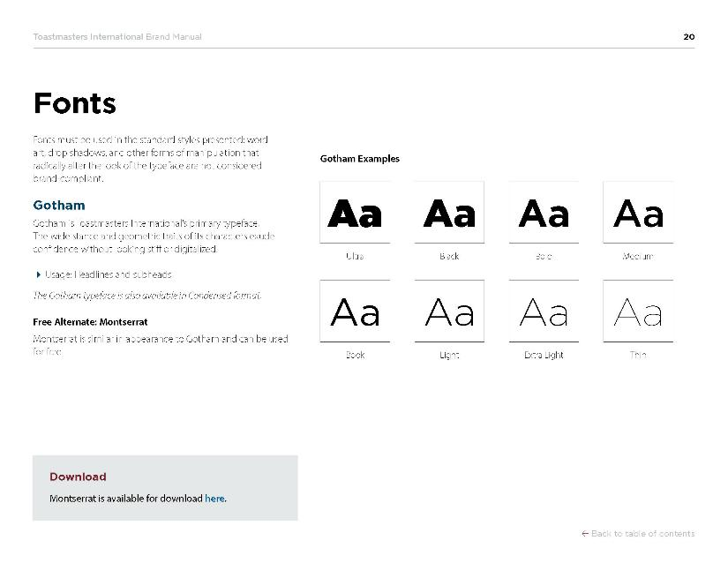
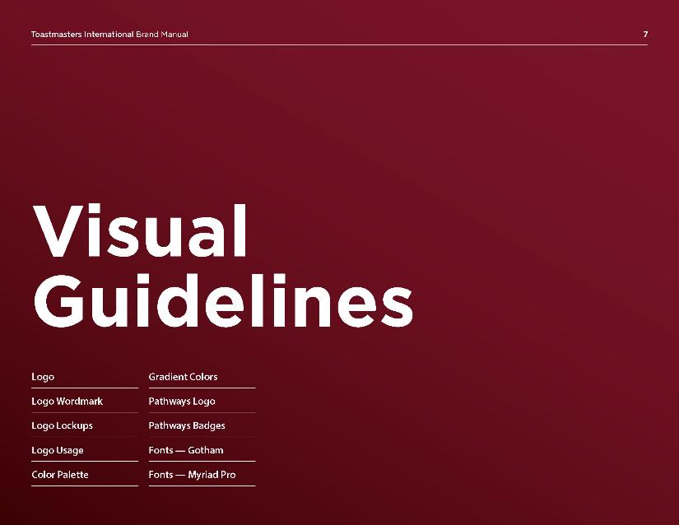
Brand Manual & Resources
Notes:
Time on slide: 1 minute
Elapsed time: 38 minutes
Facilitator Notes:
The next slides will highlight the available brand resources to support your VPPR role. These tools will help you execute effective public relations campaigns for your club.
Please refer to the Brand Manual for comprehensive details on using all brand elements correctly:
Toastmasters logo and word mark - proper placement, sizing, and usage guidelines
Colors and tints - official color codes for digital and print materials
Typefaces - approved fonts for headlines, body copy, and all text applications
Using photos - guidelines for selecting and incorporating imagery that aligns with brand standards
Layout principles - spacing, alignment, and composition requirements
Tone of voice - messaging guidelines that reflect Toastmasters values
The Brand Manual is your essential reference for maintaining consistent, professional communications that strengthen the Toastmasters brand worldwide.
Please scan the QR code for immediate access to these critical resources.

Slide 31



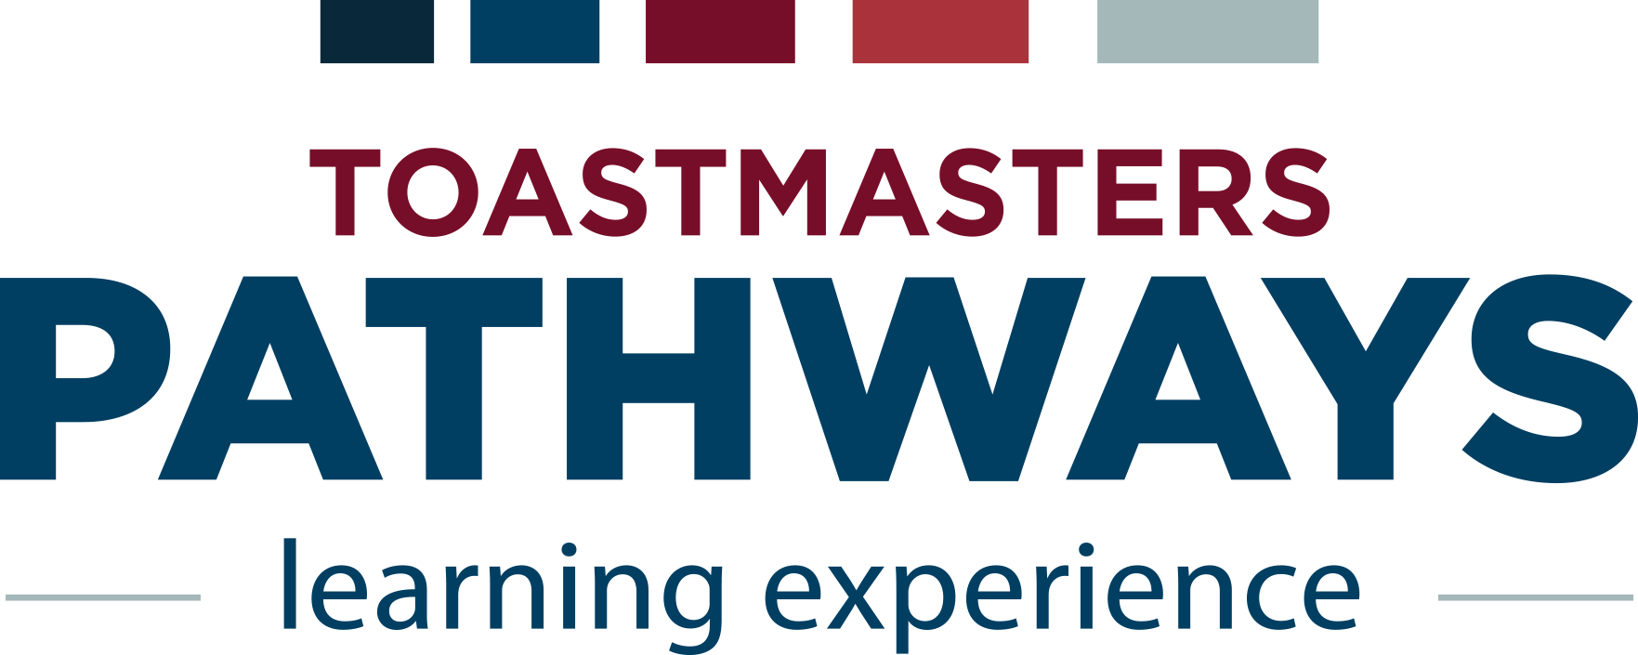
Toastmasters Logo
Notes:
Time on slide: 1 minute
Elapsed time: 39 minutes
Facilitator Notes:
(Emphasize the importance of brand compliance and direct officers to the Brand Manual as their authoritative resource for visual identity questions.)
Visual identity requirements are strict and important:
Do not change or alter the Toastmaster logo in any way. Clubs cannot use their own logos, and neither can Areas, Divisions, or Districts.
Important: Pathways is not a logo or sub-brand for external communications. It's the name of our structured education program and should only be used internally when discussing our educational curriculum.
All external communications must use the official Toastmasters International logo following brand guidelines, including the minimum size and clear space arrangements.
See the Brand Manual for the latest information on proper logo usage, color specifications, clear space and placement requirements.
Consistent branding protects and strengthens the Toastmasters reputation worldwide.

Slide 32

Typefaces
Notes:
Time on slide: 1 minute
Elapsed time: 40 minutes
Facilitator Notes:
(Emphasize that these font choices ensure brand consistency while providing cost-effective alternatives for clubs. Font downloads are available in the Brand Manual along with specific usage guidelines.)
(Also suggest that the Ultra Light, Thin or Black, Extra Black versions of these fonts are not used as they are difficult to use in a design unless you have extensive design experience.)
There are over 10,000 different typefaces and hundreds of thousands of fonts. The Toastmasters Brand Manual specifies which typefaces to use:
For Headlines and sub-headings:
Gotham is the official typeface and is a paid licensed typeface
Montserrat is the free alternative from Google Fonts.
For body copy (main text):
Myriad Pro is the official typeface and it's also a paid licensed typeface
Source Sans 3 is the free Google Fonts alternative.
Both free alternatives are available at fonts.google.com and provide consistent branding while staying within budget constraints. To use both Gotham and Myriad Pro clubs will have to pay a royalty fee to use these fonts as they are copyrighted. Montserrat and Source Sans 3 are both “free fonts” being Google fonts so clubs don’t have to pay a license fee to use them.
Consistent typography maintains professional appearance and brand recognition across all club materials.

Slide 33
Toastmasters Color Palette
TI Dark Blue
Pantone (Print) | Pantone 302
CMYK (Print) | C100, M43, Y12, K56
RGB (Screen) | R0, G65, B101
Hex (Screen) | #004165
TI Dark Red
Pantone (Print) | Pantone 188
CMYK (Print) | C12, M95, Y59, K54
RGB (Screen) | R119, G36, B50
Hex (Screen) | #772432
Notes:
Time on slide: 2 minutes
Elapsed time: 41 minutes
Facilitator Notes:
Color plays an important part of any brand identity as it helps unify the brand image. The Colors chosen by Toastmasters are given in the Brand Manual. There are two Primary colors:
True Maroon and
Loyal Blue
In addition, there are two secondary colors:
Cool Grey and
Happy Yellow which can be used as an accent color.

Slide 34
Toastmasters Color Palette
TI Yellow*
Pantone (Print) | Pantone 127
CMYK (Print) | C0, M15, Y57, K0
RGB (Screen) | R242, G223, B116
Hex (Screen) | #F2DF74
TI Grey
Pantone (Print) | Pantone 442
CMYK (Print) | C23, M7, Y12, K18
RGB (Screen) | R169, G178, B177
Hex (Screen) | #A9B281
TI Dark Blue
Pantone (Print) | Pantone 302
CMYK (Print) | C100, M43, Y12, K56
RGB (Screen) | R0, G65, B101
Hex (Screen) | #004165
TI Dark Red
Pantone (Print) | Pantone 188
CMYK (Print) | C12, M95, Y59, K54
RGB (Screen) | R119, G36, B50
Hex (Screen) | #772432
Black
Pantone (Print) | Pantone Black
CMYK (Print) | C0, M0, Y0, K100
RGB (Screen) | R242, G223, B116
Hex (Screen) | #F2DF74
White
Pantone (Print) | n/a
CMYK (Print) | C0, M0, Y0, K0
RGB (Screen) | R255, G255, B255
Hex (Screen) | #ffffff
Notes:
Time on slide: 1.5 minutes
Elapsed time: 43.5 minutes
Facilitator Notes:
The color recipes for both print and screen use, can be found in the Brand Manual. The brand manual also explains how tints and gradients for these colors can be used.

Slide 35
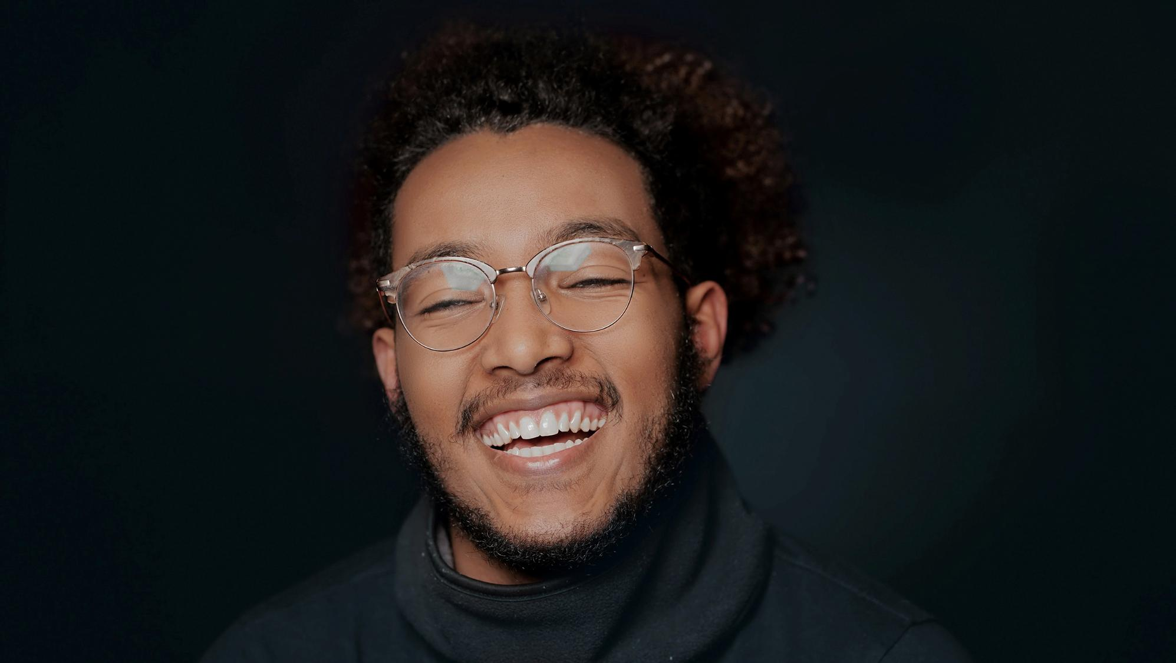
Phrase Guidelines
Find your confidence
Notes:
Time on slide: 0.5 minute
Elapsed time: 44 minutes
Facilitator Notes:
Phrase Guidelines for advertisements and marketing materials:
Use one phrase per piece - whether image, ad, or flyer. Ensure the phrase has good contrast against the background. Don't cover faces or compete with the image.
A full list of approved phrases is available in the Brand Manual for your reference, but you can add your own.

Slide 36
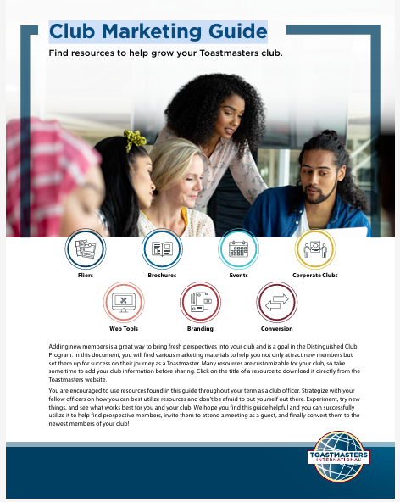

The Club Marketing Guide
Flyers
Brochures
Events
Corporate Clubs
Web Tools
Branding
Conversion
Notes:
Time on slide: 2 minutes
Elapsed time: 46 minutes
Facilitator Notes:
(Emphasize this as a time-saving toolkit that maintains brand standards while providing professional-quality materials ready for immediate use.)
Marketing Resource Guide: Your centralized online hub for every customizable tool you need. Email templates, slide decks, flyers, videos, and more, all in one convenient location. Access, download, and personalize these vetted resources to accelerate your public relations efforts and maintain a consistent, professional brand.
This essential resource will save you significant time and effort in your VPPR role. Using these professionally designed materials ensures consistency with the Toastmasters brand and prevents you from creating marketing materials from scratch.
Scan the QR code of the Marketing Resource Guide and explore its contents within your first week as VPPR. Everything you need is already created and ready to customize.

Slide 37
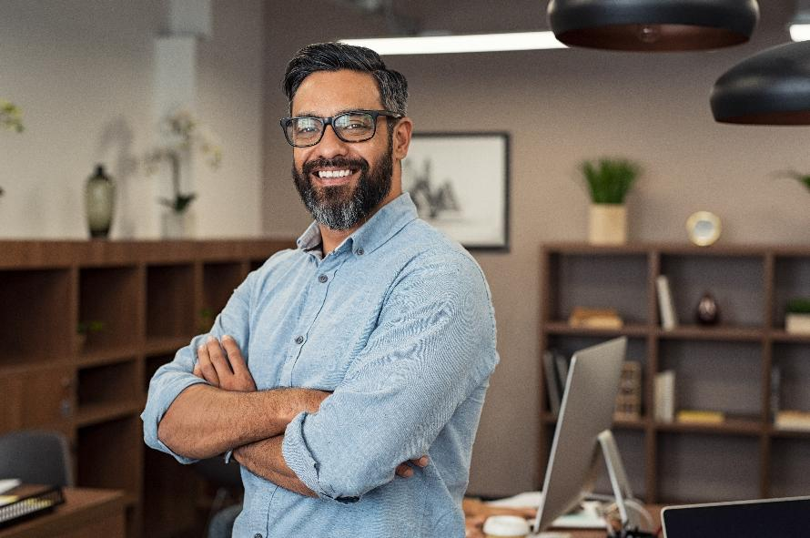
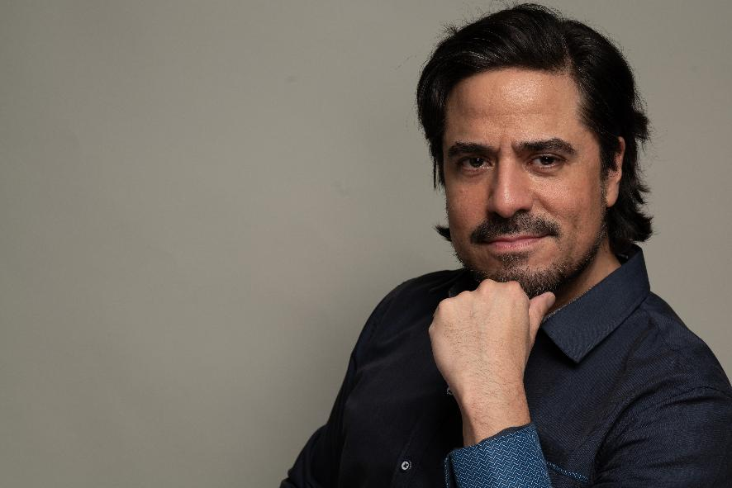

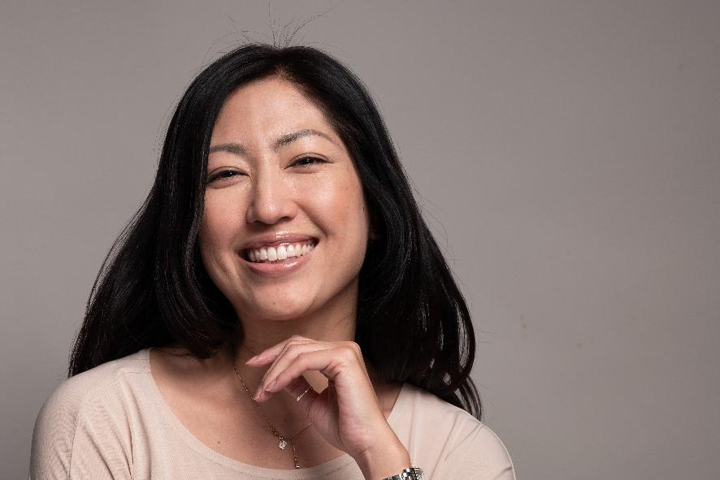
Photos/Images – How to save money?
Notes:
Time on slide: 4 minutes
Elapsed time: 50 minutes
Facilitator Notes:
(Emphasize the serious legal and financial risks of copyright violation. Use real examples if available. During questions, reinforce the importance of using only approved sources and checking licensing requirements.)
Photo usage is crucial for effective marketing, but legal compliance is essential to protect your club.
Approved photo sources:
Toastmasters approved photos found in the Brand Manual
Photo libraries: Unsplash, Pexels, Pixabay, Canva. There is also a small photo library on the Toastmasters International web site.
Critical warning: Using photos from internet searches can create serious legal problems for your club if you violate copyright laws.
The risks: Copyright holders can demand payment, sometimes thousands of dollars, for unauthorized use. Your club could face legal action, financial penalties, and damage to its reputation.
How copyright violation happens: You search Google Images, find a perfect photo, download it, and use it in your flyer. That photo belongs to a photographer or stock photo company. They find your usage and demand payment or take legal action.
Safe alternatives: Stick to royalty-free photo libraries like Unsplash, Pexels, and Pixabay where photographers have given permission for free use. Canva provides licensed photos as part of their service. Toastmasters approved photos in the Brand Manual are completely safe to use.
Best practice: Always check licensing before using any photo. When in doubt, don't use it. The few minutes saved aren't worth the potential legal costs.
Remember: Your club's reputation and finances depend on using legally compliant materials.
Questions (2 min): (Allow time for officers to ask about specific photo scenarios, copyright concerns, or clarification about approved sources.)

Slide 38
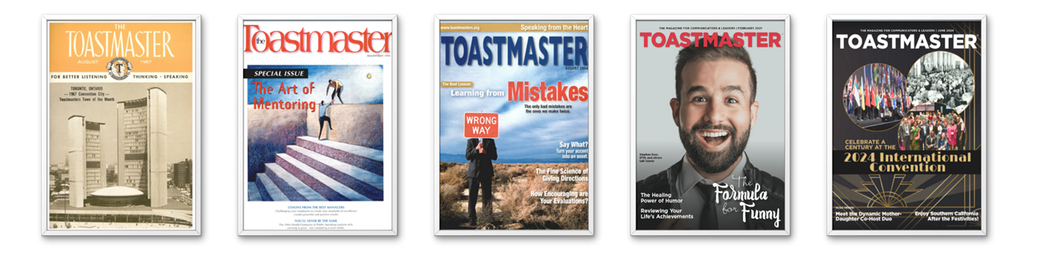
Toastmaster Magazine Articles to Share
Notes:
Time on slide: 2 minutes
Elapsed time: 52 minutes
Facilitator Notes:
(Emphasize that the Toastmaster Magazine articles provide professional, ready-made content that supports club promotion while maintaining brand consistency and credibility.)
Toastmaster Magazine provides excellent content for your public relations efforts. You're encouraged to share articles with members, friends, family, and colleagues using online article links or full PDF issues.
Use the "Share this article" icons at the bottom of each page to send by email or share on Facebook, Twitter, or LinkedIn. Articles are also posted on Toastmasters' social media channels monthly.
Club website posting is allowed with proper attribution: include the Toastmaster magazine name, month/year of the article, author's name, and a link back to the original article.
For full article reprints or translation questions, email the magazine at, magazine@toastmasters.org

Slide 39
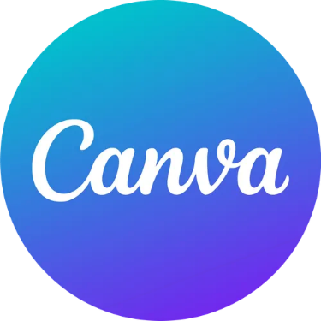



Free Software
Canva
Adobe Express (Design)
Adobe Firefly (Images)
Chat GPT Free version (Text and Social Media posts)
Notes:
Time on slide: 3 minutes
Elapsed time: 55 minutes
Facilitator Notes:
(Emphasize Canva as the primary design recommendation while acknowledging that digital-focused strategies work best with free tools. Suggest testing combinations to find what works for their specific club needs.)
There are many free software options available for creating marketing content, including Canva, Adobe Express, ChatGPT, Microsoft Copilot, and Google Gemini.
Canva stands out as the clear winner for Toastmasters clubs. The free tier provides exceptional value with 250,000+ free templates covering everything you need: social media posts, flyers, presentations, and event invitations. Most importantly, free designs export without watermarks, making them suitable for professional club communications.
Why Canva works for VPPR needs: Direct social media sharing to Facebook, Instagram, and LinkedIn. 5GB storage accommodates hundreds of saved designs. Easy drag-and-drop editing means no design experience required. You can create consistent-looking materials that maintain your club's professional image.
Canva limitations to consider: Free exports are limited to 96 DPI standard resolution, which may appear pixelated in printed materials. No Brand Kit features means you cannot upload custom logos or maintain consistent color schemes across all materials. However, for digital-first marketing strategies, these limitations rarely impact effectiveness. You can access a wide range of Canva templates for Toastmasters at https://ccdn.toastmasters.org/medias/files/brand-materials/canvatemplates.pdf
AI content creation tools: ChatGPT, Microsoft Copilot, and Google Gemini all offer free assistance for writing social media captions, event descriptions, and marketing copy, though with usage limitations during peak times.
Strategic recommendation: Pair Canva with one AI writing tool for a complete content creation workflow. Use AI to generate compelling copy, then use Canva for visual design. This combination covers both text and visual needs while staying within free tier limitations.
There are many free software options out there to help you produce Social Media and other advertisements, videos and leaflets. Many of them are gateways to paid version of the same software which offers greater capabilities, but the free versions are still very good. Learn to use only one or two programs to help you develop your design and copywriting skills. Canva, Adobe Express, Adobe Firefly, Chat GPT

Slide 40

Summary
Two audience types (Internal/External)
Channel update
Post regularly on Social Media
Notes:
Time on slide: 2.5 minutes
Elapsed time: 57.5 minutes
Facilitator Notes:
(Use “raised hands” to gauge current practices and identify areas needing attention. Keep shout-outs brief and energetic. Use their responses to reinforce the importance of audience-specific messaging and regular content updates.)
Let me remind you of the two types of audiences through quick interaction.
Show “raised hands”: Who remembers the two main audience types we discussed earlier?
Good! They are Internal and External audiences.
Quick shout-out: What are some internal audiences? (Take responses - acknowledge Club Members, Other Clubs, District Officers, Club Alumni)
Internal audiences include club members, other clubs, district officers, and club alumni.
Another shout-out: What about external audiences? Who are you trying to reach outside Toastmasters?
(Take responses - acknowledge Potential members, Local Community Organizations, Professionals, Retirees, Graduate Students, Self-help enthusiasts.)
Excellent! External audiences include potential members, local community organizations, professionals seeking development, retirees wanting to give back, graduate students, and self-help enthusiasts.
Raised hands/Show of hands: How many of you know all the communication channels your club currently uses? Keep them up.
Those with hands down - that's your first priority! You need to audit your existing channels before creating new ones.
Another show of hands: Who posts on social media at least twice per week?
For those without hands up, remember: regular posting matters. Social media algorithms favor consistent content creators, increasing your organic reach.
Key reminder: Each audience needs different messages and channels. Internal audiences want club updates and achievements. External audiences need Toastmasters benefits and solutions to their problems.
Your success depends on knowing your existing communication channels and maintaining consistent social media presence.

Slide 41

Next Steps
Audit existing PR channels
Maintain/add club images to club websites and club management systems
Acquire passwords from outgoing VPPR
Verify “Find a Club” information is up-to-date
Ensure compliance to GDPR and other country privacy laws
Plan and activate club PR campaign
Contribute to Club Success Plan
Notes:
Time on slide: 2 minutes
Elapsed time: 59.5 minutes
Facilitator Notes:
(Present these as a logical sequence of actions that builds from foundation (audit) to implementation (success planning). Emphasize collaboration with other officers throughout the process.)
Your next steps after this meeting are:
First, audit existing PR channels with the outgoing VPPR and update where necessary. Don't start from scratch - build on what already works.
Second, update your club website and club management software (like Easy-Speak) with images showing club members where possible to make your club listing more attractive and authentic.
Third, acquire passwords from the outgoing VPPR. Secure access to all social media accounts, email lists, and communication platforms.
Fourth, check “Find a Club” information on the Toastmasters website is current and amend if required with the VPM. This is how many potential members find you.
Fifth, ensure GDPR (General Data Protection Regulation) compliance or local data protection rules with the club Secretary. Data protection is legally required, not optional.
Sixth, plan and activate your club PR campaign using Toastmasters branding guidelines and the channels and strategies discussed today.
Finally, contribute to the club success plan with your committee colleagues. VPPR success supports overall club growth.
Key message: Don't try to do everything at once. Start with the audit and handover, then build systematically.

Slide 42
Build Momentum in Your Club—Act Now!
Thank you for serving as a club officer!
Notes:
Time on slide: 30 seconds
Elapsed time: 60 minutes
Facilitator Notes (30 seconds):
Thank you for stepping up to serve as the Vice President Public Relations of your club! Your role is vital to your club’s success. Enjoy promoting your club to increase its visibility to bring guests to your club!

