Slide 1
Facilitator Instructions (not for presentation)
Session: This presentation is the one-hour Club Sergeant at Arms breakout session for Round 1: New Year Club Officer Training. The order of presentations for the full Club Officer Training: Hall of Fame slides shown before the training starts, Round 1: New Year General Session Part 1 followed by the individual club officer breakout sessions and ending with Round 1: New Year General Session Part 2. The Round 1: New Year General Session Parts 1 and 2 are presented to all club officers.
Facilitator notes on each slide: These notes begin with the estimated time to present the individual slide and then the overall elapsed session time. It is essential that you review the facilitator notes on each slide and practice delivering the presentation to familiarize yourself with the material and stay on time. Facilitator notes should be used as a guide rather than a script that must be stated “word-for-word”. Parentheses denote instructions for facilitators – what facilitators should “do”.
Interaction: To interact in online training, ask participants to enter their responses in the chat. Ask the Chat Master to share a few of the responses. If the training is physically in-person, ask a few of the participants to share their responses verbally. For interaction in a hybrid training, do both.
Zoom/Chat Masters: For online training, it is critical to have sufficient District technical support to manage the training. To facilitate interaction, please assign a Zoom/Chat Master to each session.
Notes:
A duration of 4 hours is recommended for Club Officer Training, allowing for comprehensive review and discussion of topics, like the Club Success Plan, the Distinguished Club Program, and leadership development. The full Club Officer Training is composed of three 1-hour sessions, but we recommend breaks between each session. This leaves approximately 30 to 45 minutes for another session or keynote presentation focused on the needs of the clubs in your District.

Slide 2
Sergeant at Arms (SAA)
Club Officer Training (COT)
Round 1: New Year Training
Notes:
Time on slide: 2 minutes
Elapsed time: 2 minutes
Facilitator Notes:
Welcome to the Sergeant at Arms training! Today, we will highlight the often-unsung hero of every Toastmasters meeting—YOU, the Sergeant at Arms.
(To begin the session, ask attendees why they are serving as their club’s Sergeant at Arms. For online training, ask the SAAs to enter their answers into the Zoom chat and read a few of their responses. For in-person training, ask a few SAAs to answer in ONE SENTENCE.)
Club officers dedicate valuable time and provide a tremendous service to Toastmasters. Let’s discuss the importance of your role as the club’s Sergeant at Arms.

Slide 3

Why SAA?
Club Success Cycle
Transferable Skills
Sergeant at Arms Responsibilities
Best Practices
Q&A
Next Steps
Notes:
Time on slide: 2 minutes
Elapsed time: 4 minutes
Facilitator Notes:
(Outline the high-level agenda and items to be covered in the session.)
Why is the SAA role important?
Club Success Cycle
Transferable Skills
Sergeant at Arms Responsibilities
Best Practices
Q&A
Next Steps

Slide 4
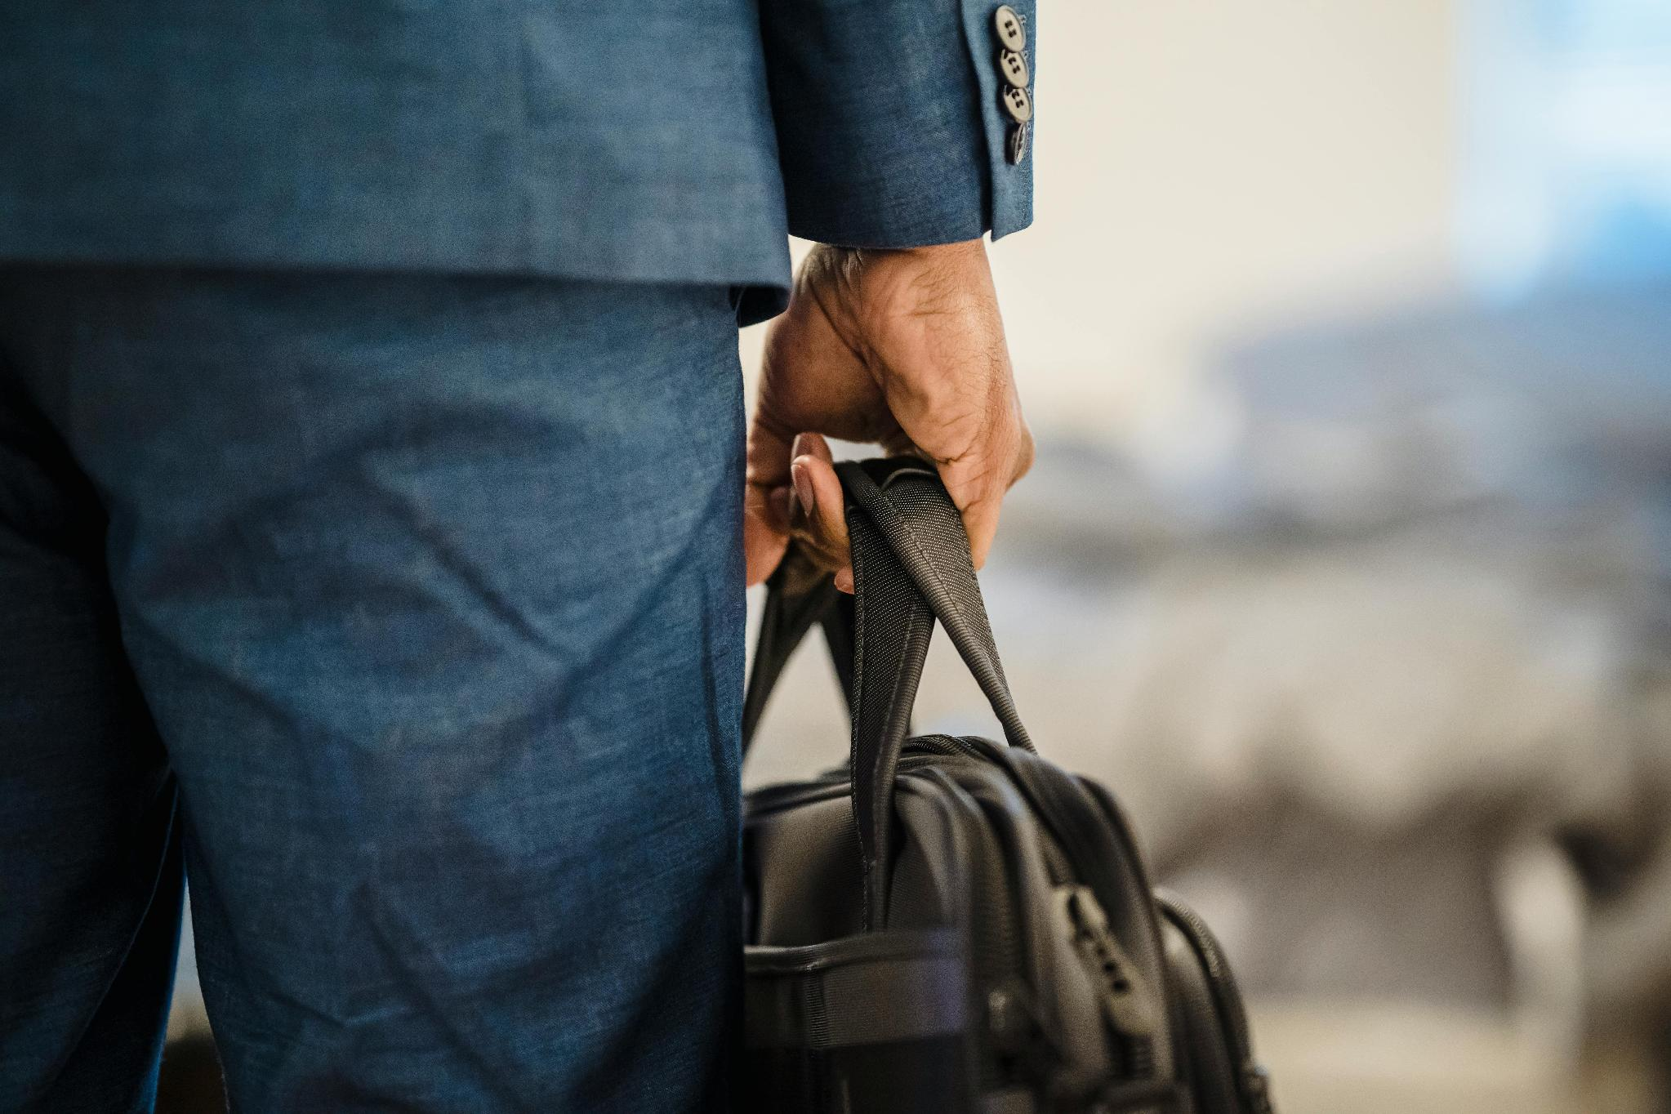
Why is the Sergeant at Arms role important?
Sets the tone of the meeting
Foundation for a professional experience
Creates a welcoming environment
Keeps meetings on track
Embodies the Toastmasters brand
Notes:
Time on slide: 2 minutes
Elapsed time: 6 minutes
Facilitator Notes:
(Ask) Why is the Sergeant at Arms role important to every club? (Then show and discuss the answers.)
While the role may seem behind-the-scenes, its impact is front and center. The Sergeant at Arms is responsible for setting the tone of the meeting—literally and figuratively. From arranging the room and setting up equipment to welcoming guests and ensuring the meeting starts on time, this role is the foundation of a smooth, professional club meeting experience.
This role teaches discipline, organization, and leadership through service. It’s about creating a welcoming environment where members feel comfortable to speak and grow. A well-prepared room signals respect for everyone’s time and effort. And when things go wrong—like a missing mic or a late start—the Sergeant at Arms is the calm problem-solver who keeps things on track.
Being a Sergeant at Arms is more than logistics—it’s about leadership through action. It’s the first step for many into club leadership, and it builds the confidence and reliability that Toastmasters is all about. So, let’s learn more about the ones who make our meetings possible—our Sergeants at Arms. You!
The Sergeant at Arms is responsible for club property management, meeting room preparation, and hospitality. Everything you do as Sergeant at Arms should support the club mission.

Slide 5
Club Success Cycle – Sergeant at Arms (SAA)
Guest Interest
Leadership
Research
VPPR
Sergeant at Arms
VPM
VPE
President
Secretary
Treasurer
Advocate – All Members
Engage-ment
Meeting
Advocate
Pathways
Member-ship
Mentoring
Orientation
Notes:
Time on slide: 2 minutes
Elapsed time: 8 minutes
Facilitator Notes:
(Ask) Where does the Sergeant at Arms fit into the Club Success Cycle that we viewed at the end of General Session Part 1? (Then see the answers on the next slide.)

Slide 6
Club Success Cycle – SAA
Guest Interest
Leadership
Research
Creates a welcoming meeting environment
Greets guests
Provides sign-in
Prepares materials for induction ceremonies
Sets up recognition events
Engage-ment
Meeting
Advocate
Pathways
Member-ship
Mentoring
Orientation
Notes:
Time on slide: 2 minutes
Elapsed time: 10 minutes
Facilitator Notes:
Several steps in the Club Success Cycle are touched by the SAA.
During the Guest Interest (Attracting Guests) phase of the Club Success Cycle, the SAA:
Supports by setting up a welcoming, professional meeting environment in-person or online.
Ensures signage, seating, and materials are ready—helping make a strong first impression.
During the Meeting phase, the SAA:
Welcomes and greets guests at the door or online, introduces them to members, and helps them feel comfortable.
Provides name tags, agendas, and answers basic questions.
During the Membership (Converting Guests to Members) phase, the SAA:
Assists the VPM by ensuring guests have access to membership forms and materials.
Helps create a smooth, organized experience that encourages guests to return.
During the Orientation (Onboarding New Members) phase, the SAA:
Prepares materials for induction ceremonies.
Ensures the meeting space is ready for the new member’s first official meeting.
During the Engagement (Engaging and Retaining Members & Celebrating Achievements) phase, the SAA:
Maintains a consistent, professional meeting setup that supports member participation.
Helps foster a positive, respectful club culture through meeting readiness and hospitality.
Sets up awards and recognition materials for ceremonies.
Helps create a celebratory atmosphere that motivates continued member engagement.

Slide 7

Transferable Skills
IT skills
Problem solving
Organization
Inventory control
Record maintenance
Meeting management
Hospitality
Notes:
Time on slide: 2 minutes
Elapsed time: 12 minutes
Facilitator Notes:
(Ask the club officers what transferrable skills they will gain serving as Sergeant at Arms. Then Click show the bullet points)
Each skill developed as a Toastmasters Sergeant at Arms is transferable to professional and personal settings:
IT Skills: Setting up projectors, microphones, and virtual meeting tools builds technical proficiency—valuable in any modern workplace where tech-savviness is essential.
Problem Solving: Handling last-minute issues like missing materials or tech failures sharpens your ability to think quickly and stay calm under pressure—skills crucial in any job.
Organization: Managing meeting logistics and timing teaches planning and prioritization, which are key to managing projects, events, or daily tasks efficiently.
Inventory Control: Keeping track of club supplies mirrors inventory management in business, retail, or administrative roles, where resource tracking is vital.
Record Maintenance: Maintaining attendance logs or setup checklists builds attention to detail and documentation habits—important for compliance, reporting, and accountability.
Meeting Management: Ensuring meetings start on time and run smoothly translates directly to leading or supporting professional meetings with confidence and structure.
Hospitality: Welcoming guests and creating a positive environment enhances interpersonal skills and customer service—valuable in any role involving people.

Slide 8

Sergeant at Arms
Responsibilities
Notes:
Time on slide: 2 minutes
Elapsed time: 14 minutes
Facilitator Notes:
The Sergeant at Arms maintains all club materials and equipment between meetings, arranges the room and equipment for the meeting, welcomes all guests and members to the meeting, and, in some clubs, collects and tallies votes for Best Speaker, Best Evaluator, etc.
Let’s break down the SAA responsibilities into the four core buckets.
Meeting Quality
Club Success
Guest Hospitality
Member Relations

Slide 9

Meeting Quality
Favorable Impression
When a guest walks into a meeting, their first impression counts.
Notes:
Time on slide: 2 minutes
Elapsed time: 16 minutes
Facilitator Notes:
Meeting quality is the first bucket of responsibility.
Every club should strive to make a favorable impression upon everyone each time it meets. Any physical club meeting location should be pleasant, comfortable, neat, and clean. The room should be set up in a professional manner before members arrive, with agendas at each place. A table should be set up to display a guest book, brochures, membership applications, and newsletters that members may find of interest. The club banner should be displayed at the front of the room.
All of these demonstrate pride in the club and create a good impression for each person who enters the room.
(Ask for a few concise responses – 15 to 20 seconds each – to the following question.)
What are some things your club does to create a favorable impression?

Slide 10

Meeting Quality
Greet Members and Guests
Present the club as a safe & friendly environment.
Notes:
Time on slide: 2 minutes
Elapsed time: 18 minutes
Facilitator Notes:
Greeting members and guests
First opportunity to welcome guests to club by signing guestbook and seating them with members who can answer questions
Present club as safe & friendly environment – perfect place to develop skills

Slide 11
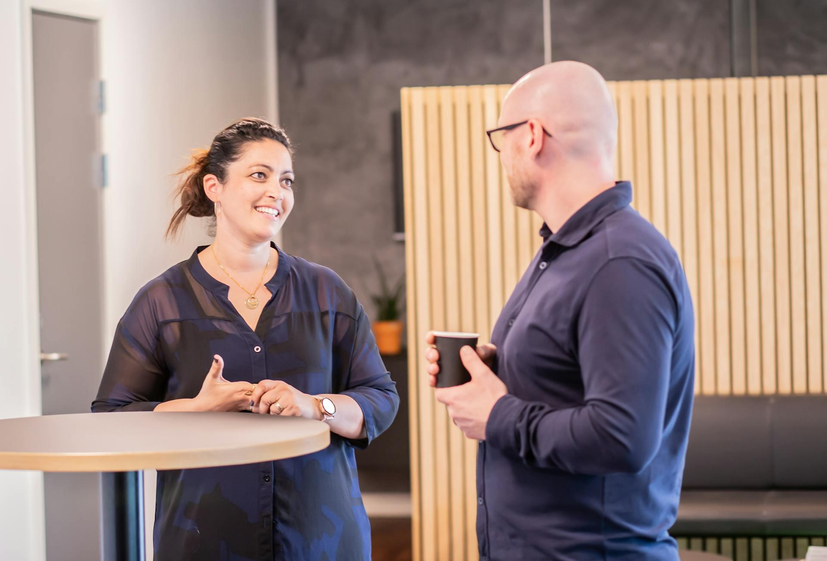
Club Success
Club Liaison
Secure, maintain, and manage your meeting space.
Notes:
Time on slide: 2 minutes
Elapsed time: 20 minutes
Facilitator Notes:
Club success is the second bucket of responsibility.
As Sergeant at Arms, you are in charge of the meeting place itself, obtaining a new space when necessary, and maintaining contact with the people who allow you to use it for your club’s meetings.
You are the club’s liaison to the meeting venue:
Liaise w/Management of your club meeting place ensure that messages from the management are communicated to the necessary parties
Be sure to provide appropriate accommodations for people with disabilities
Confirm meeting room reservations a few days before the meeting and act as a liaison between the club and the meeting room management.
You are responsible for making sure that the meeting space is available when your club needs it and for making the necessary arrangements if it isn’t.

Slide 12
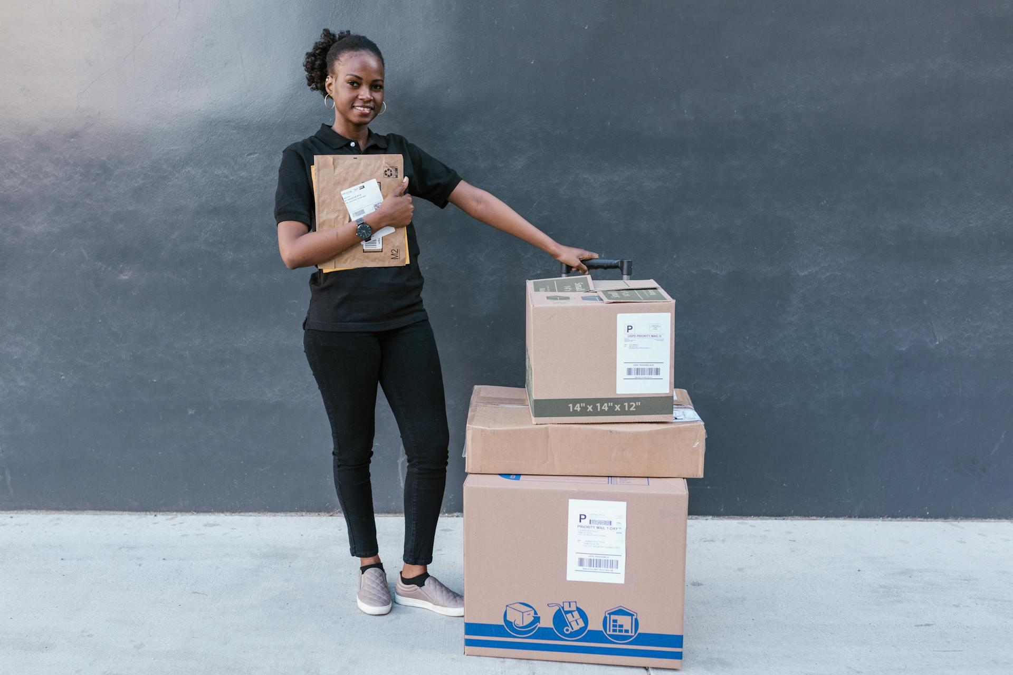

Club Success
Supplies & Property
Keep track of physical property and manage supply levels.
Notes:
Time on slide: 2 minutes
Elapsed time: 22 minutes
Facilitator Notes:
The Sergeant at Arms maintains all club materials and equipment between meetings and arranges the room and equipment for the meeting. You also keep track of the club’s physical property, such as the banner, lectern, timing device, and other meeting materials. Check to see that plenty of supplies are on hand, such as Ballots and Brief Evaluations, name badges, Guest Packets, Member Welcome Kits, pens and paper, etc.
Order new supplies when they are needed, like award ribbons, ballots, and evaluation forms.

Slide 13
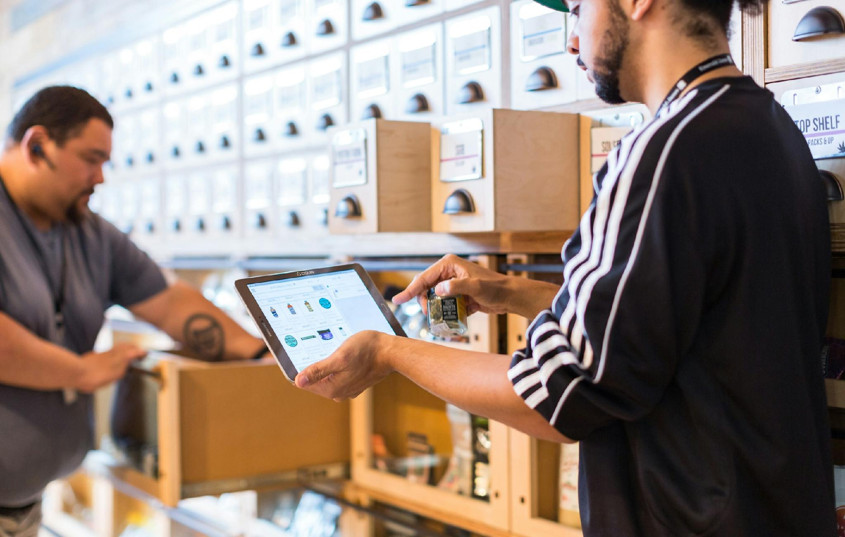
Club Success
Meeting Logistics
Be adaptable – meetings can be in-person, online, or hybrid!
Notes:
Time on slide: 5 minutes
Elapsed time: 27 minutes
Facilitator Notes:
(Ask) How many of you are the SAA for a physically in-person club?
How many of you are the SAA for an online club?
How many of you are the SAA for a hybrid club?
(Ask the SAAs with physically in-person clubs the following question. Then make sure that all the points below are covered.) What are the responsibilities of a Sergeant at Arms for club meetings that are held in-person at a physical location?
Upon Arrival at the Meeting
Arrange the meeting room and equipment at least 30 minutes before the meeting begins, arranging tables and chairs appropriately, so the meeting can start on time.
Set out the lectern, gavel, club banner, national flag (optional), timing lights and/or cards, ballots, trophies, ribbons, buttons, and club charter certificate.
Place a table near the door to display promotional brochures, name tags, guest book, and educational materials such as manuals, club newsletters, etc., for members to see.
Check room temperature and adjust the thermostat if the room is too hot or too cold.
Greet all guests and members as they arrive and help them feel welcome.
Arrange for new members and guests to sit with experienced members who can answer any questions they may have during the meeting.
Ask all guests to sign the Guest Book (Item 84) and give each a name tag to wear.
During the Meeting
Sit near the door to welcome late arrivals and help them be seated, prevent interruptions, and perform any necessary errands.
Arrange for food service, if any. (1) Collect payment for food service if applicable from members during a break or before the meeting. (2) If coffee, tea, or water is available during the meeting, serve it to those in attendance to avoid having members moving around while someone is speaking.
Collect ballots and tally votes for Best Speaker, Best Evaluator, etc. if you do not have a Vote Counter meeting role, if the club has such awards. Give the results to the Toastmaster or personally announce them when called upon for the results.
After the Meeting
Return the room to its original configuration.
Take inventory of club supplies to prepare for the next meeting.
Pack up all club materials and store them in a safe place.
Dispose of any stray items or trash

Slide 14

Club Success
Online & Hybrid Meetings
Know your technology to avoid last-minute mishaps and meltdowns.
Notes:
Time on slide: 5 minutes
Elapsed time: 32 minutes
Facilitator Notes:
(Ask the SAAs with online and hybrid clubs the following question. Then make sure that all the points below are covered.) What are the responsibilities of a Sergeant at Arms for club meetings that are held online or in a hybrid environment?
In the online and/or hybrid environment, the Sergeant at Arms can act as the moderator for the meetings. This will allow them to set the expectations at the beginning of the meetings to ensure they are conducted with the professional atmosphere of a Toastmasters club meeting. The Toastmasters International website offers lots of resources, tips, and supplies available for purchase for online and hybrid meetings.
Before the meeting
Arrive early to get things hooked up and tested.
Make sure the projector, microphone, and speakers are working.
Have all the right connections and cables with you. Never assume the venue where you are speaking will have what you need.
Bring extras; have adapters and extensions.
If using a laptop, make sure you have power. It’s always best to have access to a power source with battery as your backup.
Provide virtual backgrounds such as the Timer backgrounds
Practice and Preparation
Before you start your meetings, it’s a good idea to prepare for the meeting. You might find holding practice meetings beneficial as well.
Before a meeting starts, club officers should:
• Test technology and ensure it is working as intended
• Allow virtual attendees to join early to test their equipment
• Have any documents, including agendas, open and ready to share
• Be ready to help members troubleshoot technology issues
• Find a solution to collect guests’ contact information
Meeting Location
Your meeting location should:
• Be an appropriate size to accommodate all in-person members and guests
• Allow for access to a strong internet connection
• Fit any technology needed to integrate online participation
Technology Requirements
To run effective meetings, your club will need:
• An online meeting platform that allows for online participation (i.e., Zoom, Microsoft Teams, and Google Hangout)
• Webcam(s) – ensure online participants can view the speaker’s area. If possible, multiple webcams can be used to also share the rest of the meeting space with virtual attendants
• Microphone – determine what type of microphone will be used and whether that microphone will remain in the speaker’s area or be passed along by members and guests
• Speakers – have speakers and computers positioned to avoid microphone feedback
• Projector/screen/television – find a strategic way to show online participants in the meeting space
• Phone/tablet/laptop – a device will be needed for a club officer or member to monitor chat and provide support to remote members

Slide 15

Guest
Hospitality
Notes:
Time on slide: 2 minutes
Elapsed time: 38 minutes
Facilitator Notes:
(Ask the club officers what the responsibility of “Guest Hospitality” includes. Then show the next slide with the answers.)

Slide 16

Guest Hospitality
Welcome guests
Provide information packets
Introduce guests to the club
Seat them next to an experienced member
Invite them to actively participate
Notes:
Time on slide: 2 minutes
Elapsed time: 40 minutes
Facilitator Notes:
As we’ve mentioned, the Sergeant at Arms welcomes all guests and members to the meeting. Welcoming guests and creating a positive environment enhances their club visit experience. Guests (and members) are likely to respond most favorably to club experiences that offer personal value, enjoyment and absorbing connections. Reach out to them prior to the meeting to determine any special needs.
Many clubs, have a welcome table with a guestbook to be signed. Guest packet contents vary, but many include a membership application form (which has been translated into many different languages), the Toastmaster magazine, information explaining the organization and, sometimes, details on the Pathways Structured Education program. Consider giving guests a choice between a hard copy and an email version of the packet.
Many clubs also give the guest a choice of whether to participate in Table Topics. Let the guests decide whether to participate in Table Topics or talk about themselves.

Slide 17

Collecting Guest Information
Notes:
Time on slide: 4 minutes
Elapsed time: 44 minutes
Facilitator Notes:
(ASK) Why is guest Information collected? (Allow a few responses, then share answers.)
Follow-Up Communication - To share meeting details, thank guests for attending, and invite them back—helping convert guests into members.
Support Membership Growth - The information is passed to the Vice President Membership (VPM), who uses it to track interest and manage the onboarding process.
Event Planning & Hospitality - Knowing how many guests attended helps the club plan for future meetings—seating, materials, and refreshments.
Club Reporting & Recognition - Guest attendance can be used in reports and evaluations, helping the club track engagement and growth trends.
Creating a Welcoming Experience - Personalized greetings and follow-ups show professionalism and care, making guests feel valued and more likely to return.

Slide 18

Data Protection & GDPR
Notes:
Time on slide: 2 minutes
Elapsed time: 46 minutes
Facilitator Notes:
Toastmasters International adheres to GDPR (General Data Protection Regulation) by implementing several key practices to protect the personal data of members and guests, especially those residing in the European Economic Area (EEA).
Consent and Transparency
Members and guests are informed about how their data is used and must give explicit consent for communications and data processing.
Privacy and consent settings can be managed through individual profiles on the Toastmasters website.
Data Access and Control
Individuals can opt out of marketing communications and request to delete their accounts permanently.
Clubs are encouraged to provide privacy notices to all members and guests, explaining how their data is handled.
Data Minimization and Purpose Limitation
Only necessary personal data is collected (e.g., name, email, attendance), and it is used strictly for club operations and communication.
Club-Level Responsibility
Clubs are encouraged to appoint a GDPR contact person (often the VP Membership or Secretary) to manage compliance and distribute privacy notices
Secure Data Handling
Data is stored securely, and meeting management platforms like Pathways and Easy Speak are designed to be GDPR-compliant
***More information can be found on the Toastmasters International website under FAQs > Technical section (https://www.toastmasters.org/footer/faq/GDPR)

Slide 19

Member Relations
Notes:
Time on slide: 2 minutes
Elapsed time: 34 minutes
Facilitator Notes:
Member relations is the third bucket of responsibility. Your duties extend beyond the tasks of a Sergeant at Arms
Assist your fellow officers with the success of the club by:
Building relationships with members
Take time to find out club members motivations for joining and their goals both personal and professional
Help foster a positive, respectful club culture through meeting readiness and hospitality.

Slide 20

Member Relations
Celebrate Successes
Show your pride in member achievements and celebrate their learning journey.
Notes:
Time on slide: 2 minutes
Elapsed time: 36 minutes
Facilitator Notes:
Celebrate successes! Share how proud you are of their dedication and perseverance
Think about how good it feels when you accomplish a goal
Now think about how good it feels when someone recognizes your achievement and congratulates you – share that feeling with fellow members
Set up awards and recognition materials for ceremonies. Don’t forget that you set the tone for the club meetings! Helps create a celebratory atmosphere that motivates continued member engagement.
Remember, strong, healthy relationships result in a strong, healthy club

Slide 21

Best Practices
Notes:
Time on slide: 2 minutes
Elapsed time: 48 minutes
Facilitator Notes:
Never underestimate the role of SAA. Setting the tone for the club meeting, preparing the room, greeting members and recruiting volunteers demonstrates competent leadership skills. Be sure to work closely with the Executive Committee to achieve Distinguished Club status. You are a key member of the team!
(Ask) What are some of the best practices of your club’s previous Sergeant at Arms?

Slide 22

Best Practices
Arrive early and be prepared
Create a professional and welcoming environment
Manage equipment and supplies
Adapt and stay calm under pressure
Notes:
Time on slide: 2 minutes
Elapsed time: 50 minutes
Facilitator Notes:
Arrive Early and Be Prepared: Ensure the meeting space is set up with all necessary materials (agenda, lectern, timer, flags, etc.) before members arrive.
Maintain a Professional and Welcoming Environment: Greet guests warmly, assist with sign-ins, and help create a positive first impression of the club.
Manage Equipment and Supplies: Keep track of club inventory (e.g., gavel, banner, ballots) and ensure tech (microphones, projectors) is functional.
Adaptable and Calm Under Pressure: Handle unexpected issues (e.g., room changes, tech failures) quickly and calmly to keep meetings running smoothly.

Slide 23
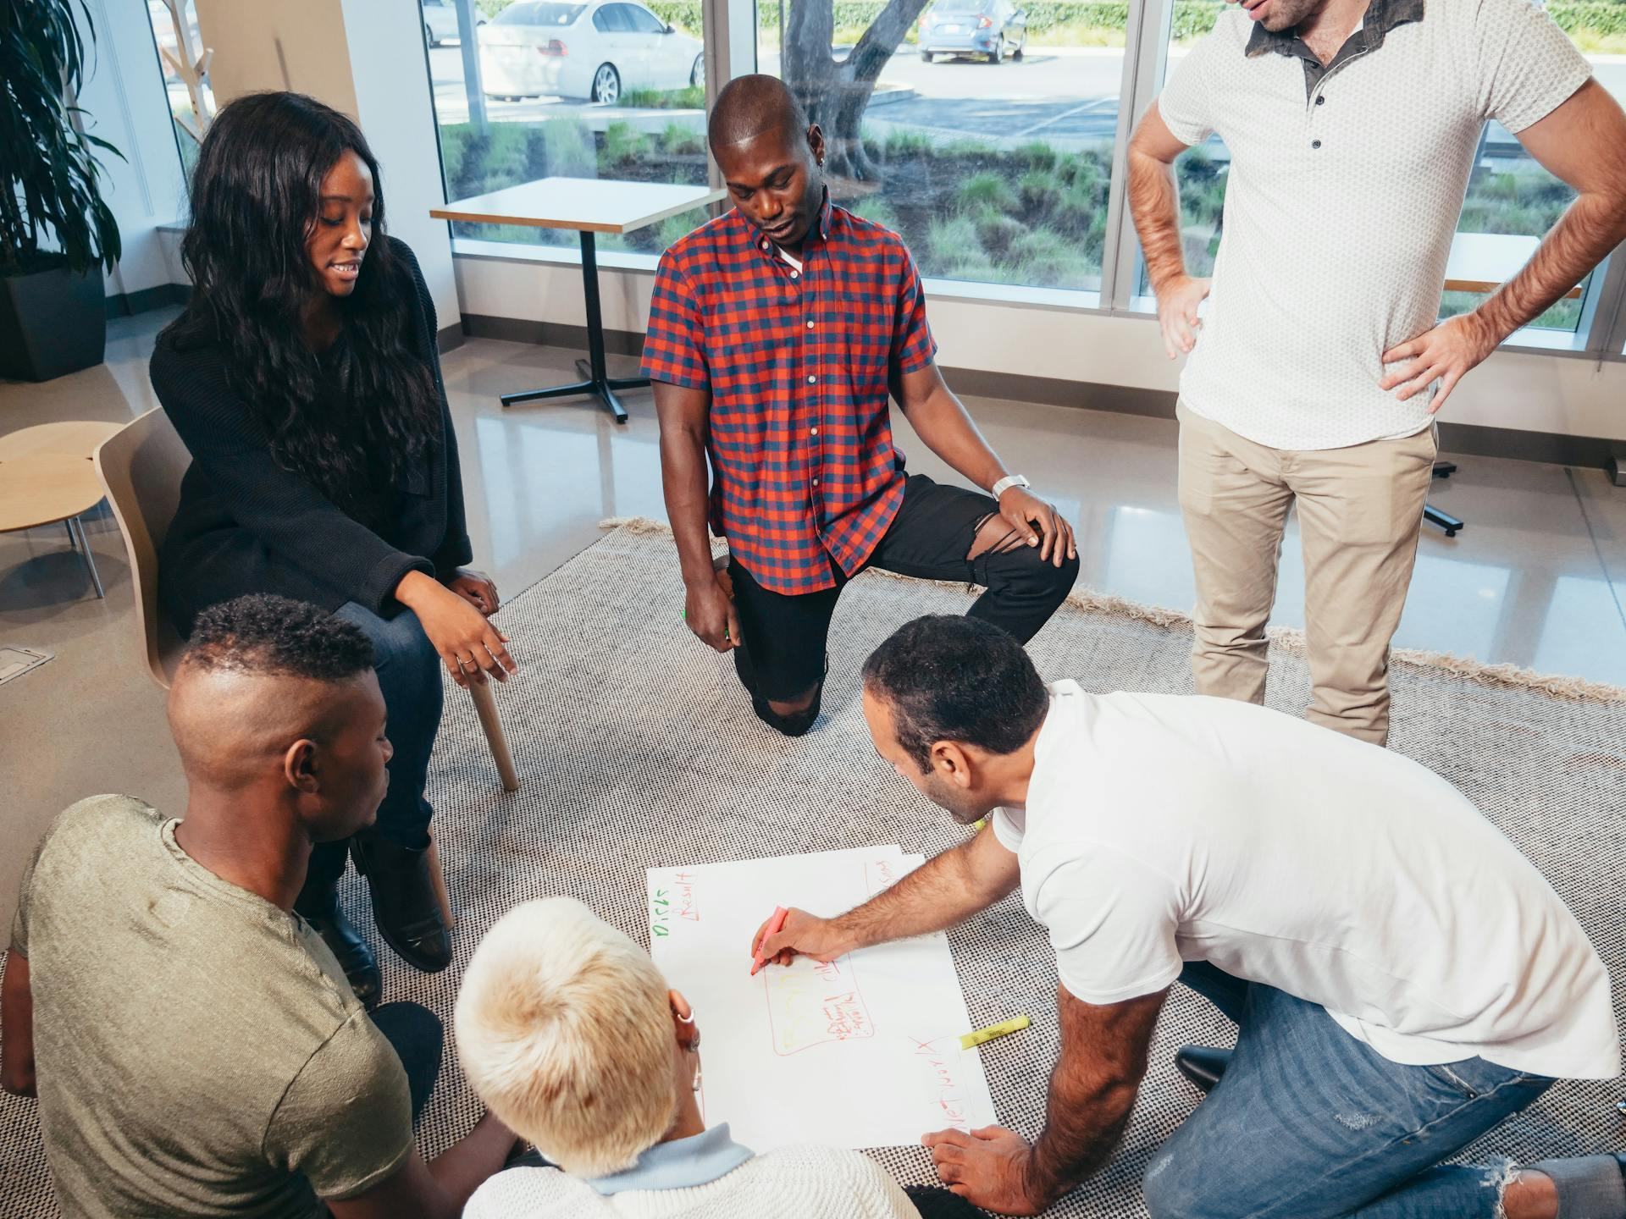
Important
Engage and
coordinate
with other
club officers
Notes:
Time on slide: 3 minutes
Elapsed time: 53 minutes
Facilitator Notes:
(Review how the SAA collaborates with all the other officers.)
The Sergeant at Arms (SAA) plays a supportive but essential role, collaborating with several key officers to ensure a smooth and welcoming experience for both guests and members.
Vice President Public Relations (VPPR): You support promotional events by setting up venues, managing signage, and ensuring the club looks organized and inviting to visitors.
Vice President Membership (VPM): You are the primary collaborator during guest visits and onboarding. The SAA helps set up the room, greet guests, and ensure they feel welcome—creating a positive first impression that supports the VPM’s recruitment efforts.
Vice President Education (VPE): You coordinate with the VPE to ensure the meeting environment supports the agenda (e.g., room layout, materials, tech setup). And you help ensure speakers and evaluators have what they need to succeed.
President: You work with the President to maintain a professional and orderly atmosphere, reinforcing club standards and values. You may assist in special ceremonies like inductions or awards.
Treasurer & Secretary: Occasionally, you may assist with materials distribution (e.g., membership forms, agendas) and record-keeping logistics during meetings.

Slide 24

Questions &
Answers
Notes:
Time on slide: 3 minutes
Elapsed time: 56 minutes
Facilitator Notes:
(Ask the SAAs if they have any questions about their role and responsibilities.)

Slide 25

Next Steps
Attend District-sponsored club officer training program
Meet with outgoing and incoming club officers
Schedule your club meetings
Ask for volunteers to assist you
Introduce yourself to meeting space contacts (if applicable)
Request online administrator rights, if meetings are online
Read Club Leadership Handbook, DCP and CSP
Contribute to the CSP
Notes:
Time on slide: 3 minutes
Elapsed time: 59 minutes
Facilitator Notes:
Never underestimate the role of SAA. Setting the tone for the club meeting, preparing the room, greeting members and recruiting volunteers demonstrates competent leadership skills. Be sure to work closely with the Executive Committee to achieve Distinguished Club status. You are a key member of the team!
After this training, what action steps will you take? (Let participants share their ideas and then show the list of next steps.)
Attend District-sponsored club officer training program. You can check this one off your list because you are doing this right now!
Meet with the outgoing Sergeant at Arms to transfer any necessary files or information.
Meet with the outgoing Executive Committee to transfer any necessary information.
Meet with the current Executive Committee and develop the Club Success Plan and budget.
Schedule your club meetings.
Ask for volunteers to assist you, especially if time is limited.
Contact the people responsible for the meeting place and introduce yourself.
Request online administrator rights, if meetings are online.
Read the Club Leadership Handbook (Item 1310) and Distinguished Club Program and Club Success Plan (Item 1111).
Contribute to the CSP (Club Success Plan).

Slide 26
Build Momentum in Your Club ̶ Act Now!
Thank you for serving as a club officer!
Notes:
Time on slide: 1 minute
Elapsed time: 60 minutes̶
Facilitator Notes:
(Encourage the Sergeant at Arms club officers to take action today to schedule the full year of club meetings.)

