Slide 1
Facilitator Instructions (not for presentation)
Session: This presentation is the one-hour Club Treasurer breakout session for Round 1: New Year Club Officer Training. The order of presentations for the full Club Officer Training: Hall of Fame slides shown before the training starts, Round 1: New Year General Session Part 1 followed by the individual club officer breakout sessions, ending with Round 1: New Year General Session Part 2 . Round 1: New Year General Session Parts 1 and 2 are presented to all club officers.
Facilitator notes on each slide: These notes begin with the estimated time to present the individual slide and then the overall elapsed session time. It is essential that you review the facilitator notes on each slide and practice delivering the presentation to familiarize yourself with the material to stay on time. Facilitator notes should be used as a guide rather than a script that must be stated “word-for-word”. Parentheses denote instructions for facilitators – what facilitators should “do”.
Interaction: To interact in online training, ask participants to enter their responses in the chat. Ask the Chat Master to share a few of the responses. If the training is physically in-person, ask a few of the participants to share their responses verbally. For interaction in a hybrid training, do both.
Zoom/Chat Masters: For online training, it is critical to have sufficient District technical support to manage the training. To facilitate interaction, please assign a Zoom/Chat Master to each session.
Notes:
A duration of 4 hours is recommended for Club Officer Training, allowing for comprehensive review and discussion of topics, like the Club Success Plan, the Distinguished Club Program, and leadership development. The full Club Officer Training is composed of three 1-hour sessions, but we recommend breaks between each session. This leaves approximately 30 to 45 minutes for another session or keynote presentation focused on the needs of the clubs in your District.

Slide 2
Treasurer
Club Officer Training (COT)
Round 1: New Year Training
Notes:
Time on slide: 2 minutes
Elapsed time: 2 minutes
Facilitator Notes:
Welcome to the Treasurer training!
(To begin the session, briefly ask the club officers why they are serving as Treasurer.)

Slide 3

Why?
Club Success Cycle
Transferable Skills
Responsibilities
Creating a Club Budget
Best Practices
Club Finances Timeline
Next Steps
Notes:
Time on slide: 1 minute
Elapsed time: 3 minutes
Facilitator Notes:
(Outline the agenda as listed below. Explain that the session describes the role and responsibilities of the Treasurer and also includes some “how to’s” and best practices.)
Why are Club Finances Important
Club Success Cycle
Transferable Skills
Responsibilities
Creating a Club Budget
Best Practices
Club Finances Timeline
Next Steps

Slide 4

Why are
Club Finances important?
Notes:
Time on slide: 2 minutes
Elapsed time: 5 minutes
Facilitator Notes:
(Ask the question to the club treasurers. If the training is delivered online, ask participants to enter their responses in the chat feature. If the training is physically in-person, ask for three to five concise responses – a phrase or a single sentence. The picture which should emerge from their contributions is that finance is important to a club’s operations.)

Slide 5
Club Success Cycle
Guest Interest
Leadership
Research
VPPR
Sergeant at Arms
VPM
VPE
President
Secretary
Treasurer
Advocate – All Members
Engage-ment
Meeting
Advocate
Pathways
Member-ship
Mentoring
Orientation
Notes:
Time on slide: 2 minutes
Elapsed time: 9 minutes
Facilitator Notes:
(Refer to the Club Success Cycle all attendees saw in session 1 and ask where they think the Treasurer role fits into the Club Success Cycle.)

Slide 6
Club Success Cycle – Treasurer
Prepare club budget, pay club expenses, and order supplies, which fits into the Meeting phase
Support the VPM by collecting new member fees and renewing members by 30th September and 31st March
Advocate for the club by inviting guests
Volunteer to be part of the “Meet and
Greet Team”
Meeting
Advocate
Membership
Notes:
Time on slide: 1 minute
Elapsed time: 10 minutes
Facilitator Notes:
Meeting and Membership: The Treasurer’s role in the Club Success Cycle begins when a new member joins. The Treasurer collects the membership fees. By 30th September and 31st March, the Treasurer processes on-time semi-annual membership renewals. By budgeting for club meeting venue or online costs, club supplies, recognition awards, and other expenses, the Treasurer also has an impact on meeting quality and potentially on all other stages of the cycle as well.
Advocate: The Club Treasurer is an advocate for the club, like other club members. The Treasurer should invite guests and volunteer to be a part of the “Meet and Greet Team”.

Slide 7

Transferable Skills
Accounting and reporting
Non-profit governance
Critical thinking
Financial planning
Notes:
Time on slide: 2 minutes
Elapsed time: 7 minutes
Facilitator Notes:
(Ask club treasurers what transferable skills they expect to learn as the Club Treasurer. Then click to review each of the transferable skills on the slide. Underscore that these are highly transferable to corporate environments or even to becoming an entrepreneur. This is because competencies around managing budgets and finances are sought after, especially if the Treasurer ensures that finances at the end of the year are left in a better place than they found them.)
Accounting and reporting – Creating an annual club budget and regularly reporting on how actual revenues and expenses are tracking against the budget.
Non-profit governance – Strict rules set by Toastmasters International and potentially by local legislation, must be followed as a club leader but especially as the Club Treasurer due to fiduciary responsibilities.
Critical thinking – Especially needed if difficult decisions need to be made to balance the budget.
Financial planning – Linked with budgeting and extends beyond a single term of the Treasurer. Financial planning is a long-term view of the club’s finances.

Slide 8

Treasurer
Responsibilities
Notes:
Time on slide: 2 minutes
Elapsed time: 12 minutes
Facilitator Notes:
(Ask club treasurers about the main responsibilities of their role. Then in the following slides those responsibilities will be shown and discussed.)
What are the main responsibilities of the Club Treasurer role?

Slide 9

Club Finance Terms & Definitions
Membership Periods – 1st April to 30th September and 1st October to 31st March
October and April Renewals – Members renewing for the next membership period
TI Dues – $10 per month per member paid to Toastmasters International
Club Dues – Money collected by the club to cover its own expenses other than TI dues
New Member Fee – $25 one-time fee for joining Toastmasters International
Toastmasters
Fees
Notes:
Time on slide: 2 minutes
Elapsed time: 14 minutes
Facilitator Notes:
(Explain the definitions on the slide and ask if there are any questions on these.)
Toastmasters International (TI) can only collect TI dues from clubs. TI does not have the capability to collect separate local club dues and give these back to the clubs.
(Highlight that not all clubs need to charge Club Dues and then move to the next slide.)

Slide 10

Community versus Corporate/Organizational Clubs
Community Clubs – Toastmasters clubs with no affiliations or restricted membership
Corporate/Organizational Clubs – Clubs affiliated with a corporation, government agency, association, university, or other organization
Notes:
Time on slide: 1 minute
Elapsed time: 15 minutes
Facilitator Notes:
(Ask the club treasurers which are members of community clubs and which are affiliated with organizational clubs, like corporate, government, association, university clubs.)
Are you a member of a community club or a club affiliated with a corporation, government agency, university, or other organization?
Toastmasters clubs are often called “community clubs” when they have no organizational affiliations or membership restrictions. When a Toastmasters club is affiliated with an organization (e.g. corporations, government agencies, associations, universities, etc.), the club may restrict membership to employees of the organization, and the organization may pay all, part, or none of the Toastmasters membership fees.

Slide 11
How Does Your Club Collect Membership Fees?
Confirm payment method with the corporation’s/ organization’s Finance Department
Does the corporation/organization pay the TI Dues and Club Dues?
YES
NO
Club Treasurer collects TI and Club Dues, or members Self-Pay
TI Dues
YES
Is your club affiliated
with a corporation or organization?
NO
Club Treasurer collects Club Dues. TI Dues may be Self-Pay or collected by Club Treasurer
Does your club charge Club Dues in addition to TI Dues?
YES
NO
Consider using
Self-Pay
Notes:
Time on slide: 3 minutes
Elapsed time: 18 minutes
Facilitator Notes:
(Review this flowchart for understanding. Then Introduce the flowchart to club treasurers and answer any questions.)
Important Note: If a company/organization pays for the Toastmasters member dues and renewals, the club may send an email to membership@toastmasters.org, requesting Corporate Liaison access to the club’s Club Central portal for submitting the club dues. In the email, simply state the name, phone number, and email of the person being assigned as Corporate Liaison and once the person is approved, they will be given access to Club Central. A Corporate Liaison does NOT have to be a member or officer of the club.

Slide 12

Member Self-Pay
Notes:
Time on slide: 2 minutes
Elapsed time: 20 minutes
Facilitator Notes:
(Explain) Your club can opt to allow members to pay their Toastmasters dues directly online via toastmasters.org if you enable the “Self-Pay” option in Club Central. The Self-Pay option can be enabled and/or disabled for the entire club as well as by individual member under the Membership Management tab in Club Central.
(Time permitting – Show the Self-Pay option by going into Club Central directly at https://www.toastmasters.org/membership/how-to-join.
Club Central > Membership Management > Green bar at the top > Club Contact and Meeting Information > Club Setting (disable or enable Self-Pay))
(Emphasize) The decision to allow members to self-pay should be carefully considered by the Executive Committee because it may not be suitable for your club. (Transition to a PROS vs CONS discussion on the next slide.)

Slide 13

Self-Pay Pros
Self-Pay Cons
Ideal for collecting TI dues
Self-pay enabled members can pay annual dues
Monitored via Club Central
Can greatly simplify the Treasurer’s role
Does not cover collection of local club dues
Club must collect club dues separately to cover budgeted expenses
Does not integrate with a club bank account
Notes:
Time on slide: 2 minutes
Elapsed time: 22 minutes
Facilitator Notes:
(Ask attendees for perceived “pros and cons” of both options for 1 minute. Then share the list of pros and cons from this slide, explaining each point clearly.)
Treasurer Tips:
Since Self-Pay can be enabled or disabled for the entire membership or by individual member, a best practice may be to disable self-pay until the local club dues are received from the member.
Members who self-pay can select the option to pay more than one period, e.g. paying October to March and April to September dues in August.
Note: From the TI website home page, click on Membership and How to Renew to access the Renew membership button (https://www.toastmasters.org/membership/how-to-join). If you are unable to self-pay, then your club has not enabled this feature for you or for your club.

Slide 14

Settling Payments and Invoices
The Treasurer must ensure that the Club is always up-to-date with these.
Membership payments and renewals
Venue and refreshment costs
Website and technology subscriptions
Expenses made by members
Regular payments
Notes:
Time on slide: 2 minutes
Elapsed time: 24 minutes
Facilitator Notes:
(Explain) The Treasurer is responsible for ensuring that payments made to the club are deposited and invoices paid timely. Actual payments made by clubs will vary, so the list given in the slide is non-exhaustive. Instead focus on the mechanics of making these payments, as well as best practices for these.)
The Treasurer must ensure that the club is always up-to-date with these.
Membership payments and renewals – Enter these into Club Central within 24 hours of receipt. For new members who join less than 8 weeks before renewal time, we suggest that you ask them to pay for both the current dues period and the next six months period, so they are not asked to pay twice in a short period of time.
Venue and refreshment costs
Website and technology subscriptions
Expenses made by members with prior approval by the club
Regular payments – If it doesn’t exist, create a list of regular payments made by the club

Slide 15

Reporting Finances to the Club
At least monthly at Executive
Committee meetings
At club business meetings
Club budget and actuals should
always be available upon request
Notes:
Time on slide: 2 minutes
Elapsed time: 26 minutes
Facilitator Notes:
(Emphasize that the Treasurer should know how much money the club has in its bank account at all times.)
Reporting the finances to the Executive Committee at monthly meetings will help to keep club spending within the approved budget.

Slide 16

Club Bank Account
If there is one, the Treasurer must be a signatory on the bank account to make payments as needed
Having access to a Club Debit Card is recommended
Notes:
Time on slide: 2 minutes
Elapsed time: 28 minutes
Facilitator Notes:
(Explain that it may not be possible for a club to have access to a bank account in its name everywhere, so highlight that alternatives will be covered later on in the session. Some corporate clubs do not open a club bank account because dues are submitted through the Accounts Payable department at the company.
Nevertheless, if a club is allowed to have a bank account, one should be opened. The Treasurer and President are signatories on it with authority to make deposits and pay expenses, as needed.)

Slide 17



Club Bank Account
Using a dedicated club bank account is ideal, but if this is not possible, consider some alternatives:
Notes:
Time on slide: 2 minutes
Elapsed time: 30 minutes
Facilitator Notes:
(Present these platforms as an alternative to having a dedicated club bank account. Explain that the following criteria must be met by any platform to ensure smooth operations.)
Ability to receive member payments in the desired currency
Ability to settle invoices from a third-party
Having access to a linked debit card (VISA, Mastercard …) to make payments to Toastmasters International or another party

Slide 18

Financial Governance
Article XI of Club Constitution
“The use of the funds of this club shall be limited to educational purposes.
They may not be used for social or political purposes, or for the benefit of any individual.”
Notes:
Time on slide: 2 minutes
Elapsed time: 32 minutes
Facilitator Notes:
(READ the excerpt from the Club Constitution and ask the club treasurers what the implications of this extract are.)
A useful guide on how clubs can spend funds, can be found at - https://www.toastmasters.org/Membership/Leadership/general-finance/use-of-club-funds/
Background:
Club Constitution: Article XI
Most clubs have a treasury in which they keep funds for club use. The Toastmasters program is designed to be supported by members through club dues. Clubs may also raise funds on a limited basis.
Each club should prepare a budget at the beginning of the year to designate income and expenses. A majority of the club members should approve the budget, as well as any unanticipated expenses throughout the year.
Authorized uses include:
Educational/administrative materials for club/member use
Meeting place rental fees (if applicable)
Refreshments for club meetings (must be approved by the club)
Donations to the Ralph c. Smedley Memorial Fund can be made via - https://www.toastmasters.org/about/smedley-fund
Unauthorized uses include:
Pathways educational materials
Parties and social gatherings
Scholarships
Payment of dues for individuals
Donation of money or goods:
to outside causes or individuals
to individuals at any level of the Toastmasters organization
The authorized and unauthorized uses shown above are NOT intended to be all inclusive.
Fundraising: Protocol 8.2
It is important that fundraising activities be conducted within the above guidelines. Toastmasters International is a 501(c)(3) corporation, which means that clubs and districts are allowed to raise funds- from time to time but not on a regular basis. To do so would jeopardize the organization’s tax status; this could result in increased taxes and a substantial dues increase.
The Toastmasters program is designed to be self-supporting through club dues. However, it may be necessary for clubs, areas, divisions or districts to raise funds to offset costs for education sessions and to further the purpose of Toastmasters International.
Toastmasters International is an education organization and not a service club such as Lions, Kiwanis and Rotary, whose main focus is to raise funds for community or charitable causes.
Before you start on your fundraising project, review Protocol 8.2 at https://www.toastmasters.org/Membership/Leadership/governing-documents/

Slide 19
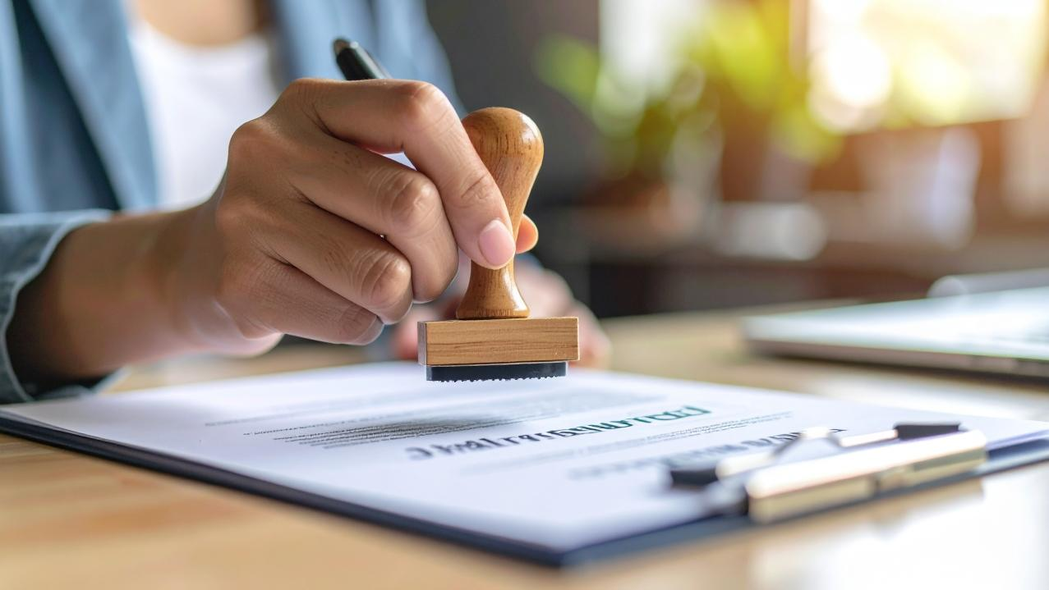
Uses of Club Funds
Authorized uses
Educational and administrative materials for the club and members
Equipment for the club
Meeting venue rental
Refreshments at meetings (approved by the club)
Donations to the Smedley fund
Notes:
Time on slide: 2 minutes
Elapsed time: 34 minutes
Facilitator Notes: Toastmasters International -Use of Club Funds - https://www.toastmasters.org/Membership/Leadership/general-finance/use-of-club-funds/
(PRESENT unauthorized and authorized uses of club funds. Highlight that nothing in this list supersedes common sense and that asking questions about whether or not something appears to be a good use of club funds is healthy. Since a club is run by its members, all major expenses should be approved at a Club Business Meeting beforehand.)
(Time permitting, discuss use of club funds for the following.)
Are discounts on membership fees allowed? This is allowable within reason if the discount only applies to the club portion of the fees and not to the $10/month paid out to Toastmasters WHQ.
Can clubs pay speaker expenses? These alongside any gifts or tokens of appreciation must be reasonable.
Background: Club Constitution: Article XI
Authorized uses include:
Educational/administrative materials for club/member use
Meeting place rental fees (if applicable)
Refreshments for club meetings (must be approved by the club)
Donations to the Ralph C. Smedley Memorial Fund - https://www.toastmasters.org/about/smedley-fund

Slide 20

Uses of Club Funds
UNauthorized uses
Membership fees
Pathways paths for members
Parties and social events
Scholarships
Donations of money or goods
Notes:
Time on slide: 2 minutes
Elapsed time: 36 minutes
Facilitators Notes:
(PRESENT unauthorized and authorized uses of club funds. Highlight that nothing in this list supersedes common sense and that asking questions about whether or not something appears to be a good use of club funds is healthy. Since a club is run by its members, all major expenses should be approved at a Club Business Meeting before funds are spent.)
A useful guide on how clubs can spend funds, can be found at - https://www.toastmasters.org/Membership/Leadership/general-finance/use-of-club-funds/
Background:
Club Constitution: Article XI
Most clubs have a treasury in which they keep funds for club use. The Toastmasters program is designed to be supported by members through club dues. Clubs may also raise funds on a limited basis.
Each club should prepare a budget at the beginning of the year to designate income and expenses. A majority of the club members should approve the budget, as well as any unanticipated expenses throughout the year.
Unauthorized uses include:
Pathways educational materials
Parties and social gatherings
Scholarships
Payment of dues for individuals
Donation of money or goods:
to outside causes or individuals
to individuals at any level of the Toastmasters organization
The authorized and unauthorized uses shown above are not intended to be all inclusive.

Slide 21

Creating a Club Budget
Must be created at the start of every year
Notes:
Time on slide: 2 minutes
Elapsed time: 38 minutes
Facilitators Notes:
(Discuss what a club budget is. Underscore that creating a budget at the start of every year is one of the Treasurer’s main responsibilities. Ask club treasurers about their club budgets.)
How many of your clubs create a club budget every year?
How many club treasurers report your club’s financial status (your club’s profit and loss statement) to your members regularly?
As Club Treasurer, what will YOU do about creating a budget?

Slide 22

Financial Planning Considerations
How much money does your club currently have?
How will you determine your club budget for the year?
What are your monthly revenues and expenses?
What percentage of membership growth/retention do you expect this year?
What other expenses and/or price increases should you consider?
Photo by AdobeStock
Notes:
Time on slide: 4 minutes
Elapsed time: 42 minutes
Facilitator Notes:
(Ask and discuss the questions on slides with the audience to ensure that everyone understands the implications and possibilities.)

Slide 23
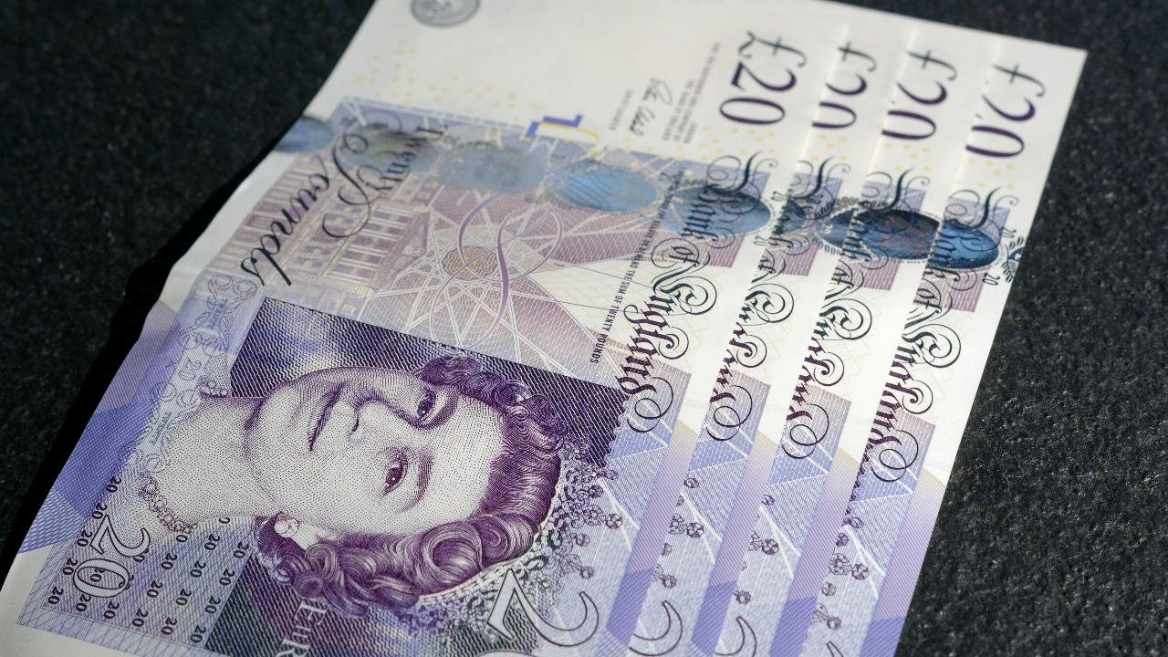
Key Budgeting Principles
Generate your actuals from an auditable year-end ledger (yearly audit needed)
Know your break-even point & how much money you have in the bank
Check if your club fees are sufficient
Consider membership growth & retention
Be conservative with any expenses
Notes:
Time on slide: 2 minutes
Elapsed time: 44 minutes
Facilitator Notes:
(PRESENT the core concepts of effective budgeting, elaborating on the bullet points, as needed.)
Audit – Core accounting concept of having a few people looking over transactions to ensure that everything is in order, that receipts are available, etc.
Break-even point – This is how many members a club needs to cover its costs. This is especially relevant to clubs that do not have a free meeting venue. The formula to calculate this will be explained in the next slide.
Fees amount – Ideally fees must always be sufficiently high to cover all club-related costs and expenses. There may be times when this is not the case, such as when club membership drops.
Conservative expenses – Self-explanatory, a club should only spend what is budgeted and if/when funds are available.

Slide 24

How to calculate your monthly membership fees
$\left(\frac{Monthly club costs}{Number of Members}\right)+\left(\frac{Monthly TI dues}{exchange rate to \$}\right)$ = $Monthly Membership Fee$
Notes:
Time on slide: 2 minutes
Elapsed time: 46 minutes
Facilitator Notes:
(Explain the formula shown in the slide. For currency conversion, it must be the exchange to US Dollars, USD. So how much is 1 USD $ worth in the local currency.)
Tip: For easy reference, create a month-by-month breakdown of what your club and international dues are. When a new member joins close to a renewal period, remember to request the additional six months of fees. You may also collect annual dues, if your club votes to do so.

Slide 25
Monthly membership fees example
A club with 20 members, meeting twice a month whose venue costs $50 (USD) per meeting and who additionally has $20 of extra monthly costs
$\left(\frac{Monthly club costs}{Number of Members}\right)+\left(\frac{Monthly TI dues}{exchange rate to \$}\right)$ = $Monthly Membership Fee$
$\left(\frac{\$120}{20}\right)+\left(\frac{\$10}{1}\right)$  $\left(\$6\right)+\left(\$10\right)$  $16 per month
Notes:
Time on slide: 2 minutes
Elapsed time: 48 minutes
Facilitator Notes:
(Explain the formula example.)
Reiterate Tip: When a new member joins close to a renewal period, remember to request the additional six months of fees. You may also collect annual dues, if your club votes to do so.

Slide 26
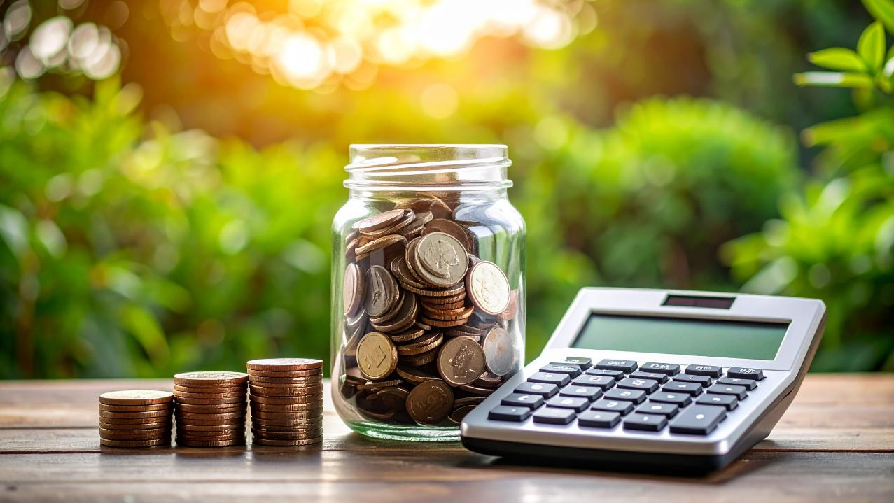
Best Practices
Notes:
Time on slide: 1 minute
Elapsed time: 49 minutes
Facilitator Notes:
Let’s consider some best practices of club treasurers.

Slide 27

Know the Legal Status of your Club
Work closely with the Secretary to understand where your club stands and whether any registration is needed to comply with local laws
Not doing so may affect your ability to open a club bank account
Notes:
Time on slide: 2 minutes
Elapsed time: 51 minutes
Facilitator Notes:
(Explain what the legal status of a Toastmasters club is in the country/region where the club operates (the Trainer will need to do some research beforehand). Based on this legal status explain whether opening a club bank account is possible or not. If the legal status of Toastmasters clubs in the country/region where the Club operates is unknown, encourage officers present to do extra research.)

Slide 28
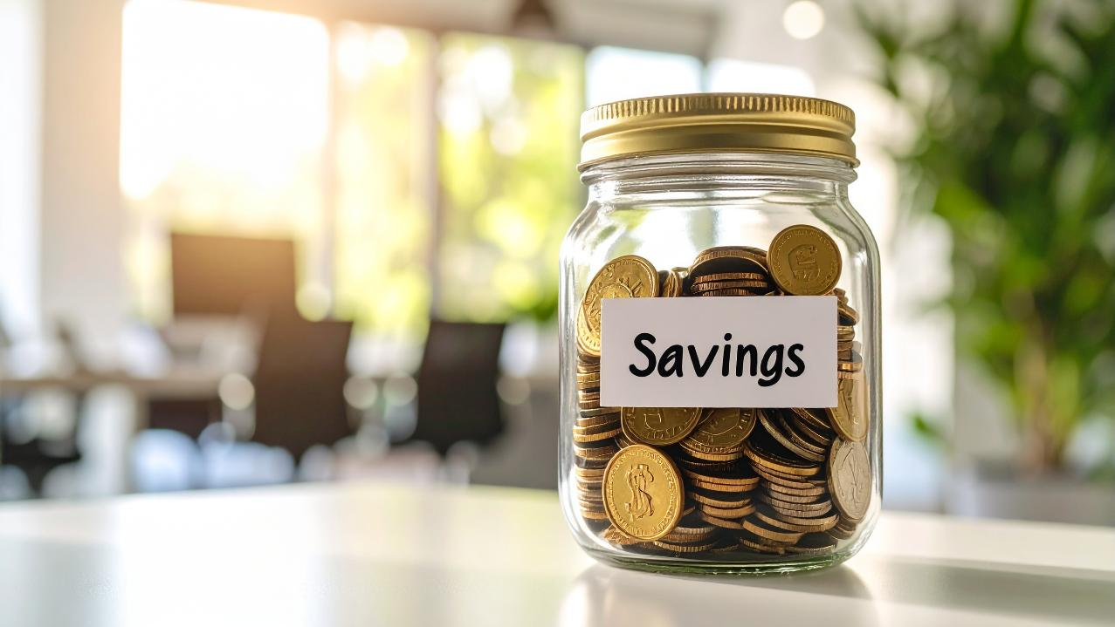
Conservative Budgeting
Keep a 3-to-6-month reserve for emergencies.
Notes:
Time on slide: 2 minutes
Elapsed time: 53 minutes
Facilitator Notes:
(Discuss this slide and what the implications could be for various clubs. If a club has a free venue, only a small reserve of funds may need to be kept. If the club has large monthly expenses, the club may want to keep more than 6 months in reserve.)

Slide 29
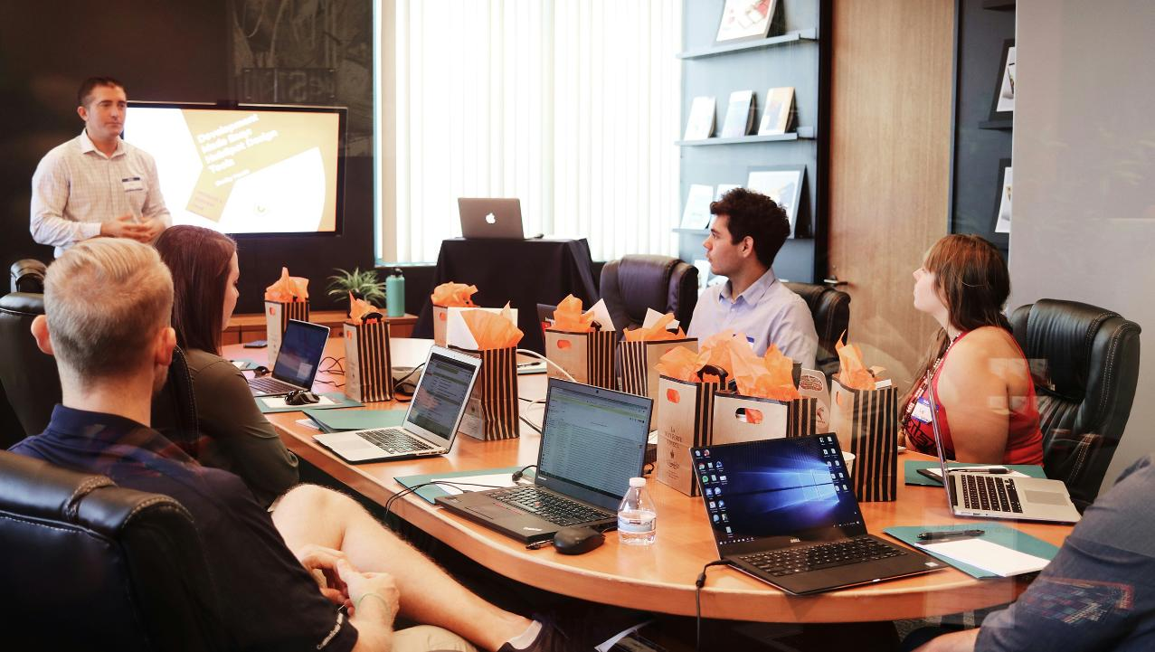
Key Learnings
Notes:
Time on slide: 2 minutes
Elapsed time: 55 minutes
Facilitator Notes:
(Ask the club treasurers what they have learned during this training.)

Slide 30
Club Finances Timeline
Club Officer Training (1st)
Club Officer Training (2nd)
Renewal Period
Renewal Period
Update Signatories
JUL
AUG
SEP
OCT
NOV
DEC
JAN
FEB
MAR
APR
MAY
JUN
`
`
`
Start of Year Tasks
Club Success Plan
Initial Budget
Club P & L
Send Member Renewal Notices
Membership Renewals Deadline
Mid Year Tasks
Budget vs. Actuals
Executive Committee Review
Send Member Renewal Notices
Membership Renewals Deadline
Succession Planning
Year-end Audit
Notes:
Time on slide: 2 minutes
Elapsed time: 57 minutes
Facilitators Notes:
(Present the timeline, answering any questions from the club treasurers. P&L stands for Profit and Loss.)
Important: The deadline for collecting membership renewals is October 1 and April 1, but treasurers should collect and pay membership renewal fees early for the club to remain in good standing. Members can lose access to Base Camp and be disqualified from competing in contests due to non-payment of TI membership renewal fees.
Members who self-pay can select the option to pay more than one period, e.g. paying October to March and April to September dues in August.

Slide 31

Next Steps
Create and/or complete the Club Budget
Begin collecting membership renewals
Document all club payments and expenses
Notes:
Time on slide: 2 minutes
Elapsed time: 59 minutes
Facilitators Notes:
(Introduce each action item. If time is available, ask the club treasurers why these are important. Then encourage the club treasurers to return to their clubs, create and/or complete their club budget, present it to the Club Executive Committee and then to the club members, and finally to request approval from the club members. Club treasurers should begin collecting membership renewal fees in July/August for the October renewals and in February/March for the April renewals. Treasurers should develop a process for documenting all club payments and expenses.)

Slide 32

Build Momentum in Your Club—Act Now!
Thank you for serving as a club officer!
Notes:
Time on slide: 1 minute
Elapsed time: 60 minutes
Facilitator Notes:
(Encourage the club treasurers to act now on their budget and membership renewals. to create their club budget, present it to the Club Executive Committee and then to the club members, and finally to request approval from the club members. Begin collecting membership renewal fees in August and develop a process for documenting all club payments and expenses.)

