Slide 1
Facilitator Instructions (not for presentation)
Session: This presentation is the one-hour Vice President Education breakout session for Round 1: New Year Club Officer Training. The order of presentations for the full Club Officer Training: Hall of Fame slides shown before the training starts, Round 1: New Year General Session Part 1 followed by the individual club officer breakout sessions, ending with Round 1: New Year General Session Part 2 . Round 1: New Year General Session Parts 1 and 2 are presented to all club officers.
Facilitator notes on each slide: These notes begin with the estimated time to present the individual slide and then the overall elapsed session time. It is essential that you review the facilitator notes on each slide and practice delivering the presentation to familiarize yourself with the material and stay on time. Facilitator notes should be used as a guide rather than a script that must be stated “word-for-word”. Parentheses denote instructions for facilitators – what facilitators should “do”.
Interaction: To interact in online training, ask participants to enter their responses in the chat. Ask the Chat Master to share a few of the responses. If the training is physically in-person, ask a few of the participants to share their responses verbally. For interaction in a hybrid training, do both.
Zoom/Chat Masters: For online training, it is critical to have sufficient District technical support to manage the training. To facilitate interaction, please assign a Zoom/Chat Master to each session.
Notes:
A duration of 4 hours is recommended for Club Officer Training, allowing for comprehensive review and discussion of topics, like the Club Success Plan, the Distinguished Club Program, and leadership development. The full Club Officer Training is composed of three 1-hour sessions, but we recommend breaks between each session. This leaves approximately 30 to 45 minutes for another session or keynote presentation focused on the needs of the clubs in your District.

Slide 2
Vice President Education (VPE)
Club Officer Training (COT)
Round 1: New Year Training
Notes:
Time on slide: 2 minutes
Elapsed time: 2 minutes
Facilitator Notes:
Welcome to the Vice President Education training!
(To begin the session, briefly ask the participants why they are serving as their club’s Vice President Education.)

Slide 3

Agenda
Notes:
Time on slide: 1 minute
Elapsed time: 3 minutes
Facilitator Notes:
(Please outline the agenda as listed below. Explain that the session describes the role and responsibilities of the Vice President Education but also includes some “how to’s” and best practices.)
Club Success Cycle
Transferable Skills
Responsibilities
Best Practices and Resources
Q&A
Next Steps

Slide 4

Agenda
Club Success Cycle
Transferable Skills
Responsibilities
Best Practices
Resources
Q&A
Next Steps
Notes:
Time on slide: 1 minute
Elapsed time: 3 minutes
Facilitator Notes:
(Please outline the agenda as listed below. Explain that the session describes the role and responsibilities of the Vice President Education but also includes some “how to’s” and best practices.)
Club Success Cycle
Transferable Skills
Responsibilities
Best Practices
Resources
Q&A
Next Steps

Slide 5

Vice President Education
Responsibilities
Notes:
Time on slide: 1 minute
Elapsed time: 4 minutes
Facilitator Notes:
The Vice President Education (VPE) role is fundamental to the success of every Toastmasters club.

Slide 6
Club Success Cycle
Guest Interest
Leadership
Research
VPPR
Sergeant at Arms
VPM
VPE
President
Secretary
Treasurer
Advocate – All Members
Engage-ment
Meeting
Advocate
Pathways
Member-ship
Mentoring
Orientation
Notes:
Time on slide: 1 minute
Elapsed time: 5 minutes
Facilitator Notes:
(Refer to the Club Success Cycle all attendees will have seen in session 1 and ask club officers where they think the Vice President Education role fits into the Club Success Cycle.)
Understanding the Club Success Cycle is crucial for enhancing member experience and retention. Each stage, from Guest Interest to Leadership, plays a role in a member's journey. To help new club officers understand the role each club officer has in recruiting new members and retaining existing members we have developed the Club Success Cycle. It is also important to consider how we deliver core benefits at each stage to ensure all members feel valued and engaged.

Slide 7
Club Success Cycle – Vice President Education
Engagement
With the help of the VPM, assigns a mentor to each new member
Explains Pathways to members
Enrolls members in Pathways
Schedules members to fill meeting roles and speech projects
Coordinates club contests
Ensures member engagement by member participation
Pathways
Mentoring
Notes:
Time on slide: 2 minutes
Elapsed time: 7 minutes
Facilitator Notes:
The role of the Vice President Education (VPE) is vital in helping new members develop and achieve their reasons for joining Toastmasters. The VPE is responsible for three key stages of the Club Success Cycle. Once a guest joins, their new member journey begins. With the help of the VPM, a mentor should be assigned to each new member.
The VPE then continues the new member’s journey by explaining Toastmasters structured education program – Pathways, to help them select a Path that meets their development needs, such as focusing on presentation skills by selecting the Presentation Mastery Pathway. The VPE also needs to train the new member to use Base Camp on the Toastmasters website. It will also be necessary to explain how the club’s meeting management system works. The meeting management system is often Easy-Speak or FreeToastHost, but other clubs will use different tools, including an Excel spreadsheet, a paper-based system, or something similar. Other clubs, especially corporate clubs, may have to use a program that their IT department specifies.
The third part of the VPE’s role on the Club Success Cycle is to help keep both new and existing members engaged. Engagement is crucial for applying knowledge and skills in real-world scenarios, ensuring members remain active and invested. This can be achieved by ensuring members regularly schedule meeting participation with speech projects and fulfilling other meeting roles, including giving feedback by evaluating speeches or chairing the meeting by serving as the Toastmaster. This can be done by encouraging members to take active roles in their club meeting and is described in more detail later in this session.

Slide 8

Vice President Education Transferable Skills
Strategic planning
Relationship building
Motivational techniques
Process and compliance
Mentoring and coaching
Interpersonal communication
Technology expertise
Succession planning
Notes:
Time on slide: 2 Minutes
Elapsed time: 9 Minutes
Facilitator Notes:
(Ask what transferable skills can be gained by serving as Vice President Education. Then share them.)
Learning how to enable, motivate and inspire others can easily be transferred to your work or other outside roles. The main transferable skills for the Vice President Education role are:
Strategic planning:
Planning annual club meeting calendar purposefully, determining types of meetings to incorporate to engage members and achieve club goals
Organizing special events, like Open Houses, Speechcrafts, and Moments of Truth
Contingency planning
Relationship building – which communication channels to use to interact with and engage members
Motivational techniques:
Internal motivation / External Motivation / Positive Reinforcement
Learning how to use which technique when
Learning who responds best to different techniques
Process and Compliance
Time-based task management to include club management process and club scheduling process
(Click to show the last four bullet points and describe them in more detail.)
Mentoring and coaching in Pathways and the club management software used by your club
Interpersonal communication – use multiple communication channels to engage all member communication styles
Technology expertise, e.g. Base Camp, club management software
Succession planning – grooming your VPE replacement

Slide 9

Supporting Members
Onboard new members to Pathways
Track educational achievements
Provide motivation and accountability
Coordinate with other officers
Leverage tools for tracking
Notes:
Time on slide: 4 minutes
Elapsed time: 13 minutes
Facilitator Notes:
The Vice President Education (VPE) plays a vital role in the success of the club throughout the year. VPEs are instrumental in retaining current members and supporting new members as they begin their Toastmasters journey. As VPE, you can make the biggest impact by onboarding and guiding members through Pathways to achieve their goals. You are the compass for them. You are responsible for coordinating each meeting agenda to ensure it supports both club goals and individual member goals.
(Ask) How does your club onboard new members? How does your club support retaining members? (Share some of their responses. Then summarize the information below.)
Onboard New Members to Pathways
Contact new members early (phone, email, or text) to explain what to expect and reassure them that everyone started as a beginner.
Offer onboarding sessions (one-on-one or small groups, in person or via Zoom/Teams).
Explain how the meeting agenda works and encourage commitment to regular attendance.
Explain the Pathways program and help members select a path.
Provide a quick orientation on Base Camp navigation.
Pair new members with mentors for guidance.
Avoid overwhelming new members—focus on basics first.
Sit new members with an experienced member during meetings for support.
Include recurring educational moments about Pathways during meetings.
Track Educational Achievements
Regularly review member progress in Pathways.
Approve level completions promptly in Base Camp.
Encourage members to schedule speeches aligned with their goals.
Aim for each member to have their next speech planned—ask: “When would you like to schedule your next speech?”
Provide Motivation and Accountability
Check in with members who haven’t spoken recently.
Use positive reinforcement and reminders to keep them engaged.
Celebrate milestones during meetings to boost morale.
Encourage members to commit to attending all meetings for consistent growth.
Coordinate with Other Officers
Work with VP Membership to understand new member needs.
Collaborate with President and Secretary for contests and special events.
Share progress updates with the club to maintain transparency.
Leverage Tools for Tracking
Use Base Camp reports or spreadsheets for easy monitoring.
Maintain a shared digital folder for educational resources.

Slide 10

Mentoring and Engagement
Assign Mentors for New Members
Foster Member Participation
Notes:
Time on slide: 3 minutes
Elapsed time: 17 minutes
Facilitator Notes:
Onboarding and tracking progress are essential, but they work best when members feel supported and connected. That’s where mentoring and engagement come in—helping members stay active and motivated throughout their journey.
(Ask at least one of these questions.) How do you assign mentors? Who is responsible for the Mentoring Program in your club? What are the responsibilities of the mentors? How long do they serve as mentors?
(Share some of their responses. Then summarize the information below.)
Assign Mentors for New Members
Pair each new member with an experienced mentor early.
Provide mentors with clear expectations and resources.
Encourage regular check-ins between mentors and mentees.
Mention the official Pathways mentoring project for added context.
Highlight benefits for mentors: skill development and emotional rewards.
Foster Member Participation
Personally invite members to take roles and give speeches.
Use positive reinforcement—thank members publicly for contributions.
Rotate roles to keep meetings dynamic and fair.
Organize special events (e.g., speakathons, contests) to boost engagement.
Additional Tip: Use mentoring as a way to build confidence and connection. Encourage mentors to share their own Toastmasters journey with new members.

Slide 11

Execution
Assign roles
Share stories
Close with CTA
Culture and Communication
Create a supportive environment
Decide engagement strategies
Monitor and adapt
Notes:
Time on slide: 3 minutes
Elapsed time: 20 minutes
Facilitator Notes:
Guests will be attracted to join if your club has a welcoming and inclusive environment, and the meetings are well-planned and feel organized.
(Ask) What is your club’s culture? How does your club create a positive and supportive learning experience? (Share some of their responses. Then summarize the information below.)
Create a Supportive Environment
Promote a culture of learning and encouragement.
Address reluctance or fear of speaking with empathy.
Celebrate achievements during meetings (e.g., level completions).
Engagement Strategies
Use communication channels (WhatsApp, Teams, email) for reminders and updates.
Organize special events—speakathons, workshops, contests—to keep energy high.
Encourage members to set personal goals and share progress.
Monitor and Adapt
Identify disengaged members and reach out personally.
Offer flexible options for participation (online roles, backup roles).
Keep engagement consistent with “little-and-often” nudges rather than overwhelming asks.

Slide 12

Plan and Manage Meetings
Create and maintain agendas
Assign roles strategically
Ensure meeting quality
Align with member goals
Notes:
Time on slide: 3 minutes
Elapsed time: 23 minutes
Facilitator Notes:
(Ask) How does your club currently fill meeting roles—do members volunteer, or does someone assign them? What works well and what could be improved? (Encourage responses in chat or verbally.)
Here are some tips for you to consider:
Create and Maintain Agendas
Schedule meetings well in advance (ideally 4–6 weeks ahead). Use a meeting management tool (Easy-Speak, FreeToastHost, or Excel template).
Develop a culture where members commit to meetings and volunteer for roles.
Plan agendas 1–3 months ahead to help members prepare.
Assign Roles Strategically
Rotate roles, so members gain varied experience.
Avoid the same person filling the same role repeatedly.
Confirm assignments early and send reminders.
Use messaging tools to confirm attendance and ask members which roles they want to fill.
Encourage members to schedule their next speech early.
Consider auto-assigning roles when needed.
Ensure Meeting Quality
Fill speaking slots ahead of time for smooth flow.
Prepare backup speakers for cancellations.
Include variety—educational sessions, contests, and special events.
Always have backup roles—especially a backup speaker.
Align with Member Goals
Know each member’s educational objectives.
Schedule speeches and projects that support those goals.
Coordinate with VP Membership for onboarding and mentoring.
Delegate agenda planning to the Toastmaster of the Day or Education Committee to build leadership skills.
Finally: Use supportive nudges instead of pressure:
Instead of “You HAVE to do this!” try “I believe in you! If you decide to try, I’m here to help.”

Slide 13

Special Meetings
& Events
Decide purpose
Plan the agenda
Delegate roles
Determine location, equipment, and supplies
Promote the meeting/event
Notes:
Time on slide: 3 minutes
Elapsed time: 26 minutes
Facilitator Notes:
(Ask VPEs to enter their answers into the online chat or to share in a phrase or ONE sentence verbally at in-person training.)
What types of special meetings and events does your club plan? Why?
(Share some of their answers and then click to show the list.)
The VPE also helps to organize special meetings and events which help members engage with the club. These might include club contest meetings, speakathons, an entire meeting of table topics, or educational meetings to help bring variety to meetings. Some clubs plan these special meetings for the last meeting of each month or quarterly. These special meetings should be scheduled at the beginning of the year when planning your annual club calendar.
A publicly advertised Open House meeting is dedicated to inviting numerous guests. Club members explain the benefits of the Toastmasters education program and demonstrate a shortened version of a typical club meeting. Seek support from experienced members. The main objective of an open house is to encourage membership growth.
Contests – Club contests are held for International Speech, Humorous Speech, Tall Tales, Table Topics and Evaluation – allocate a Chief Judge and Contest chair as well as other roles. Encourage as many club members to participate as possible. Read the Contest rule book (1171-speech-contest-rulebook). Ensure all the contestant paperwork is signed before the contest.
Decide the purpose, and if a small team is needed to organize. Learn from others who may have organized the same event before.
Plan the Agenda - Plan well in advance, leaving adequate time for advertising and publicity
Secure Key Roles
Guest speakers
Team Roles - Delegate roles to other club members and ensure they are well briefed.
Publicity - well in advance – work with VPPR
Meet & Greet – registration – work with VPM and SAA
Resources / Logistics – work with Sergeant at Arms
Location / Room – directions
Refreshments/food
Presentation materials – Lectern, Projector, Screen, Computer

Slide 14
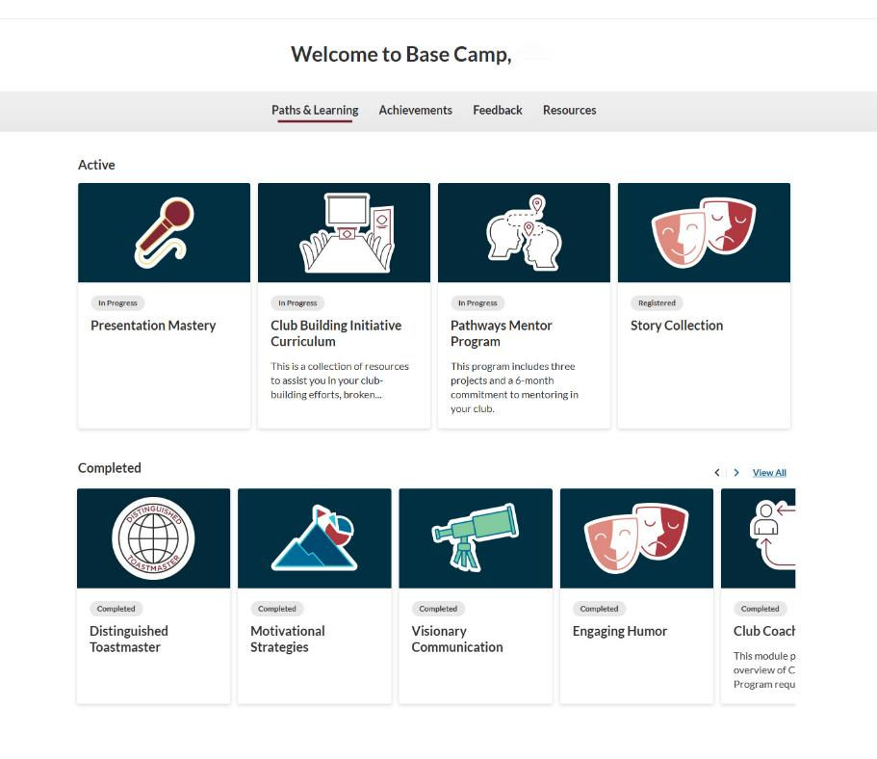
Pathways Base Camp
Base Camp training
  Basic Pathways onboarding
  Advanced Pathways sessions
Tying member goals to a Path
Connecting speaker to
evaluator
Notes:
Time on slide: 3 minutes
Elapsed time: 29 minutes
Facilitator Notes:
(Ask who are Pathways experts. Ask if they are willing to share their contact information.)
Who considers yourself to be a Pathways expert? Would you be willing to share your contact information with all of us?
If you do not consider yourself to be a Pathways expert, please reach out to those who are to increase your Pathways knowledge. As VPE, you are considered the club expert on the Toastmasters Education Program, and members will look to you for guidance on navigating and using Base Camp. Pathways is an experiential learning platform designed to help individuals develop and improve their communication and leadership skills. Through Pathways, members can build over 300 communication and leadership competencies, complete projects tailored to their interests, and earn recognition as they progress. The program is available online in multiple languages, allowing participants to learn anytime, anywhere. For step-by-step guidance, review Pathways resources and video tutorials on the Toastmasters International website.
Where can I find the over 300 Pathways Competencies?√
Access the item 8078 Project Competencies by Path document at this link: https://ccdn.toastmasters.org/medias/files/pathways/8078-project-competencies-by-path.pdf (Facilitator: You may copy and paste the link into the chat as a resource for the participants.)
Pathways Base Camp Training
Use Base Camp to access projects, track progress, and approve level completions.
Offer regular Base Camp training sessions for new members and invite existing members for refreshers.
Start with a basic session for beginners, then follow up with an advanced session for experienced members.
Schedule these trainings outside regular club meetings for focused learning.
Basic Pathways Onboarding
How to log in
Understanding Path selection and navigation
Completing projects and marking completion
Levels and level completion process
Demonstrate the Ice-Breaker project step-by-step
Advanced Pathways Training
Where to find resources
How to print or send evaluation sheets
Using feedback badges effectively
Organizing and storing documents
Tying Member Goals to a Path
You can help members choose the right Path by discussing their personal goals and understanding their needs.
Familiarity with the Pathways assessment process is essential so you can provide informed guidance when needed.
Connecting Speaker and Evaluator
Encourage pre-meeting contact between the speaker and evaluator.
Ensure the evaluator knows the project details, has the evaluation form, and shares feedback promptly.
Speakers can assign evaluators from within the Complete Your Project link in their Pathways path, triggering an email that sends the evaluation form to the selected evaluator.
Evaluators complete and submit the form online directly to the speaker’s Base Camp profile.

Slide 15

Pathways Level Approvals and Submissions
Member progress reconciliation
Member project completion assistance
Base Camp approval notifications
Base Camp approvals automatically updated in Club Central
Notes:
Time on slide: 3 minutes
Elapsed time: 32 minutes
Facilitator Notes:
The Vice President Education should access Pathways Base Camp regularly to track member progress and support members in achieving their goals.
Member Progress Reconciliation: Log into Pathways Base Camp frequently and compare members’ progress with their club meeting speeches and roles. Encourage members who are not completing projects to do so and explain the value of pre-speech preparation and post-meeting reflection.
Member Project Completion Assistance: After each meeting, review speeches and projects completed. Confirm that members are closing out their projects in Base Camp.
Base Camp Approval Notifications
When you receive notifications for level or path completions:
Verify the completion against your club’s speech agendas and project records before approving.
Print Level Completion Certificates and present them at the start of the next club meeting.
Pathways Level Approvals
Approvals only need to be completed in Base Camp. With the new Learning Management System (LMS), Pathways level completions are automatically updated in Club Central after approval by the VPE or any club officer. Be sure to coordinate with other club officers and communicate your club’s procedure for level completion approvals in Base Camp. These completions contribute to the Education Goals in the Distinguished Club Program (DCP). The Distinguished Club Program includes ten goals focused on educational achievements (goals 1-6), membership growth (goals 7-8), and administrative excellence (goals 9-10).

Slide 16

Area and District Council Meetings
Area and District meetings
Voting rights
Club’s second ranking officer
Notes:
Time on slide: 2 minutes
Elapsed time: 34 minutes
Facilitator Notes:
As a club VPE together with your club President and VPM, you are a member of the Area Council and will be invited to attend Area Council meetings coordinated and chaired by your Area Director. There should be at least two Area Council meetings held during the year but can be more frequent. The purpose of Area Council meetings is to support clubs, share best practice, introduce updated processes and programs, emphasize deadlines, and announce upcoming District events, such as contests.
Since you are a voting member of both the Area and District Council, it is important for you to attend to represent your club. The club VPE can, therefore, influence the overall direction of the District regarding budgets, alignment of clubs to areas and divisions, as well as electing incoming District officers.
Ensure any items on the Area Council and District Council Agenda have been discussed with the Executive Committee and your club in advance, if appropriate. You can then share your club’s view as well as your personal views and vote accordingly.
As the club’s second ranking officer, you (the VPE) take charge in the absence of the Club President. Work with the President to liaise with your Area Director to plan club visits and Area contest participation.

Slide 17

Best Practices and Resources
Notes:
Time on slide: 1 minute
Elapsed time: 35 minutes
Facilitator Notes:
In this section, we will discuss the following subjects:
Planning Ahead (club program planning for the year)
Member and Meeting Management (i.e. FreeToastHost, Easy-Speak, )
Dealing with the unexpected, e.g. cancellations
Time Management, especially in club meetings

Slide 18

Planning Ahead
Regular Club Meetings
Contest Dates
Open Houses
Onboarding Training
Club Success Plan
Moments of Truth
Notes:
Time on slide: 3 minutes
Elapsed time: 38 minutes
Facilitator Notes:
Planning ahead is important because it ensures meetings run smoothly and members have time to prepare, which improves engagement and overall club success. It also helps you anticipate challenges and avoid last-minute stress. Work with the other club officers to plan a calendar for the whole Toastmasters year and review it at every Executive Committee meeting.
Regular Club Meetings: It is a best practice to have your meeting dates planned and publicized well in advance.
Contest Dates: Plan Contest dates and check with your Area Director when the District’s dates will be available.
Open House: Plan and lead the Open House meetings as necessary
Onboarding Training: Set up regular onboarding dates in advance – usually about once a month or more frequently if you have many new members joining.
Club Success Plan: The Club Success Plan is a strategic tool used by Toastmasters clubs to set goals and track progress toward achieving Distinguished Club status. It helps clubs align their activities with Toastmasters International’s mission while fostering growth, engagement, and leadership development. Completion of the plan provides a structured approach to the activities and tasks needed to create a positive support club environment.
Moments of Truth: The Moments of Truth is a self-evaluation tool used by Toastmasters clubs to assess their effectiveness and to ensure they provide a positive experience for members and guests. Lead the Team to complete the Club Success Plan and to schedule the Moments of Truth meeting.

Slide 19

Member and Meeting Management
Easy-Speak, FreeToastHost or other platforms for Meeting Management
Pathways Base Camp – for Tracking Progress
WhatsApp or Teams – for Communication
Notes:
Time on slide: 3 minutes
Elapsed time: 41 minutes
Facilitator Notes:
(Ask) Which tool or tools does your club currently use for meeting management? Why do you use these?
(Share some of their responses. Then summarize the information below.)
Essential Tools for VPEs:
Easy-Speak https://easy-speak.org, FreeToastHost https://support.toastmastersclubs.org/home, or Excel – for meeting management and role assignments.
Pathways Base Camp – for tracking member progress and approving levels and educational accomplishments.
Communication Platforms – WhatsApp, WeChat, Teams, or email for reminders and updates.
Why Tools Matter
Well-planned meetings create a welcoming, organized environment that attracts guests and retains members.
Members should be able to sign up for roles and speeches at least a month in advance to prepare effectively.
If Your Club Doesn’t Use a Meeting Management Tool Yet - Start simple with an Excel template or explore FreeToastHost.
Tips for Success
Get training on your club’s chosen tool from the outgoing VPE or a District expert.
Corporate clubs may need to use in-house platforms like Teams due to IT restrictions.
If possible, migrate to advanced options like Easy-Speak or FreeToastHost for better functionality.
Become the Club Expert - As VPE, you’ll often be seen as the go-to person for these tools. Take time to learn them—or delegate to a tech-savvy member. This builds teamwork and leadership.
Toastmasters Videos - Toastmasters International has great tutorials on Base Camp, EasySpeak, and other tools. Bookmark these resources—they’ll save you time.
Club Management Software Training - Get training from your outgoing VPE or District leaders. Many Districts offer workshops or videos to help you master these tools.
Visit Other Clubs - One of the best ways to learn is by observing. Visit other clubs and see how they manage agendas and roles. You’ll pick up tips and ideas you can bring back to your own club.

Slide 20
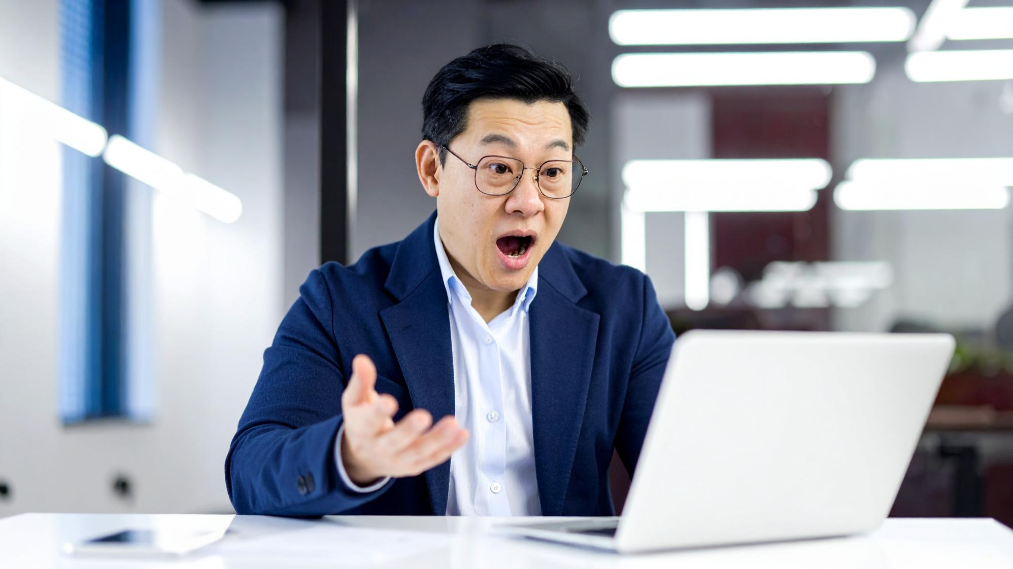
Dealing with the unexpected
Member Responsibility
Contingency Planning
Culture of A.R.T.S.
Notes:
Time on slide: 2 minutes
Elapsed time: 43 minutes
Facilitator Notes:
Even with a positive and supportive environment, unexpected challenges can still arise—like last-minute cancellations or venue issues. Let’s look at how you can prepare for these situations and keep your meetings running smoothly.
Member Responsibility: Communicate to members that when they are called away and unable to attend a meeting where they committed to serve in a meeting role it is their responsibility to secure a replacement. Instead of simply notifying the VPE or the Toastmaster of the Day that you will be absent, secure your replacement first and then communicate “I am out and here’s the name of my replacement.”
Contingency Planning: What if your meeting room suddenly gets taken over by another group? What if the venue informs you that your room is not available today? Do you have a contingency plan in place to communicate to members? Will you be able to move to an online meeting? Cancelling the meeting is not recommended as a contingency plan. Having a back up plan will allow the “show to go on” and will respect and serve the members with excellence in alignment with the Toastmasters core values.
Culture of A.R.T.S: Create a culture of A.R.T.S. (Always Ready to Speak) among the membership. Encourage members to have a “pocket” speech and be willing to step in when others either don’t sign up or are called away on short notice. This creates a resource for assigning speakers and meeting functionaries with no pressure.

Slide 21

Time Management
Timed Meeting Agendas
Adjust Meeting Roles
Notes:
Time on slide: 2 minutes
Elapsed time: 45 minutes
Facilitator Notes:
Managing meeting time is a transferable skill practiced and learned in Toastmasters meetings.
The core value of respect is exhibited when we start on time and end on time. Remember that time is a non-renewable resource; once it is spent, we cannot get it back.
Time Management: Beginning with the call to order, the clock is ticking. Agendas with timed meeting segments will assist the Toastmaster with ensuring each segment on the agenda runs as planned. The goal for every meeting is to start on time and end on time and respect everyone’s time.
Create a culture in your club of respecting each other’s time by following speech timing and avoid going over your allotted time on the agenda.
The Timer should be showing signals for the speaker and keep them visible the entire time so that the speaker is always aware of how much time has elapsed and how much time is remaining.
Adjust Meeting Roles before the meeting begins.
Taking time during the meeting does not make a good impression on guests and members.
What do you do when a member consistently disregards the timing of a speech, table topics response or evaluation presentation?
Suggestion: Have a conversation with them about how this disrespects the time of other members and causes the meeting timing to run longer.
Encourage them to rehearse their presentations before the meeting.

Slide 22

VPE Recipe for Success
Know your members and their goals
Plan club meetings well in advance
Communicate clearly, concisely, and often
Encourage proactively
Notes:
Time on slide: 2 minutes
Elapsed time: 47 minutes
Facilitator Notes:
(Summarize as the recipe for success.)
Know your members and their goals – Get to know them personally. Why did they join Toastmasters? Why do they stay? What do they want to achieve? How will you support them in achieving their goals?
Plan club meetings well in advance – Planning gives you the opportunity to adapt to unexpected changes. Schedule members to actively participate in club meetings. Schedule members for different roles.
Communicate clearly, concisely, and often – Determine how to communicate with your members. Multiple channels can be effective. Which group chat application (e.g. WhatsApp, Telegram, WeChat, Signal, etc.) would be best for your club?
Encourage proactively – Nudge, nudge, nudge, support, help and guide. Be the role model. Some members lack the self-confidence to step up. Encourage, motivate, cajole your members to move forward to achieve their goals – their MyWhy – their reason for joining/staying in Toastmasters.

Slide 23
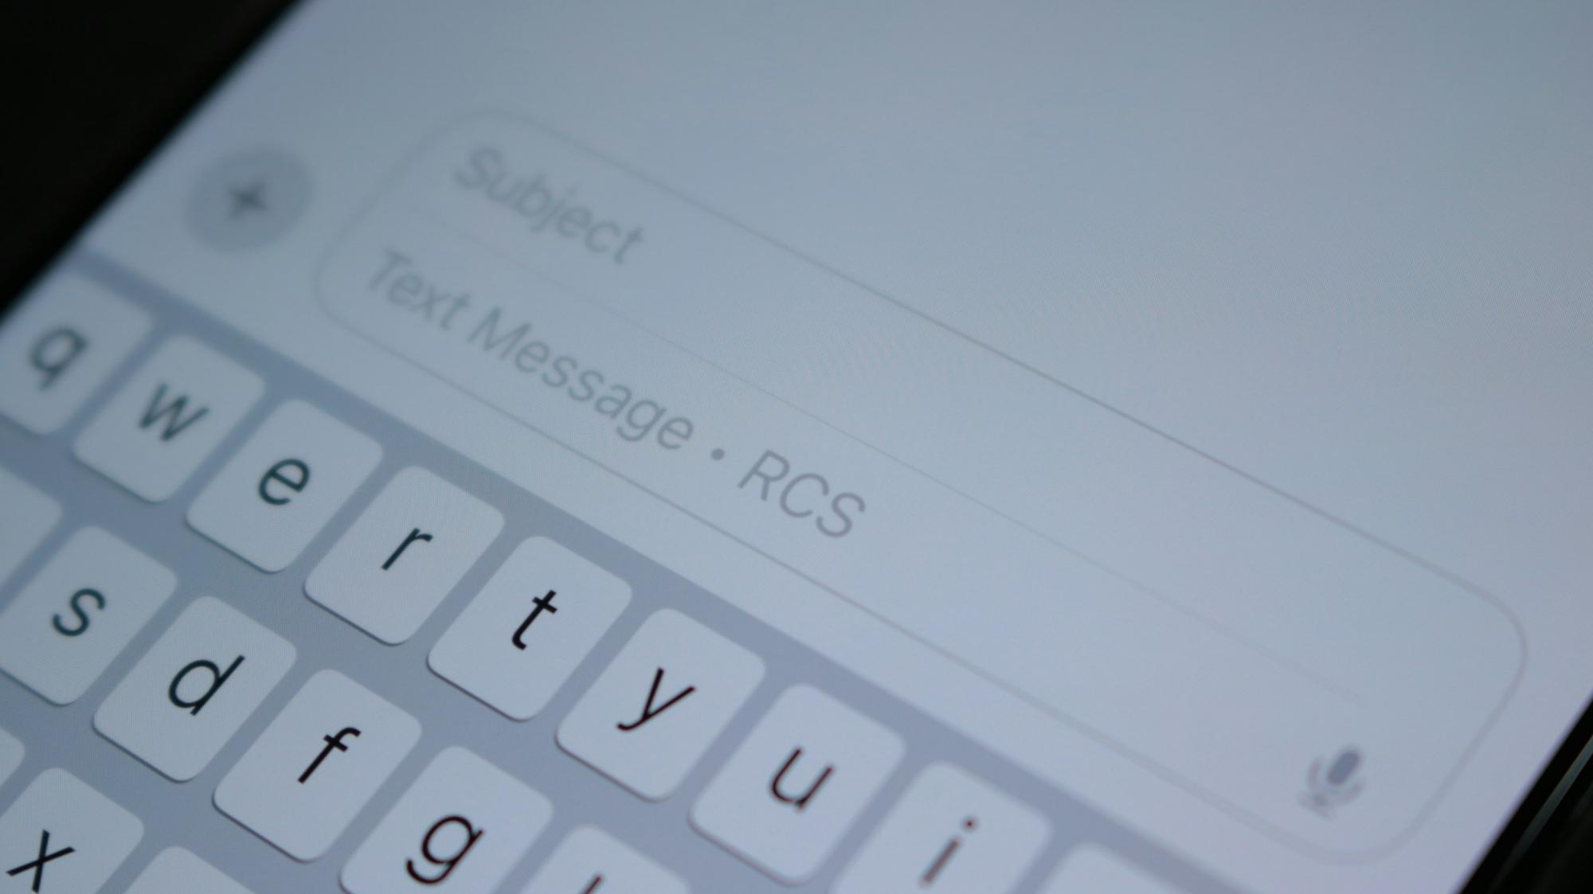
Resources
Meeting Management links
  FTH Link
  Easy-Speak FAQ
Pathways links
  Pathways Overview
  Basecamp Videos
  Updates Page
Effective Club Practices
Club Excellence Curriculum
Notes:
Time on slide: 2 minutes
Elapsed time: 49 minutes
Facilitator Notes:
(Ask) What are some useful resources for VPEs?
(Copy and paste the resource links into the online chat for participants to access, if training online and tell participants to “save the chat”.)
Meeting Management Links
- FTH (FreeToastHost)
- https://support.toastmastersclubs.org
- Easy-Speak FAQ
- https://easy-speak.org/faq.php
Pathways Links
Pathways Overview
https://www.toastmasters.org/education/pathways
- Base Camp Videos
- https://www.toastmasters.org/education/base-camp-videos
- Updates Page (use for finding coming changes to the platform)
- https://www.toastmasters.org/education/pathways/pathways-updates
Effective Club Practices – manual for being a high performing club
https://ccdn.toastmasters.org/medias/files/department-documents/club-documents/1315-effective-club-practices.pdf
Club Excellence Curriculum
https://content.toastmasters.org/image/upload/club-excellence-curriculum.pdf

Slide 24

Questions &
Answers
Notes:
Time on slide: 3 minutes
Elapsed time: 52 minutes
Facilitator Notes:
(Address any questions from the VPE participants.)

Slide 25
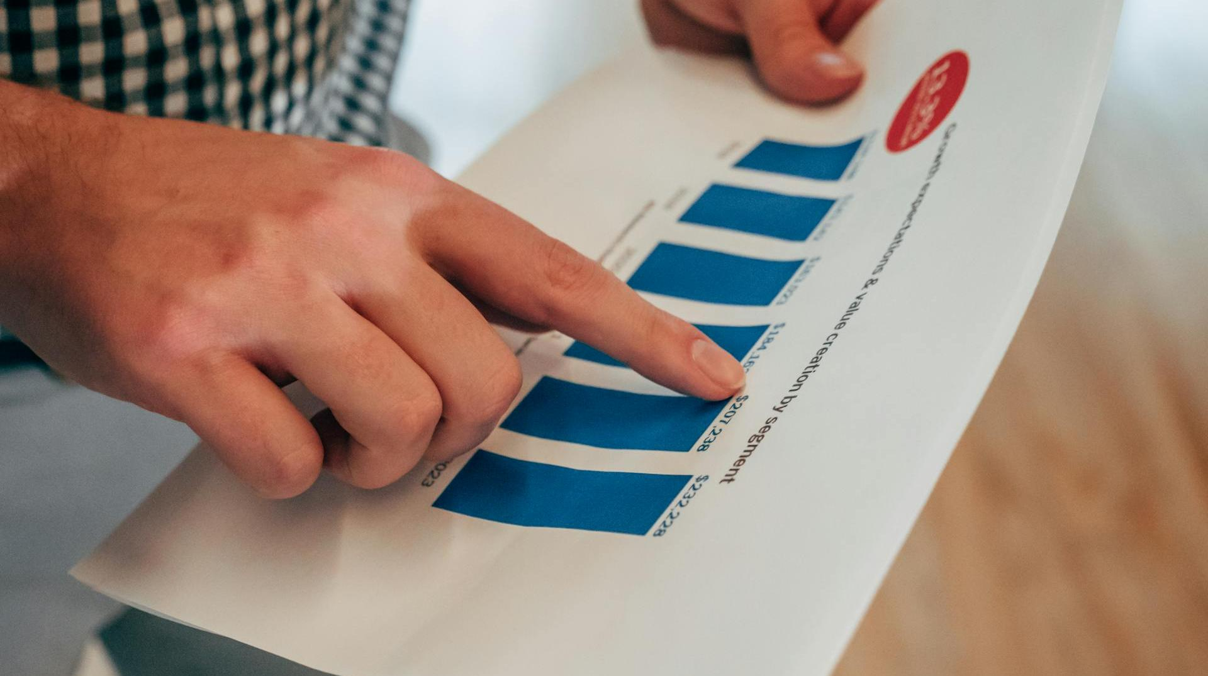
Next Steps
What club management software will you/do you use?
When will you hold your club meetings and club contests?
Who will serve on your Education Committee/Team?
What are the goals of your members to achieve through Pathways?
Notes:
Time on slide: 3 minutes
Elapsed time: 55 minutes
Facilitator Notes:
(Ask the VPEs what their next steps will be. Then show and discuss the first four questions on the list. After discussing these, show the next slide.)

Slide 26

First 90 Days – Quick Wins
Contribute to the Club Success Plan
Schedule all club meetings and special events for the year
Become familiar with your club’s educational tracking tools
Review member status in Pathways
Connect personally with members
Find the best communication tool
Recruit your Education Team
Notes:
Time on slide: 3 minutes
Elapsed time: 58 minutes
Facilitator Notes:
Your first 90 days set the tone for your term. Here are quick wins:
Contribute to the Club Success Plan – Due September 30th
Schedule all club meetings and special events for the year – encourage tentative dates to be confirmed later
Become familiar with your club’s educational tracking tools
Review member status in Pathways
Connect personally with members – begin to learn their goals for the year
Learn the best way to engage with your members (Chat group, Facebook, etc)
(Ask) Which of these will you tackle first? These steps build momentum and confidence early. To do all this effectively, you need the right tools and an Education team/committee. How will you break these down into next 1-2 weeks, 30 days, and 90 days? What could you use help with? How will you delegate this to members who want to serve on the Education team/committee?

Slide 27
Build Momentum in Your Club—Act Now!
Thank you for serving as a club officer!
Notes:
Time on slide: 1 minute
Elapsed time: 59 minutes
Facilitator Notes:
(Encourage the VPEs to take action today to ensure all their members are enrolled and active in Pathways and
to schedule their members to regularly participate in upcoming club meetings.)

