Slide 1
Facilitator Instructions (not for presentation)
Session: This presentation is the one-hour Club Vice President Membership breakout session for Round 1: New Year Club Officer Training. The order of presentations for this Club Officer Training: Hall of Fame slides shown before the training, Round 1: New Year General Session Part 1 followed by the individual club officer breakout sessions, ending with Round 1: New Year General Session Part 2 . Round 1: New Year General Session Parts 1 and 2 are presented to all club officers in attendance.
Facilitator notes on each slide: These notes begin with the estimated time to present the individual slide and then the overall elapsed session time. It is essential that you review the facilitator notes on each slide and practice delivering the presentation to familiarize yourself with the material and stay on time. Facilitator notes should be used as a guide rather than a script that must be stated “word-for-word”. Parentheses denote instructions for facilitators – what facilitators should “do” (not say).
Engagement Questions: Some slides include “engagement questions”. For online training, you can ask all attendees to answer the questions in the chat and then your Chat Master can read aloud a few of the responses. For physically in-person training, you must manage the timing for these questions. For in-person training, emphasize that club officers need to give concise verbal answers,15 to 20 seconds in length AND ask different club officers to answer these questions each time to involve more club officers.
Zoom/Chat Masters: For online training, it is critical to have sufficient District technical support to manage the training. To facilitate interaction, please assign a Zoom/Chat Master to each session.
Notes:
A duration of 4 hours is recommended for Club Officer Training, allowing for comprehensive review and discussion of topics, like the Club Success Plan, the Distinguished Club Program, and leadership development. The full Club Officer Training is composed of three 1-hour sessions, but we recommend breaks between each session. This leaves approximately 30 to 45 minutes for another session or keynote presentation focused on the needs of the clubs in your District.

Slide 2
Vice President Membership (VPM)
Club Officer Training (COT)
Round 1: New Year Training
Notes:
Time on slide: 2 minutes
Elapsed time: 2 minutes
Facilitator Notes:
Welcome to the Vice President Membership training!
(To begin the session, briefly ask the vice presidents why they are serving as Vice President Membership.)

Slide 3

Why VPM?
Club Success Cycle
Transferable Skills
Responsibilities
Membership Building
Membership Engagement
Best Practices, Metrics and Resources
Next Steps
Notes:
Time on slide: 1 minute
Elapsed time: 3 minutes
Facilitator Notes:
(Outline the agenda as listed below. Explain that the session describes the role and responsibilities of the Vice President Membership but also includes some “how to’s” and best practices.)
Why VPM?
Club Success Cycle
Transferable Skills
Responsibilities
Membership Building
Membership Engagement
Best Practices, Metrics and Resources
Next Steps

Slide 4

Why VPM?
Membership Growth
Member Retention
First Impressions
Guest Conversion
Member Engagement
Club Vitality
Notes:
Time on slide: 2 minutes
Elapsed time: 7 minutes
Facilitator Notes:
(Take 1 minute to ask why the Vice President Membership role is important to the club. Listen attentively to officers' perspectives, acknowledging each contribution. Use their responses to highlight how the VPM role touches every aspect of club success. This question sets a collaborative tone for the session and validates the importance of their position. Then show the list.)
Why is the Vice President Membership role key to the success of any Toastmasters club? (Ask a few to give 15-20 second responses - one sentence responses.)
The VPM is at the very heart of membership-building and retention. Without members, there's no club! And without engaged, satisfied members, the club loses its energy and momentum. As VPM, your role is about much more than just numbers. It's about creating a vibrant, welcoming environment where people feel they belong.
Think of the member journey as a cycle: from the first time a guest walks through the door (or logs into a Zoom meeting), to becoming a member, to staying involved and growing. The VPM influences every stage of that journey.
You and the Sergeant at Arms make the first impression when guests arrive.
You guide the guests toward joining the club.
And you help create an environment where members want to stay, contribute, and thrive.
A strong VPM can transform guests into committed members and ensure that existing members feel connected, valued, and motivated to renew.

Slide 5
Club Success Cycle
Guest Interest
Leadership
Research
VPPR
Sergeant at Arms
VPM
VPE
President
Secretary
Treasurer
Advocate – All Members
Engage-ment
Meeting
Advocate
Pathways
Member-ship
Mentoring
Orientation
Notes:
Time on slide: 1 minute
Elapsed time: 8 minutes
Facilitator Notes:
We viewed the Club Success Cycle at the end of General Session Part 1.
Which stages of the Club Success Cycle are influenced by the VP Membership?

Slide 6
Club Success Cycle – Vice President Membership
Responds to Prospective Member Management contacts
Greets guests at club meetings, asks what they want to gain from Toastmasters, and introduces them to members
Records guest contact information and gives them a guest packet with information on Toastmasters
Asks guests to join
Follows up with every guest
Orients new members
Assigns mentors with VPE
Meeting
Membership
Mentoring
Orientation
Notes:
Time on slide: 2 minutes
Elapsed time: 10 minutes
Facilitator Notes:
(Emphasize that effective membership management requires coordinated efforts across the entire Executive Committee. Highlight that while the VPM has specific responsibilities, their success depends on smooth information flow and collaboration with other officers. Encourage new VPMs to establish regular check-ins with their counterparts, especially the VPPR and VPE, to ensure a seamless experience for both prospective and current members.)
Let's see how you, as VPMs, partner across the Executive Committee. Sometimes prospective members find Toastmasters online and enter their contact information into the Prospective Member Management portal on the TI website. As VP Membership, you are responsible for following up with every contact in the Prospective Member Management portal.
At club meetings, your work as VP Membership begins when a guest walks through your club's door, even before a guest considers joining. This places you right at the transition from the Meeting stage to the Membership stage.
How do you collaborate with the rest of the Executive Committee?
VPPR → You (VPM): After the VPPR promotes the club and a guest enters the room, your VP Membership role begins. You greet guests, ask what they want to gain from Toastmasters, record their contact information, introduce guests to members, and before they leave the club meeting, you ask them to join. If they do not join immediately, you follow up with a warm email, invite them back, and again, encourage them to join. After joining, you invite them to a new member orientation, induct them, and introduce them to their mentor.
You ↔ Secretary & Treasurer: Rely on them for accurate attendance and dues data. Their accuracy means your welcome messages and invoices arrive on time.
You ↔ VP Education: Synchronize calendars for new member orientations and mentoring meetings. Review Pathways progress together to keep members moving through the program.
You → President: Deliver a concise monthly report on guest visits, conversion rates, and retention trends, so the Executive Committee can set realistic growth goals.

Slide 7

Transferable Skills
Communication
Marketing
Networking and relationship-building
Strategic planning
Collaboration
Professional development
Notes:
Time on slide: 2 minutes
Elapsed time: 5 minutes
Facilitator Notes:
One of the hidden benefits of the VPM role is the incredible set of transferable skills you develop along the way. These skills don't just help you in Toastmasters, they are assets you can apply to your career, other volunteer roles, and everyday life.
Let's break them down:
Communication Skills: As VPM, you communicate regularly with guests, members, and fellow officers. Whether it's through email, phone calls, or speaking in front of a group, you'll hone both your written and verbal communication.
Marketing: Because your role is to encourage guests to join your club and to retain your current members, you are essentially “marketing” your club, selling the benefits of communication and leadership skills development.
Networking & Relationship Building: The VPM role puts you on the front line of building relationships. You are welcoming guests, building rapport, and fostering a sense of belonging.
Strategic Planning: Growing a club isn't random. It takes goal-setting, planning, and execution. As VPM, you'll strategize how to attract new members and retain current ones.
Collaboration: You're not working alone! You'll be part of a team, collaborating with the President, VPPR, VPE, Treasurer, and other officers to achieve common goals.
Professional Development Benefits: All these skills enhance your leadership profile and make you more versatile. They help you stand out in job interviews, grow in your career, and take on larger leadership roles.
Engagement Question (1 minute):
Which of these transferable skills do you most hope to develop during your term as VPM, and how could it benefit your professional life? (Ask club officers to express their answers in one sentence or a phrase. Take a few thoughtful responses.)

Slide 8
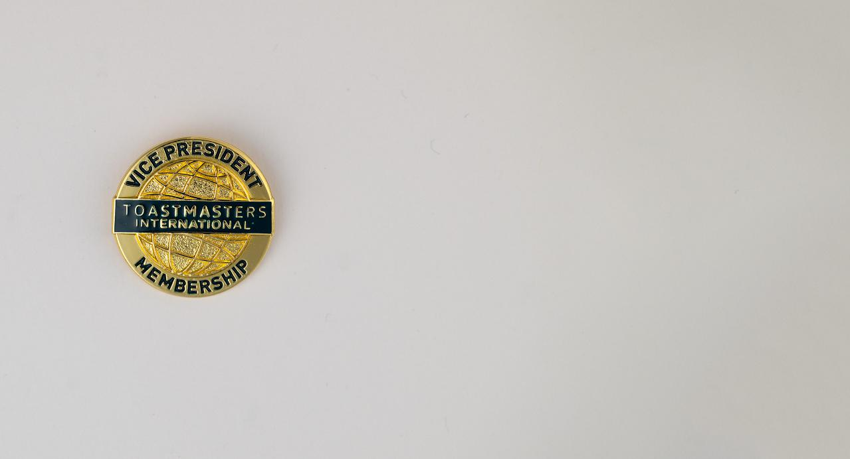
Vice President Membership Responsibilities
Notes:
Time on slide: 30 seconds
Elapsed time: 10.5 minutes
Facilitator Notes:
The Vice President Membership role is fundamental to the success of every Toastmasters club.
Membership Retention
Membership Building
New Member Orientation
Open House Organization
Speechcraft

Slide 9

Guest Hospitality
When a guest walks into a
meeting, their first impression
counts.
Notes:
Time on slide: 2.5 minutes
Elapsed time: 13 minutes
Facilitator Notes (30 seconds):
As VPM, your mission is to partner with the Sergeant-at-Arms to make guests feel instantly welcome. A genuine greeting sets the tone for their entire experience. Quickly orient them to our meeting format and highlight Toastmasters core benefits: leadership skills, public speaking practice, and supportive environment. Whenever possible, ensure guests are seated next to an experienced member who can quietly explain the meeting structure and answer questions during transitions. Consider their demographics and introduce them to members with similar demographics when possible. This personal touch makes a huge difference.
Quick Engagement Questions (2 minutes total):
(Pick one or two of the questions below to ask the vice presidents. Keep a brisk pace. Aim for 30-45 seconds per question, including the responses. Acknowledge each speaker with a nod or brief "thank you" to maintain momentum.)
Please keep your responses concise, from 15 to 20 seconds, so that more people can participate.
What is one thing that made you feel welcome at your first meeting? (Take 2-3 brief responses.)
How would you describe Toastmasters in one sentence to a potential guest? (Take 2-3 quick answers.)
What is the most valuable skill you have gained through Toastmasters? (Take 2-3 short responses.)

Slide 10

Collecting Guest Details
Guests who feel understood and valued are much more likely to join.
Notes:
Time on slide: 2 minutes
Elapsed time: 15 minutes
Facilitator Notes (2 minutes):
After welcoming guests, your next crucial step is collecting their details—this opens the door to building a lasting relationship. Gather their name, contact information (especially email), and understand their interests and goals. Remember, guests who feel valued are much more likely to return and join. Have a simple sign-in system ready and be conversational when collecting information. Show genuine interest rather than just gathering data.
Be sure to provide each guest with a simple, professional-looking guest package—including a welcome flyer, club contact details, and a membership application—to help them feel informed and appreciated.
(Conclude by reinforcing that effective guest tracking starts the membership journey.)

Slide 11
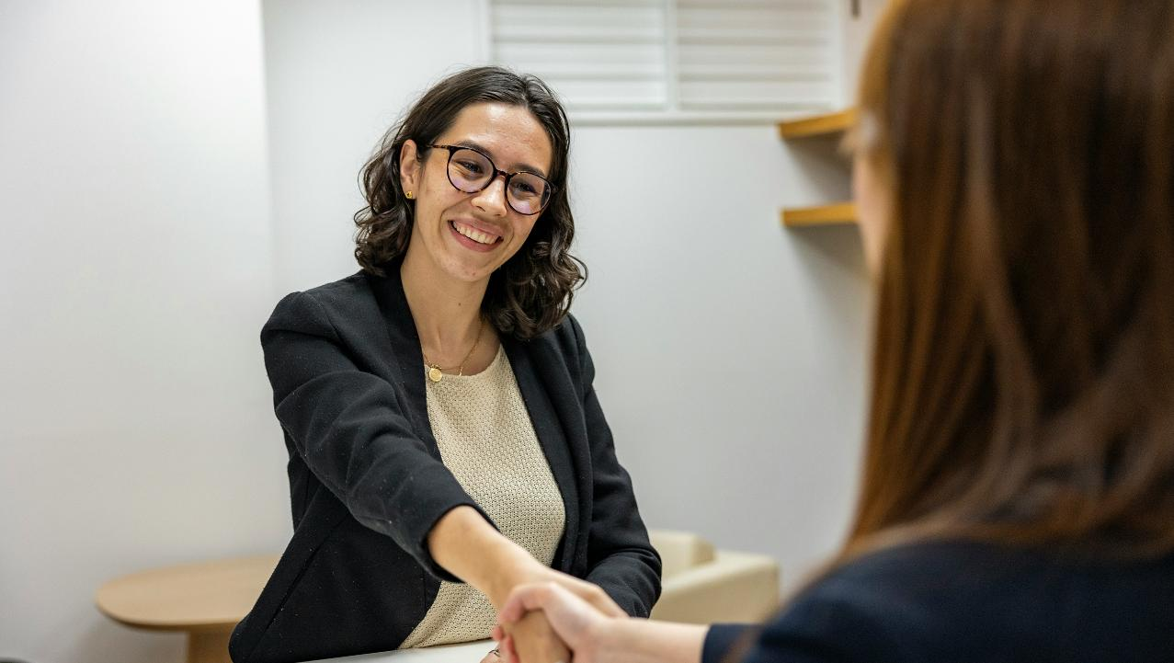
After the meeting ends but before the guests leave, personally invite each guest to join!
Notes:
Time on slide: 1 minute
Elapsed time: 16 minutes
Facilitator Notes (1 minute):
Before the meeting ends, ask guests to speak, to share what they saw at the meeting that would be of value to them. Then tell guests that you would welcome them to join as members. Once the meeting is adjourned, be sure to speak with each guest personally. Ask what they learned from the meeting. Ask them how they could see themselves benefiting from being a member? Then gently ask if they are ready to join. Immediately following a meeting is often when guests feel most inspired and connected. Use a simple question like:
“We would love to have you as a member. Would you like to join our club today?”
If not, don't pressure them. Invite them back to the next meeting. Not everybody joins after their first meeting. If they are not ready to join, be warm and welcoming:
“No worries at all. We would be delighted to welcome you back anytime!”
This friendly, respectful approach helps guests feel appreciated—not pressured—and leaves the door open for future visits and membership.
How you ask a guest can make the difference in whether the guest joins or will return. If they want to join now, please help them with their application. This is one of the most important roles of the Vice President Membership.
(If time permits, encourage participants to practice saying the invitation out loud in pairs. Emphasize tone—keep it friendly, not like a sales pitch. Remind them this moment is about building trust, not closing a deal.)

Slide 12

Guest Follow-Up Process
Send a thank you email and ask for feedback.
Notes:
Time on slide: 2 minutes
Elapsed time: 18 minutes
Facilitator Notes:
(Emphasize the importance of prompt, personalized follow-up as a critical step in the membership pipeline. Remind officers that this simple practice often makes the difference between one-time visitors and committed members. Encourage them to develop a follow-up system they can implement consistently after each meeting.)
Follow-up is where you turn a good guest experience into real momentum. Within 48 hours, send a thank-you email. Keep it warm and personal. Mention something specific about their visit, if you can. And always invite them to the next meeting.
But don't stop there, ask for feedback! Guests often appreciate the chance to share their thoughts, and this feedback helps you and the club improve. If they had a positive experience, gently encourage them to leave a review on platforms like Facebook or Google. Social media personal reviews help attract future guests.
Quick Tips: Use an email template but personalize it! Include the date and details of your next meeting. Make it easy by sharing direct links for reviews. A small, thoughtful follow-up can leave a big, positive impression.

Slide 13
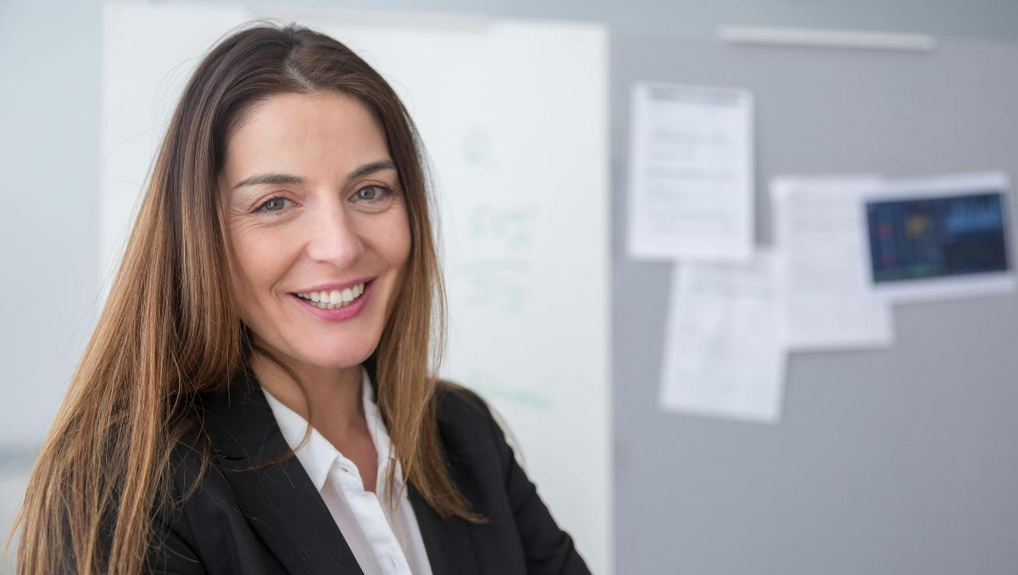
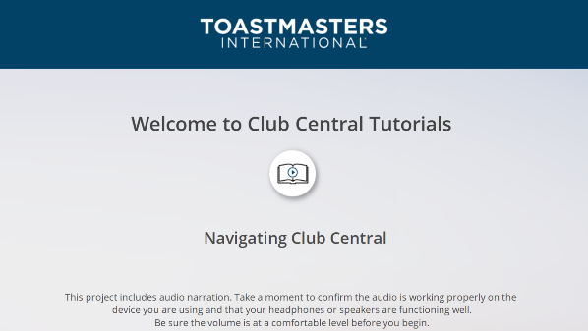
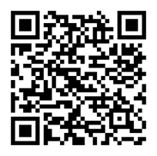
Guest-to-Member Conversion
Scan the QR code for video tutorial
Notes:
Time on slide: 2 minutes
Elapsed time: 20 minutes
Facilitator Notes:
(Remind officers that the conversion from guest to member often happens in personal conversations rather than through formal presentations. Emphasize that being prepared with clear answers about the process, addressing common objections confidently, and connecting Toastmasters benefits to individual goals will significantly improve conversion rates. Point out the QR code resource as an additional tool to help them master the technical aspects of member registration.)
This is where you help guests take the next step—joining the club!
Start by guiding them through the (paper) sign-up process. Some guests may find it confusing or intimidating, so walk them through it step-by-step. If possible, offer to assist them during or right after the meeting. You will then transfer the applicant's data to Club Central. For detailed online training, please see the training on the “Add Membership” page on the Toastmasters website and scan the QR code.
For new members who join less than 8 weeks before renewal time, we suggest that you ask them to pay for both the current dues period and the next six months period, so they are not asked to pay twice in a short period of time.
Next, be ready to address concerns. Common ones include time commitment, fees, or public speaking anxiety. Listen carefully and reassure them by highlighting the supportive nature of Toastmasters and how flexible and member-driven the program is.
Finally, make sure to promote the benefits – personal growth, leadership development, communication skills, and belonging to an international network.
Quick Tips: Personalize your conversation. Connect benefits to their goals. Share member success stories. Always follow up after they sign-up to make them feel welcome.

Slide 14
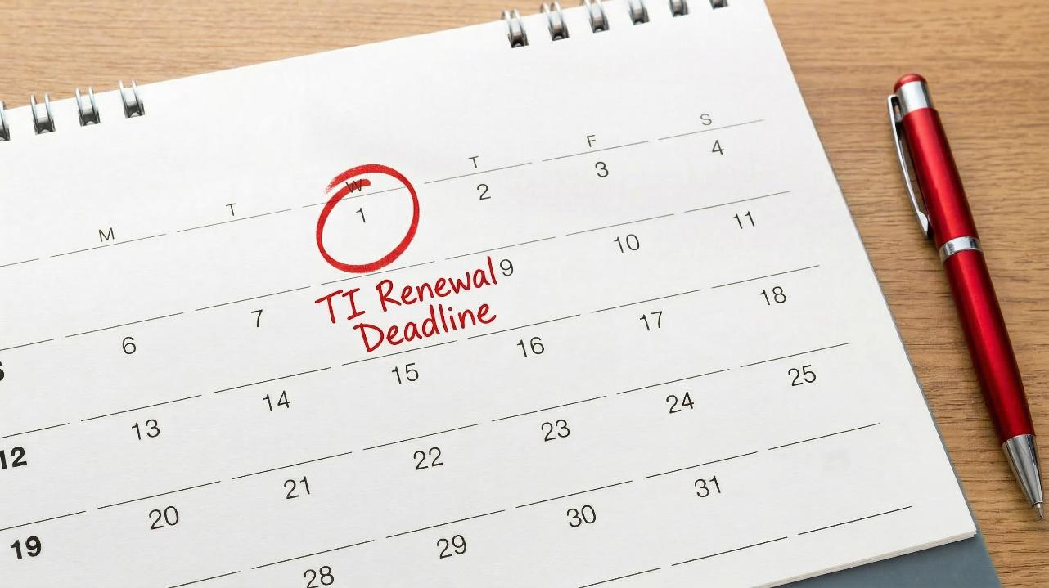
Membership Renewals
Notes:
Time on slide: 2 minutes
Elapsed time: 22 minutes
Facilitator Notes (2 minutes):
(Emphasize that renewal periods are critical moments when clubs often experience membership drops. Remind officers that renewal is fundamentally about demonstrating ongoing value, not just collecting dues. Encourage them to view each renewal period as an opportunity to reconnect members with their original motivation for joining and to highlight the progress they've made. Suggest creating a calendar alert 6 weeks before each renewal deadline to ensure timely preparation.)
Renewals are key to keeping your club strong and stable. As VPM, you will work closely with the Treasurer to ensure members renew on time. Your main responsibility in the renewal process is to keep members engaged throughout the year, so that they continuously experience the value of their membership and want to renew. When members miss meetings, send them a “miss you” message. For continuous absences, reach out to the member(s) to express personal concern and support.
Start with timely communication. Don't wait until the last minute! Begin reminding members 4 to 6 weeks before the renewal deadline. Use meetings, emails, and personal conversations to communicate that it is time to renew their membership. Please do not say “dues are due”. We want to communicate the value of renewing their membership to continue to receive the benefits from their membership.
Next, be proactive in overcoming barriers. Some members may hesitate due to cost, personal schedules, or feeling disconnected. Take the time to listen, offer solutions, and remind them why they joined, what they have gained so far, and what they can gain by continuing their membership.
Quick Tips: Use both group and one-on-one reminders. Highlight upcoming club events or contests as reasons to stay involved. Work with the Treasurer to make the payment process easy and clear. Your goal? To show members that renewing is worth it!

Slide 15

Support Member Goals
Be a source of support and motivation.
Check in with members regularly.
Are they achieving their goals?
Notes:
Time on slide: 3 minutes
Elapsed time: 25 minutes
Facilitator Notes (1.5 minutes):
Your VPM role extends well beyond recruitment—you'll partner with the Vice President Education to ensure member fulfillment and progress. Help align members' personal goals with appropriate Pathways tracks, whether they're focused on public speaking or leadership development. Be their ongoing source of support and motivation by checking in regularly on their engagement and milestone achievements. Remember to celebrate all wins and keep the focus on personal growth, as members who see progress are far more likely to stay active and renew.
Quick Engagement Questions (1.5 minutes total):
(Only choose one question to ask or ask one person to answer each question. Use members' insights to illustrate how retention is about personal connection, not just programs. Emphasize that the VPM-VPE partnership creates the support system that transforms new members into committed Toastmasters.)
Please keep your responses concise, from 15 to 20 seconds, so that more people can participate. Also, if you have responded to a previous question, it would be great to have others participate.
What is the most helpful support you have received as a member? (Take 2-3 brief responses.)
What keeps you motivated to achieve goals? (Take 2-3 short responses.)
How do you know when a fellow member is losing interest or engagement and how do you re-engage them? (Take 2-3 quick answers.)

Slide 16
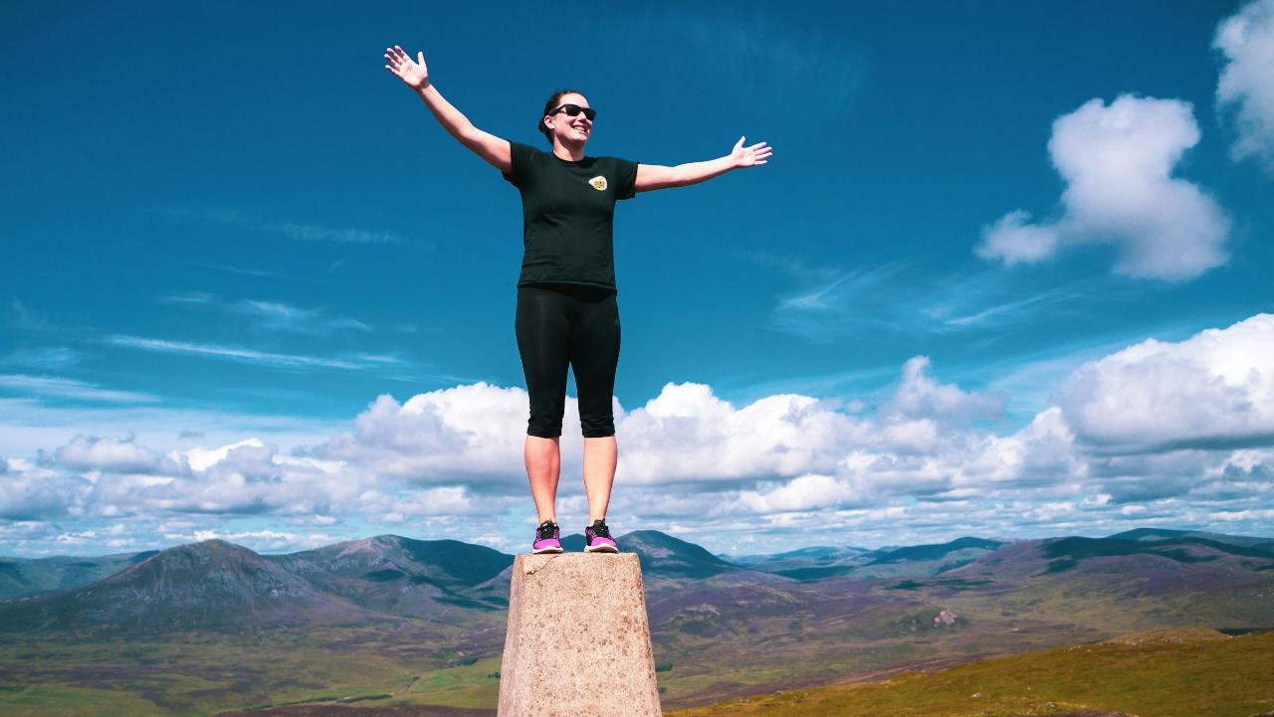
Recognition
One of the most powerful ways to keep members engaged is with recognition.
Notes:
Time on slide: 2.5 minutes
Elapsed time: 27.5 minutes
Facilitator Notes (1 minute):
Recognition is one of the most effective ways to keep members engaged. When we take the time to celebrate achievements like completing a Pathways level, giving a first speech, or stepping into a new role, we build confidence and reinforce a sense of progress.
It is just as meaningful to recognize accomplishments outside of Toastmasters. Whether a member has earned a promotion, completed a certification, or contributed to their community, acknowledging these moments shows that we value them as individuals.
As Vice President Membership, you can support this by working with the Club President to make sure recognition happens regularly. A simple mention during a meeting or in a message can have a lasting impact.
Creating a positive experience also means making meetings enjoyable. Work with the Vice President Education to ensure that club meetings are well run and fun. Themed sessions, creative formats, and social activities give members something to look forward to and help strengthen the sense of community. Toastmasters should feel like the best part of the week. When members feel appreciated and enjoy the environment, they are much more likely to stay and grow within the club.
Quick Engagement Questions (1.5 minutes total):
(Maintain a lively pace – 15-20 seconds per response – to model the energy you're discussing. Use members' examples to illustrate how simple recognition practices and fun elements create the "secret sauce" of member satisfaction. Close by emphasizing that everyone—not just officers—plays a role in creating the positive culture that keeps members coming back.)
What form of recognition has meant the most to you in your Toastmasters journey? (Take 3-5 brief responses.)

Slide 17
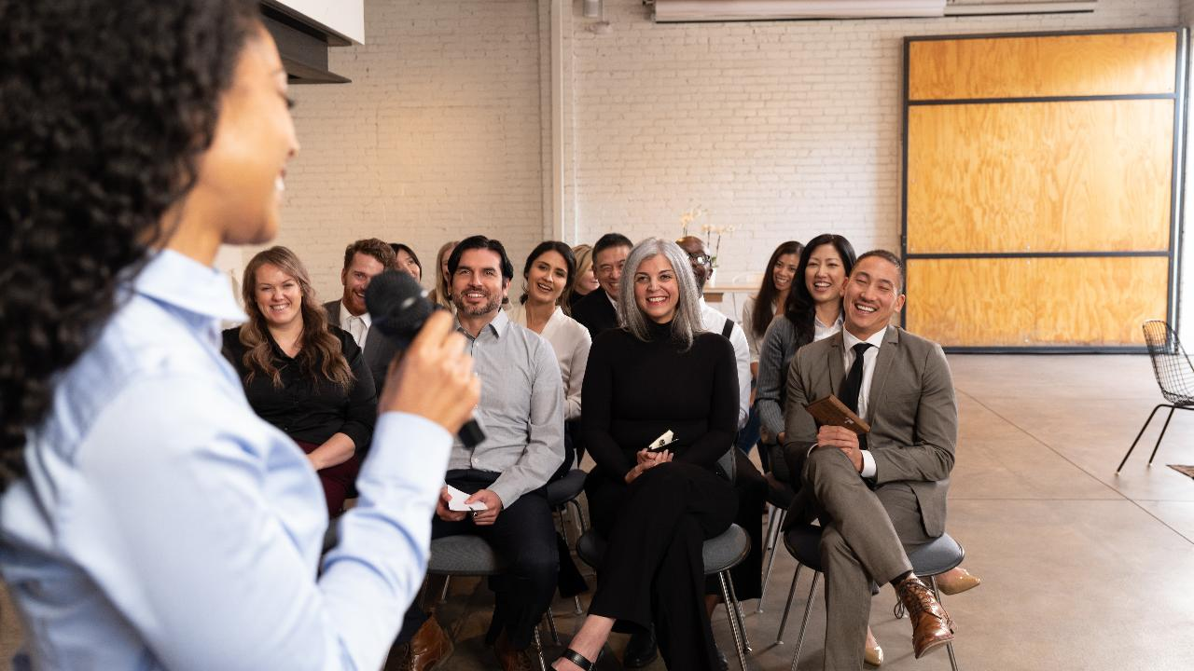
Membership Building
Notes:
Time on slide: 30 seconds
Elapsed time: 28 minutes
Facilitator Notes:
Now let’s discuss your role in building membership.

Slide 18
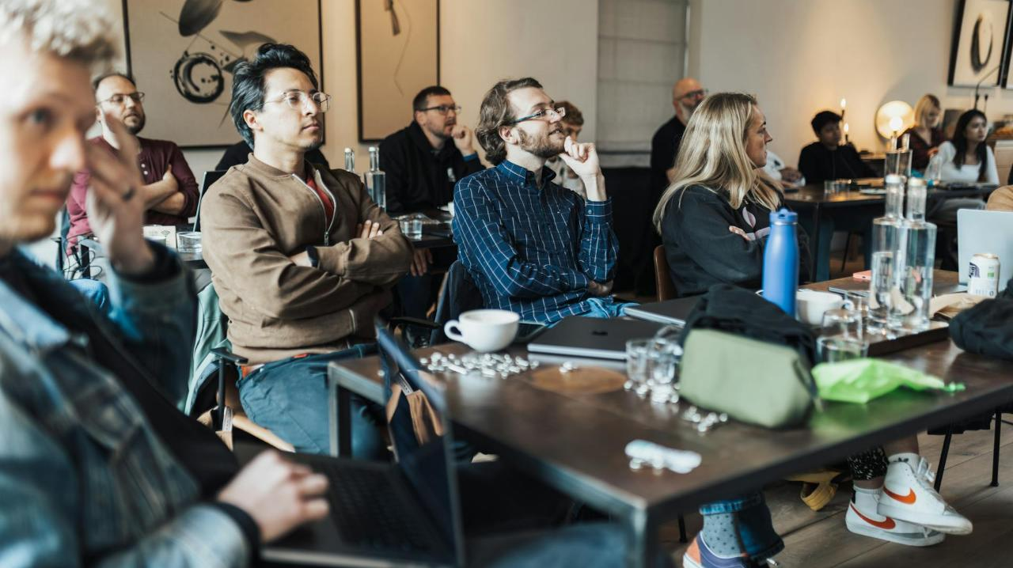
Open House
An Open House is a special event where your club opens its doors to the public.
Special Events
Notes:
Time on slide: 2 minutes
Elapsed time: 30 minutes
Facilitator Notes:
(Explain that Open Houses represent one of the most effective targeted recruitment strategies available to clubs. Emphasize that successful Open Houses require planning and purposeful differentiation from regular meetings to create a special experience. Encourage officers to schedule at least two Open Houses annually and to coordinate closely with their VP PR to maximize promotional opportunities. Mention that the next section will provide a practical framework for executing these special events.)
First, let's define what an Open House is: An Open House is a special event where your club opens its doors to the public. Guests, friends, coworkers, or anyone interested in learning more about Toastmasters. It's a chance to give them a firsthand experience of what makes your club special.
So, why are Open Houses important?
They showcase your club's value. Guests get to see the friendly atmosphere, the quality of your meetings, and the growth opportunities Toastmasters offers.
They boost your visibility in the local community. The more people know about your club, the more likely you'll attract new members and build a diverse and dynamic membership.
Most importantly, they highlight the personal growth benefits Toastmasters provides. Public speaking, leadership, networking, and confidence-building.
Quick Tips: Make it a warm, exciting event, not just another meeting. Share personal success stories to make the experience relatable. Treat every guest as a future member, because they might be!
We'll get into how to organize and promote Open Houses next.

Slide 19
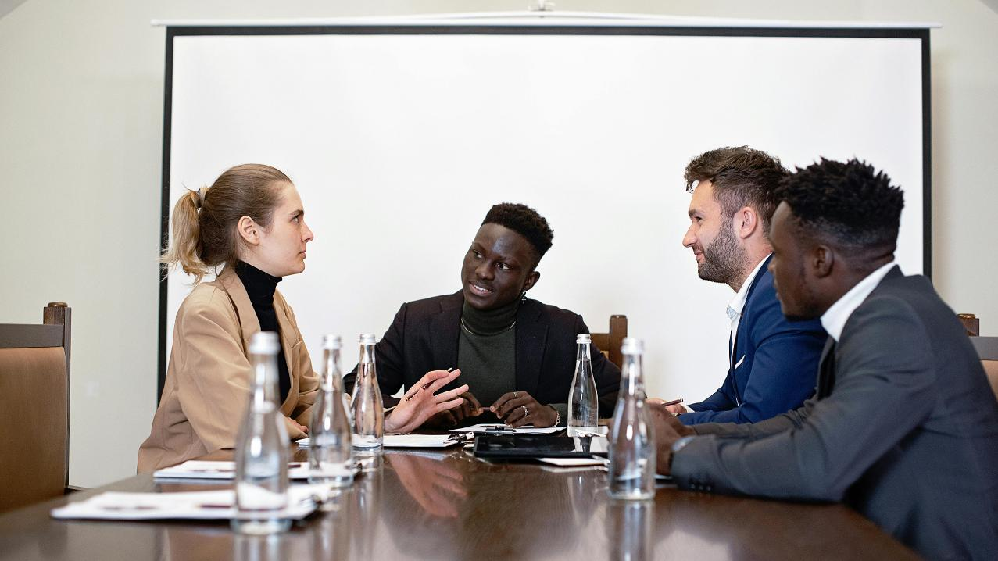
How to Organize an Open House
Planning
Start Early
Pick a Theme
Choose Timing
Notes:
Time on slide: 1.5 minutes
Elapsed time: 31.5 minutes
Facilitator Notes:
(Emphasize that successful Open Houses require a balance of careful planning, broad promotion, and enthusiastic execution. Suggest that officers create a reusable Open House planning template or checklist that can be passed down to future VPMs. Remind them that while the Open House itself is important, the follow-up process is equally critical to convert visitors into members, so they should have their follow-up system ready before the event occurs.)
Now that we know the why we organize Open House events, let's focus on the how.
Step 1: Planning. Start early. In fact, schedule at least two Open Houses on your club calendar at the beginning of the Toastmasters year. Then two months prior to your dates, choose the team to organize the Open House. Pick an Open House theme that will attract your target audience – something fun, relevant, or aligned with your club's strengths. For example, "Level Up Your Public Speaking" or "Leadership in Action." Also, choose the right timing. Avoid public holidays or busy seasons when attendance may drop.
Quick Tips: Rehearse to ensure a smooth flow. Make the event fun and interactive, not just formal speeches. Collect guest details and follow up within 48 hours. With the right preparation, your Open House can become one of the most effective tools for growing membership in your club.

Slide 20
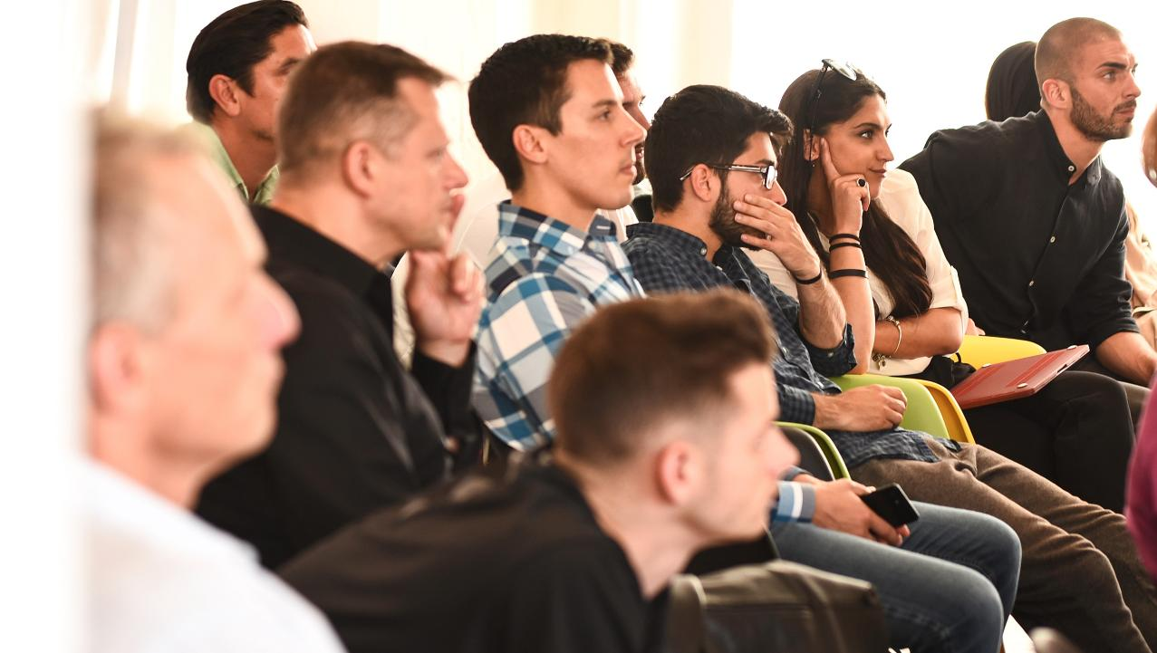
Promoting an Open House
Work with VPPR
Social Media
Emails
Outreach
Notes:
Time on slide: 1.5 minute
Elapsed time: 33 minutes
Facilitator Notes (1 minute):
Step 2: Promotion. You won’t do this alone. Work closely with your VPPR to create media visibility. Use a mix of channels:
Social media (Facebook, LinkedIn, Instagram)
Email invitations to past guests and your network
Flyers, community boards, or word-of-mouth
Corporate communication channels for a corporate Open House
Quick Tips: Rehearse to ensure a smooth flow. Make the event fun and interactive, not just formal speeches. Collect guest details and follow up within 48 hours. With the right preparation, your Open House can become one of the most effective tools for growing your club.

Slide 21

Conducting an Open House
Execution
Assign roles
Share stories
Close with CTA
Notes:
Time on slide: 2 minutes
Elapsed time: 35 minutes
Facilitator Notes (2 minutes):
Step 3: Execution. Treat this like a major event! Assign clear roles: greeters, speakers, timers, and even someone to welcome guests after the meeting for a casual chat. Include testimonials or personal stories from current members. These real-life examples are often what inspire guests the most. And always close with a strong CTA (call to action). Invite them to join on the spot or come back for the next meeting.
Quick Tips: Rehearse to ensure a smooth flow. Make the event fun and interactive, not just formal speeches. Collect guest details and follow up within 48 hours. With the right preparation, your Open House can become one of the most effective tools for growing your club.

Slide 22
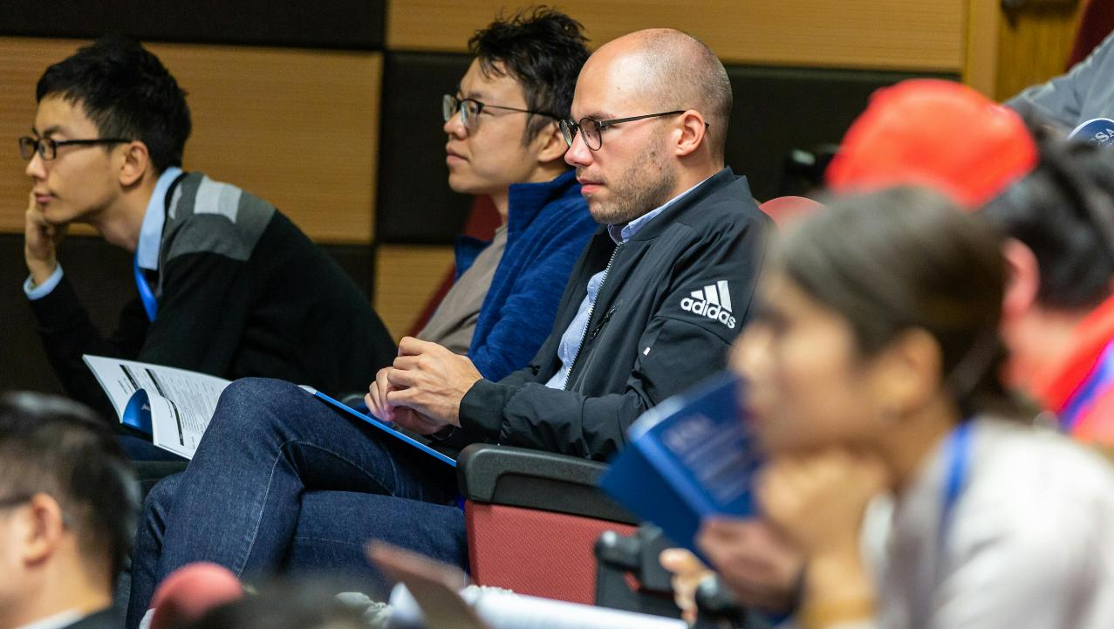
Community or Corporate Speechcraft
Adult Education
Non-members
During Meetings
Outside the Club
Notes:
Time on slide: 2 minutes
Elapsed time: 37 minutes
Facilitator Notes (2 minutes):
(Highlight Speechcraft as a recruitment tool that creates a pipeline of well-prepared potential members who already understand and value the Toastmasters program. Encourage officers to consider implementing a Speechcraft program at least once per year, possibly during traditionally slower membership periods to maintain momentum.)
Speechcraft is a premium recruitment tool for community and corporate clubs. Speechcraft can provide a significant influx of new members upon completion of the program. While Speechcraft requires more planning and commitment than an Open House, it often results in higher-quality conversions and more engaged members. Speechcraft offers a powerful adult learning experience that gives participants a clear and inspiring introduction to what a Toastmasters club offers. You can deliver it during regular meetings or as a separate workshop.

Slide 23
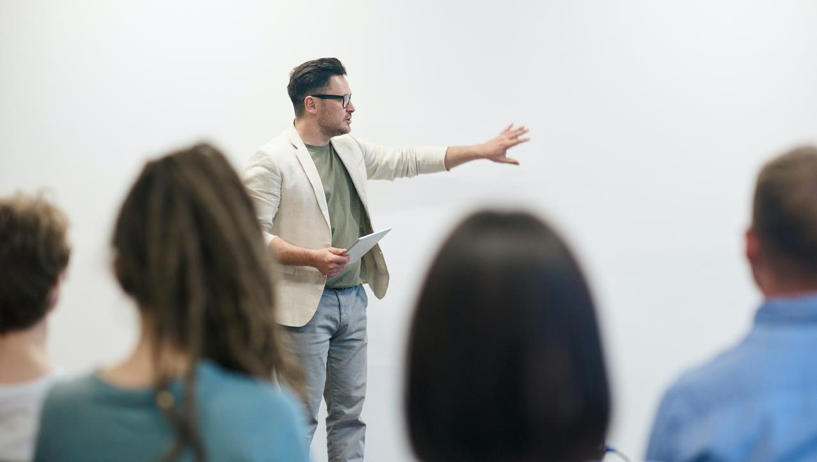
Conducting Community or Corporate Speechcrafts
Execution
4-8 Sessions
5 Speechcrafters
1 Coordinator
Digital bundle
Notes:
Time on slide: 2 minutes
Elapsed time: 39 minutes
Facilitator Notes (2 minutes):
The Speechcraft format is flexible. It can run for four, six, or eight sessions, each lasting between sixty and ninety minutes. A small group of Speechcrafters works with a single Coordinator who guides the entire process. All the materials, including manuals and evaluation tools, are available through Base Camp.

Slide 24
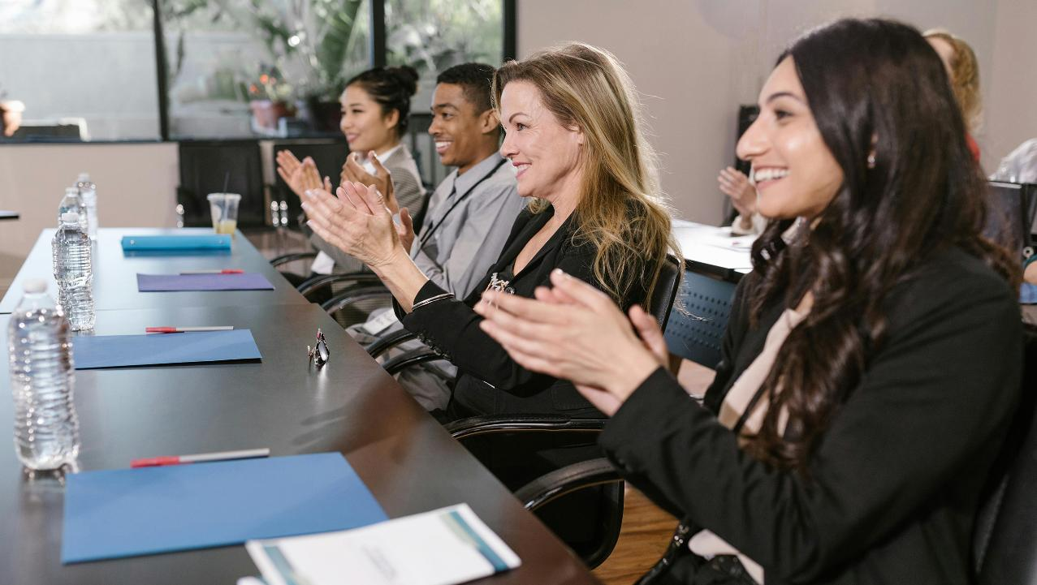
Community or Corporate
Speechcraft
Benefits
Coordinator: Earn DTM Credit
Speechcrafter: Hands-on
speech practice
Notes:
Time on slide: 2 minutes
Elapsed time: 41 minutes
Facilitator Notes (2 minutes):
As the Coordinator, you earn credit toward your Distinguished Toastmaster award. You also strengthen your leadership and facilitation skills while helping raise your club’s visibility.
Participants get hands-on practice, build confidence quickly, and earn Pathways credit along with digital badges. From about halfway through the program start to softly mention the benefits of Toastmasters membership and ask them if they would like to join at the end of the Speechcraft program, make sure to invite them again to join your club at the end of the course. The moment of completion is the best time to convert interest into membership, and it is one of the main reasons to run Speechcraft.

Slide 25

Campaigns: Membership Programs
Smedley Award
Talk Up Toastmasters
Beat The Clock
Notes:
Time on slide: 2 minutes
Elapsed time: 43 minutes
Facilitator Notes (2 minutes):
(Emphasize the strategic timing of these campaigns throughout the Toastmasters year and how they can be integrated into the club's overall membership plan. Encourage officers to mark these campaign dates on their calendars now and to begin planning specific events or initiatives to capitalize on each opportunity. Remind them that these structured campaigns provide both motivation and recognition for membership development efforts.)
Toastmasters offers three official membership campaigns throughout the year to help clubs grow and stay energized. Each one challenges your club to add at least five new, dual, or reinstated members within a specific time frame.
Let's break them down:
Smedley Award – August 1 to September 30 Named after our founder, Ralph Smedley, this program encourages clubs to start the Toastmasters year strong. Clubs that achieve this goal earn a Smedley Award ribbon for their banner and a 10% discount code for their next club order.
Talk Up Toastmasters – February 1 to March 31 This mid-year boost focuses on inviting guests to special meetings where they can experience Toastmasters firsthand. Bringing in five new members earns your club a special ribbon and a discount code.
Beat the Clock – May 1 to June 30 As the Toastmasters year closes, this campaign helps your club finish strong. Same rewards apply: ribbon plus a discount code.
Remember: Transfer and charter members do not count, and all applications and payments must be submitted on time.

Slide 26
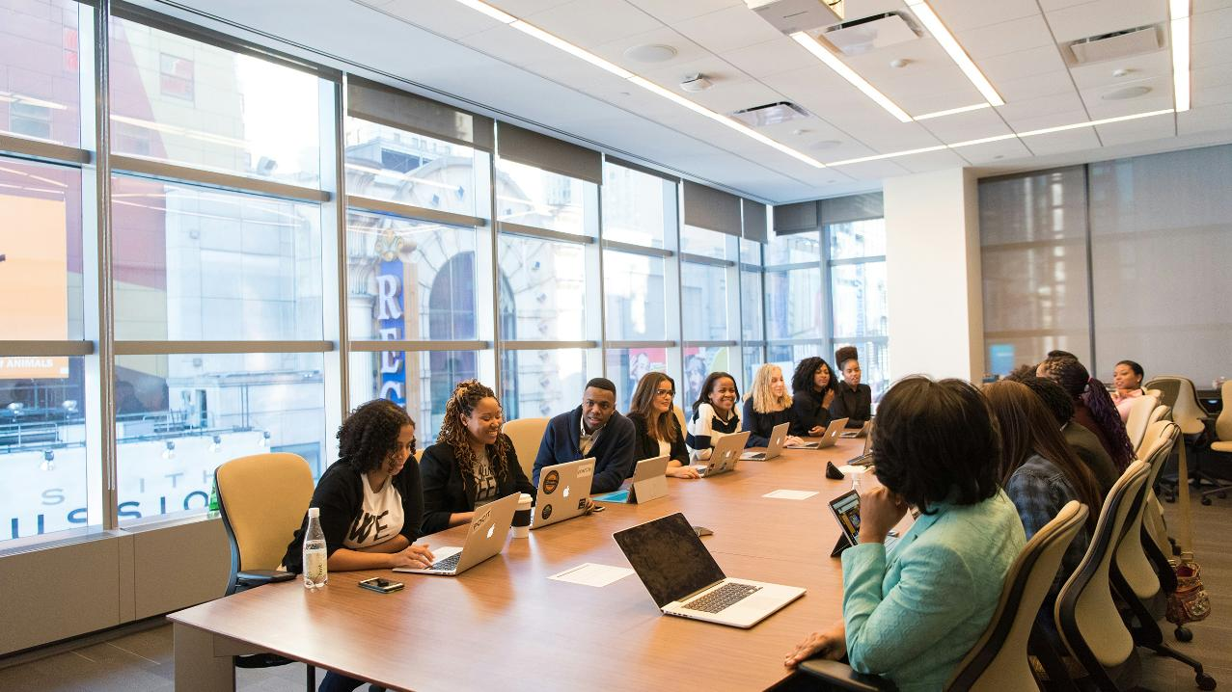
Member Engagement
Notes:
Time on slide: 30 seconds
Elapsed time: 43.5 minutes
Facilitator Notes:
Now let’s discuss your role in member engagement.

Slide 27
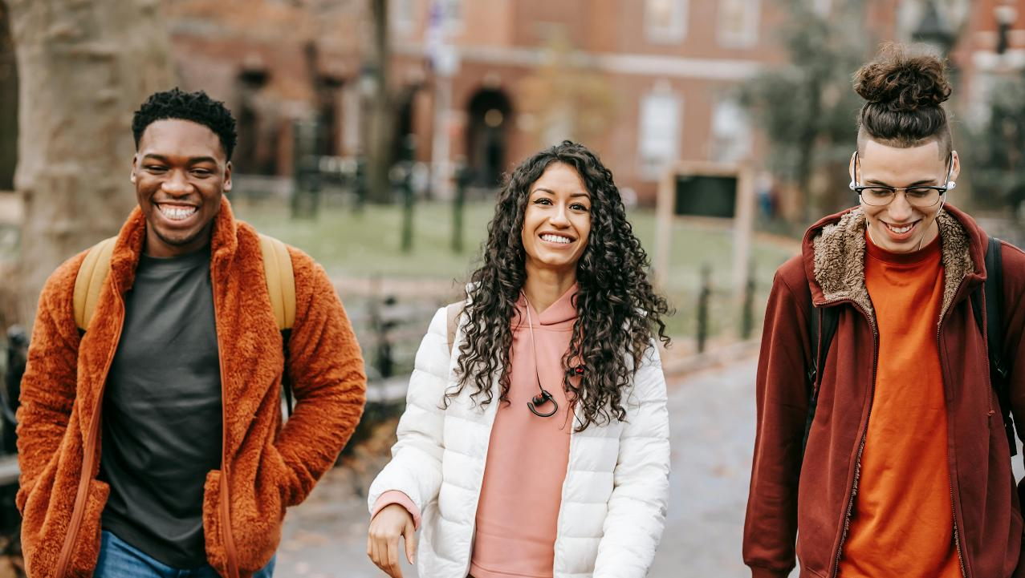
Social Activities
Notes:
Time on slide: 2.5 minutes
Elapsed time: 46 minutes
Facilitator Notes (30 seconds):
Member retention extends beyond meetings. It's about creating genuine community. Social activities are essential for building the connections that keep members committed. Whether it's monthly informal gatherings like coffee meetups or dinners, casual skill-building workshops, or collaborative events with other clubs, these opportunities for members to connect outside the formal agenda strengthen relationships and deepen club loyalty. Remember: members who find friendship alongside growth stay engaged for the long term.
Quick Engagement Questions (2 minutes total):
(Ask a few participants for brief answers to the questions below. Keep the discussion moving quickly (15-20 seconds per response) while acknowledging each contribution. Use members' suggestions to demonstrate how community-building is a collaborative effort. Conclude by encouraging everyone to participate in planning or attending an upcoming social activity, reinforcing that strong relationships are the foundation of sustained membership.)
How can we make our social events more inclusive for members with different schedules and interests? (Take 2-3 quick answers.)
What's one simple, low-effort social activity you could implement in the next month? (Take 2-3 short responses.)

Slide 28

Post-Meeting Socialization
Notes:
Time on slide: 2.5 minutes
Elapsed time: 48.5 minutes
Facilitator Notes (1 minute):
Post-Meeting Socialization
Post-meeting social time helps deepen bonds, strengthens member connections, and makes the club feel more like a community.
Actionable Tips:
Post-Meeting Food Tradition: Encourage members to share a light meal or snacks after meetings. Whether it's ordering pizza, going to a nearby café, or hosting a "bring-and-share" potluck once a month, food naturally sparks conversation and creates a relaxed, welcoming vibe.
Create a "Toastmasters Café" Atmosphere: Even for online meetings, set up a virtual "coffee chat" room post-meeting, where members bring their favorite drink or snack and chat informally for 15–20 minutes.
Make Guests Feel Included: Invite guests to join these post-meeting gatherings. Sharing a meal or snack together helps break the ice and makes them feel like part of the club community from day one.
Engagement Question (1.5 minutes):
(As officers share their ideas, highlight how these informal connections often become the foundation for mentoring relationships and member retention. Remind them that these social moments, though seemingly casual, are strategic investments in their club's long-term health.)
What simple post-meeting social activity could you implement immediately that would strengthen your club's sense of community? (Encourage officers to commit to trying one idea at their next meeting.)

Slide 29
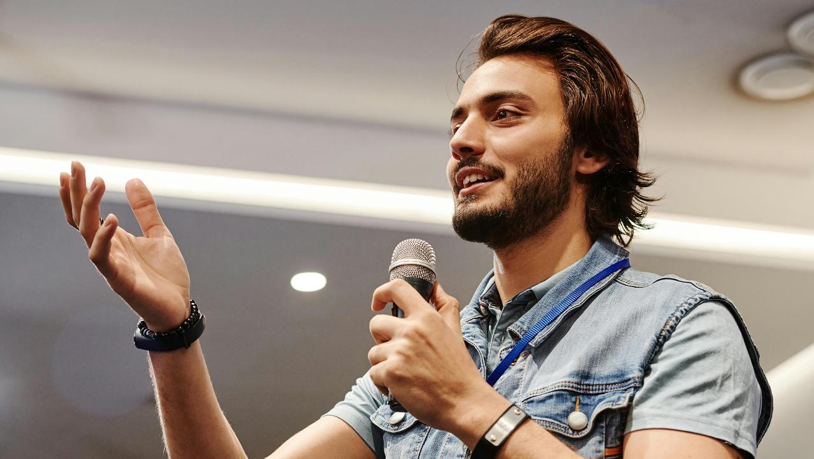
Uplifting Environment
A positive, welcoming club culture boosts retention and encourages members to
bring guests.
Notes:
Time on slide: 2.5 minutes
Elapsed time: 51 minutes
Facilitator Notes (1 minute):
An uplifting environment is key to creating a club where people feel inspired to stay and grow. A positive, welcoming club culture boosts retention and encourages members to bring guests.
Here are some ideas to put this into action:
Actionable Tips: Themed Meetings: Energize your meetings with fun themes like "Hollywood Night" or "Storytelling Café." Member Spotlights: Dedicate a few minutes each month to highlight a member's personal success story. In-Meeting Icebreakers: Add short, creative icebreakers to create positive energy. Celebrate Everything: From Pathways completions to "first-time Toastmaster of the Day" moments, recognize efforts! Create a Club Ritual: A light-hearted tradition, like ending every meeting with a fun quote, can build club spirit.
Remember, a club where people feel uplifted and appreciated will always outperform one that's purely task-focused.
Engagement Question (1.5 minutes):
(As a few officers to share their ideas in 15-20 seconds, highlighting how even small cultural elements can significantly impact the member experience and retention. Emphasize that the most effective traditions often reflect the unique personality of each club. Encourage officers to implement at least one new uplifting practice within their first month as VPM.)
What is one simple tradition or celebration you could introduce at your next meeting to boost your club’s positive energy? (Take several responses, encouraging creativity.)

Slide 30

Best Practices,
Metrics, and Resources
Notes:
Time on slide: 30 seconds
Elapsed time: 51.5 minutes
Facilitator Notes:
Now let’s finish strong by discussing best practices, metrics, and resources for your role.

Slide 31
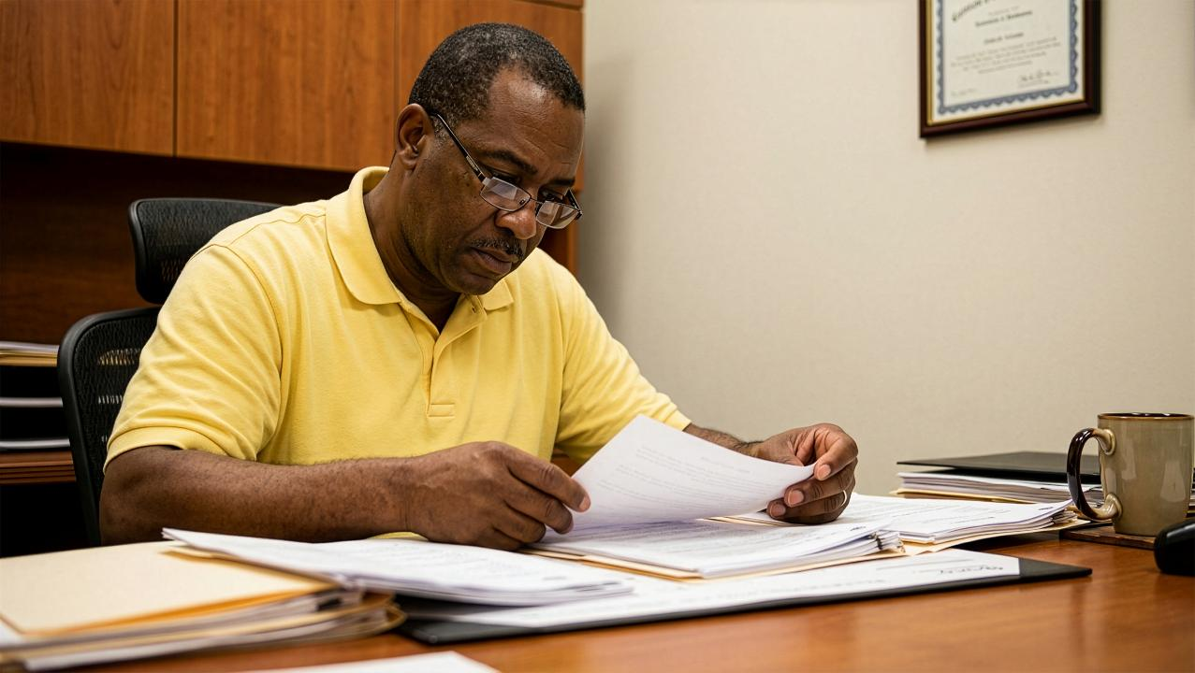
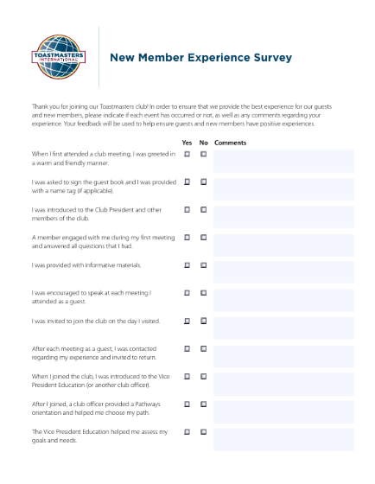
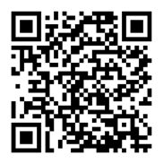
New Member Survey
Understand the new member experience
Improve onboarding
Guide follow-up and mentoring
Support continuous improvement
Notes:
Time on slide: 1.5 minutes
Elapsed time: 53 minutes
Facilitator Notes (1.5 minutes):
How should you conduct a New Member Survey?
Toastmasters International provides a ready-made survey template you can download directly from the TI website. (Scan QR code) This official template is designed to help you gather feedback that’s relevant and actionable.
Advice to a new member to fill out the form:
Check Yes or No for each question
Add comments if helpful
Takes two to three minutes to complete
Hand in to a club officer
New Member Experience Survey
Send this out about 30 days after someone joins. It helps you identify any gaps in the guest-to-member journey and make sure new members feel welcomed, informed, and engaged. If you see common issues among multiple new members, you can act quickly to improve the onboarding experience.
Quick Tips:
Share a quick summary of the survey results at a meeting or via email.
Show appreciation—thank members for their feedback and explain how you’re using it to improve the club.

Slide 32
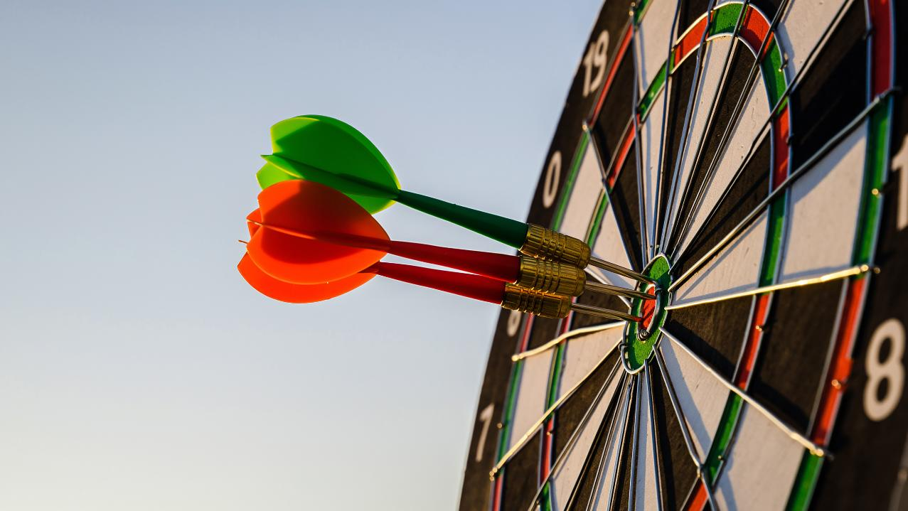
Measuring Success
What gets measured gets improved!
Notes:
Time on slide: 1.5 minutes
Elapsed time: 54.5 minutes
Facilitator Notes (1.5 minutes):
(Emphasize that data-driven membership management allows VPMs to identify trends and address issues before they become problems. Suggest creating a simple spreadsheet to track these metrics monthly and reviewing patterns quarterly. Remind officers that while the numbers matter, they represent real people and experiences, so each percentage point represents an opportunity to improve someone's Toastmasters journey. Encourage them to share these metrics regularly with their Executive Committee to maintain focus on membership health.)
As VPM, it's important to not just focus on activity, but also on results. Two key metrics will help you track how well your club is performing when it comes to membership:
1. Guest-to-Member Conversion Rate – This tracks how many guests actually become members. For example, if you had 10 guests visit in a month and 4 of them joined, that's a 40% conversion rate. Why it matters? A high conversion rate means your club is doing a great job with the guest experience and follow-up. If it's low, it could signal gaps in how you engage or follow up with visitors.
2. Retention Rate – Retention shows how many existing members renew when membership fees are due. If members stay year after year, it's a sign that they feel engaged, supported, and that the club is delivering value. If retention is dropping, it's time to evaluate why. Perhaps more member recognition or improved engagement is needed.
Quick Tips:
Track both metrics regularly, not just at membership renewal periods. Work with the Treasurer and Secretary to maintain accurate data. Use these insights to adjust your membership-building strategies and member support.
Remember: What gets measured gets improved! These numbers help you keep your club thriving.

Slide 33
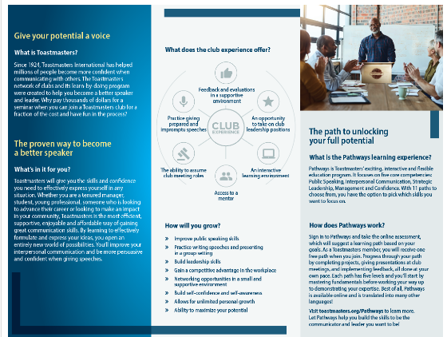
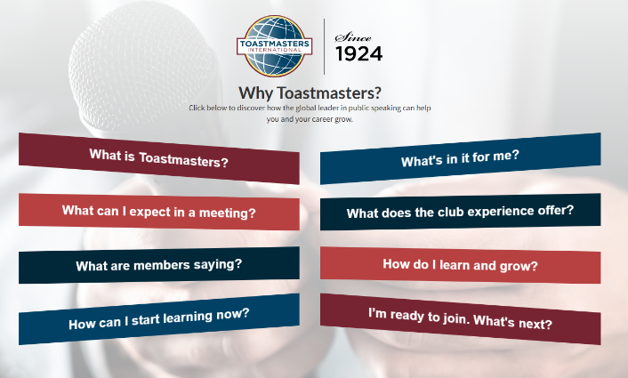
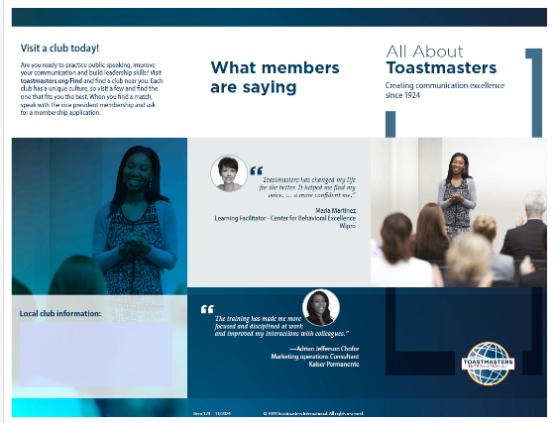
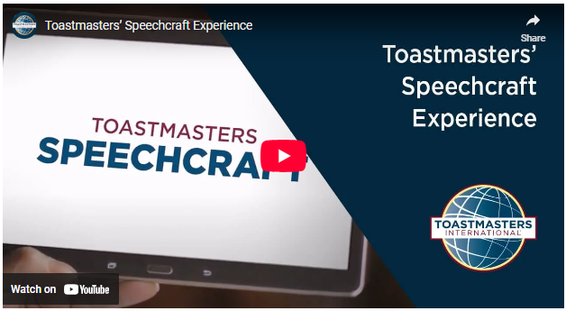
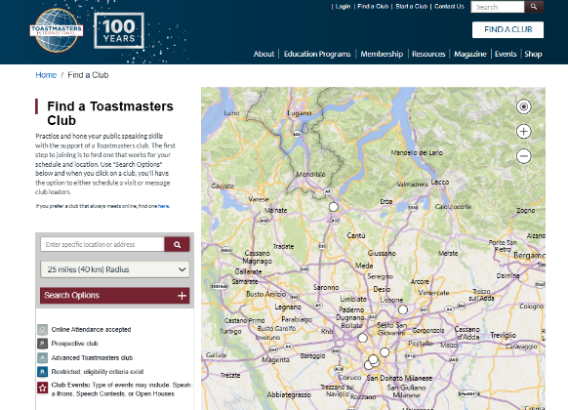
Tools and Templates to Save Time
Prospective Member Management Portal
Notes:
Time on slide: 2 minutes
Elapsed time: 56.5 minutes
Facilitator Notes (2 minutes):
Vice President Membership Toolkit
(These valuable resources will help VPMs perform their role more efficiently and professionally. Emphasize that using these pre-designed materials not only saves time but also ensures consistency with Toastmasters branding. Encourage them to explore the full toolkit during their first week in office and to leverage these resources throughout their term.)
As VPM, you wear many hats – from welcoming guests and profiling new members to promoting events and driving conversions. To streamline your workload and ensure a polished, professional image, Toastmasters International offers a suite of ready-to-use, customizable resources online.
Some examples are:
Prospective Member Management Portal in Club Central – Check here to reply to inquires and follow up with member prospects that have reached out to your club for information.
Prospective Member Follow-Up Email Templates – Nurture leads with informative, on-brand reminders about upcoming meetings and benefits.
Guest Follow-Up Email Templates – Engage first-time visitors with a warm, branded message that invites them back.
New Member Profile Sheet – Capture essential contact info and personal goals to tailor each member's experience.
Open House Slide Decks – Showcase your club's story and value in a sleek, prebuilt presentation.
Customizable Open House Flyers – Easily add your club logo, dates, and venue details to high-impact print or digital flyers.
Speechcraft Promotional Videos and much, much more – All tools are accessible via the Toastmasters website, but there is one tool that holds everything in the same place: The Club Marketing Guide.
(Point out that the centralized resource mentioned at the end is the Club Marketing Guide. You show it in the next slide.)

Slide 34
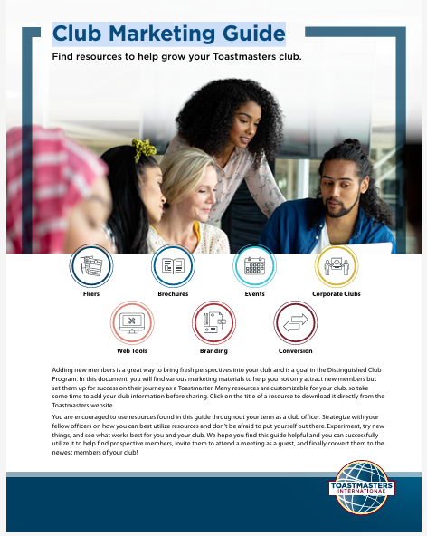
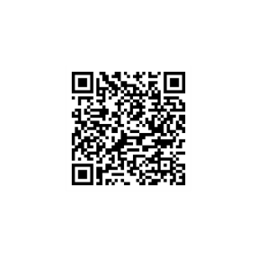
Club Marketing Guide
Flyers
Brochures
Events
Corporate Clubs
Web Tools
Branding
Conversion
Notes:
Time on slide: 1 minute
Elapsed time: 57.5 minutes
Facilitator Notes (1 minute):
(Encourage VPMs to bookmark the Club Marketing Guide and explore its contents within their first week as VPM. Using these professionally designed materials ensures consistency with the Toastmasters brand and saves VPMs the time and effort it takes to create marketing materials from scratch.)
Club Marketing Guide: This is your centralized online hub for every customizable tool you need. Email templates, slide decks, flyers, videos, and more, all in one convenient location. Access, download, and personalize these vetted resources to accelerate your membership-building efforts and maintain a consistent, professional brand.

Slide 35

Next Steps
Set clear goals
Customize your toolkit
Refine your follow-up process
Audit your current member roster
Plan member events
Notes:
Time on slide: 2 minutes
Elapsed time: 59.5 minutes
Facilitator Notes (1 minute):
To drive membership growth and retention, here are five key steps:
1. Set Clear Goals: Begin by defining your membership targets: new, renewing, and reinstated members aligned with the Distinguished Club Program metrics. Clear numbers give us focus and help rally the team.
2. Customize Your Toolkit: View the Club Marketing Guide and download ready-made assets: guest follow-ups, flyers, slide decks, and videos. Personalize them with your club's branding and upcoming dates to maintain a professional, consistent look.
3. Refine Your Follow-Up Process: Establish a simple, repeatable workflow: invite prospects, send a thank-you note within 48 hours, then a reminder about the next meeting. Log every interaction to ensure follow-through with every guest.
4. Audit Your Current Member Roster: Review your existing members: who's active, who's at risk of lapsing, and what every member’s goals are. This insight lets you tailor outreach, keeping current members engaged while targeting new audiences.
5. Plan Member Events: Map out key membership-building activities: Open Houses, demonstration meetings, Speechcraft workshops, and Youth Leadership Programs. Coordinate dates with the VP PR, secure venues or Zoom links, and schedule promotional blasts to maximize attendance.
Final Question for Action (1 minute):
(Time permitting, ask a few of the vice presidents to concisely verbalize their responses to the question below. But, ask every vice president to answer the question for themselves, to themselves. For those vice presidents who verbalize their next steps, note patterns and reinforce the importance of immediate action. Conclude by encouraging them to use the officer resources on the Toastmasters website and to reach out to their Area Director, if they need additional support. Remind them that consistent small actions, starting this week, will build the momentum needed for a successful term.)
Question: What is the very first action you will take in the next 48 hours when you return to your club as VPM? (Allow for as many responses as time permits and acknowledge each officer's commitment.)

Slide 36
Build Momentum in Your Club—Act Now!
Thank you for serving as a club officer!
Notes:
Time on slide: 30 seconds
Elapsed time: 60 minutes
Facilitator Notes:
Thank you for stepping up to serve as the Vice President Membership of your club! Your role is vital to your club’s success. Enjoy building membership in your club and strengthening relationships with all your members! Begin your role by reaching out now to all your current members!

