Slide 1
Unit 2 education
Extract 1 understanding education

Slide 2
Paragraph 1 The early forms of education
Language points:
1) Accumulate: v gradually get or gather together in an increasing number or quantity of sth； get sth in this way积累，聚积; 聚集而成某事物。
Eg Accumulate books, a library

Slide 3
Accumulate enough evidence to ensure his conviction
The accumulation of knowledge, experience
2).Term: call sth /sb by a certain name; name
Translate the sentence “ education is designed to…”

Slide 4
教育被设定为在学习文化的过程为他们起指导作用（ 教育是用来指导文化的学习），以成人的方式来塑造他们的行为，并把他们引向他们在社会中的最终角色。

Slide 5
3.Evolve: 1. (cause to) develop naturally and gradually
Eg The American constitution was planned, and the British constitution evolved
He has evolved a new theory after many years of research
2. gradually develop fro a simple form to a more complex one

Slide 6
Abstract: 1 分离的， 被分出的
Preoccupied; deep in thought出神的， 心不在焉的
Distill sth from sth: 1。蒸镏
2．Draw or derive sth from sth吸取或提取某事物
Eg useful advice distilled from a lifetime’s experience

Slide 7
Translate the sentence “ as society becomes ever more…”
随着社会日益复杂化，学校日益制度化，教育（工作）与日常生活的联系就不再那么直接，也不再是一个通过日常生活环境来演示和学习的问题，而是与日常生活越来越分离，越来越成为一个脱离具体环境而进行的提取，传授，和学习知识的过程。

Slide 8
Laden with sth: 1.loaded or weighted
Eg trees laden with apples
Shoppers with their baskets fully laden
2. troubled or burdended with sth
Laden with guilt, grief

Slide 9
Passage: 1. process of passing
Eg the passage of time
2. freedom or right to go through or across sth: 通行权， 通行自由
They were denied passage through the occupied territory.
3. way through sth通路， 通道
Force a passage through the crowd
A passage to some place

Slide 10
Elaborate: 1. adj very detailed and complicated; carefully prepared and finished.详尽而复杂；精心制作的
Elaborate plans
An elaborate five-course meal
Elaborate on : describe or explain sth in detail

Slide 11
Bureaucracy: system of government through department managed by state officials, not by elected representatives官僚制度；官僚作风
bureaucrat官员（尤指墨守成规的）
在世界范围内也可以看到更加正式，更加制度化的教育体制，在某些情况下，这些教育体制在它们的目的，构成，及目标方面显得不必要的精细和官僚化。

Slide 12
pedagogy: study or science of ways of and methods of teaching教育学；教学法
pedagogical of or concerning teaching methods教学法的

Slide 13
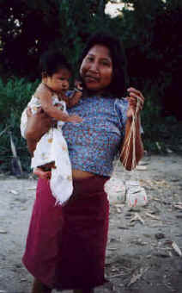
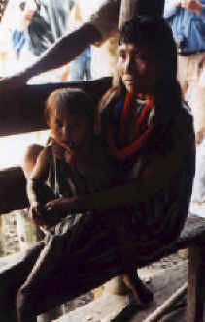
Warao Indians

Slide 14
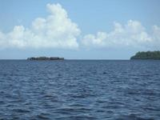
Orinoco Delta and ocean Peter and Jackie Main

Slide 15
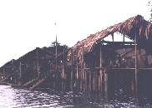

Slide 16
The Warao Indians live on the Orinoco River Delta in Venezuela (Map). The Orinoco is wider than the Mississippi. When it reaches the Delta emptying into the Atlantic Ocean, it creates a huge land area composed of many small rivers with numerous islands and marshes. The Warao Indians live in huts on stilts which usually have a thatched roof but no walls. A fire pit made of clay is in the center and the Indians sleep in hammocks. One year after

Slide 17
Columbus discovered the Orinoco Delta, Alonso de Ojeda sailed into the area, saw the huts on stilts over the water and named the area Venezuela or "Little Venice. The only mode of transportation for hundreds of miles is by bongo, or dugout canoe. The name Warao means literally "Boat People." Children here learn to paddle before they can walk.
They continue their traditional lifestyle of hunter/fishers.

Slide 18
Translate “ depending upon the specific..”
教育目标的范围依赖于一个国家或文化的具体需要，或受控于教育思想家的历史和文化局限性，因此，每个国家基本的教育目标范围各不相同。

Slide 19
1．他由于投资精明强而积蓄了一笔财产
2．房屋经常不打扫， 尘土就很快越积越多。
3． 从这个意义上来说， 它等同与社会学家所称作的社会化或文化适应性。
4．以成人的方式来塑造他们的行为。
5． 在最原始的文化中， 几乎没有正规的学习。

Slide 20
6． 整个的外部环境及人们的所有活动都被看成是学校和课堂。
7．在原始时代，学习和日常生活紧密地联系在一起。
8．在维多利亚时代， 许多人对于人是由低级生物进化而来的见解大为震惊。
9．这是一个时间问题，而不是态度问题。
10．你们既然了解这个理论，我也就不在多讲了。

Slide 21
11．基本的生存技能。
12．教育，无论是正式的还是非正式的，他的总体目标就是要传递技能，能力和价值观。
13．道德和价值观教育。
14．为了艺术而学习艺术
15．他为了家庭而努力工作。
16．通往成功之路。

Slide 22
生活教育(informal education)：一個成長歷程，使每個人從日常生活體驗中（如家庭、 朋友、傳媒或週遭環境的影響），建立自己的看法和價值觀、獲得技能和知識。 非正規 教育 (non formal education)：在正規教育以外的有系統的教育活動，透過特定的學習目标，服务有特定学习需要的人士

