Slide 1

VSS REPLACEMENT
WITH GIT
Horváth Áron
Magyari Zsuzsanna
Copyright © 2019 Accenture. All rights reserved.

Slide 2

FEATURES
TOOLS
AND
TECHNOLOGY
FUTURE DEVELOPMENT
THE STAGES
OF DEVELOPMENT
CHALLENGES
DURING
DEVELOPMENT
THE GOAL
OF THE PROJECT
USER
EXPERIENCE

Slide 3

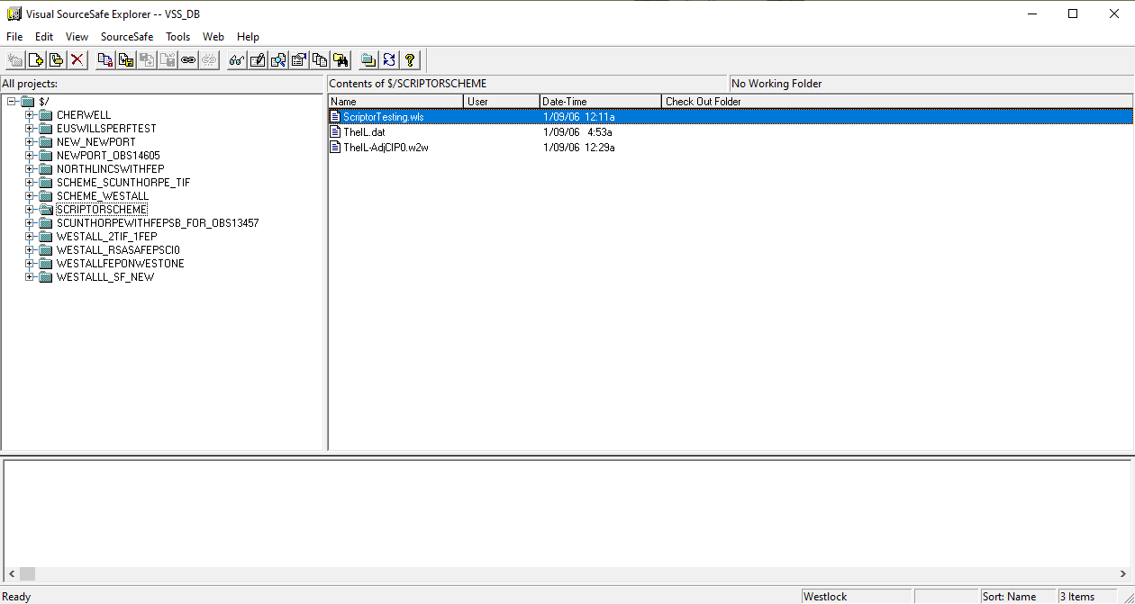
What does VSS look like?
Copyright © 2019 Accenture. All rights reserved.

Slide 4



THE GOAL OF THE PROJECT
To create an application interface identical to the Visual SourceSafe API, which was last released by Microsoft in 2005
To provide vital VSS functionalities by implementing git commands

Slide 5
FEATURES
TOOLS
AND
TECHNOLOGY
FUTURE DEVELOPMENT
THE STAGES
OF DEVELOPMENT
CHALLENGES
DURING
DEVELOPMENT
THE GOAL
OF THE PROJECT
USER
EXPERIENCE
Copyright © 2019 Accenture. All rights reserved.

Slide 6






TOOLS AND TECHNOLOGY
Notepad++
Visual Studio 2019
Qt Creator
Batch Script
DLL
C++
Copyright © 2019 Accenture. All rights reserved.

Slide 7
FEATURES
TOOLS
AND
TECHNOLOGY
FUTURE DEVELOPMENT
THE STAGES
OF DEVELOPMENT
CHALLENGES
DURING
DEVELOPMENT
THE GOAL
OF THE PROJECT
USER
EXPERIENCE
Copyright © 2019 Accenture. All rights reserved.

Slide 8

THE STAGES OF DEVELOPMENT
Identifying the commands
VSS | GIT
Set working folder | init
Add files/Check in | add, commit
Check out | fetch, checkout
Rename | mv
Delete | rm
View/Edit file | show
Export project | checkout-index -a -f --prefix
Export folder | archive --format zip --output
Copyright © 2019 Accenture. All rights reserved.

Slide 9

THE STAGES OF DEVELOPMENT
Copyright © 2019 Accenture. All rights reserved.

Slide 10
FEATURES
TOOLS
AND
TECHNOLOGY
FUTURE DEVELOPMENT
THE STAGES
OF DEVELOPMENT
CHALLENGES
DURING
DEVELOPMENT
THE GOAL
OF THE PROJECT
USER
EXPERIENCE
Copyright © 2019 Accenture. All rights reserved.

Slide 11










FEATURES
View file
Edit file
Set working folder
Check out
Check in
Add files/folder
Rename
Delete
Export project/folder
Copyright © 2019 Accenture. All rights reserved.

Slide 12
FEATURES
TOOLS
AND
TECHNOLOGY
FUTURE DEVELOPMENT
THE STAGES
OF DEVELOPMENT
CHALLENGES
DURING
DEVELOPMENT
THE GOAL
OF THE PROJECT
USER
EXPERIENCE
Copyright © 2019 Accenture. All rights reserved.

Slide 13
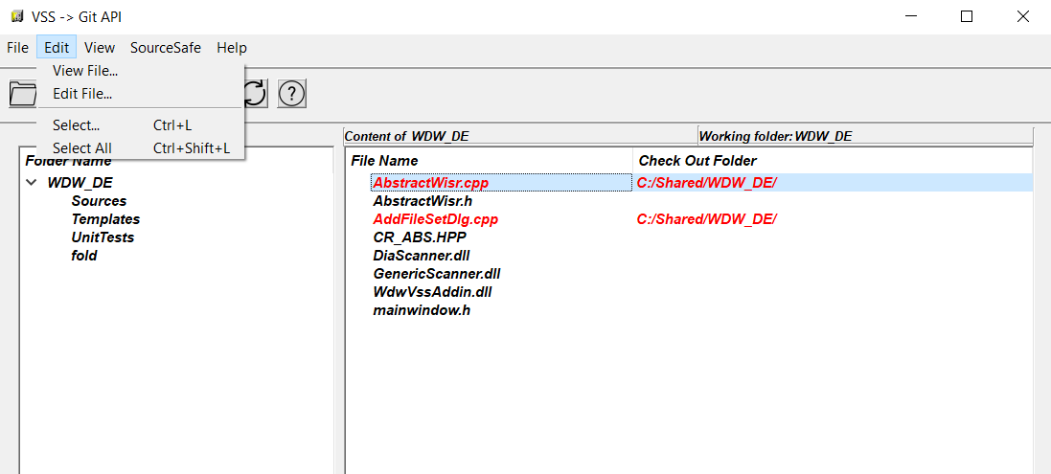
USER EXPERIENCE
Shortcuts
Menubar
Copyright © 2019 Accenture. All rights reserved.

Slide 14
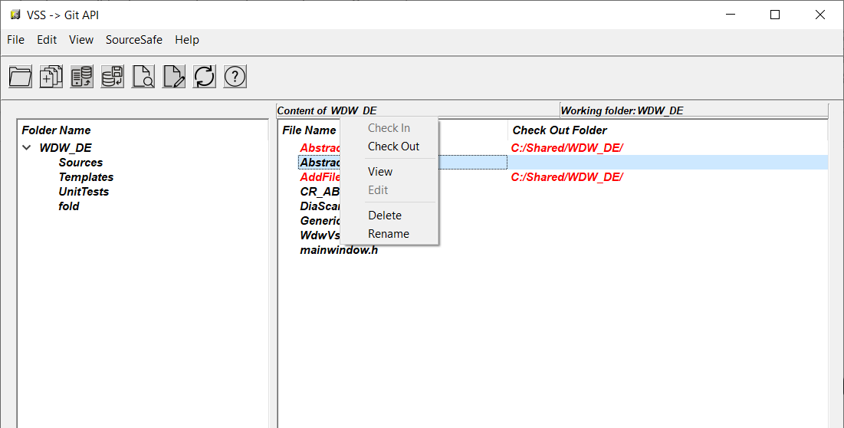
USER EXPERIENCE
Context menu
Buttons
Copyright © 2019 Accenture. All rights reserved.

Slide 15
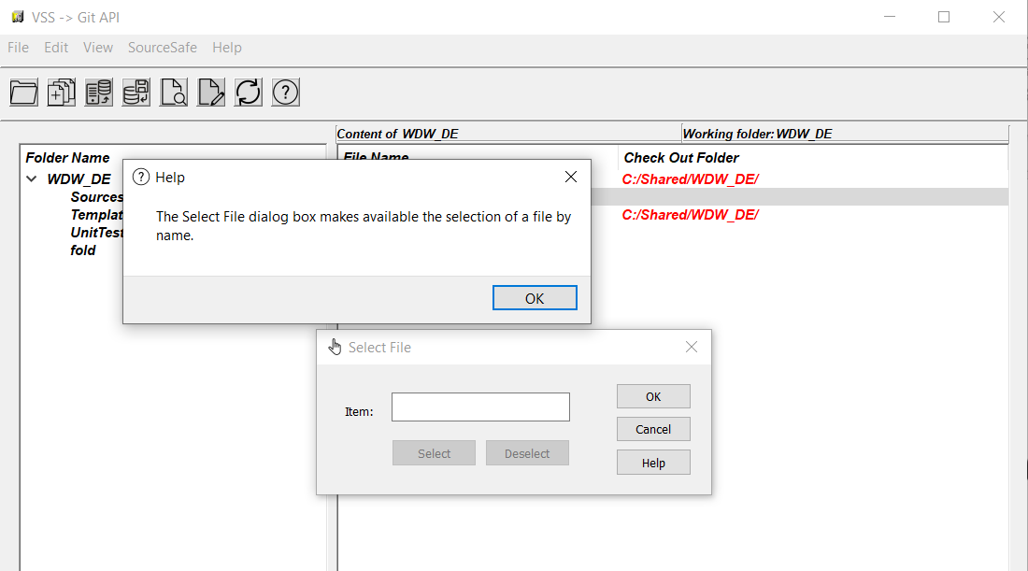
USER EXPERIENCE
Help buttons
Copyright © 2019 Accenture. All rights reserved.

Slide 16
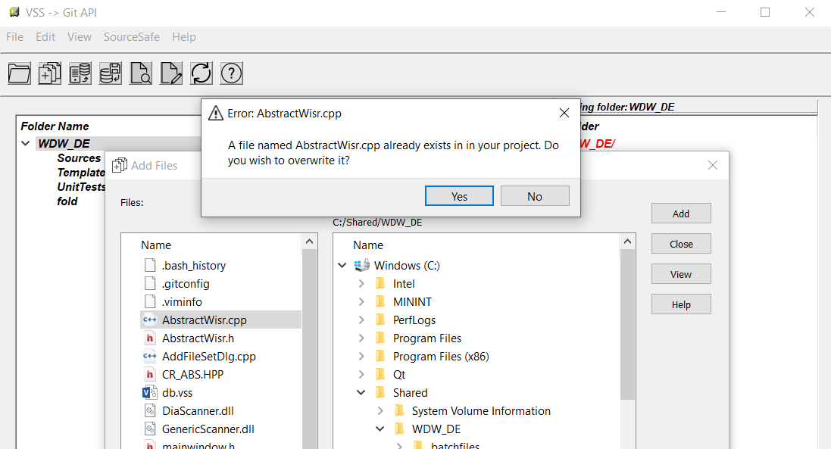
USER EXPERIENCE
Constant feedback
Copyright © 2019 Accenture. All rights reserved.

Slide 17
FEATURES
TOOLS
AND
TECHNOLOGY
FUTURE DEVELOPMENT
THE STAGES
OF DEVELOPMENT
CHALLENGES
DURING
DEVELOPMENT
THE GOAL
OF THE PROJECT
USER
EXPERIENCE
Copyright © 2019 Accenture. All rights reserved.

Slide 18

CHALLENGES DURING DEVELOPMENT
Linking DLL in Qt Creator
Scenario planning: - where would the user click
- what could possibly go wrong in the GUI
Copyright © 2019 Accenture. All rights reserved.

Slide 19
FEATURES
TOOLS
AND
TECHNOLOGY
FUTURE DEVELOPMENT
THE STAGES
OF DEVELOPMENT
CHALLENGES
DURING
DEVELOPMENT
THE GOAL
OF THE PROJECT
USER
EXPERIENCE
Copyright © 2019 Accenture. All rights reserved.

Slide 20

FUTURE DEVELOPMENT
Additional features: version history and diff
Introducing users, user rights and log in
Copyright © 2019 Accenture. All rights reserved.

Slide 21

LIVE DEMO
Copyright © 2019 Accenture. All rights reserved.

Slide 22
Thank you
for your attention.
Copyright © 2019 Accenture. All rights reserved.

Slide 23

Copyright © 2019 Accenture. All rights reserved.

