Slide 1
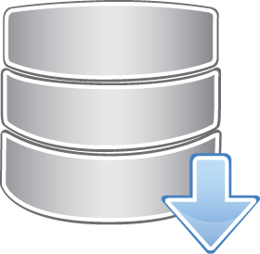
HPC/Mobile
Applications store
data in local storage
R-Drive
CLI/API
R-MStorm
ATAK
Survey
123
Applications store data in R-Drive
via CLI or API
Storing fragments
in local storage
R-Drive
Service
registration
and metadata
updates
Pulling data
from local
storage
Resilient
data
comm.
Application
metadata
RSock
EdgeKeeper
Local Storage

