Slide 1
双向变换的理论与应用的研究
A Bidirectional Preprocessor
吴逸鸣，吴阳怿 ，吴争铠

Slide 2
Outline
Background & Motivation
Design
Next Step
My Work
Conclusion

Slide 3
Background
GenProg
PAR
Automatic Repair Tool
SemFix
Minthint

Slide 4
Background
Preprocess problem for Automatic Repair Tools

Slide 5
Preprocess is Complex
#define free(x), x=null
/*If the Automatic Tool inserts this piece of code*/
if (p != null)
{
free(p);
}
#define g(x,y), x+y
#define h(x), x*x
#define NUM, 3
#define f(x,y), g(x,y)+h(x)+NUM
f(a,b) -> a+b+a*a+3 -> a+b+b*a+3
Should we delete the macro call?
or Should we make it g(a,b)+b*a+NUM?

Slide 6
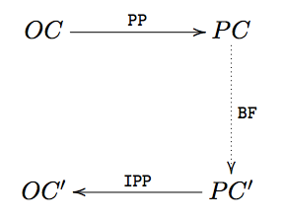
A Bidirectional Preprocessor
-BXP

Slide 7
Four Properties
Soundness - BXP should be change the semantic
Optimum - BXP should eliminate least macro calls
Coverage - BXP should give all possible solutions
Completeness - BXP should warn if there is no possible solution

Slide 8
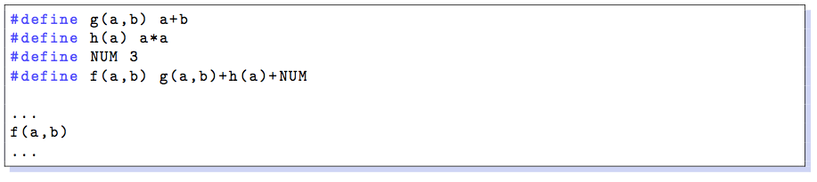
MEDG - Macro Expansion Dependency Graph

Slide 9
MEDG - Macro Expansion Dependency Graph

Slide 10
MEDG - Macro Expansion Dependency Graph

Slide 11
Next Step
A complete implementation based on Boost - already have a one way preprocessor
A better definition of Optimum

Slide 12
My Work
Co-design ‘A bidirectional transformation model based on context free grammars’
Co-design Bidirectional Preprocessor
A case study of macro calls in Linux kernel
Working on Boost lib…

Slide 13
Conclusion
1 excellent paper, 1 journal paper
2 bidirectional tools
Much Research Experience

Slide 14
Thank you!

