Slide 1
BlogAll
The Public Blog
Uday Bhargavi Meduri(jc444601)
Priya Mehta(jc442658)
Anukrit Gaur(jc442707)
Harpal Singh(jc333571)

Slide 2
Contents
Introduction
Project Concept
Project Objectives
Scope of Work & Features
What is new?
Target Audience
How does it generate revenue?
Development Life-Cycle
Technologies
Work Distribution
Schedule
Future Scope
Conclusion

Slide 3
Introduction
This section talks about:
What is a blog?
What are the categories of blog available?
Why is it popular?
What are its features?
What new can be done in the field?
A description of blog backend with pictorial depiction

Slide 4
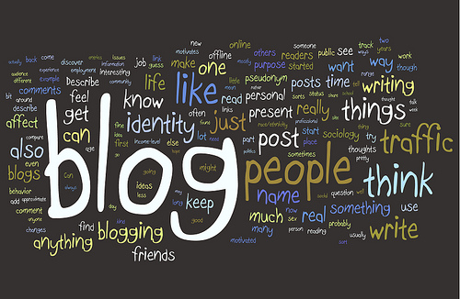
Introduction(Contd.)
A blog is a way of sharing articles in today’s world
Blog is a community of people sharing and reading content
Today there are blogs in almost every category – Travel, Life, Philosophy, Psychology, Technology, Economy and many other such topics

Slide 5
Introduction(Contd.)
Some famous blogs are:
http://GaryVaynerchuk.com
http://seomoz.org/
http://smartpassiveincome.com/
http://Copyblogger.com
http://thedishdaily.com
http://tmz.com
http://techcrunch.com
http://fourhourworkweek.com/blog
http://timothysykes.com
http://problogger.net

Slide 6
Introduction(Contd.)
Common things about blogs:
All blogs need content
All blogs require visitors
Their revenue is mostly through advertisements
They provide content to users in a pleasing manner
They have a backend dedicated to managing content
Missing features in today’s blogs
Not all blogs allow people to write content as per their wish
Blogs pay for articles they need and not for the articles authors create
Blog rely on advertisement for revenue. No other medium to leverage on

Slide 7
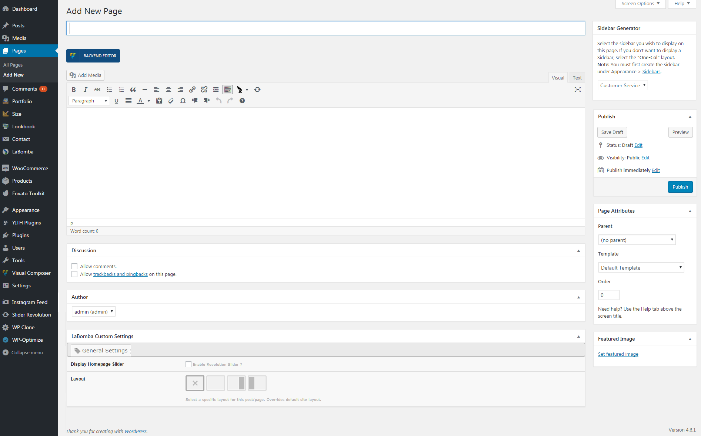
Introduction(Contd.)
The screenshot below shows a typical blog author screen
http://support.daffyhazan.com/online-docs/wp-content/uploads/page-creation-2.png

Slide 8
Introduction(Contd.)
The picture shows 3 basic components
Content Writing editor
A left panel menu
A post category selection to select blog type

Slide 9
Project Concept
This section discusses about:
What our project is about?
How it is different from others?
What will be our marketing strategy(in brief)?
How will we earn our revenue?
How it will be beneficial to the crowd?
Demo Layout of the website

Slide 10
Project Concept(Contd.)
Our project tries to cope up all the drawbacks of today’s blog
We believe in making things work differently and in a more friendly way
We believe we should fuel talent and earn from the market needs
This has brought us to the concept of “BlogAll”

Slide 11
Project Concept(Contd.)
Our project BlogAll – will be one of its kind Blog
It will be a platform for users to share information that they wish to
It will be a free platform for authors to write what they wish
The project administrator will just filter the content to make sure it isn’t anything objectionable

Slide 12
Project Concept(Contd.)
Our Blog will allow utterly any user to be a reader or writer.
To be a writer, all you need is to Register
Visitors will have facility to read what they want
There will be filters for content

Slide 13
Project Concept(Contd)
The content will be categories
As a means to generate revenue, we will gradually move towards advertisements
The adverts won’t be the only source
The main source of revenue will be content itself
Writers will be allowed to sell content on our blog

Slide 14
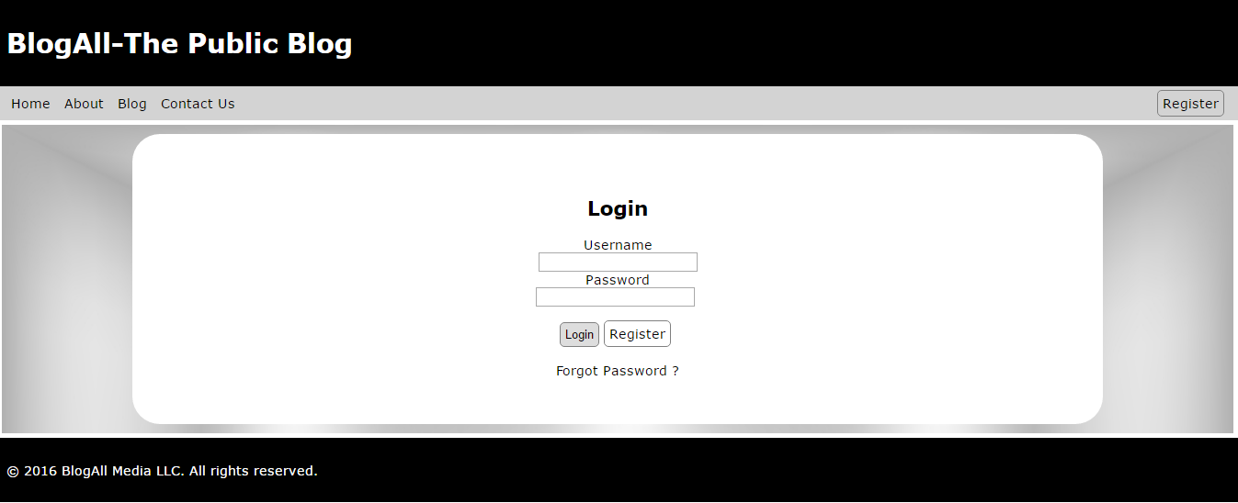
Project Concept(Contd.)
Demo Login Screen

Slide 15
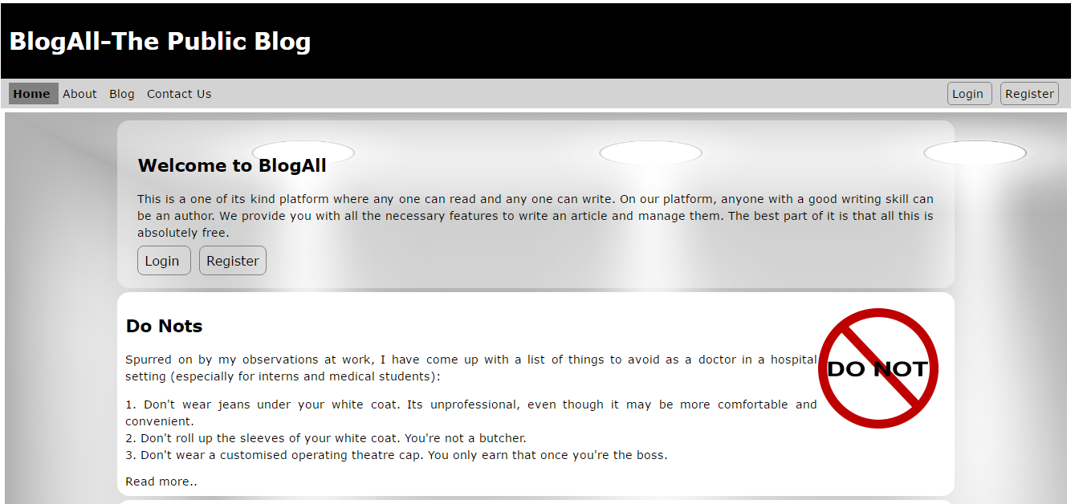
Project Concept(Contd.)
Demo Home page

Slide 16
Project Objectives
This section discusses about:
What are the main features we target?
What are the milestones?
What will be the difference that we will create?
How we will establish ourselves in the market?

Slide 17
Project Objectives(Contd.)
Provide Categorized blog content
Provide user login and registration facility
Provide article writing interface
Provide article management interface
Allow visitors to filter content
Generate constant traffic of visitors

Slide 18
Project Objectives(Contd.)
Market the content
Gain advertisement affiliations
Develop platform to securely sell content
Invent a way to sell content without exposing it entirely
Get famous bloggers to write for us
Become a one stop content solution

Slide 19
Scope of Work & Features
The scope of work for the project involves developing the below features:
Categorized and pleasing reading interface
Content search and filters
User registration and login
User management backend to control spamming
Article creation backend
Article management backend
Article approval task flow

Slide 20
What is new ?
Multi-author blog : The blog will allow multiple author to write content without any restriction
Free Blogging Platform: The content written by authors will be here for lifetime without any charges

Slide 21
What is new?
Content Marketing: In the long run, we target to sell the content to organizations in need
Easy to use platform for non-tech users: The platform is expected to have a simple interface rather than having more fancy controls.

Slide 22
Target Audience
Avid Readers
Famous Bloggers
Content Buyers
Content Critics
Freelance bloggers

Slide 23
Revenue Generation
Any online business generates revenue by 2 means:
Sell something
Refer to someone else’s items
Our Blog will rely on both
We would sell content securely
We would place affiliate adverts to earn commissions

Slide 24
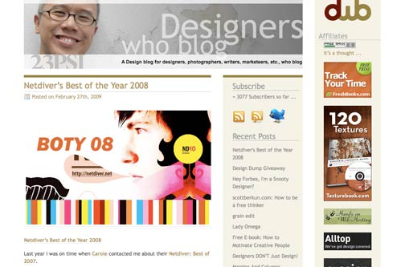
Revenue Generation(Contd.)
Advertisements samples

Slide 25
Development Lifecycle
When it comes to development, it is important to follow a well defined path
The next slide shows an image of such a path
It describes how the entire development phase is divided into 6 parts
This section describes each of them

Slide 26
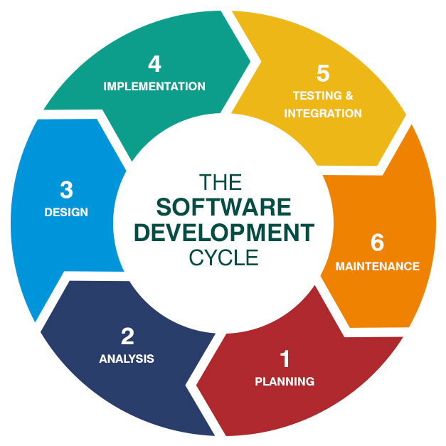
Development Lifecycle(Contd.)
Image Source: http://online.husson.edu/wp-content/uploads/2016/03/627x627-SftwareDev-Feature-HUSS.jpg

Slide 27
Development Lifecycle(Contd.)
Planning: Decide on available technologies
Analysis : Analyze benefits of each based on requirement
Design: Develop wireframes as plain web pages
Implementation: Implement the complete project

Slide 28
Development Lifecycle(Contd.)
Testing & Integration: Test the complete website functionalities
Maintenance: Keep maintaining the website to avoid spams and overload

Slide 29
Technologies – Definition & Need
Being an online platform it is highly important to decide on what technologies we’ll be using
The technology will not only affect the visual appearance of the website but also affect its performance and development time
The technology base is divided into 2 sections
Frontend: The technology which governs how the website will appear visually
Backend: The technology which governs how the website will function and handle data

Slide 30
Technologies - Overview
The following technologies have been shortlisted for the project
Frontend
HTML
Javascript
CSS
Backend
PHP
MySQL Database

Slide 31
Technologies - Overview
Tools/Software packages to be used:
Sublime Text/ Notepad++
XAMPP
MySQL Workbench
Chrome Browser

Slide 32
Technologies Frontend- Detail
HTML
HTML will be used for preparing the basic web page skeleton
CSS
CSS will be used to style up the web pages and give proper color scheme
JavaScript
JavaScript will be used to handle button clicks and validations in forms

Slide 33
Technologies Backend- Detail
PHP
PHP will be the backend language which will communicate with the frontend as well as database
MySQL Database
Any interactive web platform needs to store data. We have selected MySQL database because it is free and easy to use

Slide 34
Work Distribution
Each project planning ends with an even distribution of work between team members
Efficient work distribution makes a huge project a success
It helps in managing tasks in the form of modules
Every member is responsible only for the assigned tasks
We have distributed the work so that there is maximum independence in doing the task

Slide 35
Work Distribution
Anukrit Gaur
Develop Basic template for a post
Develop login page
Harpal Singh
Test the registration
Bhargavi Meduri
Develop Home Page, Contact page and navigation bar
Priya Singh
Develop Home Page, Contact page and navigation bar
Develop login frontend and backend
Contact page and navigation bar
Database design
Database design
Develop article
Database design
Test adding of articles and managing of articles
Test article and user approval
Database design

Slide 36
Schedule
Every project needs to be planned with milestones
We have prepared a similar plan
The responsibilities have been distributed in such a way that the tasks remain independent
The schedule has been prepared keeping a buffer of 1 week to manage the tasks well
The next slide shows our schedule in the form of Gantt Chart

Slide 37
Future Scope
The following features can be thought for in future:
Maintaining content privacy
Adding payment gateways
Making membership premium to promote certain authors
Enable commission management and payments automation

Slide 38
Conclusion
The project targets development of autonomous platform generating revenue
The only maintenance involved will be user and article approval
The website marketing and development will be the major point of investment
The expected breakeven time is 1 year

Slide 39
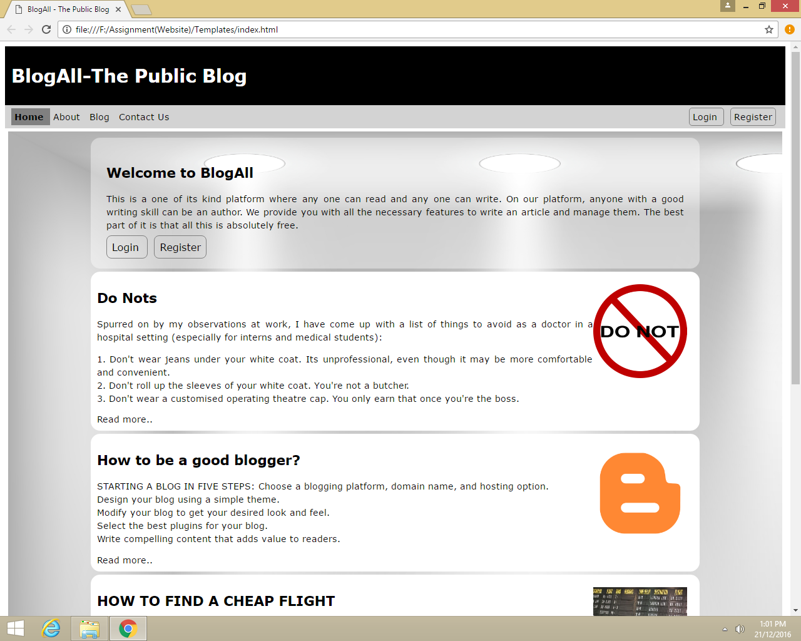

Slide 40
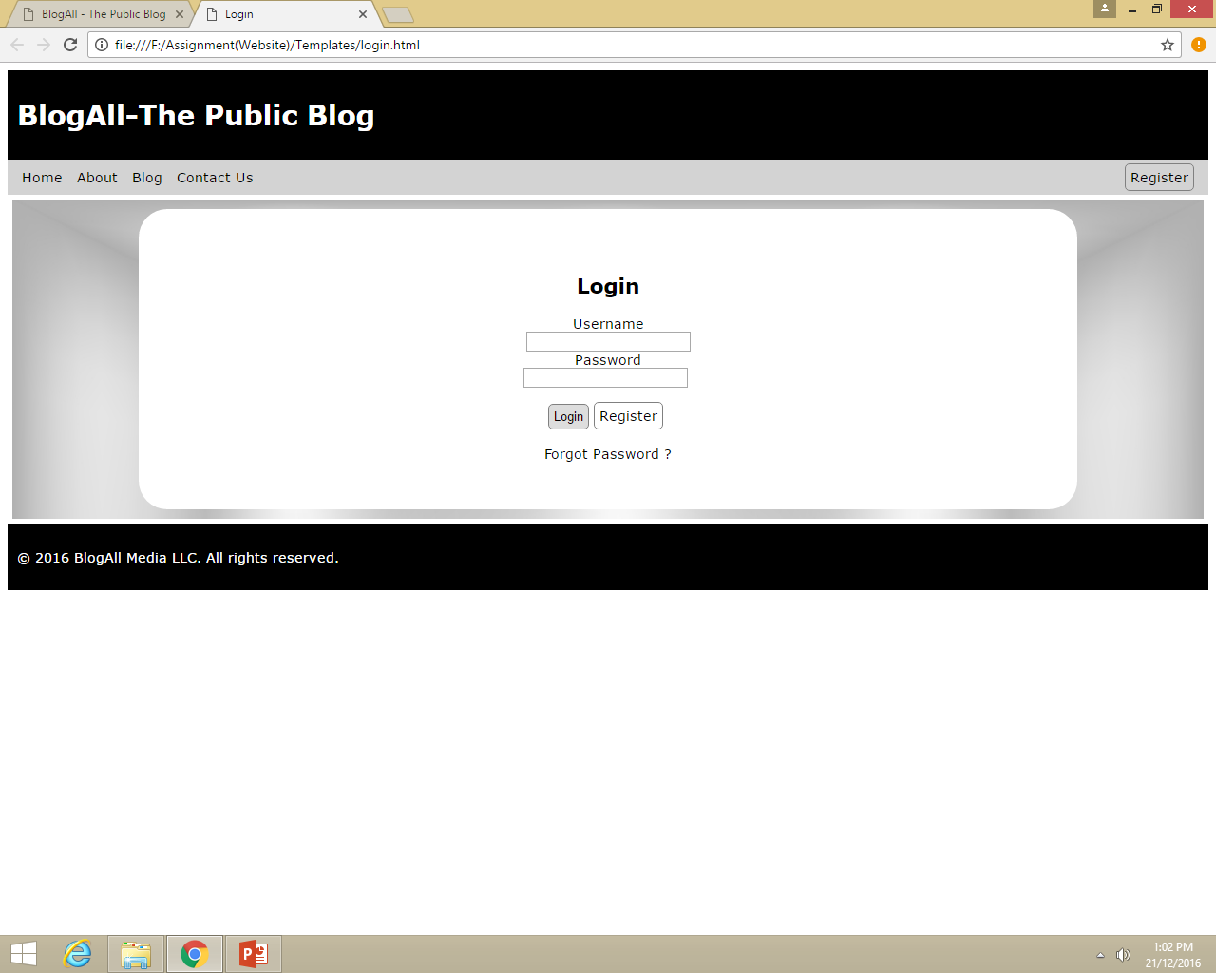

Slide 41
