Slide 1


NextMatch
AIDI 2005 Capstone Term 2
Project Title: Next Word Predictor
Group Members: 1) Vijay Kathiravan - 100933014 2) Rajeshkumar Govindasamy - 100901317 3) Rupisha Patel - 100935688 4) Harpalsinh Vaghela - 100892094 5) Yashkumar Patel - 100873142
Guided by:
Prof. Marcos Bittencourt

Slide 2

Abstract
The NextMatch is an AI-based tool, that analyses the text, identifies the patterns and recognizes the next most relevant word for the various chat-based applications.
The model will consider the last word of a particular sentence and predict the next possible word. We will be using methods of natural language processing, language modelling, and deep learning.
Since we do not have to write the whole sentence manually, it removes the language barrier, saves time and prevents spelling mistakes.

Slide 3
Project Timeline
Project-Kickoff (2/5/2024)
MVP (2/26/2024)
MMP (4/8/2024)
Final Presentation (4/15/2024)

Slide 4
Process Flow
Frontend Development
Data Collection
Data Processing/Cleaning
Words Tokenizing
Model Training
Deployment And Testing

Slide 5
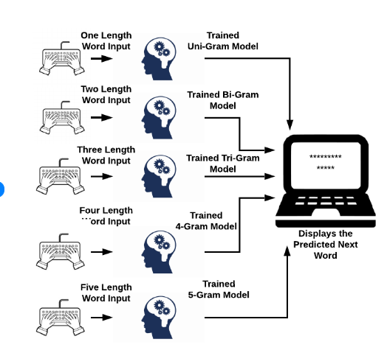

Slide 6
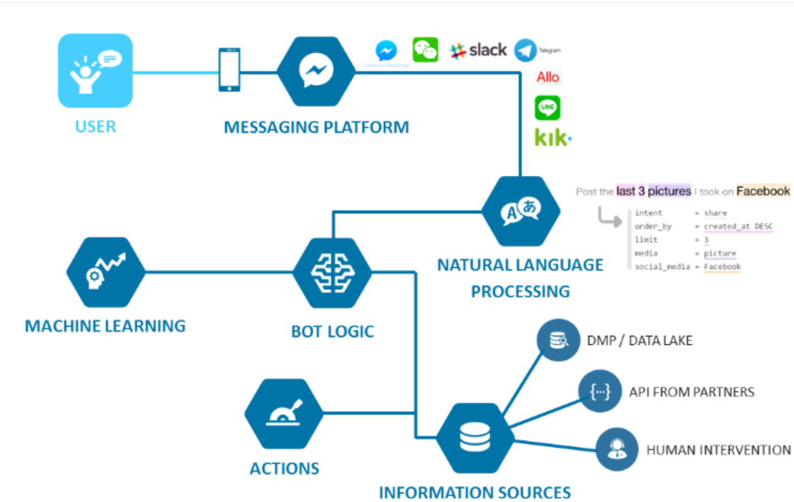
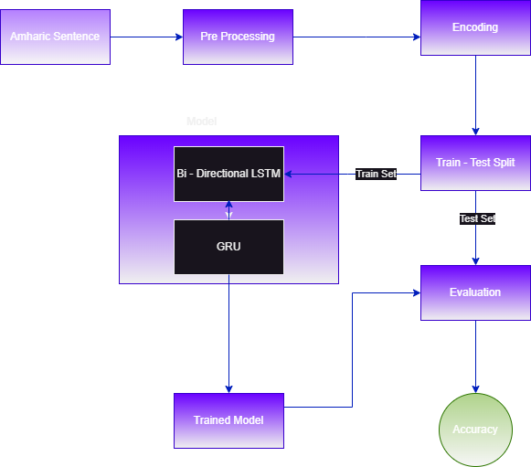
Architecture

Slide 7

AI Features
Text Tokenization
Simple Predictive Model
Deep Learning Model
Predictive Text Expansion
Personalization

Slide 8

Project repo link: Click here!

