Slide 1




NextMatch
AIDI 2005 Capstone Term 2
Yashkumar Patel - 100873142
Rajeshkumar Govindasamy - 100901317
Rupisha Patel - 100935688
Harpalsinh Vaghela - 100892094
Vijay Kathiravan - 100933014
Guided by:
Prof. Marcos Bittencourt

Slide 2
Introduction
The NextMatch is an AI-based tool, that analyses the text, identifies the patterns and recognizes the next most relevant word for the various chat-based applications.
The model will consider the last word of a particular sentence and predict the next possible word. We will be using methods of natural language processing, language modelling, and deep learning.
Since we do not have to write the whole sentence manually, it removes the language barrier, saves time and prevents spelling mistakes.

Slide 3
Basic and Advanced Features
Text Tokenization
Word Frequency Analysis
Confidence Score
Simple Predictive Model
User Interface
Deep Learning Model
Predictive Text Expansion
API Integration

Slide 4
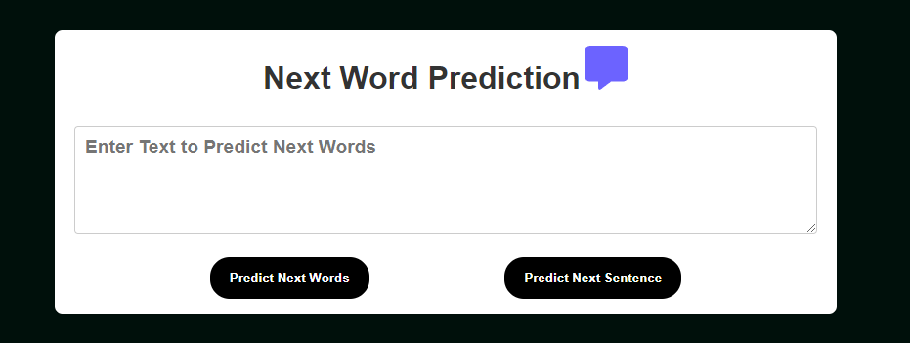
User Interface

Slide 5
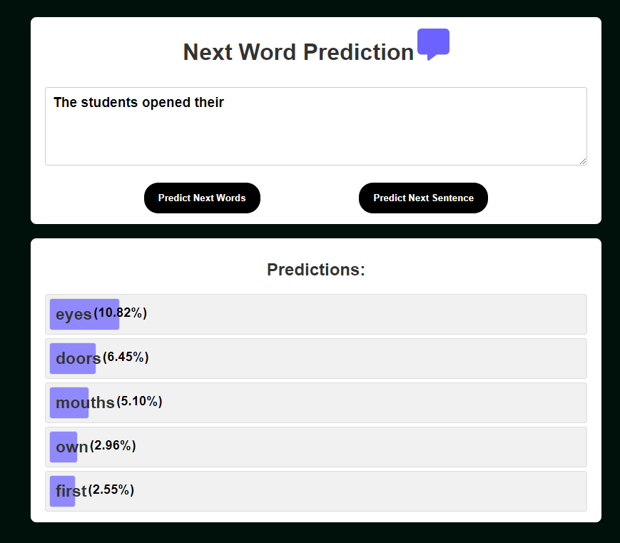
Example for next word

Slide 6
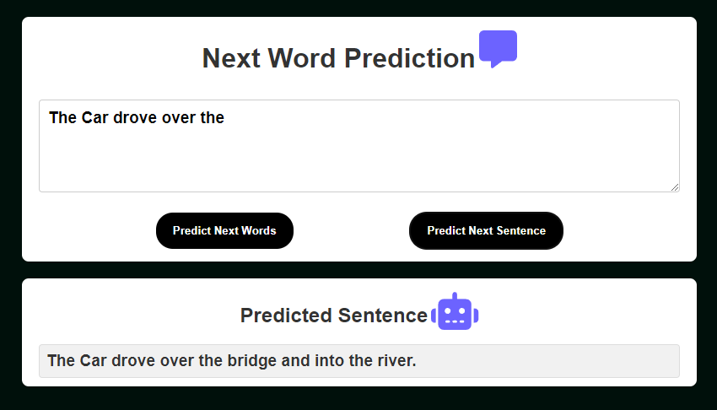
Example for next sentence

Slide 7
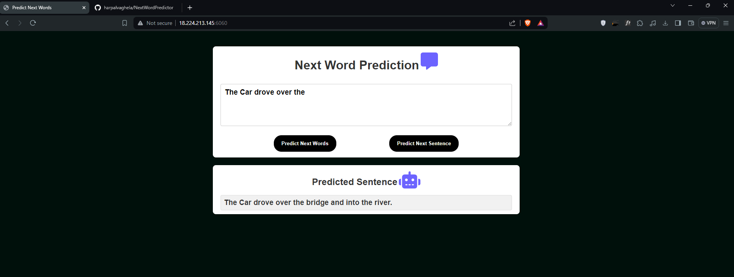

Slide 8
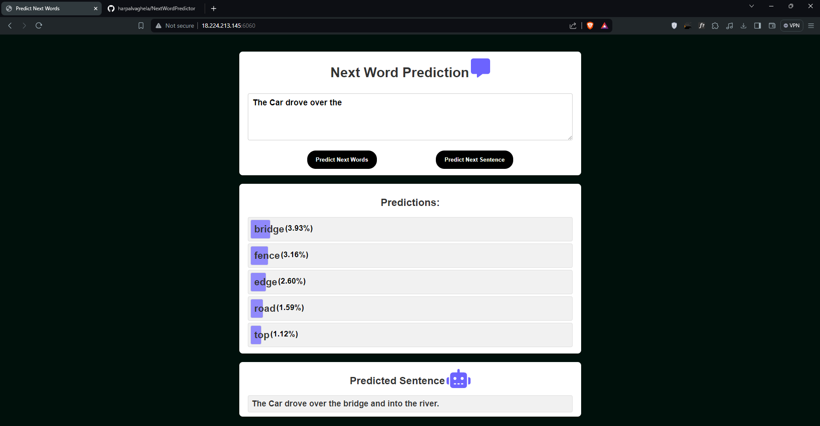

Slide 9
Thank You

