Slide 1
Woolly apple aphid and earwig modelling
Hayden Tempest

Slide 2
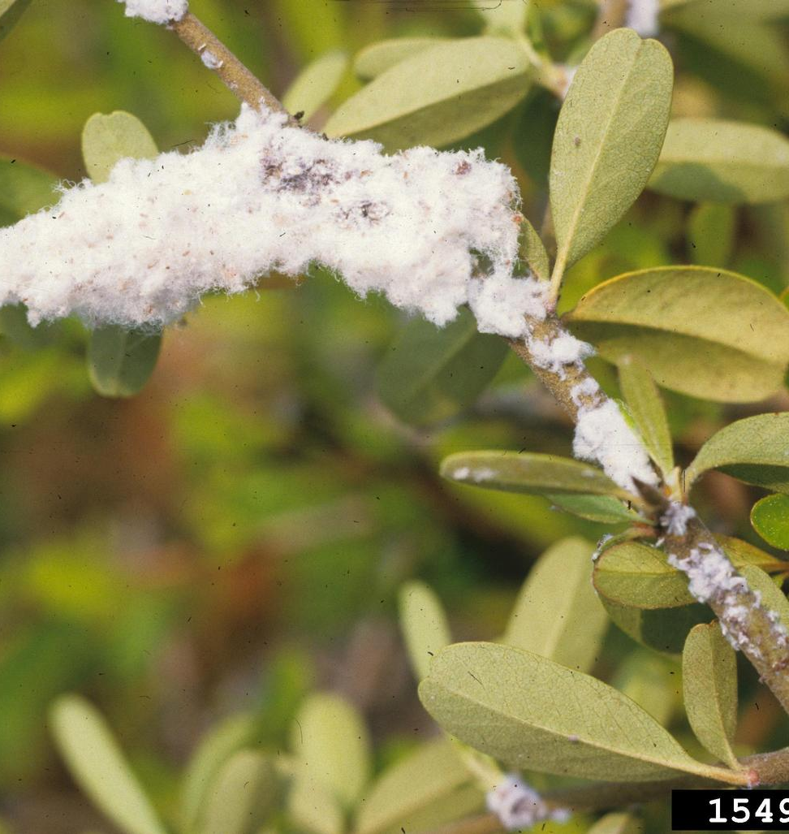
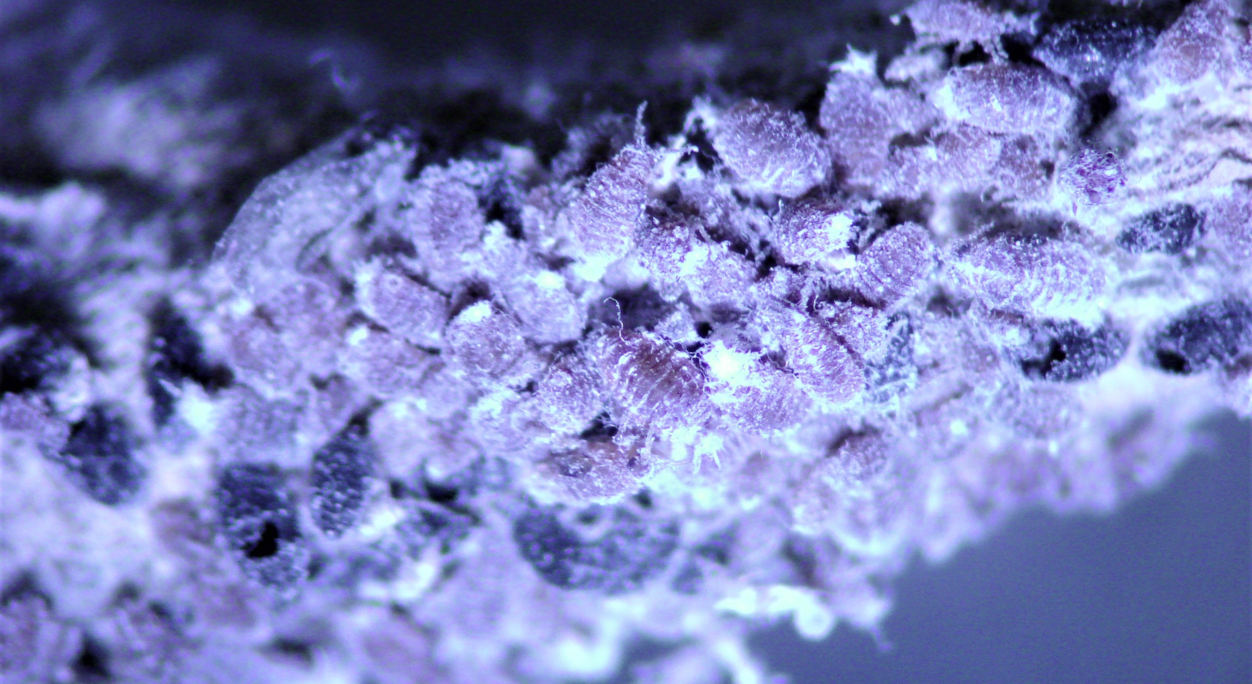
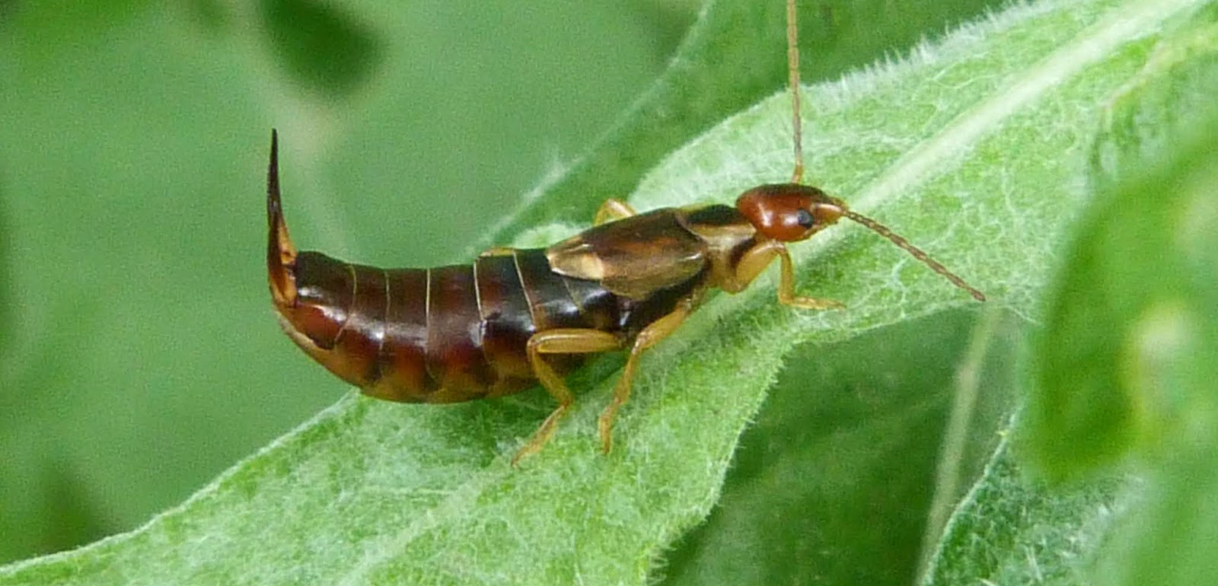

Slide 3
Cut to raw data

Slide 4
My variables
Dependent variables
Independent variables ‘Explanatory factors’
Labels
Geographic area Farming system Orchard age Rows per bed Moss score Algae score
WAA count Earwig count

Slide 5
Cut to average count data

Slide 6
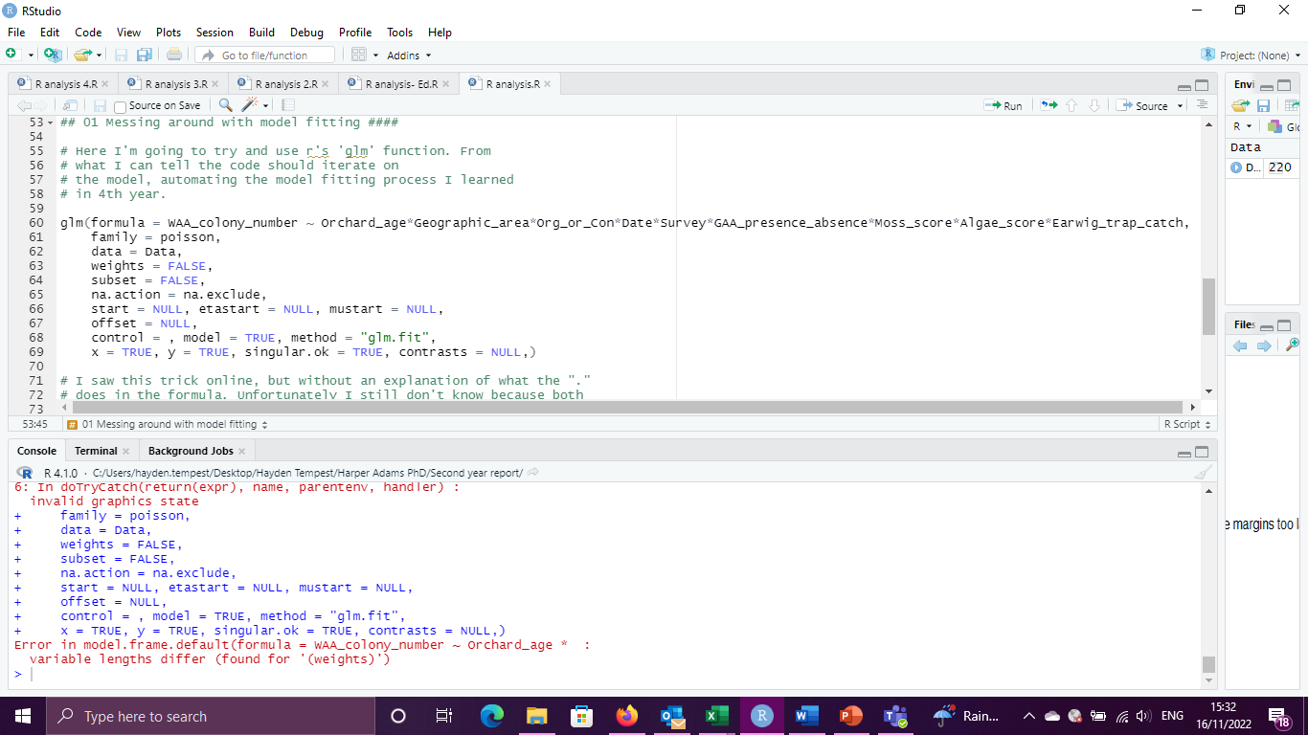
First go at model fitting (went badly)
9 variables, each separated by an ‘*’

Slide 7
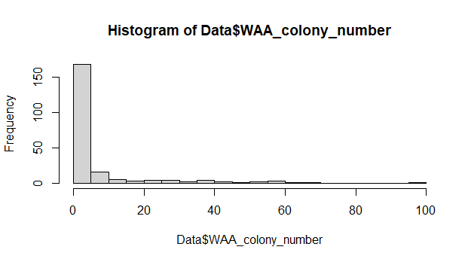
Ed to the rescue
9 variables, each separated by an ‘*’
=
Over 500 possible factors and interactions

Slide 8
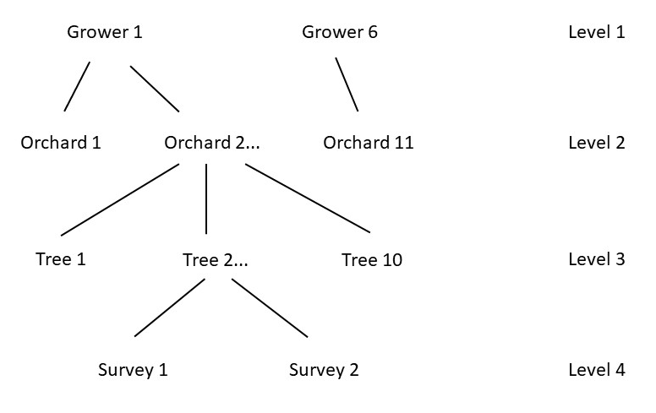
Data structure
Explanatory factors at each level
Geographic area
Farming system, orchard age, rows per bed
Moss score, algae score
WAA presence, earwig presence

