Slide 1



HARUG!
Random forests
Ed Harris
2024-08-21

Slide 2

Story about a
dataset
- GHG "carbon calculator"
- 350 farms
- many predictor vars
(> 500)
- data quality low-ish

Slide 3
Curse of dimensionality
Adding more features (dimensions) to data makes it harder for algorithms to find patterns.
As the number of features increases, the data becomes more "spread out", making it difficult to accurately analyse or make predictions.

Slide 4
Dimension reduction
Random forest can be used for dimension reduction by ranking features based on their importance in making predictions, allowing you to keep only the most relevant features.
This reduces dataset complexity while maintaining accuracy, helping to improve model performance and efficiency.

Slide 5
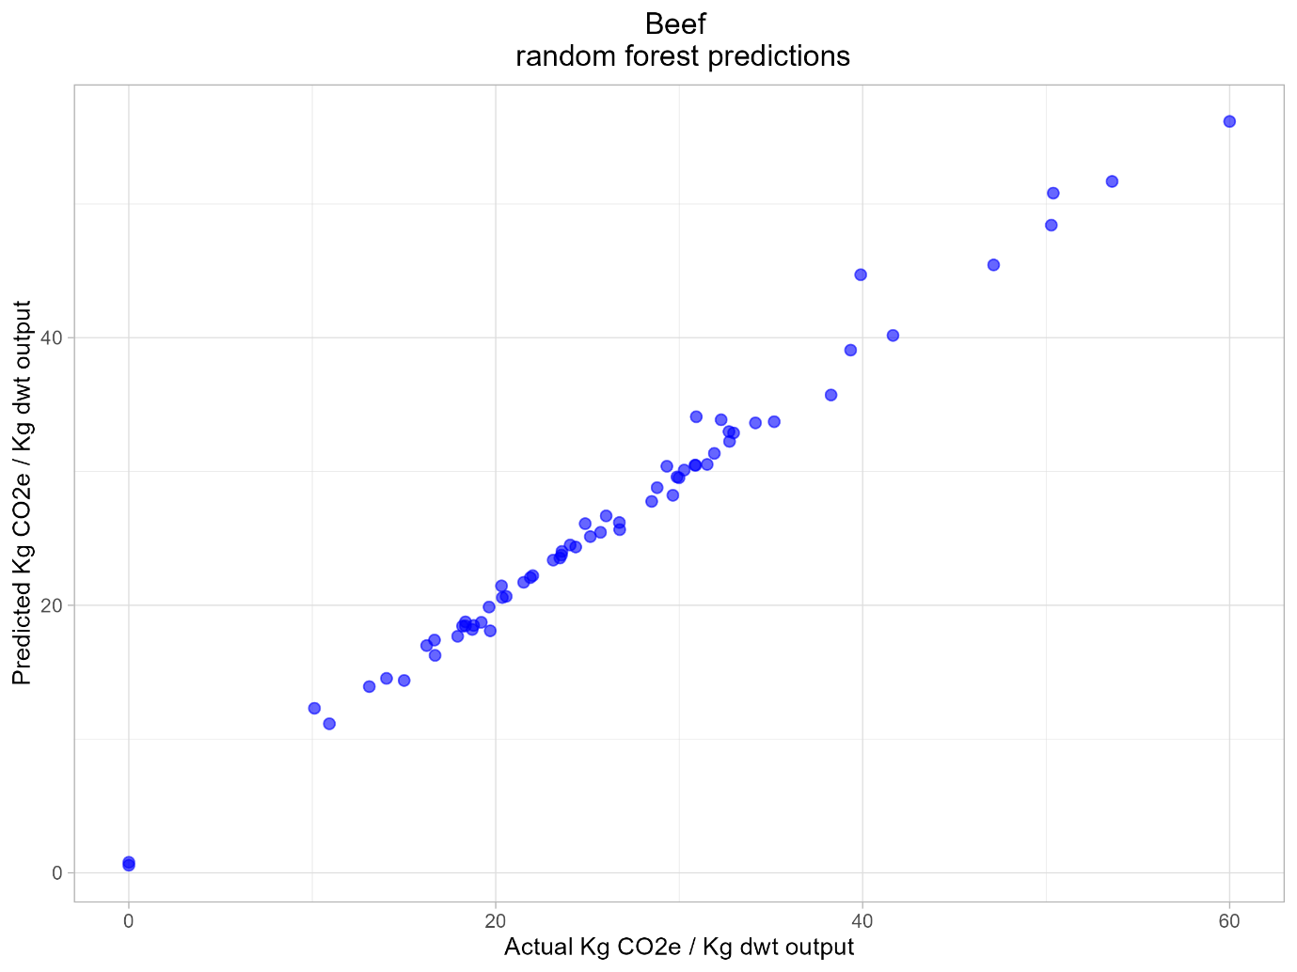
Analysis
- Random forest
- C02 ~ .
- 97% variation explained
- 328 predictors variables

Slide 6
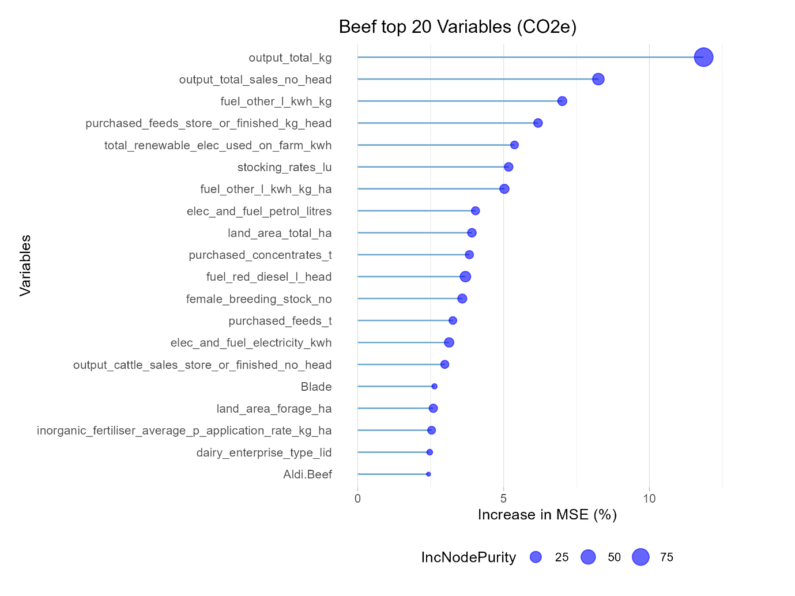
Importance
- top 20
- NB falloff

Slide 7
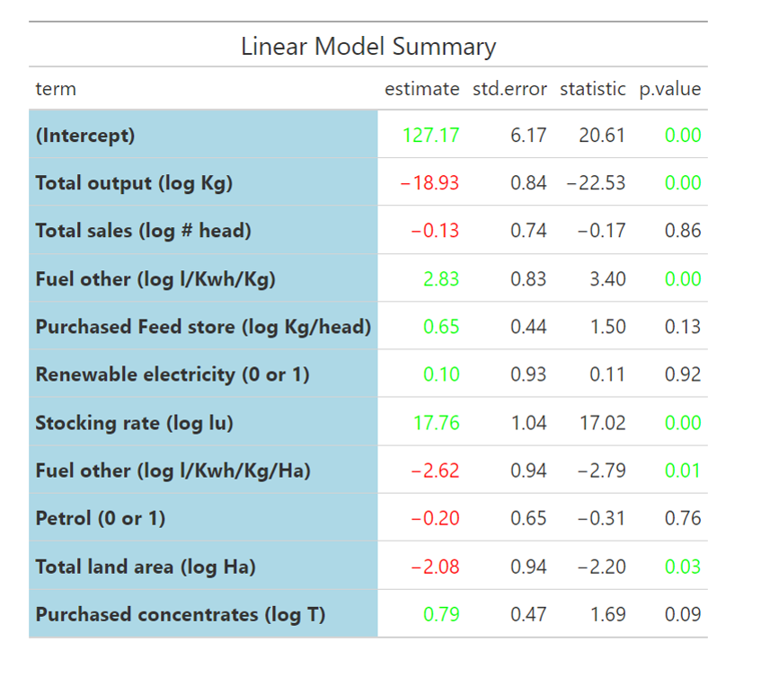
Linear model
- Top 10
- Significance pattern

