Slide 1
Using ChatGPT to support data analysis - some experimental results
Ed Harris
HARUG!
2023-05-24

Slide 2
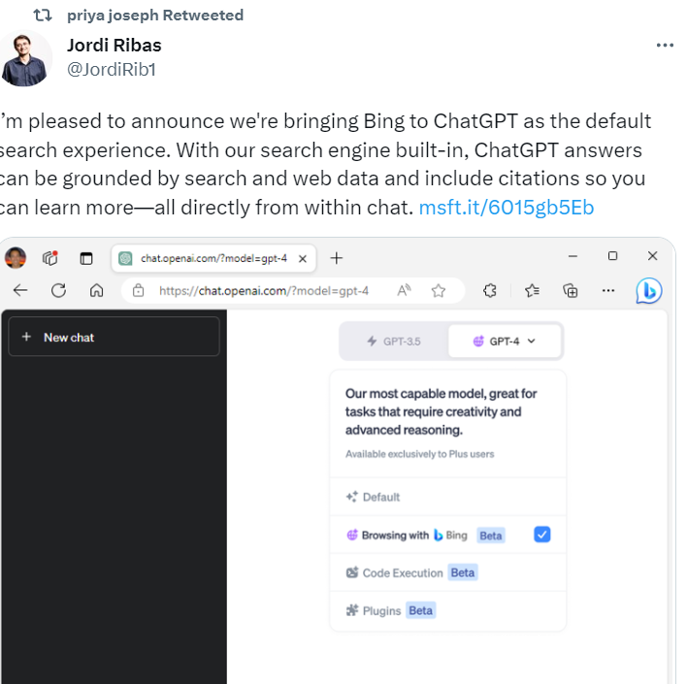
Developments
GPT-4 announced web searching is enabled
(but it does not work well)
Open AI announced Microsoft Bing plugin
(not in UK yet as of time I write this)

Slide 3
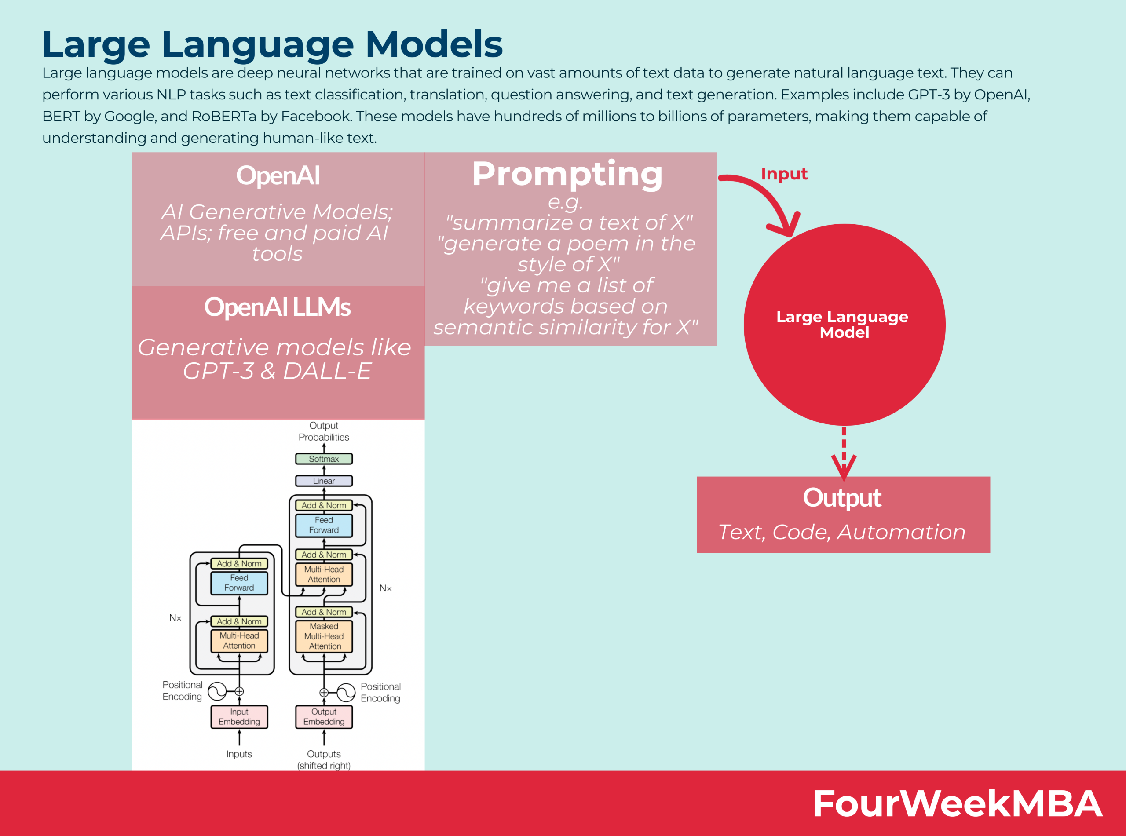









Structure of LLMs like GPT-4
"Generative pre-trained transformer"

Slide 4







The Practice of Statistics
Subject
knowledge
Data
Software
(R, Genstat)
Statistics

Slide 5
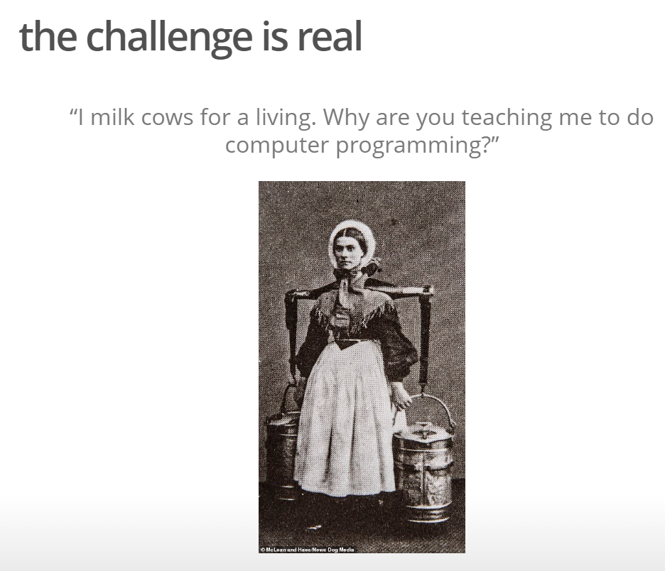

Slide 6
















The Practice of Statistics
Subject
knowledge
Data
Software
(R, Genstat)
Statistics

Slide 7
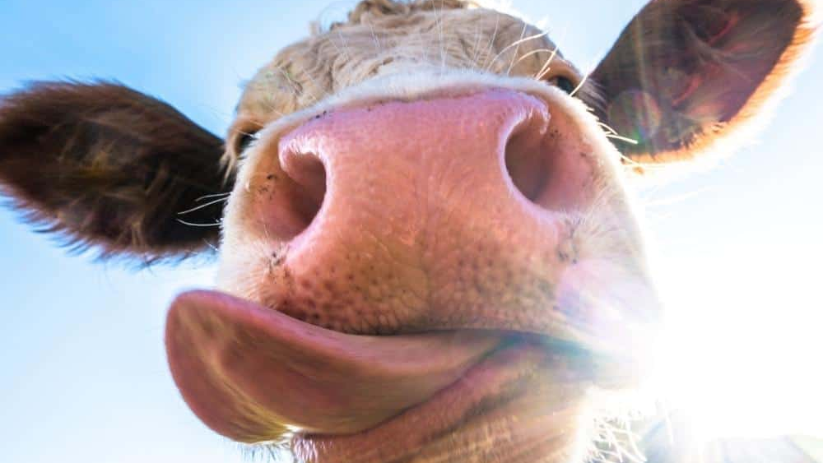
An example

Slide 8
An activity...
Free ChatGPT “playground”
https://platform.openai.com/playground
Write a prompt that enables chatGPT to help you write code to analyse the mixed effects model below
Milk yield ~ treatment + week + parity + (Cow as a random effect)

Slide 9
Free ChatGPT “playground”
https://platform.openai.com/playground
OpenAI GPT-4
https://chat.openai.com/?model=gpt-4
Google Bard
https://bard.google.com/

Slide 10
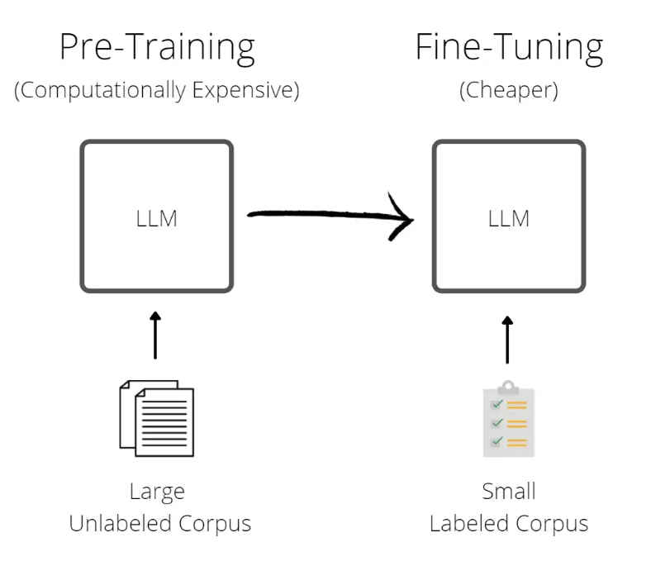












Structure of LLMs like GPT-4
"Generative pre-trained transformer"

Slide 11

















"LangChain" - what is the innovation?
GPT-4
LangChain + Storage
websites
Pdf library
Book

