Slide 1
R Stats Bootcamp 06
Data frames Ed Harris

Slide 2


Slide 3
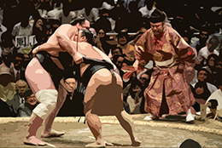
R Stats Bootcamp
R Stats Bootcamp 06
Data subsetting
With a good set of moves for manipulating data, you can overpower any dataset no matter how powerful they are. Then, you have strong data Sumo.

Slide 4
Objectives
-Indexing concept
-Using which() and subsetting
-Selection on data.frame objects
-Using aggregate()

Slide 5
Indexing concept
Vectors, Matrices and arrays. Oh my!
Think of houses on a street
Each street has an address…

Slide 6
Indexing concept
Indexing
my_vector <- c(11.3, 11.2, 10.4, 10.4, 8.7, 10.8, 10.5, 10.3, 9.7, 11.2) my_vector

Slide 7
Indexing concept
Vectors
my_vector my_vector[ ] my_vector[ 1:10]

Slide 8
Indexing concept
Matrices
my_matrix <- matrix(data = c(2,3,4,5,6,6,6,6), nrow = 2, byrow = T)

Slide 9
Using which() and subsetting
A way to exploit indices
which(vector_a > 5)

Slide 10
Selection on data.frame objects
Slice your data
data(OrchardSprays) OrchardSprays$treatment == "D"

Slide 11
Using aggregate()
Very useful to summarize your data
# NB use of list() and naming it "treatment" aggregate(x = OrchardSprays$decrease, by = list(treatment = OrchardSprays$treatment), FUN = mean)

Slide 12

Practice Exercises

