Slide 1
R Stats Bootcamp 08
Distributions Ed Harris / Megan Lewis

Slide 2


Slide 3

R Stats Bootcamp
R Stats Bootcamp 08
Distributions
Can you guess the weight of this bull? What about you and 99 friends?”.

Slide 4
Objectives
Use of the histogram
Gaussian: that ain’t normal!
Poisson distribution
Binomial distribution
Diagnosing the distribution

Slide 5
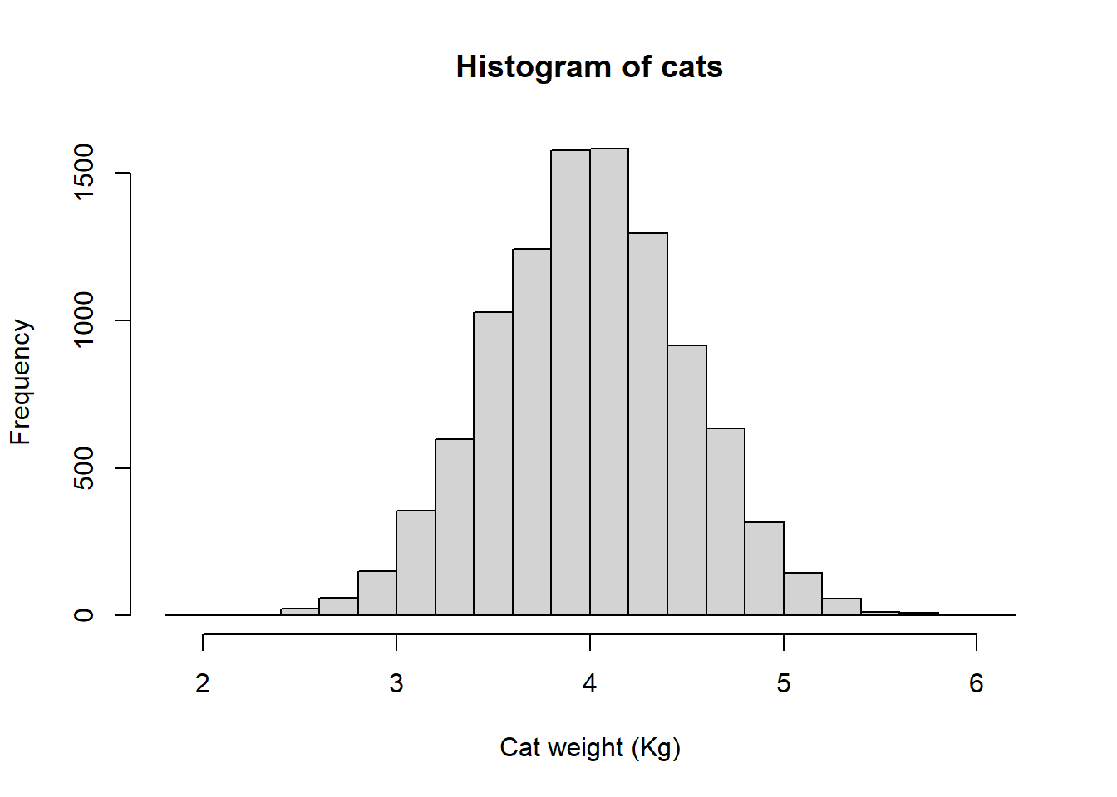
Use of the histogram
Plots a numeric variable on the x axis
Frequency of observations on the y axis

Slide 6
Sampling and Populations
Remember the concept of population versus sample?
Population of 10,000 cats versus a sample of 100 cats
Expected variation in random sample means?

Slide 7
Off to R!
Cats and more cats!

Slide 8
Gaussian: That ain’t necessarily normal!
classic “Bell curve” shaped distribution
continuous numeric variables that “measure” things (e.g., human height)

Slide 9
The Gaussian assumption (important topic)
regression and ANOVA
Gaussian is described by 2 quantities: the mean and the variance

Slide 10
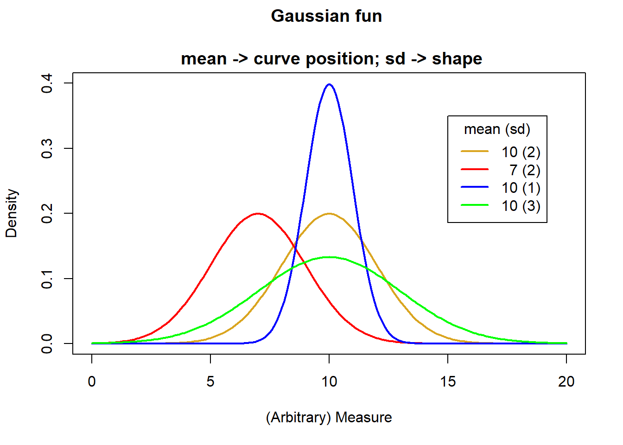
Off to R!

Slide 11
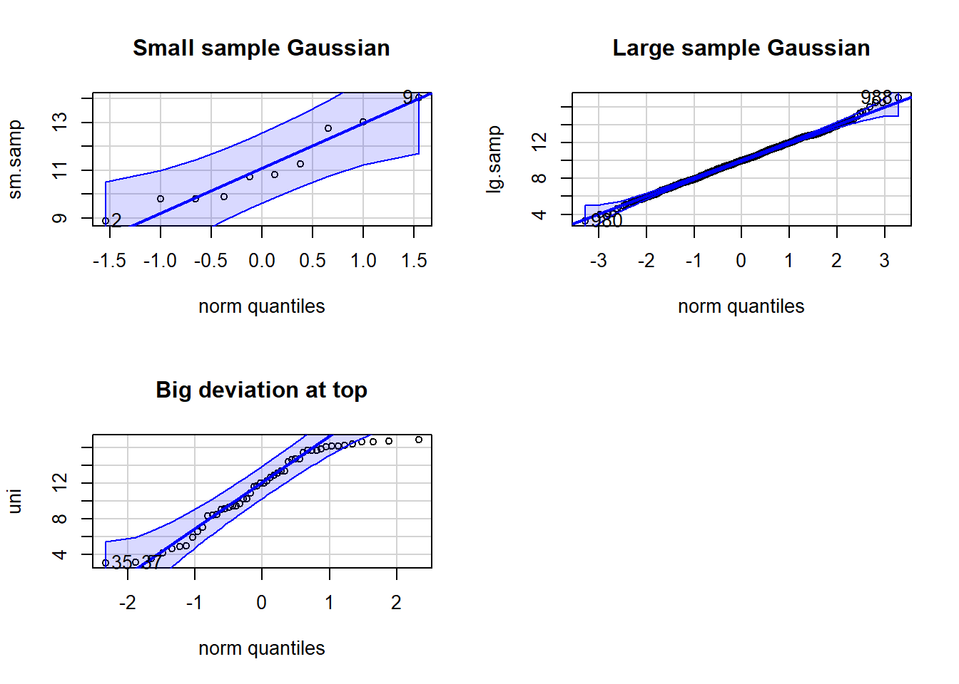
Quartile-Quartile (Q-Q) plots
Plots data against theoretical expectation of the “quantile”
Help to identify over or under dispersion

Slide 12
Off to R!
Q-Q plot example

Slide 13
Poisson distribution
Count data of discrete events, objects, etc.
Integers, for example the number of beetles caught each day in a pitfall trap
Poisson data are typically skewed to the right
Described by a single parameter, (lambda), which describes the mean and the variance

Slide 14
Off to R!
Example Poisson data
Density plot for different Poisson lambda values

Slide 15
Binomial distribution
Exactly 2 outcomes: 0 and 1, Yes and No, True and False, etc.
Data are the count of “successes”” in (binary) outcomes of a series of independent events
Data coding can be variable

Slide 16
Let’s do some coding!
Example: Nest boxes
Example: Flipping a coin
Density plot for different Binomial parameters

Slide 17
Diagnosing the distribution
Good practice - a set of steps to adhere to when diagnosing a distribution.
Develop an expectation of the distribution, based on the type of data
Graph the data i.e., histograms and q-q plots
Compare q-q plots with different distributions for comparison if in doubt

Slide 18

Practice Exercises

