Slide 1

2023-07-05 (meeting #125)
Simulation as a tool for experimental design
(Ed H)

Slide 2













What is statistical power?
The probability of detecting a statistical difference from your experiment given one actually does exist in the real world

Slide 3





















What is statistical power?
The probability of detecting a statistical difference from your experiment given one actually does exist in the real world

Slide 4




Effect size
Cohen's d (Welch's g) =
mean diff. / pooled standard deviation

Slide 5











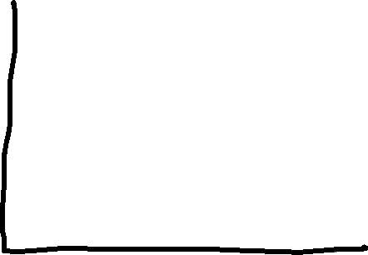

Effect size
Cohen's d (Welch's g) =
mean diff. / pooled standard deviation

Slide 6



Effect size
Power is a function of effect size and sample size
To detect small effect size, you need bigger sample size
Researcher is in control (most of the time)

Slide 7


Effect size
Easy to calculate for simple tests
1-way ANOVA
T-test
Non-parametric and linear models are harder…

Slide 8





































Latin Square designs

Slide 9













Latin Square designs

Slide 10































