Slide 1
Docker
Examples use cases

Slide 2
Introduced in this presentation
Flask – make a web app in Python
Nginx – a simple web server
Docker compose – containerise and run multiple interdependent applications. Suitable for deployment via GitHub.
Docker run – pull, containerise and run ready-made images available via a repository (e.g. docker hub) in a single command.
An example of a single image which was not built using best practices but runs multiple applications.

Slide 3
Wheat counter web app
https://github.com/onthesofa/flask-wheat-counter-demo
Clone, then from the same folder as ‘docker-compose.yml’ run the command ‘docker compose build’. It may take a long time! The two images are now on your machine.
To run: ‘docker compose up’ from the same location.
The application is now available at ‘localhost’ on your browser.
Can also be run on a webserver, e.g., hff.hopto.org

Slide 4
Harug-workspace
An image was clumsily constructed by modifying and freezing (committing) an existing Rstudio server image. Changes made include:
Compiling the DSSAT48 source code into a Linux executable
Adding a desktop environment
Adding a browser
Adding a VNC server
Running the VNC server was achieved by modifying the entry point. “/init”

Slide 5
To use the harug-workspace
Install docker desktop.
https://www.docker.com/products/docker-desktop/
Open a command prompt.
docker run -ti -v c:\harug:/home/rstudio/shared -e PASSWORD=harper -p 8787:8787 -p 5900:5901 onthesofa/harug-workspace
Rstudio can be accessed at ‘localhost:8787’ on your browser
The Linux desktop can be viewed at localhost on a VNC viewer.

Slide 6
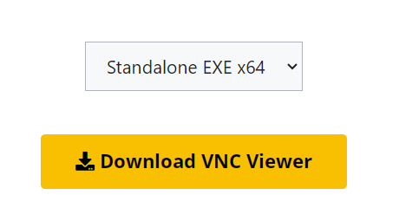
Installing a standalone VNC viewer
https://www.realvnc.com/en/connect/download/viewer/
Select ‘standalone x64’
When you first run it you do NOT need to sign in or create an account!

Slide 7
Login details
Rstudio:
rstudio
harper
VNC:
harper
Only use the shared folder for your work! C:\harug is mapped to /home/rstudio/shared. When the container is destroyed EVERYTHING ELSE IS RESET!!

Slide 8
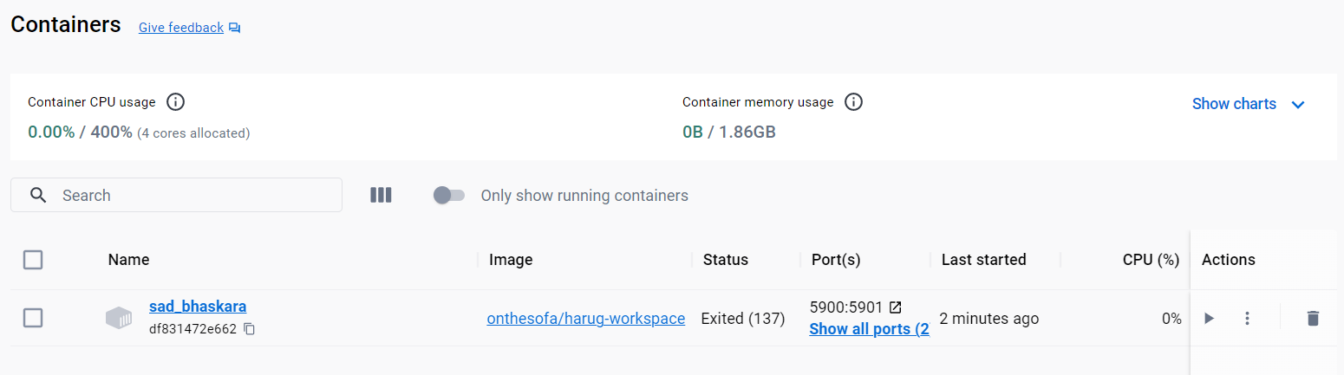
Stopping and restarting the container
For a fresh start delete the container and run this command again:
docker run -ti -v c:\harug:/home/rstudio/shared -e PASSWORD=harper -p 8787:8787 -p 5900:5901 onthesofa/harug-workspace

Slide 9
