Slide 1

HARUG!
2023-12-20
Data + viz for beginners
Ed Harris

Slide 2
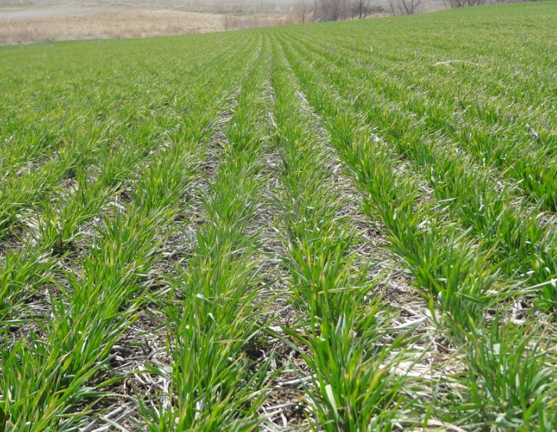
Winter (wheat) Wonderland of Data: Discovering Statistics and Graphics in R
Introduces beginners to the world of data analysis using R.
The focus is on understanding basic statistical concepts and graphical data representation.
The session is themed around a winter holiday context in agriculture, making the learning process engaging and relevant.

Slide 3
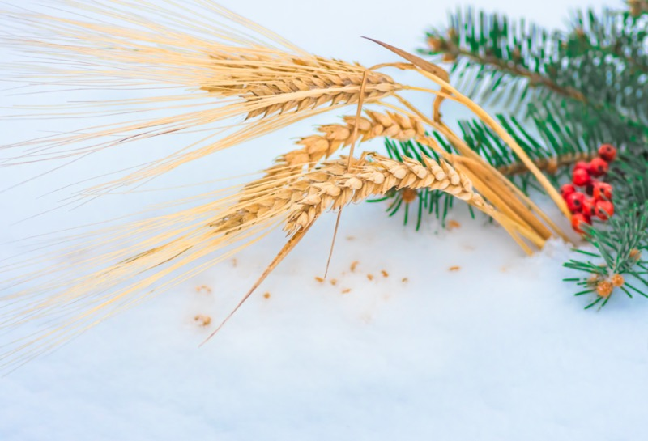
Outcomes:
Perform and interpret linear regression in R, understanding the relationship between independent and dependent variables.
Create meaningful, colorful visualizations in R using ggplot2, enhancing their skills in data presentation and interpretation.
Demonstrate R Markdown to document data analysis process for a professional report format.

