Slide 1

2023-07-05 (meeting #125)
Simulation as a tool for experimental design
(Ed H)

Slide 2












What is statistical power?
The probability of detecting a statistical difference from your experiment given one actually does exist in the real world

Slide 3




What is statistical power?
The probability of detecting a statistical difference from your experiment given one actually does exist in the real world

Slide 4
Effect size
Cohen's d (Welch's g) =
mean diff. / pooled standard deviation

Slide 5
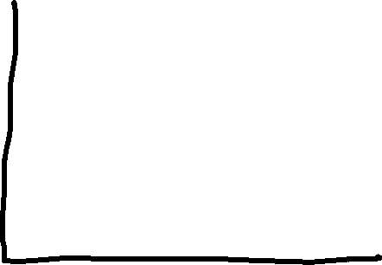



Effect size
Cohen's d (Welch's g) =
mean diff. / pooled standard deviation

Slide 6
Effect size
Power is a function of effect size and sample size
To detect small effect size, you need bigger sample size
Researcher is in control (most of the time)

Slide 7
Effect size
Easy to calculate for simple tests
1-way ANOVA
T-test
Non-parametric and linear models are harder…

Slide 8






























Latin Square designs

Slide 9







Latin Square designs

