Slide 1
Parameter | pH | Ammonia
β₀ | 6.09 | 82.88
B₁ | +0.23, +0.46, +0.70 | +11.23, +22.47, +33.71
b_{s} | 0.04 | 5.19
ε_{t} | 0.29 | 9.21

Slide 2
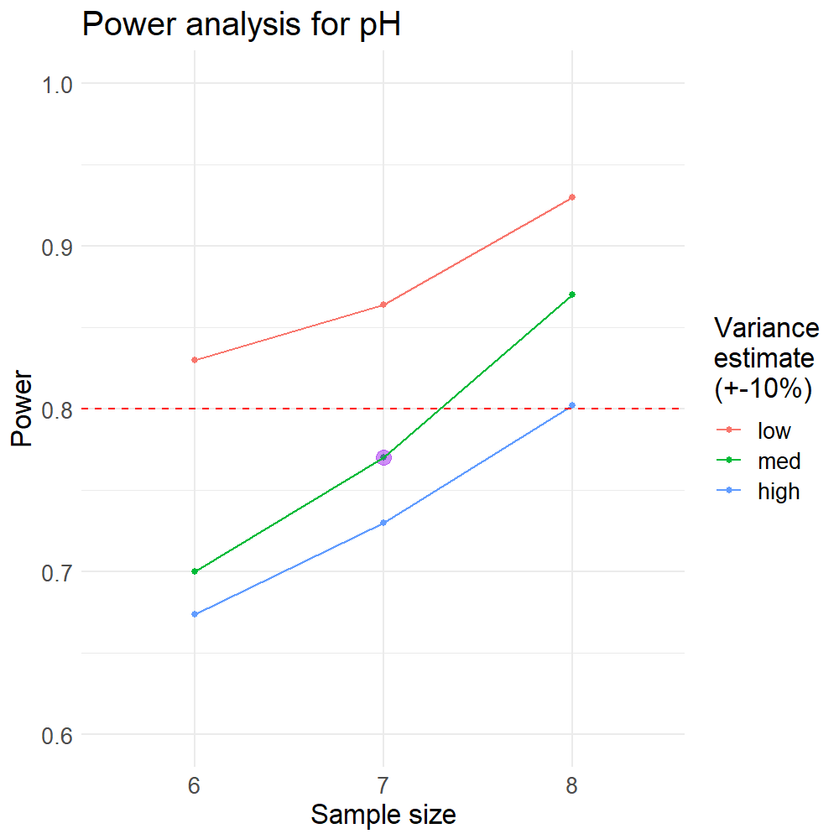
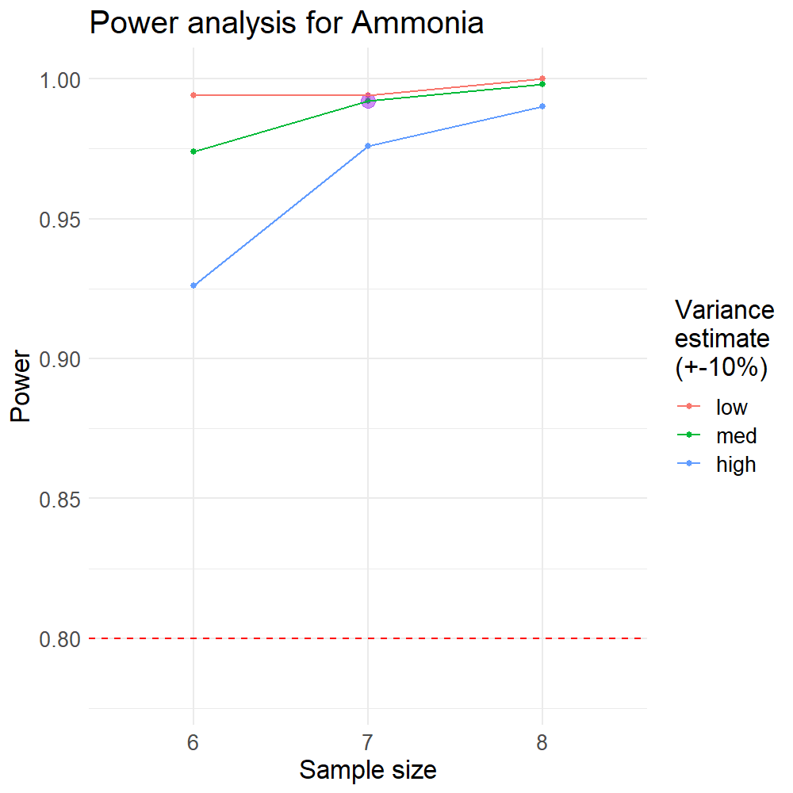
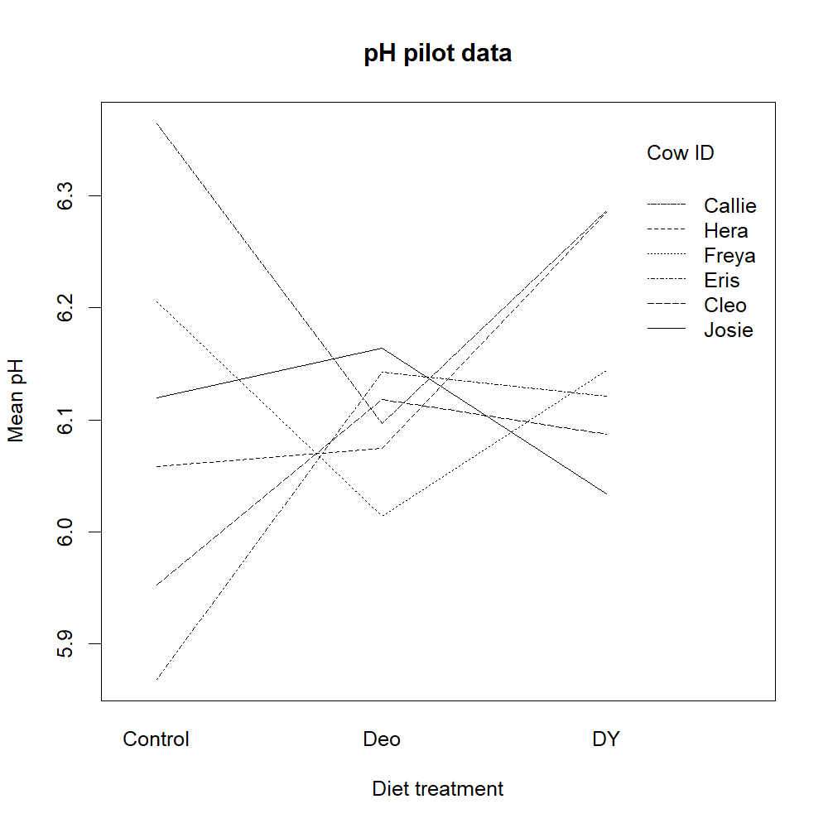
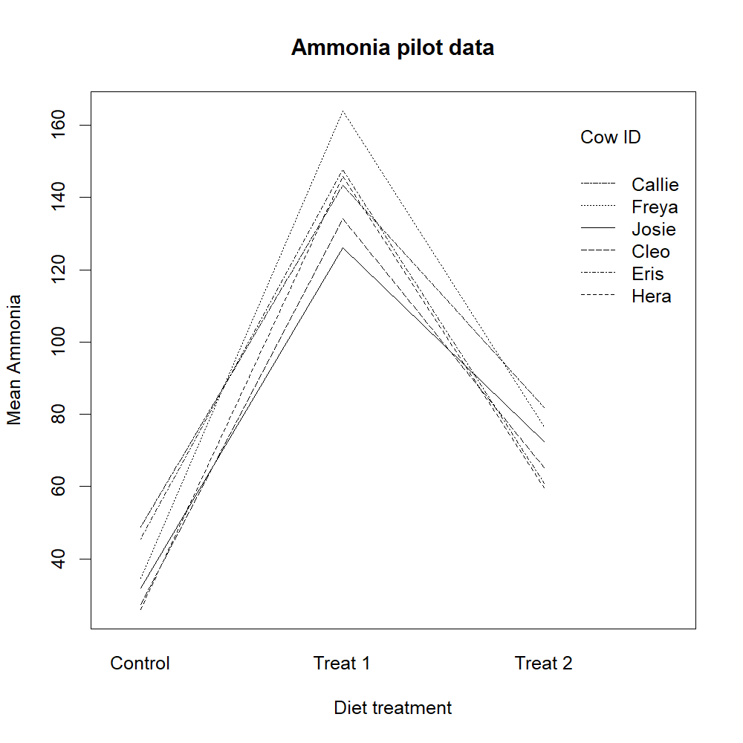
A
B
C
D

