Slide 1
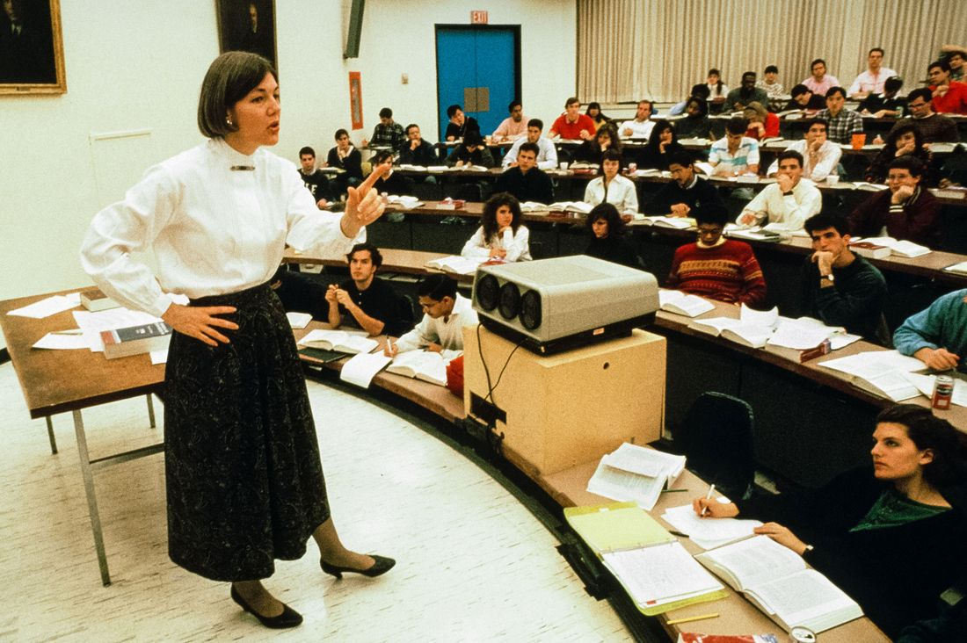
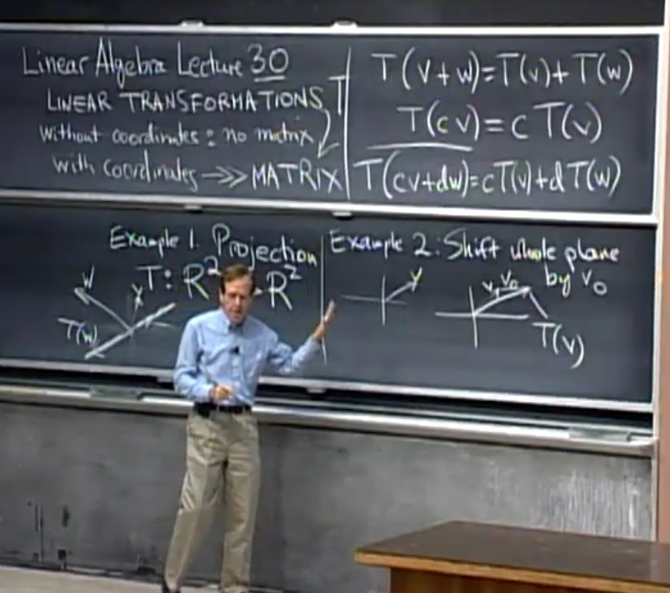

Elizabeth Warren U Penn
Gilbert Strang MIT
The "Oxford tutorial"

Slide 2
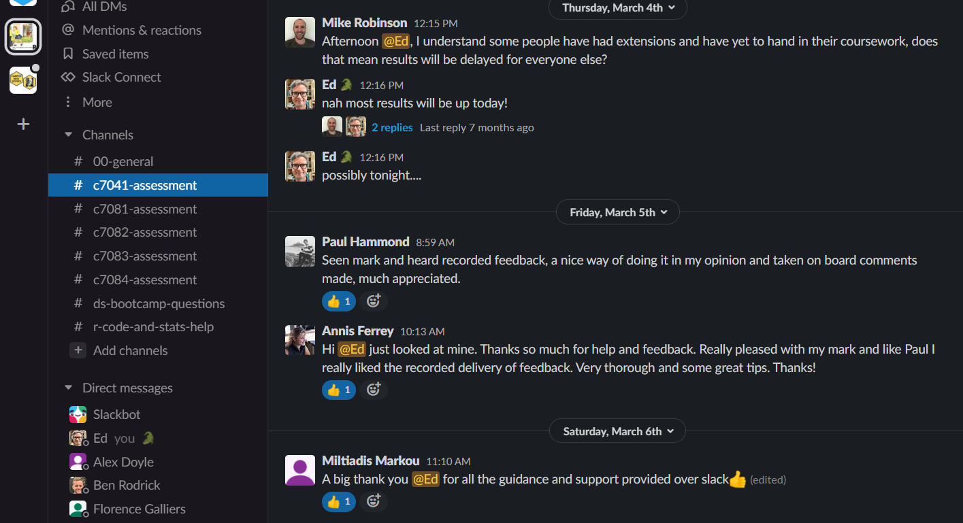
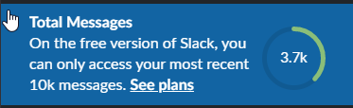

Slide 3
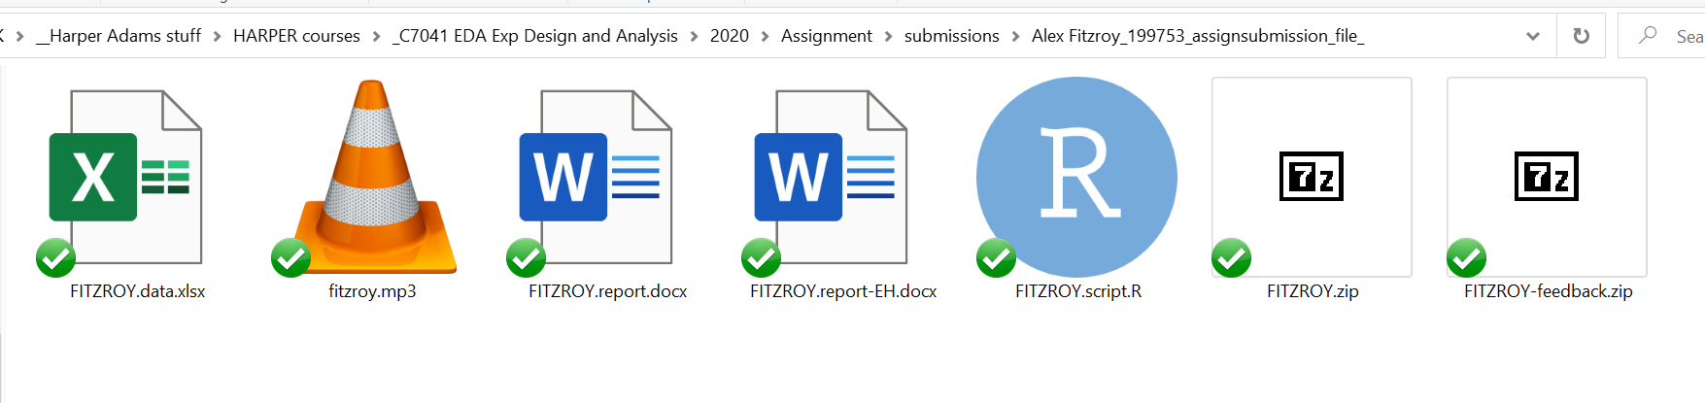

audio feedback
R code comments
MS Marklup comments
Assignment:
Here is some data, analyse it and report the results to me
(Constructive alignment)
- data file
- R script
- Report

Slide 4

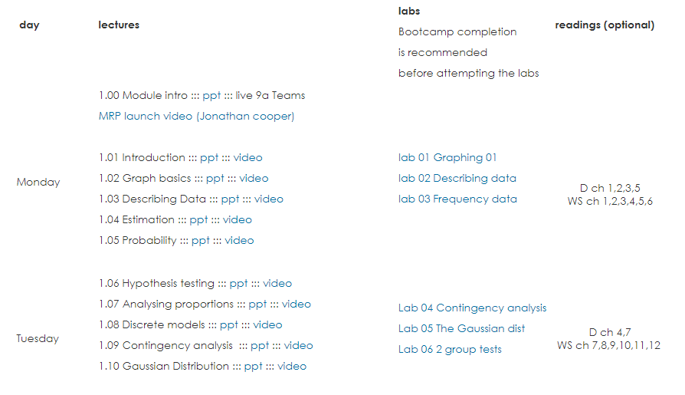
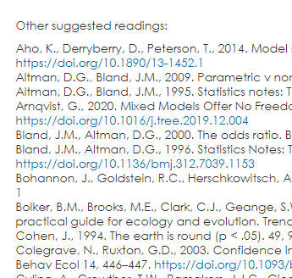


Friendly Bootcamp
User friendly
"normal" resources
Optional readings
Alternative texts

Slide 5
