Slide 1


R or Python?
Which best describes you?
Mainly interested in R
Mainly interested in Python
Equally interested in both

Slide 2

Where are you on your R journey?
Which best describes your interest?
R beginner
I know the basics
I want to learn advanced stuff

Slide 3
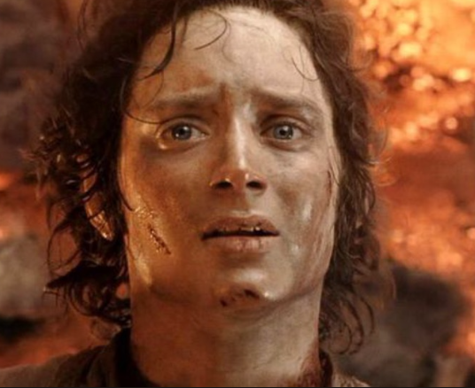
Where are you on your Python journey?
Which best describes your interest?
Python beginner
I have used Anaconda and Colab
Advanced stuff please

Slide 4
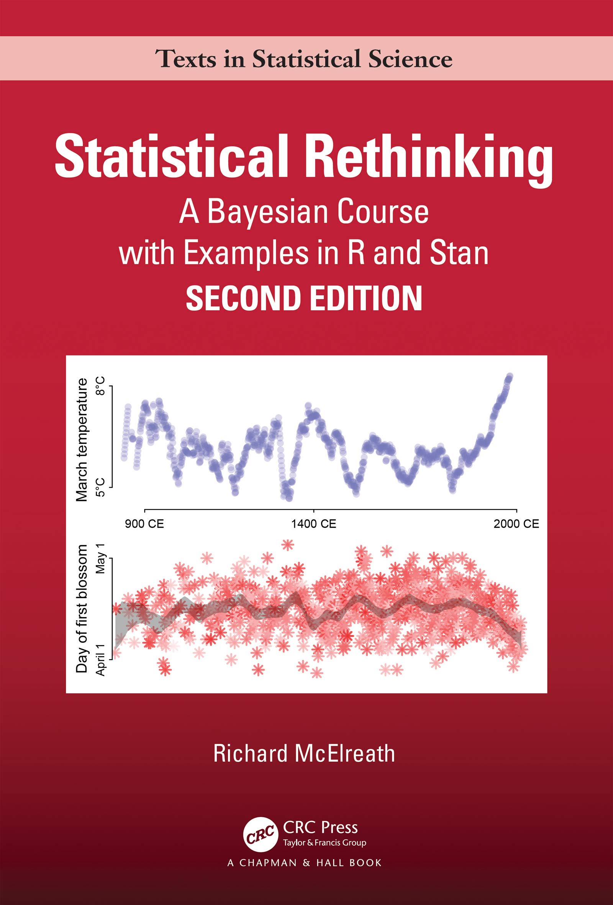
If we were to read a book in HARUG!
Would this be of interest?
Yes
No
Maybe
(Advanced Bayesian statistics)

Slide 5

If we were to read a book in HARUG!
Would this be of interest?
Yes
No
Maybe
(Intermediate spatial statistics)

Slide 6

If we were to read a book in HARUG!
Would this be of interest?
Yes
No
Maybe
(Intermediate computer vision)

Slide 7
If we were to read a book in HARUG!
Would this be of interest?
Yes
No
Maybe
(Intermediate spatial statistics)

Slide 8
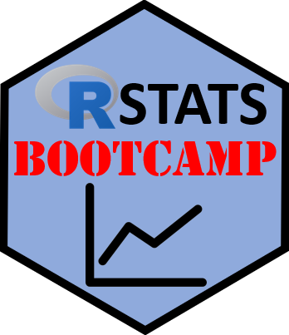

R bootcamp as a group
Would this be of interest?
Yes
No
Maybe
(Beginner statistics)

Slide 9
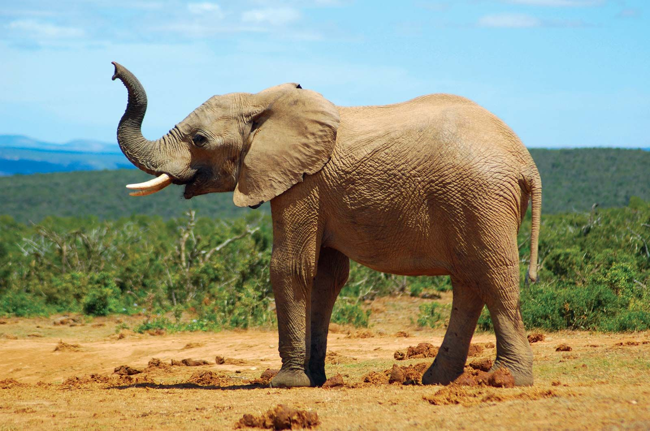
Other topics?
Design your own tutorial
Ed stats tutorials, specific topics…?
You lead and interesting tutorial you find
Kaggle project (group python computer vision project)
Hackathon (e.g. Harper farm data and DSSAT hackathon,
ag and ecology datasets R package,
synthetic data R package)
Example analyses for different participants
Live stats consulting
Other ideas…?

Slide 10
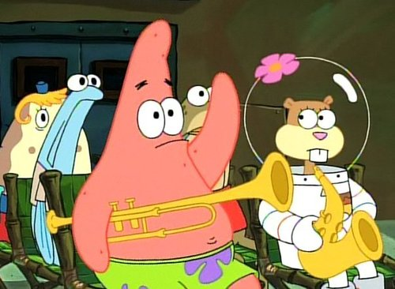
Who can volunteer today?
E.g. next week is available
-pick a date
-eventually pick a topic
-your data or…
-opportunity to learn

Slide 11
R/Coding cheat sheets activity

Slide 12
Cheat sheet concept
-existing ones concentrate info
-some are very specific, some too basic
-are they REALLY of use or is R help/Google good enough?
-perhaps MAKING your own is better (but is a skill, plus takes work)

Slide 13
Cheat sheet concept
- Activity is to review several different cheat sheets and rate them
-Spend a few minutes examining each
-Write down 1 positive and 1 negative for each sheet
-We will compare at the end
-Idea here is to develop an activity to create cheatsheets

Slide 14
The Cheatsheets
- Activity is to review several different cheat sheets and rate them
-Spend a few minutes examining each
-Write down 1 positive and 1 negative for each sheet
-We will compare at the end
-Idea here is to develop an activity to create cheatsheets

