Slide 1
R Stats Bootcamp 07
Exploring Data Ed Harris

Slide 2
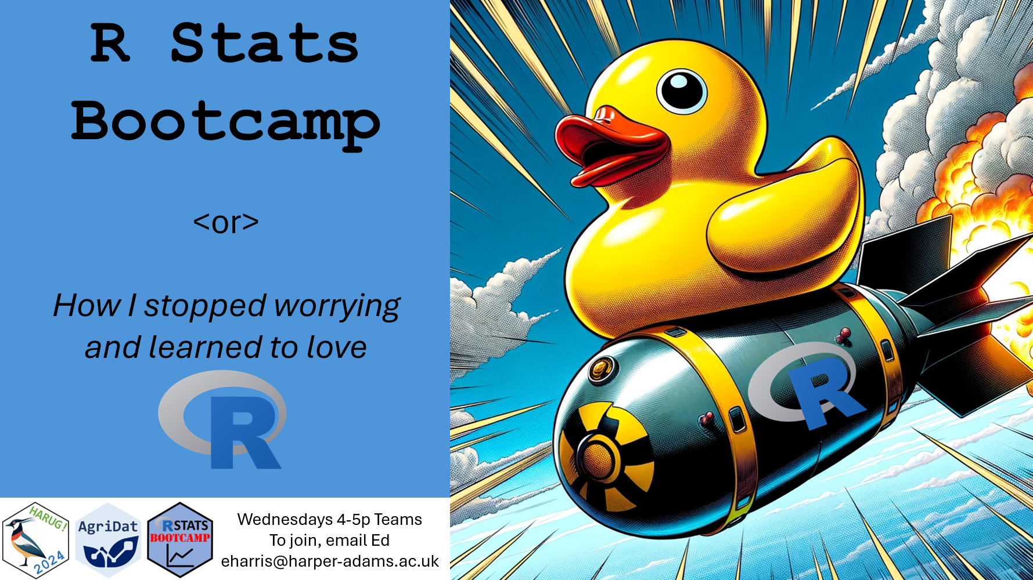

Slide 3
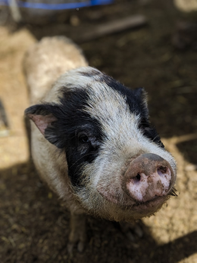
R Stats Bootcamp
R Stats Bootcamp 07
Exploring data
We call sizing up the data “weighing the pig”.

Slide 4
Objectives
-Question formulation
-Summarize: Weighing the Pig
-Variables and graphing
-“Analysis” versus “EDA”
-Statistical Analysis Plan: the concept

Slide 5
Question formulation and hypothesis testing
-“population of interest”
-samples and sampling
-test statistics
-null hypothesis
-Let’s talk about the P-value

Slide 6
Question formulation and hypothesis testing
Benefits of NHST
-Familiar and acceptable to researchers
-Typically robust to assumptions
-Strong framework for evidence
-The basic idea is simple

Slide 7
Question formulation and hypothesis testing
Criticism of HNST
-Often interpreted under error
-Validation of analysis often neglected
-Education often deficient
-Practitioners ignorant of subtleties

Slide 8
Summarize: Weighing the Pig
Chick weight dataset
The hypothesis voices “how you think the world works” or what you predict to be true”
coding

Slide 9
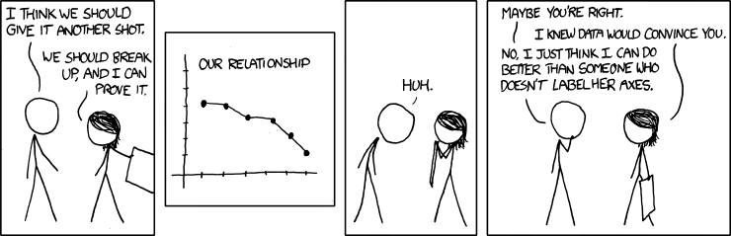
Variables and graphing

Slide 10
Variables and graphing
-Must convey relevant information
-Consistent in aesthetics
-Self-contained
-Reflect hypothesis (unless descriptive)
-Appropriate to data

Slide 11
Variables and graphing
Concept of “layering” in building graphs
coding

Slide 12
“Analysis” versus “EDA”
EDA:
-Informal, haphazard
-Gain data understanding
-Test assumptions
-Usually not for “others”
-Usually occurs before analysis

Slide 13
“Analysis” versus “EDA”
Analysis:
-Designed to fit hypothesis
-For presentation to others
-Creation of EVIDENCE to support CLAIMS
-Reproducible

Slide 14
Statistical Analysis Plan: the concept
Prior to data collection
-formally state hypothesis
-State specific statistical model(s)
-Specify data and data collection
-State and justify sample size

Slide 15
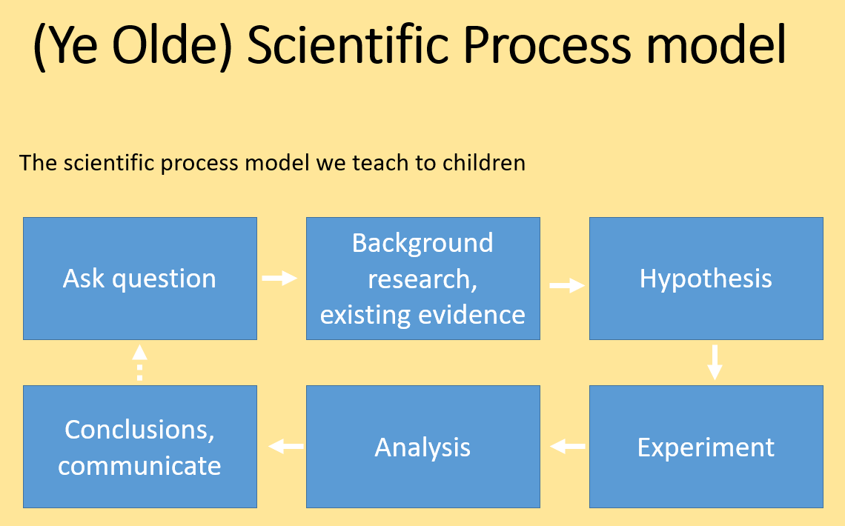
Taught to children

Slide 16
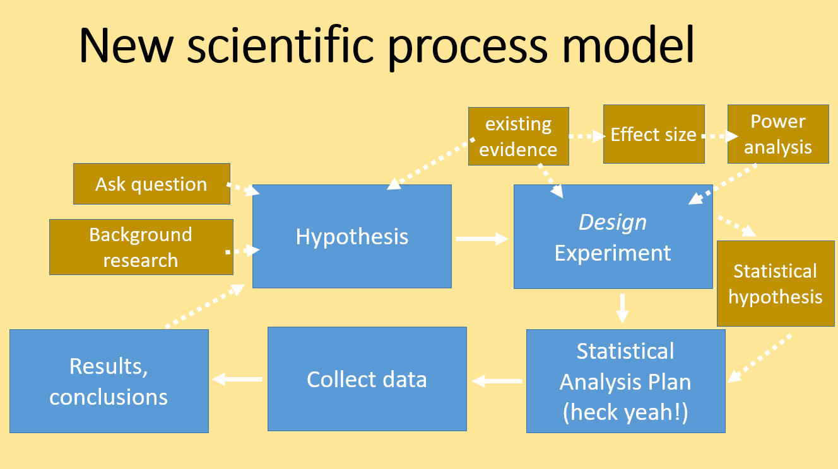
Best practice

Slide 17
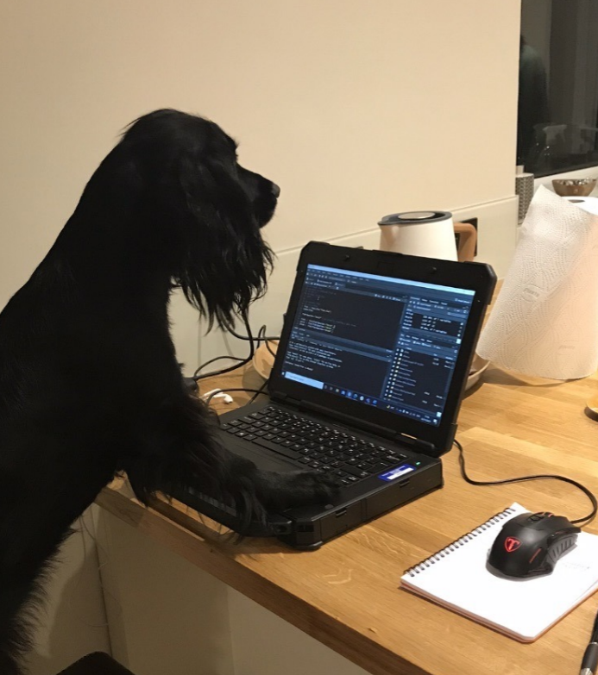
Practice Exercises

