Slide 1
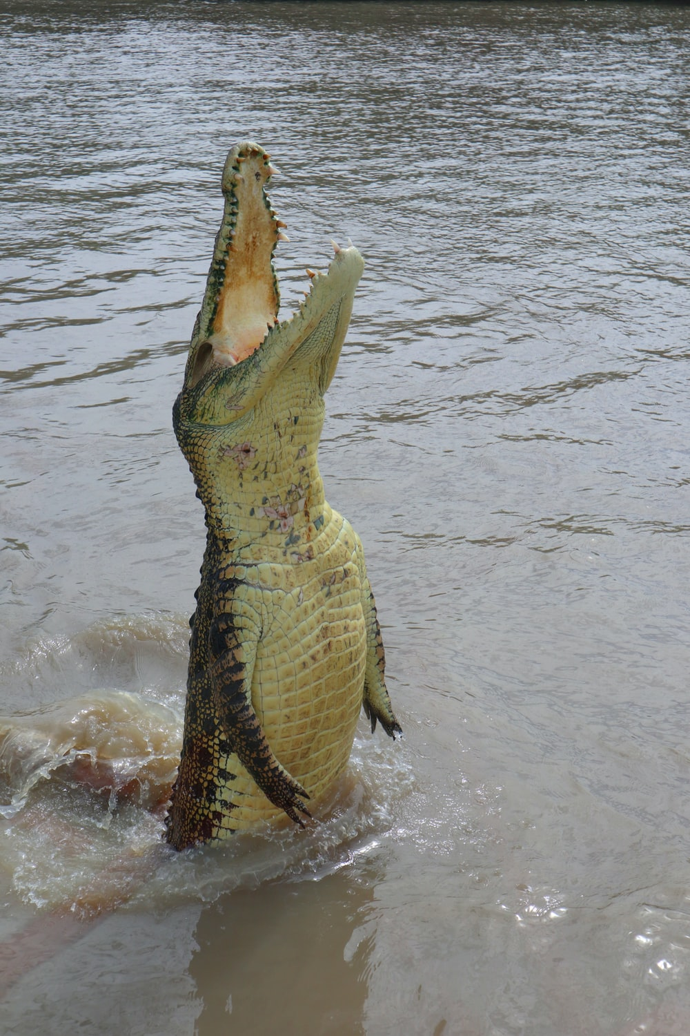

{flexdashboard}
But first results of survey
Ed Harris
HARUG!
2022-12-07

Slide 2
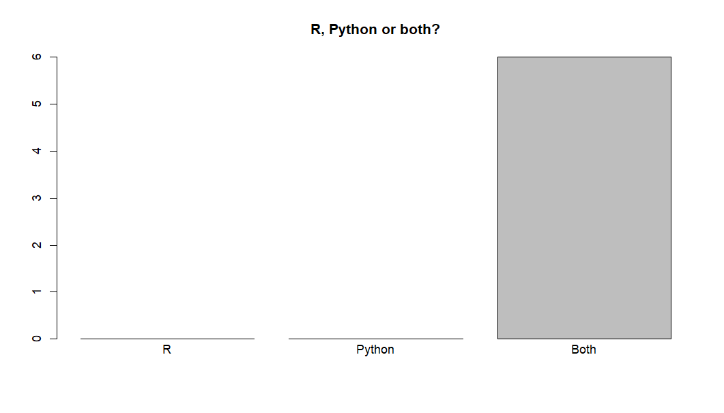
What people want

Slide 3
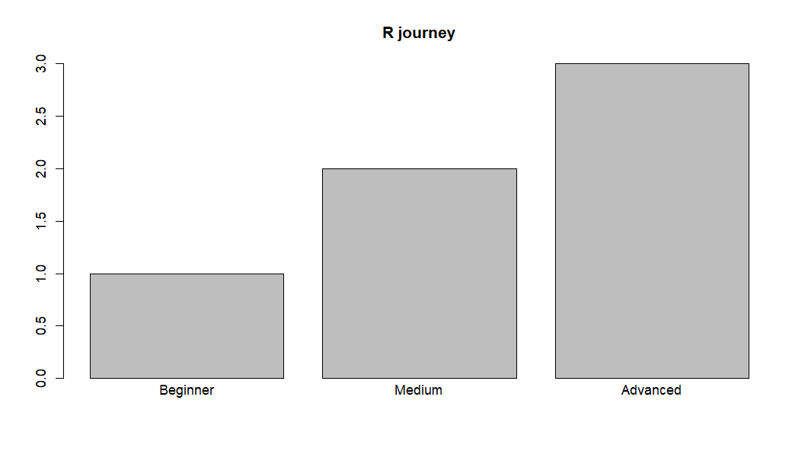
What people want

Slide 4
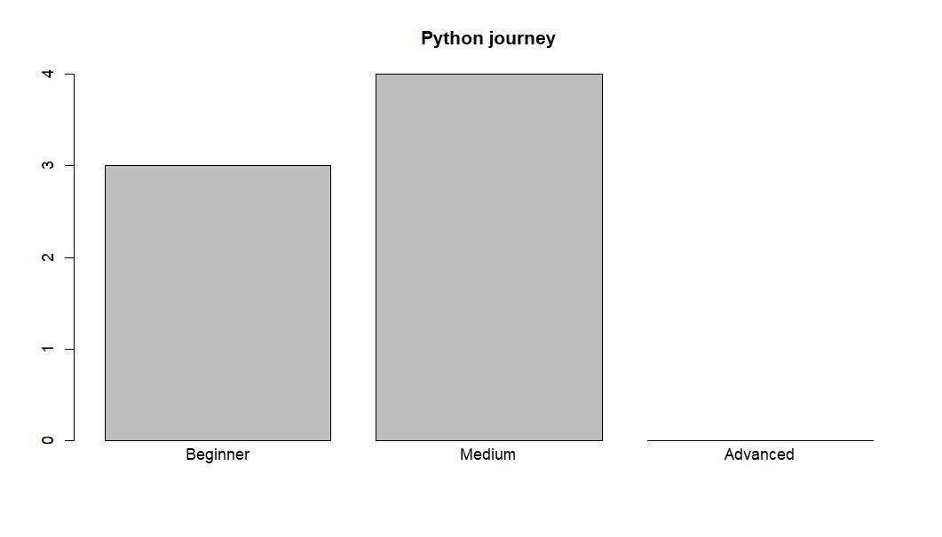
What people want

Slide 5
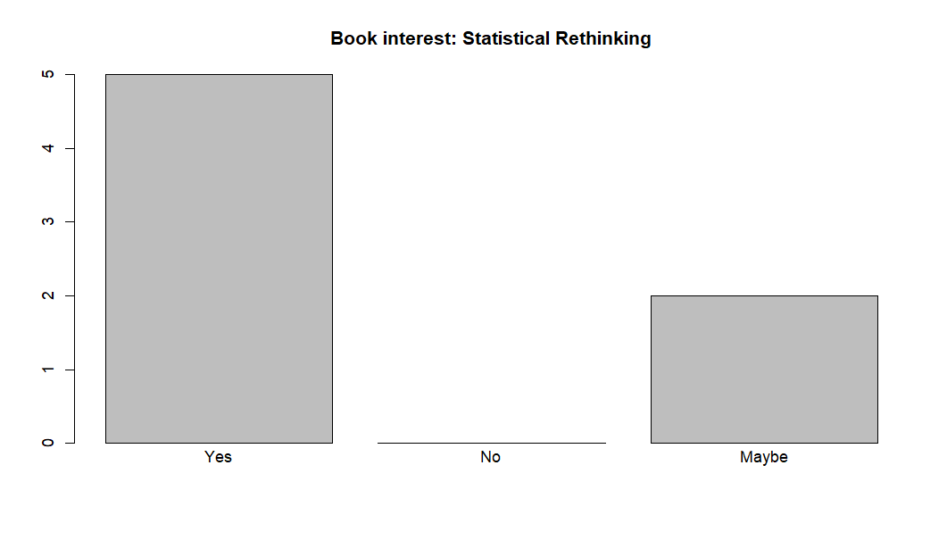
What people want

Slide 6
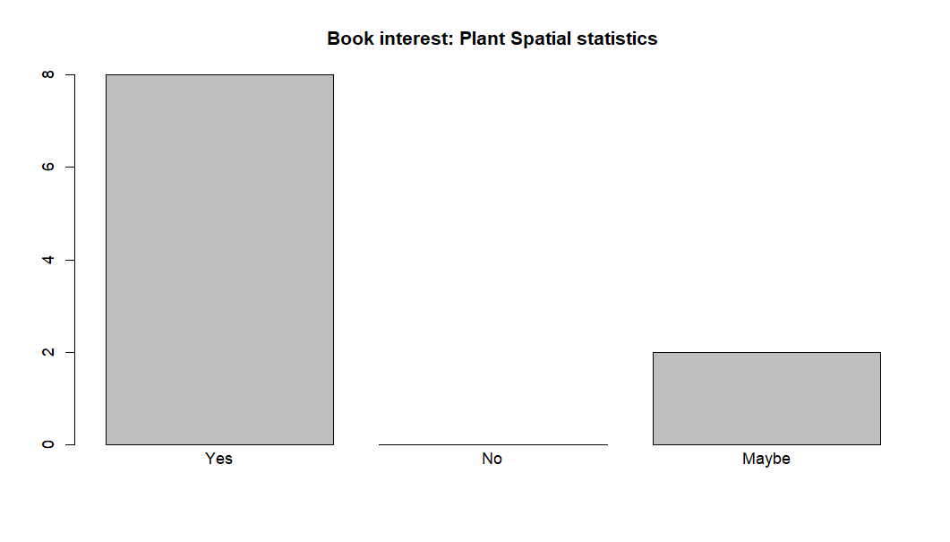
What people want

Slide 7
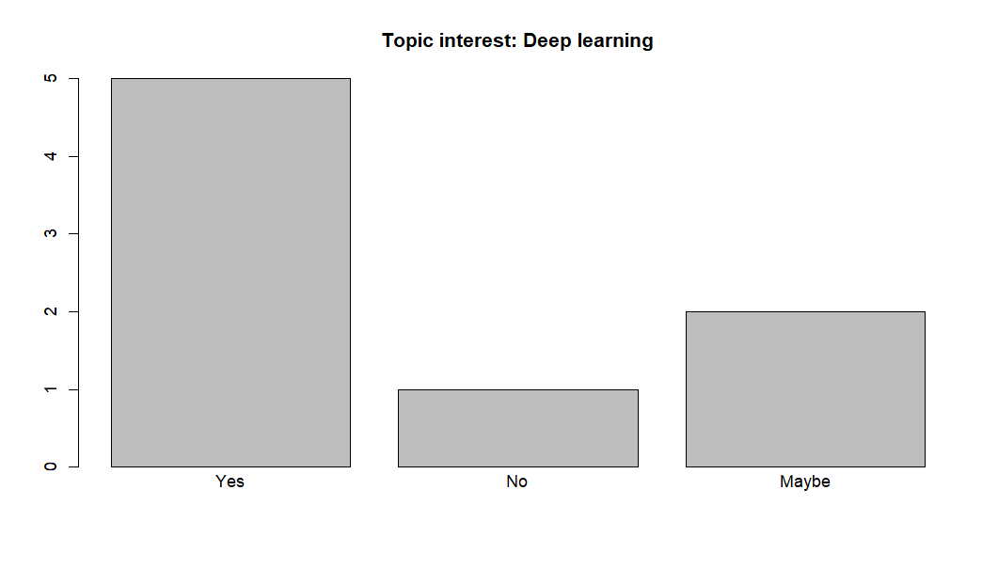
What people want

Slide 8
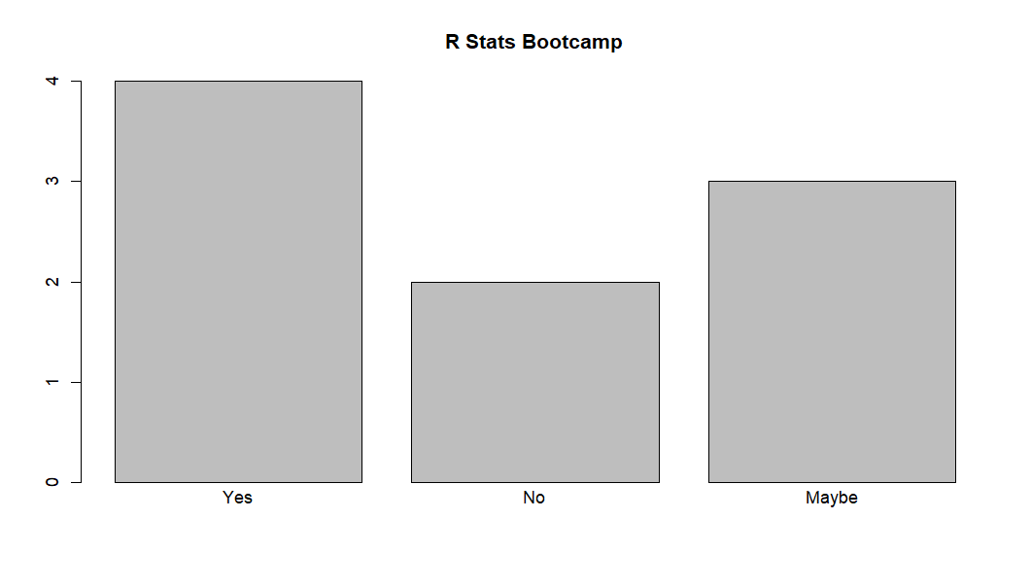
What people want

Slide 9
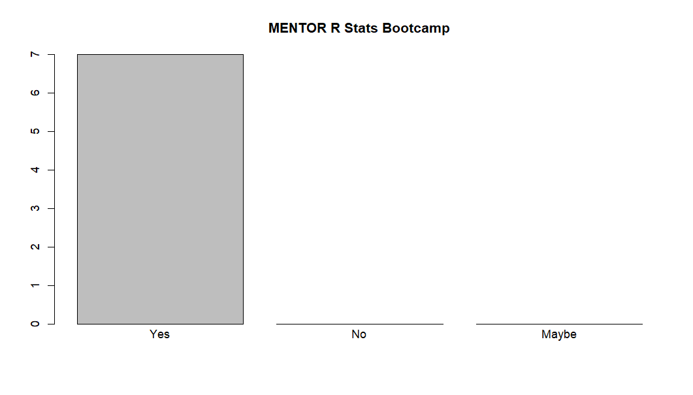
What people want

Slide 10
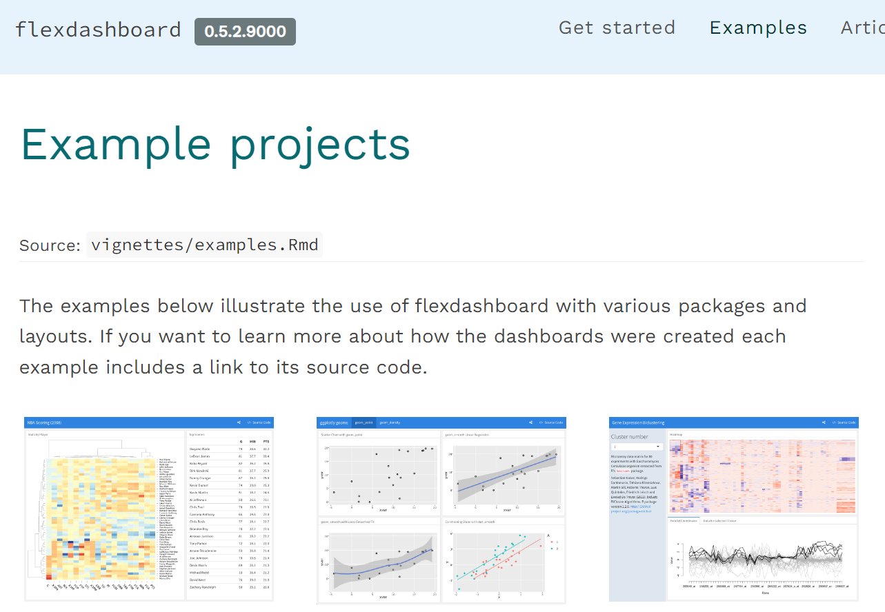
{flexdashboard}
https://rstudio.github.io/flexdashboard/articles/examples.html

Slide 11
{flexdashboard}
1 Tutorial example
2 weather-rmd code
3 deployed to shinyapps.io

Slide 12
{flexdashboard}
https://w-ed-harris.shinyapps.io/weather-example/

