Slide 1
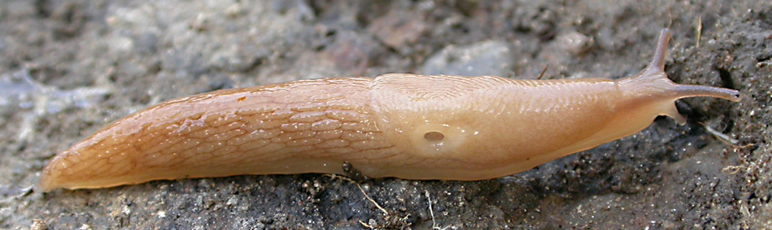
SADIE
Spatial Analysis by Distance IndicEs
HARUG!
12/09/2024
Claire Price

Slide 2
Background - SLIMERS
The grey field slug Deroceras reticulatum is an important pest of arable crops in the UK
Historically, growers have controlled this pest by applying molluscicidal pellets on the whole field
Previous research has shown that populations distribution of this slug is heterogeneous, with patches of high slug density in the field
The aim of this study is to develop a precision agriculture method to predict patch location so that growers can only treat these patches of high slug density

Slide 3
100m
10m
20m minimum
100m
Legend:
Field boundary
Slug trap

Slide 4
Background – SADIE Spatial Analysis by Distance IndicEs
Introduced and developed by Joe Perry at Rothamsted Research to enable ecologists to treat count-based data in relation to their location in two-dimensional space where locations are specified
Developed for dealing with ecological data that can be considered ‘patchy’ >> perfect for insect or slug populations

Slide 5

I_{a}
Index of aggregation
Quantifying the presence and degree of clustering
I_{a} = 1 : randomly arranged counts
I_{a} < 1 : regularly arranged counts
I_{a} > 1 : clustered counts
Associated with a probability level, P_{a}.

Slide 6

v_{i} and v_{j}
Respectively quantify the presence of patches or gaps
Part of the red-blue analysis tool
Provide a means to measure the presence of spatial pattern by identifying neighbourhoods of consistently high counts (patches or clustering) or low counts (gaps or dispersion) respectively.
v_{i} v_{j}

Slide 7
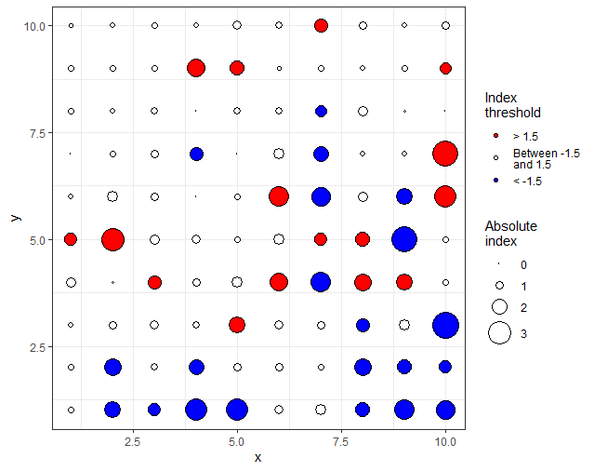
Red-blue plot
Visual representation of the degree of clustering, using v_{i} and v_{j}
Clusters are defined as areas enclosed by contour levels of +1.5 or -1.5 (based on Perry’s index)

Slide 8
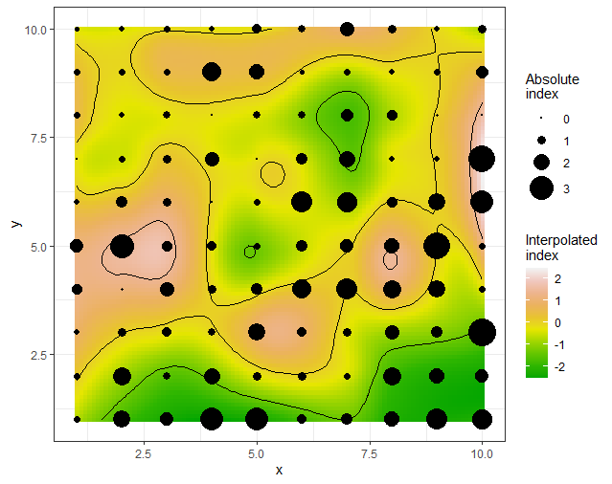
Interpolation plot
Green areas: negative values, indicating zones of gaps or dispersal.
Yellow areas: near-zero values, representing neutral areas with little or no clustering or dispersal.
Pink areas: positive values, representing zones of aggregation or clustering.

Slide 9
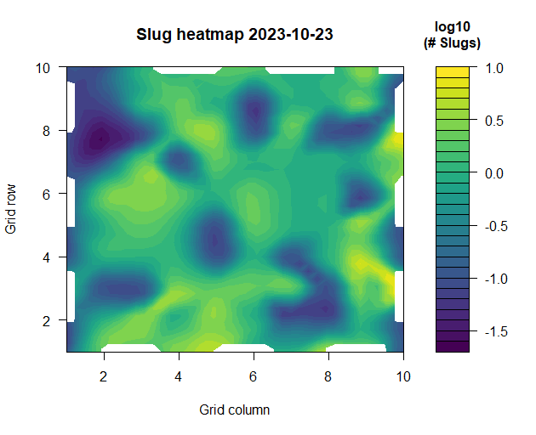

Slide 10
References
Winder, Linton, et al. "Twenty years and counting with SADIE: Spatial Analysis by Distance Indices software and review of its adoption and use." Rethinking Ecology 4 (2019): 1-16.
Perry, Joe N. “Spatial Analysis by Distance Indices.” Journal of Animal Ecology 64, no. 3 (1995): 303–14. https://doi.org/10.2307/5892.
https://cran.r-project.org/web/packages/epiphy/vignettes/epiphy.html
https://chgigot.github.io/epiphy/reference/sadie.html

