Slide 1
R Stats Bootcamp 03
R Functions Ed Harris

Slide 2


Slide 3
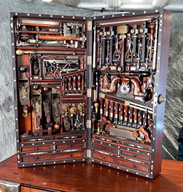
R Stats Bootcamp 02
R Stats Bootcamp 03
R Functions
(R functions are tools in a toolbox)
(R packages are themselves a toolbox)

Slide 4
Objectives
Function tour
Using functions and getting help
R packages
Finding, downloading and using packages
Practice exercises

Slide 5
Function tour
function_name()
Note:
function_name is the name (usually contextual meaning)
EVERY function has brackets ()

Slide 6
Using R functions
function_name(argument_1 = value_1, argument_2 = value_2, ...)
Arguments are like “settings” for functions
Each argument has a unique name
Arg values assigned by “=” and separated by “,”
“...” means there are optional args (ignore for now)

Slide 7
Function names
`mean()` # Calculates the arithmetic mean `log()` # Calculates the log `sd()` # Calculates the standard deviation `plot()` # Draws plots `help()` # Used to access help pages
…you get the idea

Slide 8
Using functions and help
Demo
## A workflow for using functions #### help(c) # We use this a lot - it "combines" numbers c(2, 6, 7, 8.1, 5, 6) ...

Slide 9
R packages
Extremely useful, mandatory
Lots of them (>20,000)
Community made
Must discover them
Must learn to use them, their functions

Slide 10
Installing packages
Demo
# Step 1: install a package help(install.packages) # just have a look install.packages(pkgs = "package_name")

Slide 11
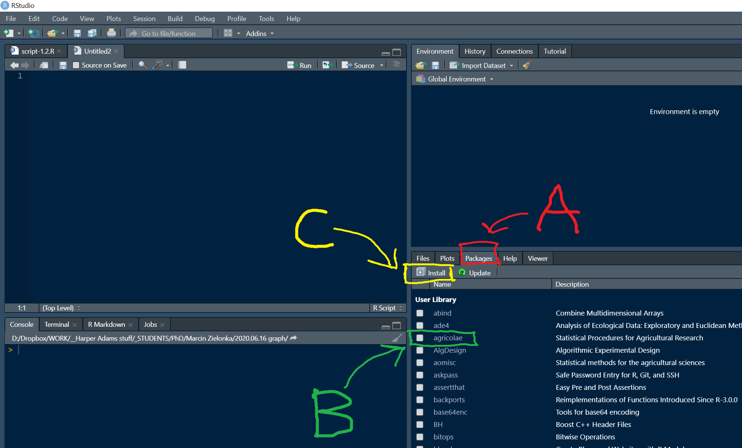
Using RStudio GUI

Slide 12

Practice Exercises

