Slide 1

Workflow
Working directory
Working directory
data
R script

Slide 2
How does Git work?
Working directory
data
R script
+
graph file

Slide 3
How does Git work?
Working directory
data
R script

Slide 4
How does Git work?
Working directory
data
R script
+
graph file

Slide 5
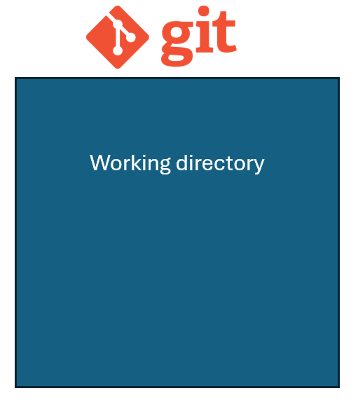
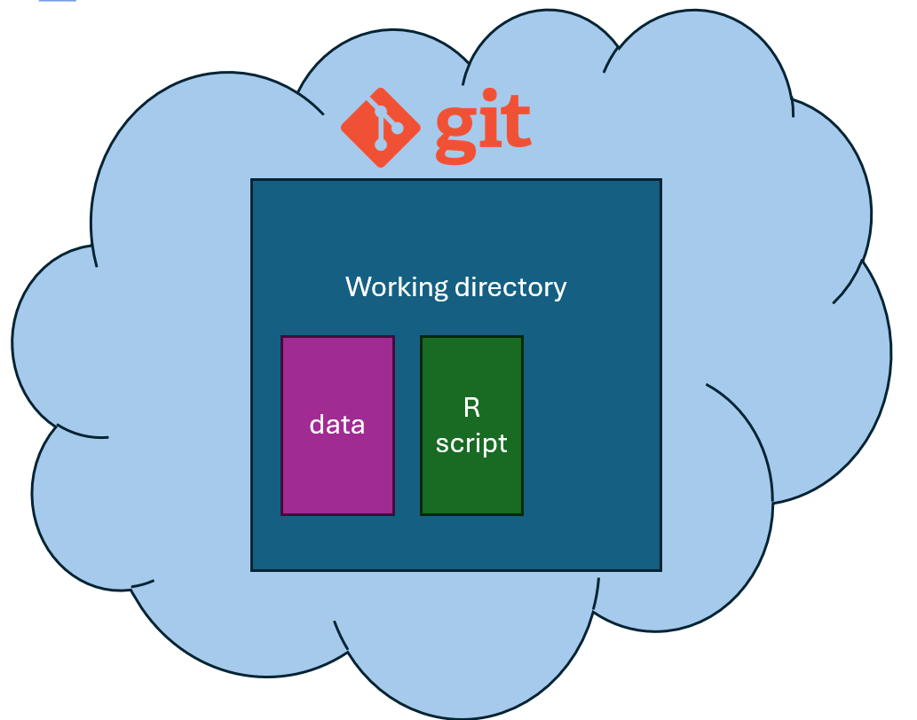
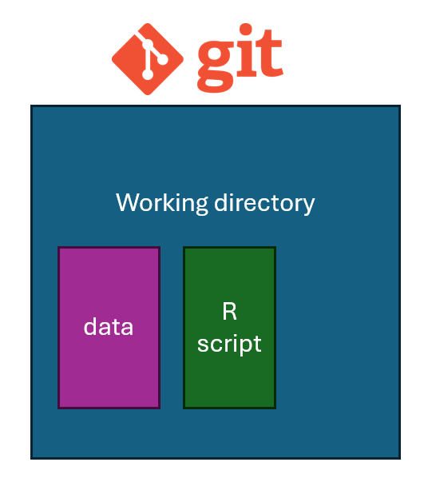
pull

Slide 6
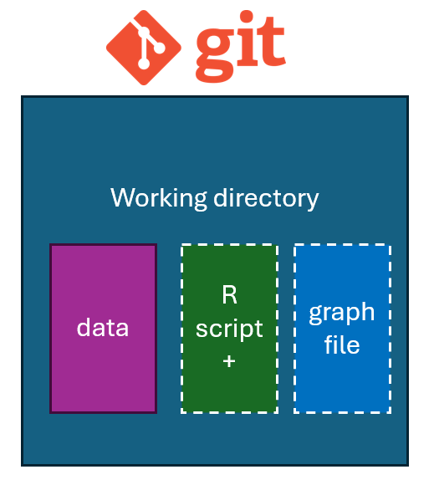
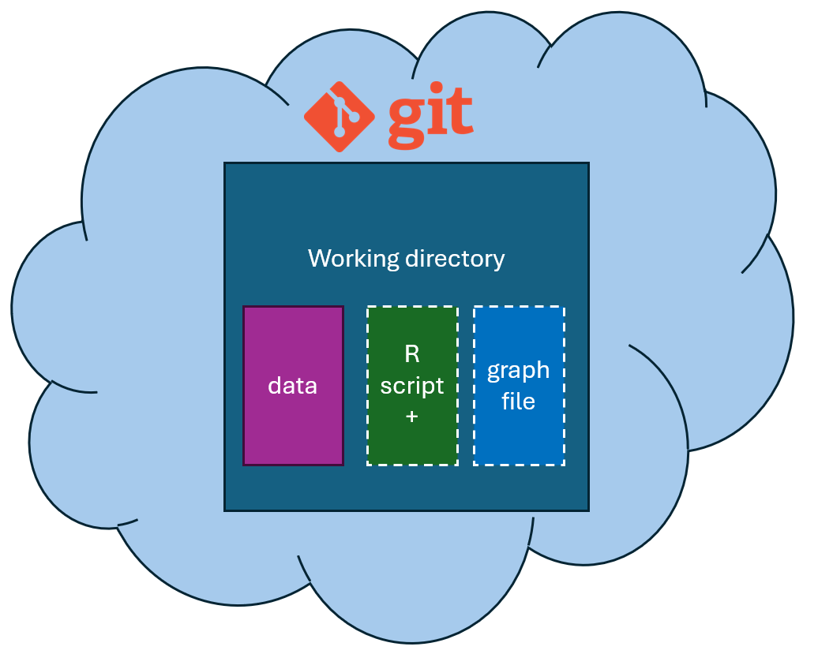
commit & merge

Slide 7
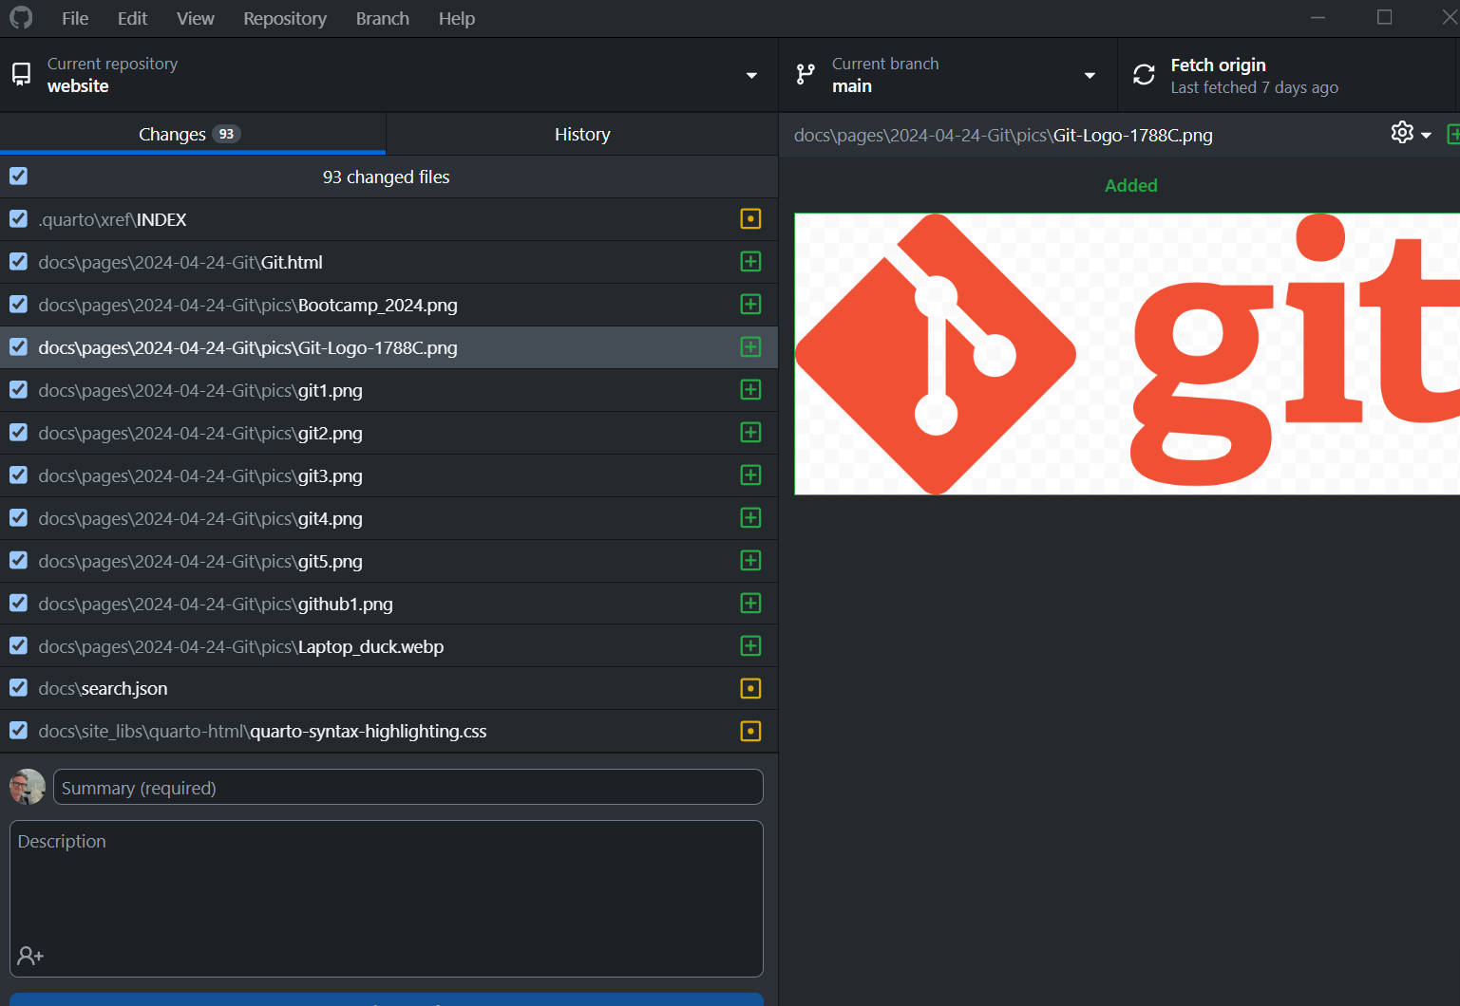
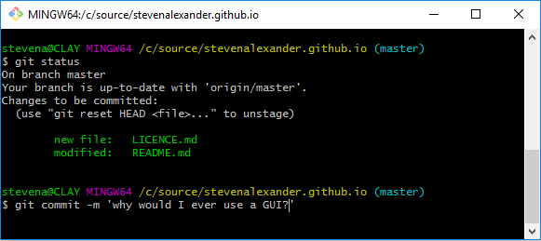
Github desktop
Github command line
Also: built into Rstudio, VS Code, etc.

