Slide 1
R Stats Bootcamp 09
Correlations Ed Harris/Megan Lewis

Slide 2


Slide 3

R Stats Bootcamp
R Stats Bootcamp 09
The data were formless like a cloud of tiny birds in the sky
Relationships between numeric variables

Slide 4
Objectives
The question of correlation
Data and Assumptions
Graphing
Tests and Alternatives
Practice exercises

Slide 5
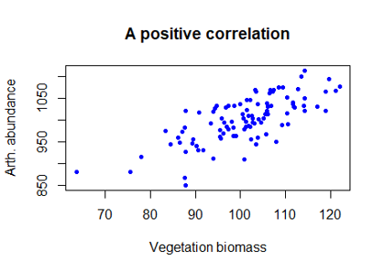
The question of correlation
Is there a demonstrable association between two numeric variables?
Do they “co-vary”?
Positive vs. negative
Strong vs. weak

Slide 6
Off to R!
FLASH CHALLENGE!

Slide 7
Data and Assumptions
Pearson’s correlation
Important assumptions
Linear relationship between variables
Numeric values are Gaussian
Technically:
the co-variance of two variables divided by the product of the standard deviations

Slide 8
Off to R!
Calculate a correlation coefficient

Slide 9
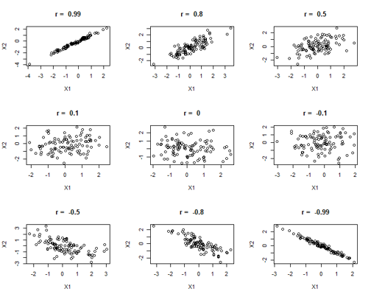
Graphing
Useful tool to assess correlations visually
Lots of variables

Slide 10
Off to R!
Correlation matrices

Slide 11
Tests and alternatives
Testing correlation coefficients
Null hypothesis testing – cor.test()
Pearson’s assumption
Linear relationship
Bivariate Gaussian distribution
Homoscedasticity – similar variance
Independent observations
No outliers

Slide 12
What if my data doesn’t meet the assumptions?
Alternative options available:
E.g., Spearman’s rank correlation, Kendall-tau etc.

Slide 13
Off to R!
Statistical test of correlations - a process

Slide 14
Results and reporting
Think about your audience

Slide 15
Results and reporting - for yourself
Comment on R script
Reproducible format
Think tidy and organised
Can also be beneficial for colleagues and collaborators

Slide 16
Results and reporting - for others

Slide 17
Results and reporting - for others
“You should NEVER PRESENT RAW COPIED AND PASTED STATISTICAL RESULTS (O.M.G!)”
– Ed Harris, (always)

Slide 18
Results and reporting - for others
Format output and figures for ease of consumption
Potential formatting options:
RMarkdown - several output options
Word processing document (how most people do it)

Slide 19
Statistical summary
Null hypothesis statistical tests - Test statistic (Varies between tests)
Sample size or degrees of freedom
The p-value
E.g., We found a significant correlation between petal width and length (Pearson’s r = 0.96, df = 148, P < 0.0001).

Slide 20
Statistical summary
E.g., We found a significant correlation between petal width and length (Pearson’s r = 0.96, df = 148, P < 0.0001).
NB:
Rounding of decimal accuracy
Usually 2 - but be consistent!
P-value format
If smaller than 0.0001, then P< 0.0001, don’t use scientific notation (no one likes that… )

Slide 21
Off to R!
Validate - histograms!
FLASH CHALLENGE!
Write a script following the steps to question, graph, test and validate for each iris species separately.

Slide 22
Correlation alternatives to Pearson’s
Spearman’s rank correlation
Data are ranked or otherwise ordered
Data rows are independent

Slide 23
Off to R!
Spearman’s rank correlation example

Slide 24

Practice Exercises

