Slide 1
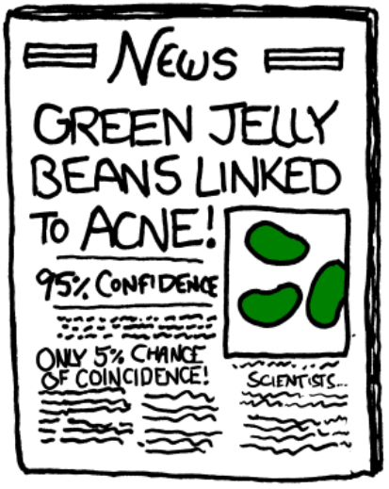
First meeting for the Harper Adams R Users Group
(HARUp!...?)
Ed Harris
2019.10.16
Effect size thinking and power analysis
(Plus some other HARUp! business)

Slide 2
First meeting for the Harper Adams R Users Group
HARUG!
Ed Harris
2023.11.22
Effect size thinking and power analysis

Slide 3
What do we want to accomplish today?
- Effect size thinking and power
- Power calculation in R
- Resources and readings; other tools
- Future of HARUp! (topics, attendees, etc.)

Slide 4
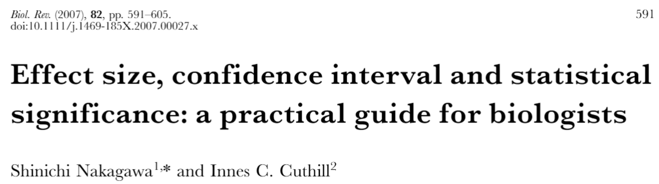
Effect size thinking and power
Null hypothesis testing:
- No prediction for HOW BIG our predicted difference
- No prediction for HOW ACCURATE our predicted difference

Slide 5
*ONE KIND OF Effect size thinking and power
y
--------
variation
--------
difference
variation
X
In general, the bigger the difference, and the smaller the variation (increased accuracy), the more likely our hypothesis is correct

Slide 6
*ONE KIND OF Effect size thinking and power
--------
y
--------
y
--------
--------
X
X
- HOW BIG is the difference?

Slide 7
*ONE KIND OF Effect size thinking and power
y
--------
y
--------
--------
--------
X
X
- HOW ACCURATELY can we estimate the difference?

Slide 8
*ONE KIND OF Effect size thinking and power
y
--------
y
--------
--------
--------
X
X
- Is the expected difference meaningful
(e.g. Biologically, medically, to consumers, etc.)?

Slide 9

*ONE KIND OF Effect size thinking and power
The technical definition of effect size is specific to
The statistical test
For a t-test -> Cohen’s d
Cohen’s d =$\frac{mean1 − mean2}{Pooled std dev}$
y
--------
--------
X

Slide 10
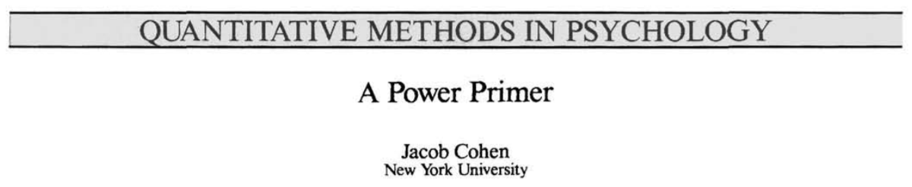
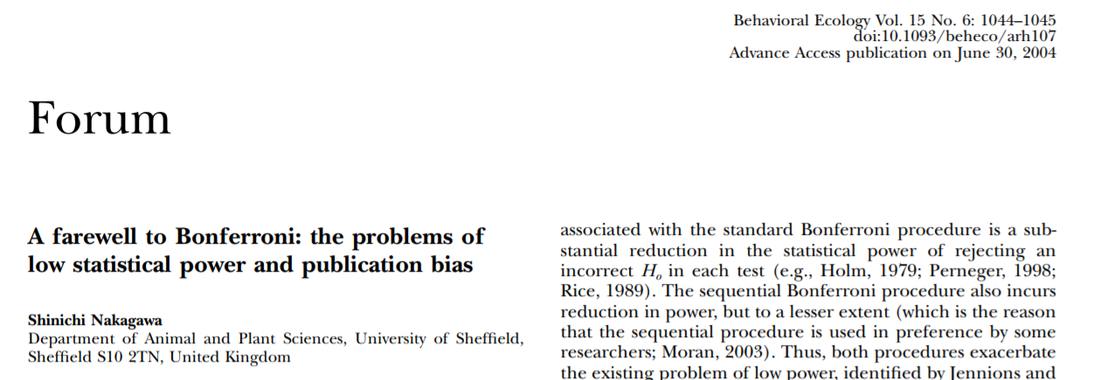
Effect size thinking and power
Statistical power: 2 classic papers

Slide 11
Effect size thinking and power
How many subjects?
Power analysis is the
justification of your sample size
Notes:
11

Slide 12
Effect size thinking and power
Real World
Null true
Null false
Null true
Correct decision
Type II error
(false negative)
Conclusion of significance test
Type I error
(false positive)
Correct decision
Null false
Notes:
12

Slide 13
Effect size thinking and power
Type I error rate is controlled by the researcher.
It is called the alpha rate and corresponds to the probability cut-off in a significance test (i.e., 0.05).
Notes:
13

Slide 14
Effect size thinking and power
Type II error is also controlled by the researcher.
The Type II error rate is sometimes called beta: the probability of failing to detect a real difference
Power = 1 - beta
80% power is a standard minimum
Notes:
14

Slide 15
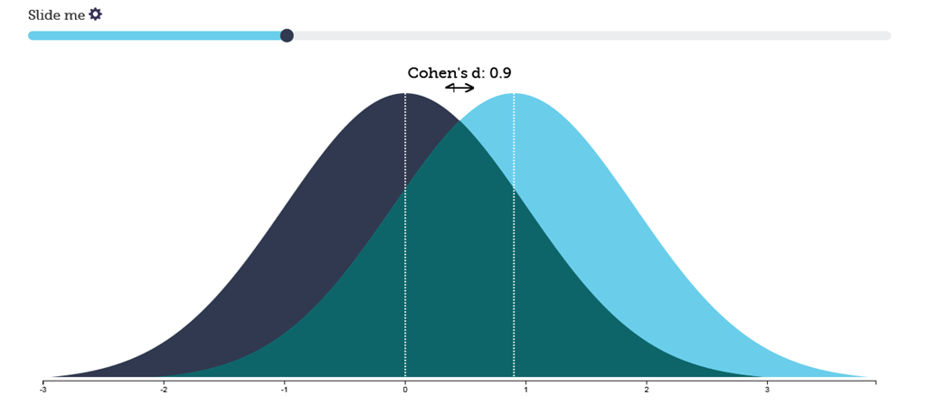
Effect size thinking and power
Cohen's d for t-test and 1-way ANOVA

Slide 16
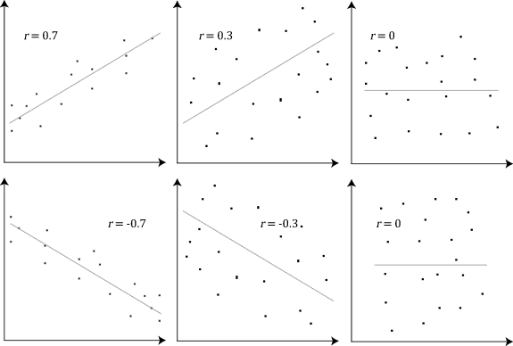
Effect size thinking and power
(little) r for correlation

Slide 17
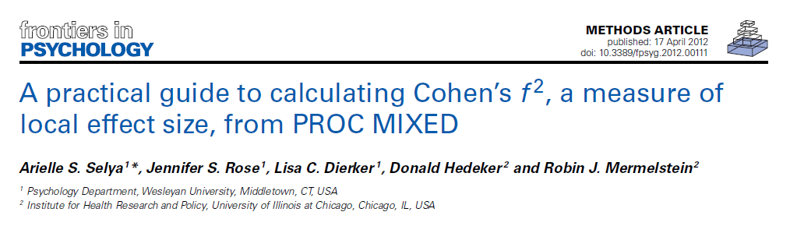
Effect size thinking and power
f2 for all sorts of linear models

Slide 18
How?
R - {pwr} {TrialSize} {agricolae}, free, easy for simple tests
G*Power - stand-alone windows app, free, kind of hard to use correctly for non-statisticians
PASS - Windows app, expensive but easier than G*Power
Rules of thumb - easy to misuse (not a magic bullet)

Slide 19
Key message 1: the effect size is tied to your STATISTICAL DESIGN
(all stats tests have different effect size estimation)
Key message 2: You must know your question and effect size to determine sample size
(power analysis is easy, the hard part is quantifying your expectation)
Key message 3: Rules of thumb do not work well in practice, especially when used in ignorance

