Slide 1
R Stats Bootcamp 03
Data structures Ed Harris

Slide 2


Slide 3

R Stats Bootcamp 02
R Stats Bootcamp 04
R Functions
Imagine your computer's memory is like space and you are alone floating in it. Anything you you can see floating with you is a Data Object in R-Space.

Slide 4
R Stats Bootcamp 02
(In R-Space, no one can hear you scream.)

Slide 5
Objectives
Basic data types in R
Data with factors
class() and converting variables
Vector and Matrix fun
Practice exercises

Slide 6
Basic data types in R
Concept of “Data Objects”
Data you can use is in the Global Environment
Data Type refers to the kind of data (important for computers)
Data Type is determined automatically in R (by the passive-aggressive Butler)
You often will need and want to tweak data type

Slide 7
Basic data types in R
# numeric vector variable_1 <- c(4,5,7,6,5,4,5,6,7,10,3,4,5,6) # logical vector variable_2 <- c(TRUE, TRUE, TRUE, FALSE)

Slide 8
Basic data types in R
There are some rules for naming data objects
Can contain letters, numbers, some symbolic characters
Begin with a letter, Does not contain spaces
Some things are forbidden, @, %, #, etc.
Should be human-readable, consistent, and not too long

Slide 9
Basic data types in R
x1 <- 5 x2 <- "It was a dark and stormy night" # hard to read my_variable_9283467 <- 1

Slide 10
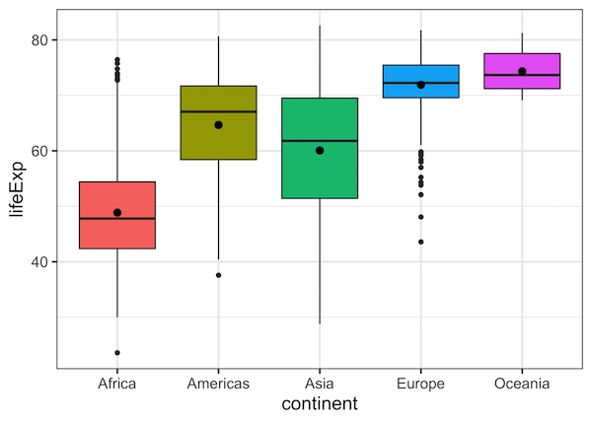
Data with factors
Let’s you want to analyse categorical data.
Sometimes this is called a “factor”.

Slide 11
Data with factors
Two types of factors
Non-ordered factors : the levels are the names of the categories cows = Martha, Ruth, Edith
Ordered factors: have a specific order dose = Control < Half < Full

Slide 12
class() and converting variables
# non-ordered factor variety <- c("short", "short", "short", "early", "early", "early", "hybrid", "hybrid", "hybrid")

Slide 13
Vector and Matrix fun
Ways of organizing data
Vector - One dimension from 1 to i, my_vec[i]
Matrix - Two dimensions rows, columns, my_mat[i, j]
Array - Three (or more) dimensions, my_array[i, j, k]

Slide 14
Vector and Matrix fun
# Vectors myvec1 <- c(1,2,3,4,5) myvec1 class(myvec1) myvec2 <- as.character(myvec1)

Slide 15
Vector and Matrix fun
vec1 <- 1:16 vec1 mat1 <- matrix(data = vec1, ncol = 4, byrow = FALSE)

Slide 16

Practice Exercises

